Slide 1

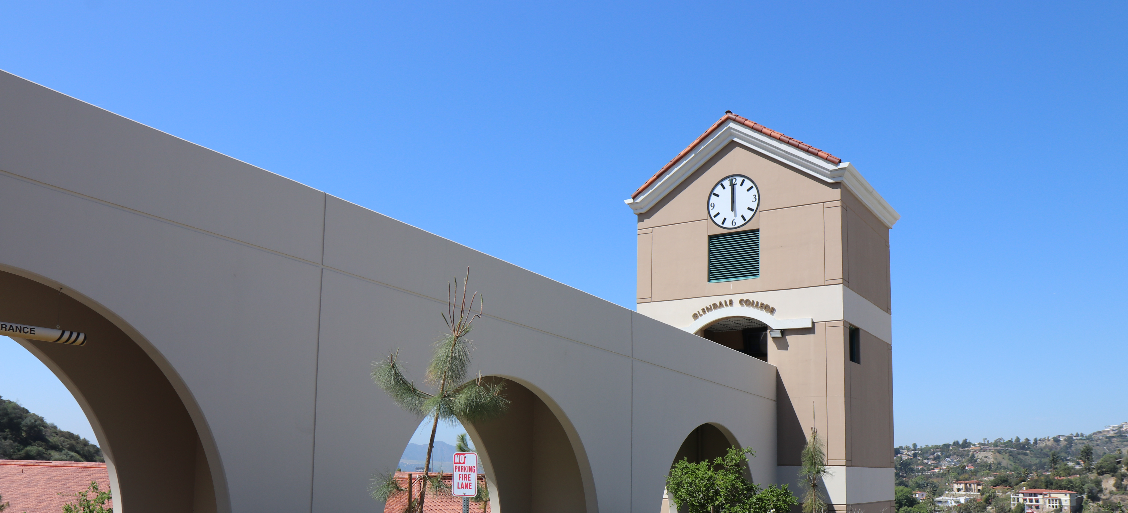

Financial Aid Workshops
Week of February 16 – February 20
Sierra Vista 365
Monday | February 16 | Closed - Holiday
Tuesday | February 17 | 11am – Closes at 3:30pm
Wednesday | February 18 | 11am – Closes at 3pm
Thursday | February 19 | Opens at 12pm – 4:30pm
Friday | February 20 | 9am – 12:00pm
For more information, please visit
Glendale.edu/financialaid
and select workshops & drop-in help
If you’re the student:
Student FSA ID/Login Info
Social security number (if applicable)
Permanent Resident number (if applicable)
2023 & 2024 Federal 1040 income tax return (if applicable)
List of schools you’re interested in attending
If you’re the parent or contributor:
Contributor FSA ID/Login Info
2023 & 2024 Federal 1040 income tax return. Amount in checking & savings account
Untaxed income such as child support received
Assets like businesses, investments, real estate, etc. (Not including retirement or primary residence)

