Slide 1
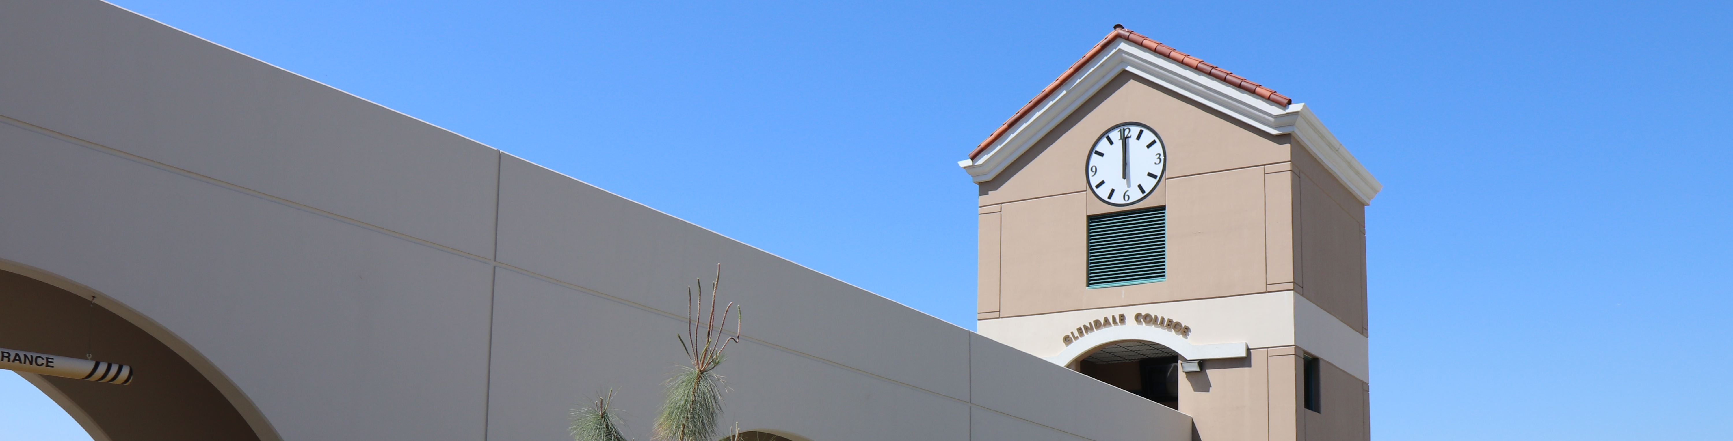

Dual Enrollment Courses Fall 2024
Glendale Unified School District Classes
COURSE | CLASS # | INSTRUCTOR | SCHEDULE | LOCATION | START DATE | END DATE
ASL 101 | 1713 | Desiree Duong | TTH 4:25-6:30pm | Remote | 9/3/2024 | 12/18/2024
ASL 101 | 1714 | Jared Perez-DeBusk | MW 4:25-6:30pm | Remote | 9/3/2024 | 12/18/2024
Admin of Justice 101 | 3381 | Lee Simoes | Sa 10:00-1:35pm | TG104 | 9/3/2024 | 12/18/2024
Anthropology 102 | 2773 | Alix Williams | MW 4:45-6:40pm | Remote | 9/23/2024 | 12/18/2024
Bus Admin 101 | 2984 | Daron Kachatourian | MW 4:15-6:10pm | Remote | 9/23/2024 | 12/18/2024
Bus Admin 101 | 2985 | Daron Kachatourian | TTh 4:45-6:40pm | Remote | 9/23/2024 | 12/18/2024
EMT 138 | 2926 | Karl Wong | Sa 9:00-11:05am | GCC Health Science - 122 | 9/3/2024 | 12/18/2024
Mass Comm 101 | 3026 | Michael Gougis | Online | Online | 9/23/2024 | 12/18/2024
Mass Comm 101 | 3027 | Deborah Zipnick | Online | Online | 9/23/2024 | 12/18/2024
MOA 182 | 2923 | 2924 | Sonali Perera | Online | Online | 10/28/2024 | 12/18/2024
Social Science 110 | 2983 | Sylvia Martin | TTH 4:45-6:40pm | Remote | 9/23/2024 | 12/18/2024
Speech 101 | 3028 | Abraham Nesheiwat | Online | Online | 9/23/2024 | 12/18/2024
Speech 101 | 3029 | Adrian Trejo | Online | Online | 9/23/2024 | 12/18/2024
Speech 108 | 3032 | Nune Dervishian | Online | Online | 9/23/2024 | 12/18/2024
Stu Dev 101 | 3057 | Vivian Barrera | Online | Online | 9/23/2024 | 12/18/2024
Stu Dev 145 | 3530 | Tiffany Nakawatase | Online | Online | 9/23/2024 | 12/18/2024
Theatre Arts 101 | 3017 | Vsev Krawczenuik | Online | Online | 9/23/2024 | 12/18/2024
Theatre Arts 101 | 3018 | Vsev Krawczenuik | Online | Online | 9/23/2024 | 12/18/2024
Burbank Unified School District Classes
COURSE | CLASS # | INSTRUCTOR | SCHEDULE | LOCATION | START DATE | END DATE
Armenian 101 | 3059 | Arevhat Nazaryan | MW 4pm-5:25pm (+ 3hrs online) | Remote | 9/23/2024 | 12/18/2024
Armenian 102 | 3060 | Arevhat Nazaryan | TTh 4pm-5:25pm (+ 3hrs online) | Remote | 9/23/2024 | 12/18/2024
Health 102 | 3386 | Jorge Mena | MW 4pm-5:55pm (Remote Monday) | BHS & Remote | 9/23/2024 | 12/18/2024
1500 North Verdugo Road • Glendale, CA 91208 • 818-240-1000 • www.glendale.edu/hs

