Slide 1

Notes:
Hello everyone my name is _____________ and I work at the Multicultural & Community Engagement Center here at GCC. I will be going over the amazing resources the MCEC has to offer to each and one of you.

Slide 2

El Centro de Participación Multicultural y Comunitaria inicia, implementa y mantiene oportunidades de participación cívica que promueven la diversidad, el pensamiento crítico, la responsabilidad personal y las habilidades de comunicación para todos los estudiantes.
Notes:
First and foremost, the MCEC initiates, implements, and sustains civic engagement opportunities that promote diversity, critical thinking,g personal responsibility, and communication skills for all students. (NEXT SLIDE)

Slide 3

MCEC
UBICACIÓN:
SIERRA MADRE 267
OFFICE HOURS:
DE LUNES A JUEVES
8:30 am a 4:30 pm
Viernes
8:30 am a 3:00 pm
NÚMERO DE OFICINA:
(818) 240-1000 | EXT. X5580
Notes:
The MCEC is located in the Sierra Madre Building room 267 and we are open Monday- Tuesday 8:30AM-4:30PM and Fridays 8:30AM-3PM You can reach us by dialing GCC's main number first (818)249-1000 and then dial our extension which is 5580. (NEXT SLIDE)

Slide 4

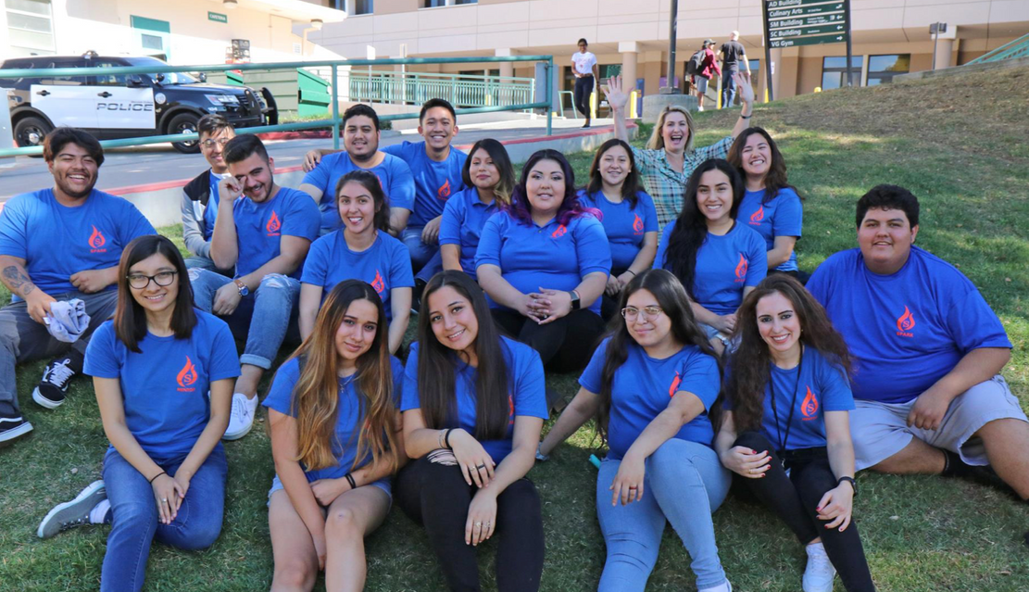
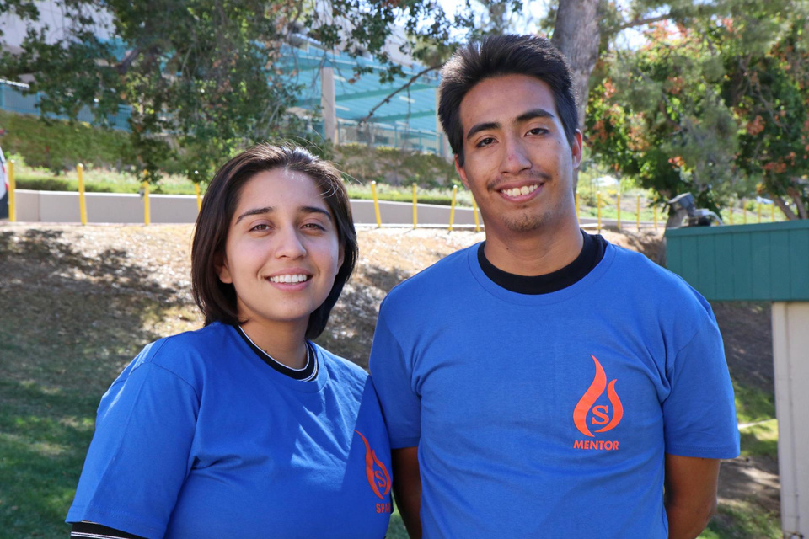


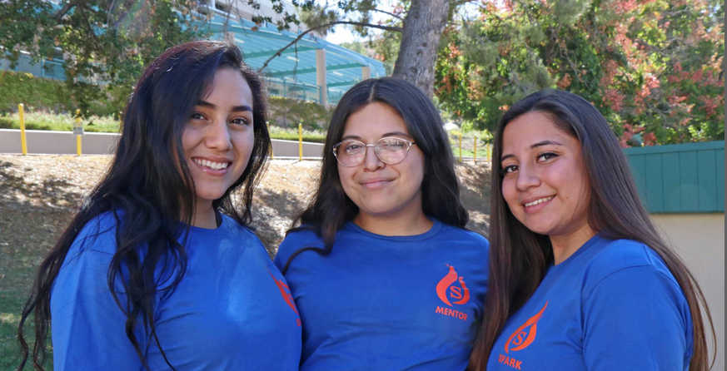
Un programa único de tutoría entre pares diseñado para ayudar a los estudiantes a navegar y tener éxito en su primer año en GCC
www.glendale.edu/spark
Notes:
The MCEC has so many amazing programs you can all benefit and learn from. This peer mentoring program is called SPARK. It is a unique peer mentoring program designed to help freshmen students navigate and be successful in their first year at GCC. It is a summer long commitment and they are paying $16/hour. If you would like more information or if you are interested in applying you can visit the website listed towards the bottom of the screen. (NEXT SLIDE)

Slide 5
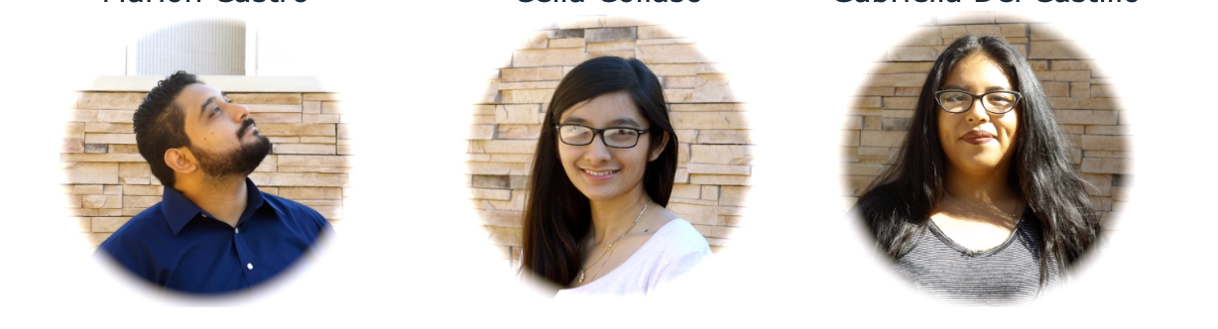
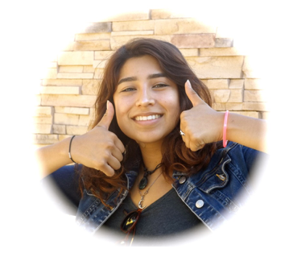

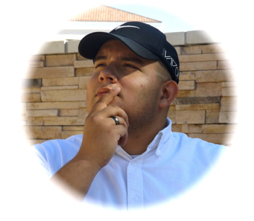


CONVIÉRTETE EN UN LÍDER, MARCA LA DIFERENCIA
LA MISIÓN DE ESTUDIANTES UNIDOS ES INSPIRAR, INVOLUCRAR Y EMPODERAR A LOS ESTUDIANTES LATINOS PARA QUE SE CONVIERTAN EN AGENTES DE CAMBIO.
y defensores de todos los estudiantes en GCC.
WWW.GLENDALE.EDU/MCEC
Notes:
Another program the MCEC has to offer is the Estudiantes Unidos leadership program. This program is designed to inspire, engage, and empower LatinX students to become agents of change and advocate for ALL student at GCC. This is an amazing opportunity for LatinX students that want to build connections, come out of their comfort zones, and become a voice for LatinX students in order to make a difference.

Slide 6
ESTUDIANTES HABLAN DE RAZA
(Estrella)
Un programa diseñado para proporcionar puestos de estudio y trabajo fuera del campus para estudiantes de GCC en escuelas locales y organizaciones sin fines de lucro.
PROGRAMA DE ATENCIÓN A LAS NECESIDADES DE LA COMUNIDAD
(SCN)
Un programa diseñado para conectar a los estudiantes de GCC con las escuelas intermedias y secundarias locales donde facilitará debates sobre racismo, sexismo, estereotipos y más.
Notes:
These next 2 programs are also part of MCEC. However, STAR is currently not active. We are still working on getting that back up and running and Serving Community needs program is updated more frequently than the others. It is constantly getting updates because new work and/or school opportunities arise. We had tutoring positions available at local elementary schools in Glendale that started at $18/hour. So that is definitely a program you want to constantly check and be up to date with.

Slide 7

INFORMACIÓN DEL CONTACTO:
HOOVER ZARIANI
(818) 240-1000 Ext. 5789
hzariani@glendale.edu
SÍGUENOS EN INSTAGRAM:
PARA OBTENER MÁS INFORMACIÓN, VISITE NUESTRO SITIO WEB:
WWW.GLENDALE.EDU/MCEC
SÍGUENOS EN INSTAGRAM:
@GCCMCEC

