Slide 1


Notes:
Hello everyone my name is _____________ and I work at the Multicultural & Community Engagement Center here at GCC. Today I will be going over the amazing resources the MCEC has to offer to each and one of you.

Slide 2


The Multicultural & Community Engagement Center initiates, implements, and sustains civic engagement opportunities that promote diversity, critical thinking, personal responsibility, and communication skills for all students.

Slide 3

MCEC
LOCATION:
SIERRA MADRE 267
OFFICE HOURS:
MONDAY THROUGH THURSDAY
8:30 A.M. TO 4:30 P.M.
FRIDAY
8:30 A.M. TO 3:00 P.M.
OFFICE NUMBER:
(818) 240-1000 | EXT. X5580
Notes:
The MCEC is located in the Sierra Madre Building Room 267 and we are open Monday- Thursday 8:30AM-4:30PM and Fridays 8:30AM-3PM You can reach us by dialing GCC's main number first (818)249-1000 and then dial our extension which is 5580. (NEXT SLIDE)

Slide 4

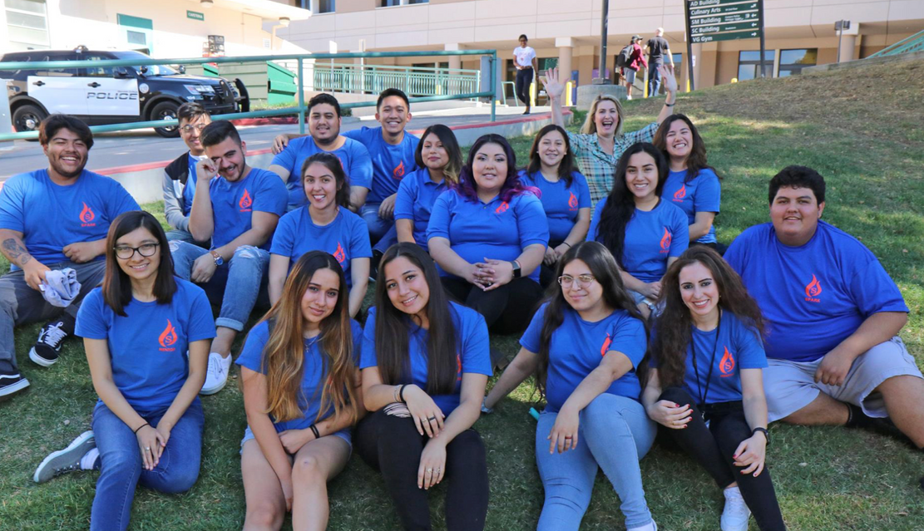
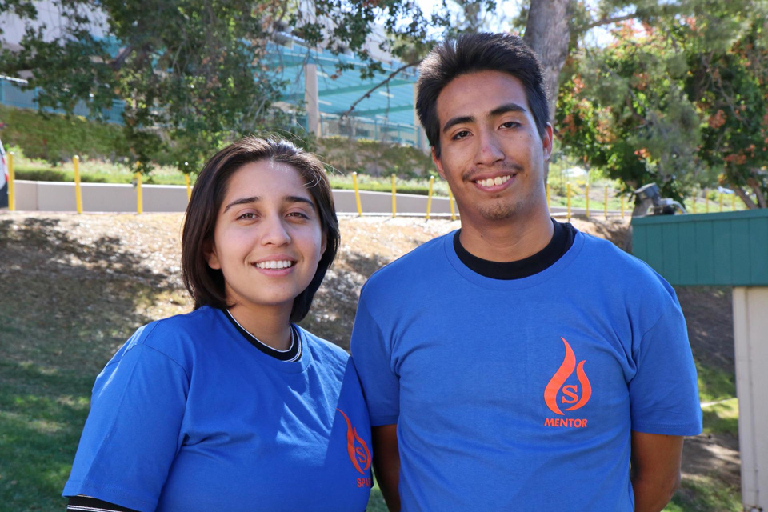


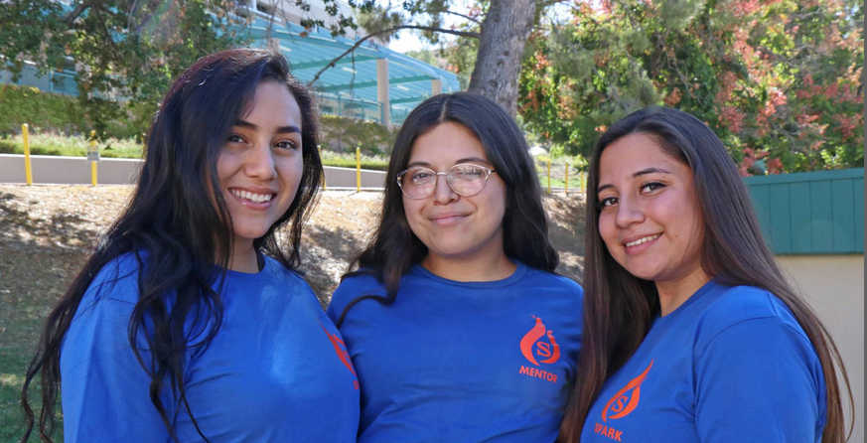
A unique peer-mentoring program designed to help students navigate and be successful in their first year at GCC
www.glendale.edu/spark
Notes:
At SPARK, we know how hard it can be as a new student. You can get overwhelmed with registration, lose your sense of direction on campus, or find yourself clueless about student orgs. Other times, you're hungry and you want the best food recommendations near campus. Or you think scantrons are too expensive, but you swear someone said an office gave them out for free (hint its MCEC) That's why we started SPARK! We wanted to create a support system for students who want guidance in their first year of college. SPARK pairs you with students in their second year or later so that you have that reliable connection you can ask help from. It’s also a great way to discover the ins and outs of the campus through their eyes.
And if by chance you see yourself as the one showing new students around campus, applications for mentors normally begin every year in January and the training/mentoring begins and carries on throughout the Summer and Fall semester.
To learn more about the program you can visit the website at www.glendale.edu/spark towards the bottom and download the pdf application.

Slide 5
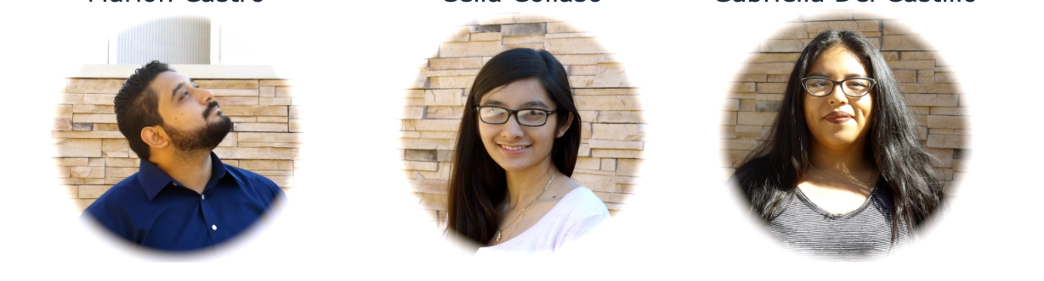
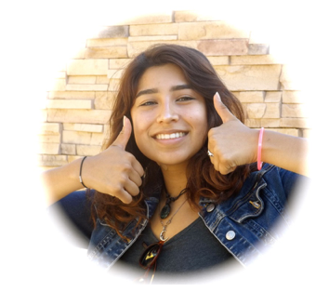

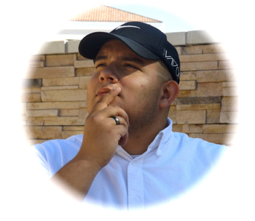


BECOME A LEADER, MAKE A DIFFERENCE
THE MISSION OF ESTUDIANTES UNIDOS IS TO INSPIRE, ENGAGE, AND EMPOWER LATINX STUDENTS TO BECOME AGENTS OF CHANGE
AND ADVOCATES FOR ALL STUDENTS AT GCC.
WWW.GLENDALE.EDU/MCEC
Notes:
At Estudiantes Unidos we challenge participants to discover and bring light to an issue on campus. From reigniting our sense of community after the pandemic to holding panels on mental health issues and career options. Students have done amazing things year after year. When we hosted the panels on mental health, students undertook the responsibilities of securing funds and resources, sending invitations to speakers, drafting the order of events, and advertising the panel itself. Each task built on the team's management and leadership skills. Not to be outdone, students last year held a social mixer complete with music, food, and activities.
Unfortunately, applications are closed at this time. Recruitment for this program begins every year around October and November. If you would like more detailed information about the program and how it works you can visit the MCEC website at www.glendale.edu/mcec and click on "PROGRAMS" and select Estudiantes Unidos

Slide 6
STUDENTS TALK ABOUT RACE
(STAR)
A program designed to provide off-campus work-study positions for GCC students in local schools and non-profit organizations.
SERVING COMMUNITY NEEDS PROGRAM
(SCN)
A program designed to connect GCC students to local middle and high schools where you will facilitate discussions about racism, sexism, stereotyping, & more.
Notes:
Race is a sensitive issue but it shouldn't be! At STAR - Students Talk about Race, we connect you, (college students) with local middle and high schools in hopes that it nurtures a generation of kind and aware individuals. As a facilitator, you will receive training to hold discussions with students about the topics of race, including prejudice, racism, homophobia, and sexism. The program lasts for eight weeks and the discussions will take place over one hour in person. As of 2023 however, this program has been on hiatus as the protocols from the pandemic are still in place.
Serving Community Needs Program
This program provides off campus work-study positions for GCC students in local schools and non profit organizations! Most currently, for the year of 2023 we are partnered with the Glendale Unified School District. This partnership entails a tutoring position for currently enrolled students to tutor kids at the K to 6th grade level. To learn more about this program and the application, visit our website at www.glendale.edu/mcec under programs. It will be listed as the serving community needs program.

Slide 7


CONTACT INFORMATION:
HOOVER ZARIANI
(818) 240-1000 Ext. 5789
hzariani@glendale.edu
FOR MORE INFORMATION VISIT OUR WEBSITE:
WWW.GLENDALE.EDU/MCEC
FOLLOW US ON INSTAGRAM:
@GCCMCEC
Notes:
For any questions not answered today or if you felt that we skimmed over something too quickly, please contact Hoover Zariani, the program manager or visit our website listed here at www.glendale.edu/mcec. You can also call us at 818-240-1000 ext. 5580 Or visit us in person at the Sierra Madre building room 267! Last but not least, don't forget to follow and keep up with us on instagram at gccmcec for future updates!

