Slide 1

RISING SCHOLARS PROGRAM
Glendale Community College
http://glendale.edu/risingscholars
Notes:
Hello and welcome to this presentation about the Rising Scholars Program here at GCC. This program supports formerly incarcerated and/or students who have been impacted by the criminal justice system. They provide free resources and services in order to help students navigate college and become successful. We will be going over more information about the program. For more details we invite you to visit our website at www.glendale.edu/risingscholars

Slide 2

Mission Statement
MISSION
The Rising Scholars’ mission is to create a pathway into higher education for formerly incarcerated, reentry, and system impacted individuals from enrollment through graduation by addressing their academic and social needs.
http://glendale.edu/risingscholars
Notes:
The Rising Scholars mission is to create a pathway into higher education for formerly incarcerated, reentry, and system impacted individuals from enrollment through graduation by addressing their academic and social needs.

Slide 3
RISING SCHOLARS
LOCATION
SIERRA MADRE 267
Office hours
MONDAY - THURSDAY
8:30AM - 4:30PM
FRIDAY
8:30AM - 3:00PM
phone number
(818) 240- 1000 ext. 5662
http://glendale.edu/risingscholars
Notes:
Rising Scholars is located at the GCC Verdugo Campus in the Sierra Madre Building, room 267. Our current hours are Monday through Thursday, 8:30 A.M to 4:30 P.M. and Fridays from 8:30 to 3:00 P.m. If you need to get in contact with Rising Scholars
please feel free to use any of the methods of contact on this page or visit https://www.glendale.edu/risingscholars. We would like to know what other programs and services students would like to see Rising Scholars offer. If you have ideas about new programs and activities, please contact us or simply come by and
say hello.

Slide 4
STUDENT SUPPORT
We are committed to your success and provide the following:
Mental Support services
ACADEMIC Counseling
Career counseling
Legal resources
Free textbooks
Gas and Grocery Gift Cards
http://glendale.edu/risingscholars
Notes:
Here at the Rising Scholars Programs we are committed to provide diverse services for every student here at GCC. These services include: Mental Support services such as counseling and referrals, Legal resources that we provide in partnership with the Department of Adult Parole Operations and the Department of Rehabilitation, transportation such as providing free metro passes, free legal representation, workshops and orientations such as post conviction legal relief, ACADEMIC Counseling to help students reach their future career goals in order, tutoring, Free textbooks, and we also provide Gas and Grocery Gift Cards to help students supplement their traveling costs while attending college here at Glendale community college. We are here to help you succeed!

Slide 5

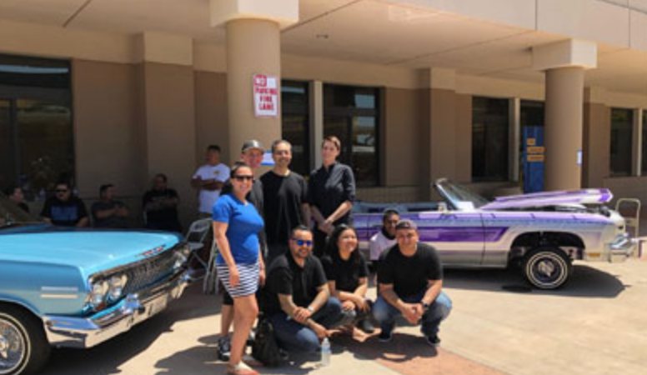


Student Club: System Impacted Intellectuals
Join System Impacted Intellectuals (SII) to help spread knowledge about the criminal justice system, its impact on underserved communities, and help make a safe space for system impacted individuals.
@siiclub_gcc
http://glendale.edu/risingscholars
Notes:
The pride center is excited to be in very close partnership with SII which stands for System Impacted Intellectuals and is a student club for all students here at GCC but particularly those who are formerly incarcerated and or system impacted. Like the Rising Scholars, SII aims to help spread knowledge about the criminal justice system, its impact on underserved communities, and help make a safe space for system impacted individuals. There are weekly meetings during the Fall and Spring semesters to support each other and organize events that bring awareness and culture to GCC. SII is a new club and is looking for leadership positions such as President, Vice President, Secretary, and treasurer. For more information follow our instagram @SIICLUB_GCC

Slide 6
Connect with Us!
David Crawford
818-240-1000 EXT. 5662
risingscholars@glendale.edu
For more information visit our website:
http://glendale.edu/risingscholars
FOLLOW US ON INSTAGRAM!
@RISINGSCHOLARSGCC
Notes:
Here at the Rising scholar program we challenge stigmas associated with incarceration while providing a safe space on campus where students can network with others and lead to navigate the educational system. We also help students develop the necessary skills to thrive in college in order to be sucessful and reach their academic goals. You will work closely with David Crawford who oversees the Rising scholars program He can be contacted at 818-240-1000 EXT. 5662 and dcrawford@glendale.edu FOR MORE INFORMATION VISIT OUR WEBSITE: WWW.GLENDALE.EDU/risingscholars and follow us on instagram @risingscholarsgcc thank you

