Slide 1

Renew, Reconnect, Reengage

Slide 2

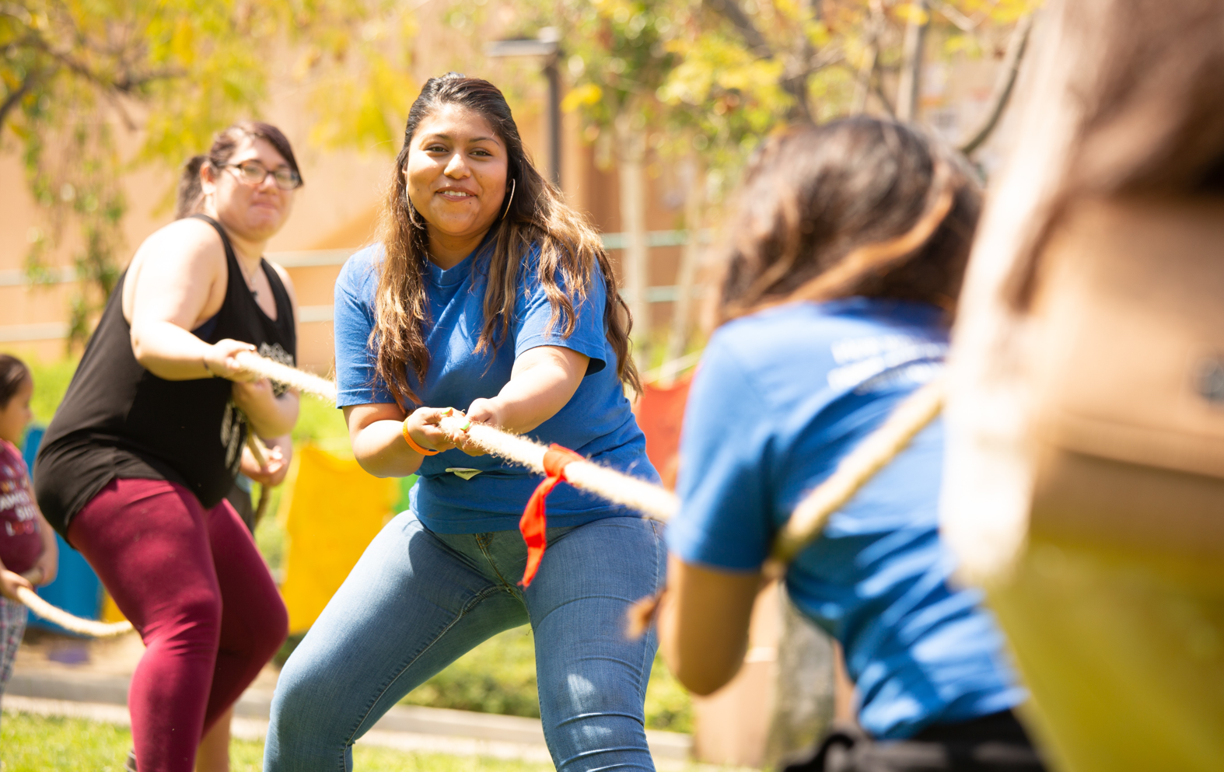
Renew​
Resume (an activity) after an interruption​
Give fresh life of strength to; revive​
Reconnect​
Connect back together​
Reestablish a bond of communication or emotion​
Reengage​
Engage in or with someone or something again

Slide 3
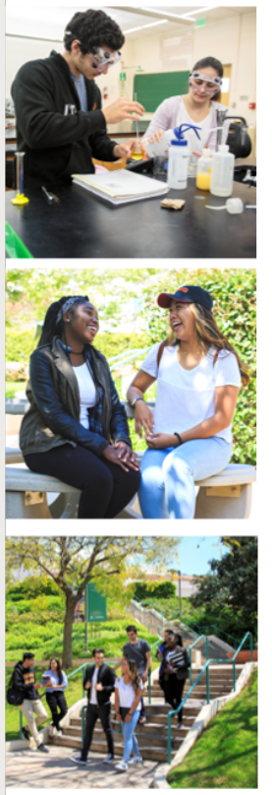
All-Student Services Meeting
Fall 2022
Theme:
Unifying Student Services: Reimagining the Student Experience from Onboarding to Completion
Unify: Make into a unit or a coherent whole; unite
Reimagine: Imagine again or in a different way

Slide 4
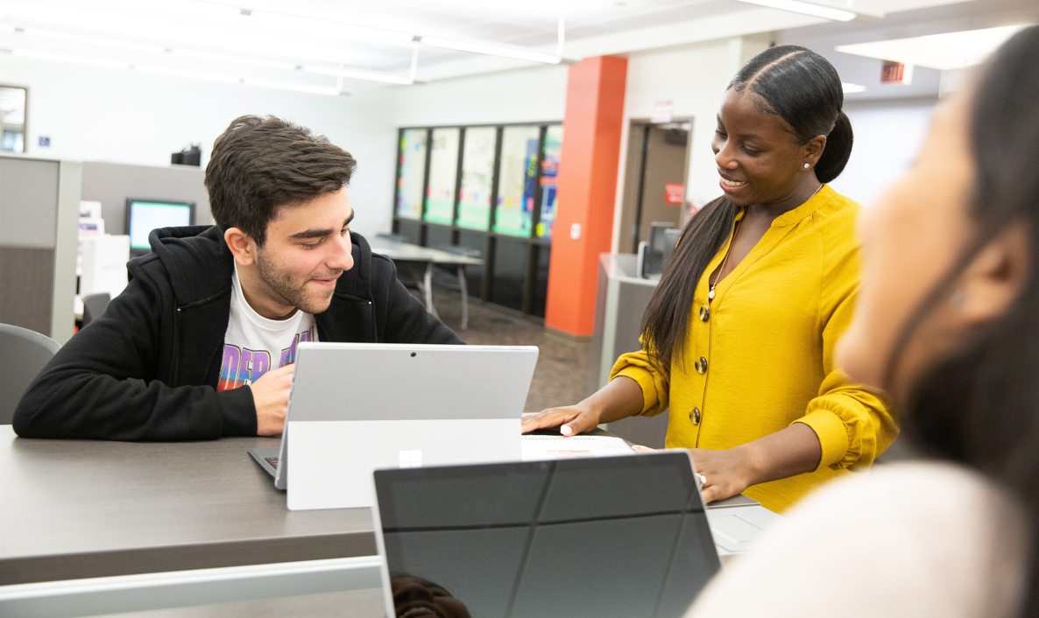
Dr. Ryan Cornner, Superintendent/President
GCC Reengagement Plan
Develop a Culture of Innovation and Equity
Promote our Pathways
Building the Student Experience

Slide 5

Program Updates

Slide 6
Academic Counseling
Develop a Culture of Innovation and Equity:​
Promise Plus – Creation of FYE counseling core team, unifying Academic Recovery and Early Alert teams with campus-wide initiatives. Preparing for Success Teams and case management models.​
Equity and PD – Continuing to explore and support other models and modes of conducting academic counseling within and external to the Academic Counseling office. Supporting division-wide academic counseling practices: e.g. Counseling Tech Mentors, FYE counseling, etc.​
Promote our Pathways:​
Continuing to explore/support LPP, CE, Nursing counseling innovative models. ASU Credit Mobility!​
Building the Student Experience:​
Continue integration and scaling of Student Development with Summer Bridge, Promise Plus. Move toward "intrusive advising" model of counseling.

Slide 7
Admissions & Records
Develop a Culture of Innovation and Equity:
Continue to assist students in navigating the college environment and services required to meet their educational goals.
Evaluate services to ensure they are both equity-minded and student centered.
Explore ways in which technology can remove barriers and provide personalized support - PeopleSoft Fluid
Promote our Pathways:
Explore ways to improve and streamline services and workflow to ensure students meet their goals.
Collaborate with other departments by providing support and data to ensure students identify and remain of their path.
Building the Student Experience:
Provide both in-person and remote services.
Expand online presence through zoom, online document submission and more staff interaction with students.

Slide 8
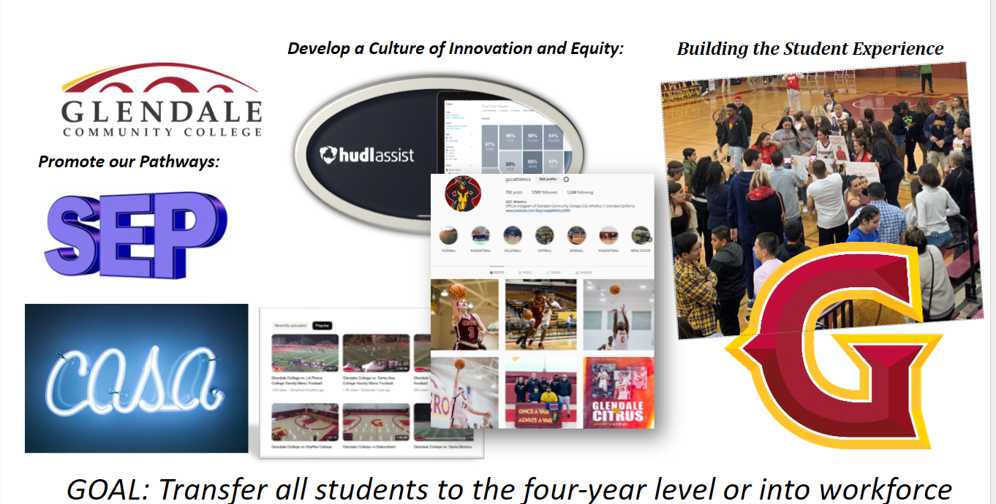
Athletics

Slide 9

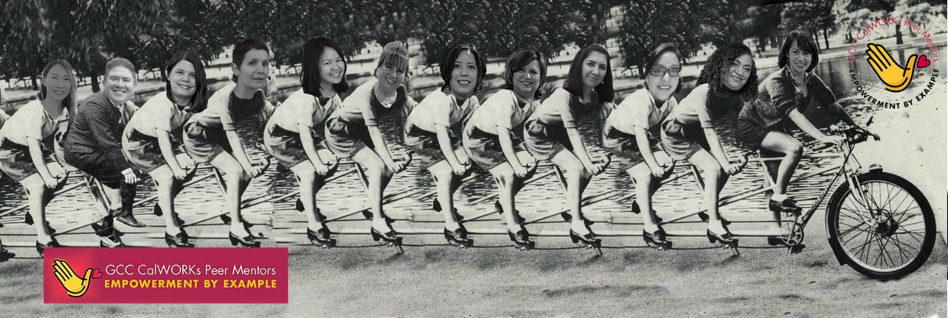
SUPPORTING PARENTING STUDENTS WHO ARE CHANGING
THEIR OWN LIVES,
TWO GENERATIONS AT A TIME!
CULTURE OF INNOVATION AND EQUITY
The CalWORKs Program doesn't run a program FOR CalWORKs students.
We run a program WITH our CalWORKs students.
We use Human-Centered Design to include CalWORKs students in the design, administration, and evaluation of all our programs, creating a truly student-centered program.
Promote Pathways
We start by working with students to envision the life they want for themselves and their families.
From there, we build backwards and find the pathway that will lead a parenting student to love their classes and their career.
Our amazing Career and Academic Counselors connect one-on-one with every CalWORKs student.
Build Student Experience
CalWORKs isn’t just a program. We're a community and a support circle.
Our students are living with their children in deep poverty, often new to the US, and often English language learners. These circumstances can make students feel isolated.
CalWORKs gives students the experience of being part of a warm family of support: Case Managers, counselors, front desk staff, Peer Mentors, and students.
CalWORKs Parents Program

Slide 10
Career Services
Develop a Culture of Innovation and Equity: ​
Continue to provide support for students to assess their life priorities and developmental needs, research current occupational and academic information, and receive individualized support in defining and achieving their career and educational goals.​
Promote our Pathways:​
Encourage all students to visit our website and take the Career Coach Assessment (both the short and long questionnaire). Expose all students to Learning and Professional Pathways. ​
Building the Student Experience:​
Deliver customized modes of interaction with career counselors (In person, Zoom or by telephone). Ensure that students have access to support staff and counselors at times that work for them. Have all Promise Plus and FYE students participate in a "Harry Potter Style" sorting activity to determine their LPP's.

Slide 11
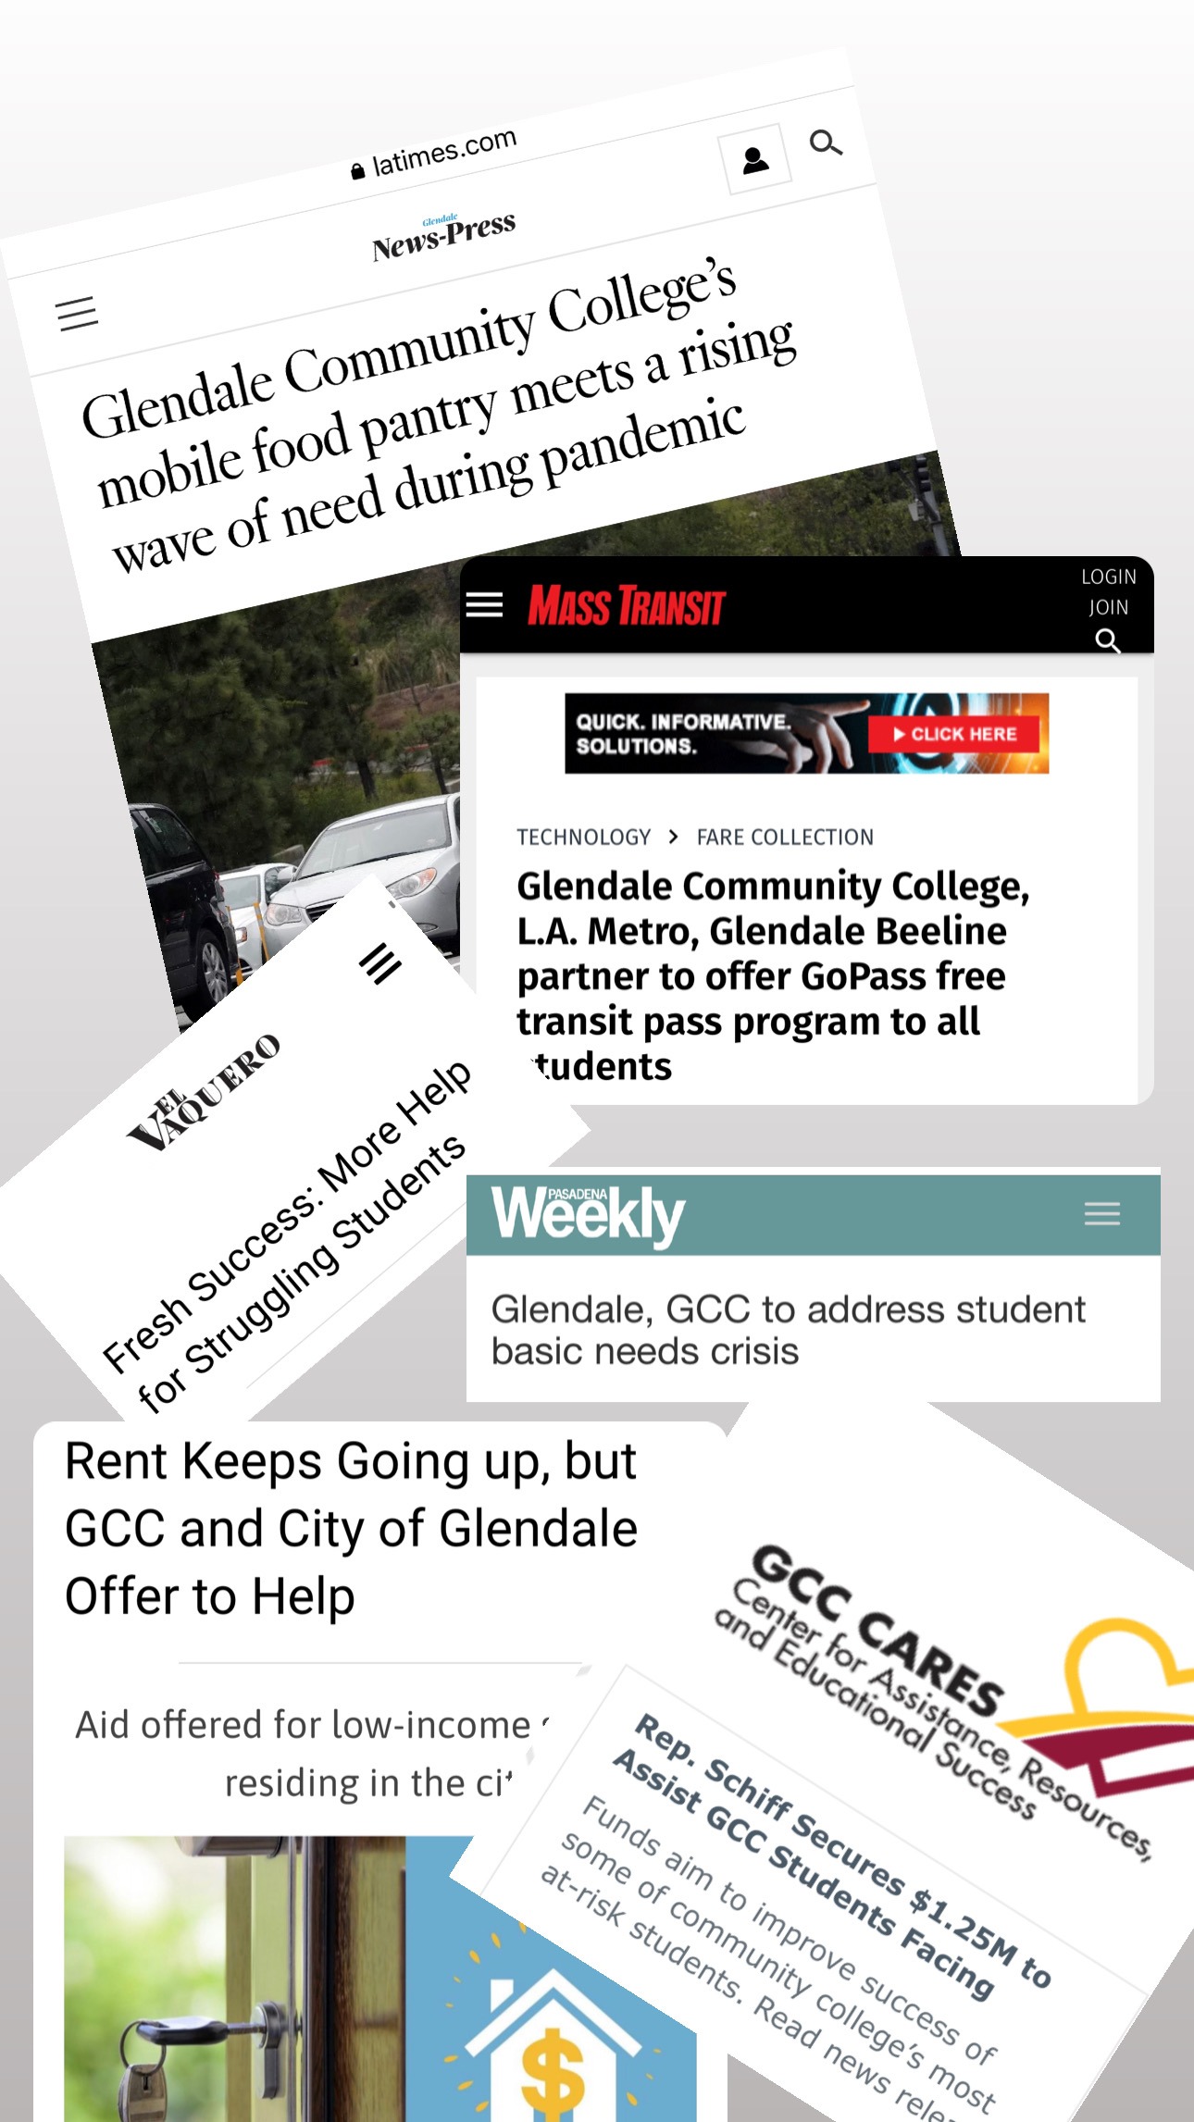

Develop a Culture of
Innovation and Equity​​
In Our First 2.5 Years We Have Grown To...
A Staff of 60+
Operating 10+ Programs
Securing $12.5M+ In Grants​
60% Student Utilization
10,000 Unduplicated Students/Year
50,000+ Contacts Per Year​
$30M+ In Support To Students
​
Promote our Pathways
Entering Pathways: Fresh Success
Learning Through Educational Workshops & Case Management
Exceptional Course Completion/Pass & Course Drop Rates
Building the Student Experience​
Mitigating Barriers for Financially Insecure Students
Developing a Sense of Inclusion

Slide 12

Develop a Culture of Innovation and Equity:​
The College Corps program led by California Volunteers and the California Office of the Governor has three core goals across the state:​
To create a generation of civic-minded leaders with the ability to bridge divides and solve problems​
To help low income students graduate college on time and with less debt​
To address societal challenges and help build more equitable communities across California​
Promote our Pathways:​
Each student serving as a College Corps Fellow for the academic year will receive:​
A $10,000 fellowship to help pay for college ($7,000 living allowance and $3,000 education award)​
An opportunity to support and learn from community-based organizations working in K-12 education and addressing food insecurity in the community​
Building the Student Experience:​
In addition to the monetary benefits, Fellows will secure:​
Access to training, networking, and professional development opportunities​
Academic credit​
Real-world job experience and resume-building skills​
A sense of pride and accomplishment in working toward a common purpose alongside young leaders from across the state

Slide 13

Develop a Culture of Innovation and Equity:​
Provide new employee orientation addressing disability as an Equity gap highlighting ableist, racist and other identity-based biases that entrench inequitable treatment of disabled students. Provide the opportunity to explore inclusion, differentiation, and the intersectional identities of disabled students. ​
​
Promote our Pathways:​
Implement a fully accessible Promise Plus Program for student who are disabled to participate in all aspects of this effort including, but not limited to, the FYE programs, mentoring, outreach, marketing, and career exploration. ​
​
Building the Student Experience: ​
Ensure all aspects of the Promise Plus Program are fully accessible and include disabled students to promote a sense of belonging and equitable enrollment and success.

Slide 14
EOPS
EOPS Admission Application Dates for Spring 2023: January 30-March 17
Develop a Culture of Innovation and Equity:​
•EOPS Student E-File Modifications: 1) Counselor Assessment of Student Progress Form and Student To Do List; 2) EOPS Student File Flagging System​
•New services to students: Online Counseling Appointment Request Form - Online Student Support Request Form​
•Students have Access to their EOPS file information through MyGCC: Program admission status, programs status, counseling contacts, Book Voucher and Grants​
•Website Updates: 1) Online Guide for New EOPS Students 2) Video Tutorials; 3) Email Archive; 4) EOPS Chatbot available 24/7; 5) Online Suggestions Box​
•Enhanced Outreach and In-reach Efforts​
Promote our Pathways:​
•Help EOPS students Identify their career interests, academic and career goals and select their educational goal and major. Review students’ academic standing.​
•Develop a comprehensive SEP, EOPS Mutual Responsibility Contract (MRC), probation contract and plan of action, as needed.​
•Monitor students’ progress. Review and revise SEP. Recommend tutoring and other student services as needed. Prepare for next semester registration.​
•Monitor students’ progress and success. Update SEPs as needed. Exit counseling is offered to students who are planning on transferring to university or leaving GCC. ​
Building the Student Experience:​
•Hybrid and fully online services and instruction: 1) Counseling-online, phone, in-person and 2) Instruction-online , remote and in-person. Convenience of 100% online services for students who need it starting from program admission, appointment scheduling, counseling, staff support; book voucher, appeals, program forms, etc.​
•More ways to connect with a front desk staff member: NEED HELP? (Submit questions online); EOPS LIVE SUPPORT (ZOOM); OFFICE EMAIL eopsdesk@glendale.edu; OFFICE PHONE/VOICE MAIL ex. 6900; IN-PERSON EOPS Office SV Building 3rd floor ​
•Proactive Approach with Probation/Dismissal Students​
•Collaborations with Student Services and Instruction to Improve Student Experience and Reduce Redundancy and Duplication of Efforts: FYE & EOPS, NextUp & Guardian Scholars, and others.

Slide 15
Financial Aid
Develop a Culture of Innovation and Equity: The Financial Aid Office has updated the SAP evaluation to an Evidence-Based and Equity-Minded model as a result of its work to align departmental processes with institutional mission and equity-based best practices. Overall, the Financial Aid Office has reduced the SAP dismissal rate by over 30%; interrupting hundreds fewer students from their educational goals. Additionally, the SAP appeal process has been transformed into a student-centered process, eliminating the requirement of documentation, and centralizing the student experience. ​
Promote our Pathways: The Financial Aid Office is engaged in online, campus wide, and community-based outreach alone and in collaboration with campus and community partners. We have implemented a workshop request form online to facilitate the FAFSA/CADAA Workshop scheduling process. ​
Building the Student Experience: The Financial Aid Office has transformed itself into a hybrid office structure that can assist students in multiple formats and in multiple languages, in real time and on demand, through our Chat Bot, Vaq.

Slide 16

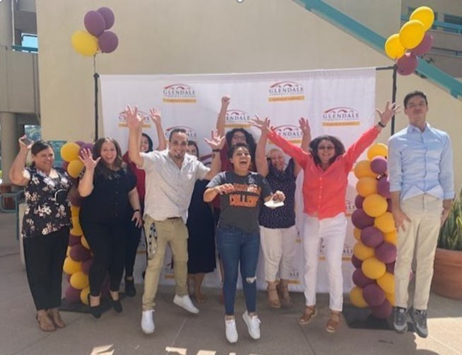
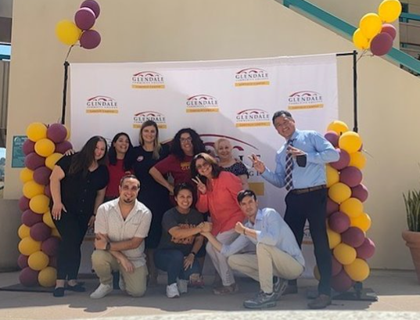
Develop a Culture of Innovation and Equity:​
Development of multilingual resources and services designed to reach all students ​
Holistic counseling provided to students (Personal/Mental Health, Academic, and Career)​
Partnerships developed across campuses (Dream Program, Rising Scholars, GCC Cares, etc.) ​ and with outside organizations (CARECEN, Verdugo Job Center, Dad's Back, Glendale Youth Alliance, DOR etc.)​
Device loan program for students​
Promote our Pathways:​
LLP noncredit to credit, Business, Health and Safety representation ​
Building Bridges from noncredit to credit by assisting our students to pursue ​
credit programs in their continued field of studies ​
Building the Student Experience:​
Welcome day (pictures)​
ESL Learning Café​
Career Workshops​
Mental Health and DSPS Services

Slide 17
Health Center
Develop a Culture of Innovation and Equity:​
Provide health and mental health related events to promote awareness and tools to improve wellness to manage life events.​
Develop/use short questionnaire to evaluate student experience of services they have received.​
Promote our Pathways:​
Promote health services and mental health counseling services through the Health Center website and social media.​
Provide classroom visits to showcase the health center services to students.​
Building the Student Experience:​
Continue to provide on-site health and mental health services to students helping to promote wellness.​
Continue to provide extended hours for counseling appointments and health visits through remote services.

Slide 18
Multicultural & Community Engagement Center
Develop a Culture of Innovation and Equity:​
Provide health and mental health related events to promote awareness and tools to improve wellness to manage life events.​
Develop/use short questionnaire to evaluate student experience of services they have received.​
Promote our Pathways:​
Promote health services and mental health counseling services through the Health Center website and social media.​
Provide classroom visits to showcase the health center services to students.​
Building the Student Experience:​
Continue to provide on-site health and mental health services to students helping to promote wellness.​
Continue to provide extended hours for counseling appointments and health visits through remote services.

Slide 19
Student Equity
Develop a Culture of Innovation and Equity:​
We will continue to review campus policies and procedures and update them as appropriate so that we ensure equitable outcomes for students. Past successes include: Probation overhaul, Academic Renewal, Third Attempt, SAP Community of Practice. ​
Continue serving students in innovative ways to ensure we cater to their needs on every level possible (i.e. MSW Internship Program with CSUN and USC, building a new learning community AAPI).​
Continue working with C & I to promote DEIA; Equity Counselor as DEIA Resource for Curriculum and Instruction (C&I)​
Promote our Pathways:​
Continue expanding our programs that support students in identifying their paths and staying on those paths.​
Summer Bridge (now expanding into Promise+) ​
Career Adventures (offering a seamless bridge to Career Services for our equity students)​
La Comunidad​
Black Scholars​
Guardian Scholars​
University Tours​
Building the Student Experience​
Leverage Canvas shell to engage learning community and summer bridge participants​
Offer intentional programming and high impact practices known to promote sense of belonging and positive outcomes for DI students: learning communities, group meetings, university tours, cultural diversity, special workshops, career adventures, mentorship programs (STEM, MMC), Black Scholars Scholarship, Guardian Scholars Emergency Support

Slide 20
International Student Center
Develop a Culture of Innovation and Equity:​
Continue to build upon programs and activities promoting the annual, nationwide celebration of "International Education Week" -- highlighting topics of global awareness & appreciation (part of the District's mission and values) and the global, multi-national community which comprises GCC.​
Promote our Pathways:​
Launch of new and improved International "Online" Application Form – set for early March; to improve new students' online application experience and for better integration & automation within PeopleSoft.​
Building the Student Experience:​
Continue to build upon "ISO Cares Month" each semester (45-min. Counseling appointments) to enhance student engagement and to keep students on track with their education plans, while maintaining their academic and immigration status.​
Continue to build and improve upon the online "Pre-Orientation" experience for newly admitted students, and to enhance the onboarding experience – as part of our on-campus Orientation Days offered prior to the start of each Semester.​
Continue to service our International Students online/remotely and in-person – whether overseas or inside the country.

Slide 21
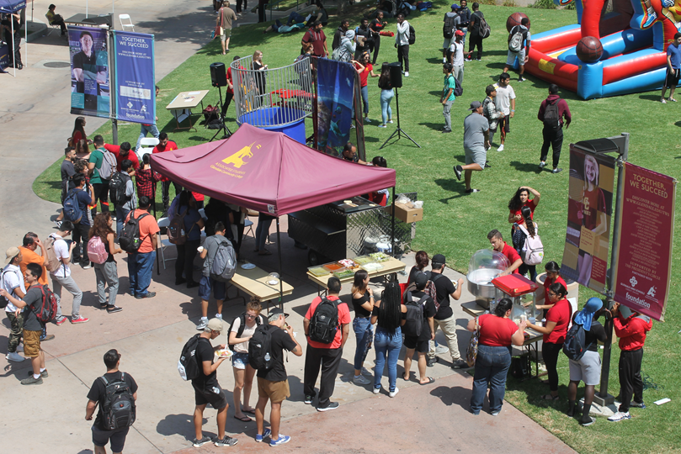
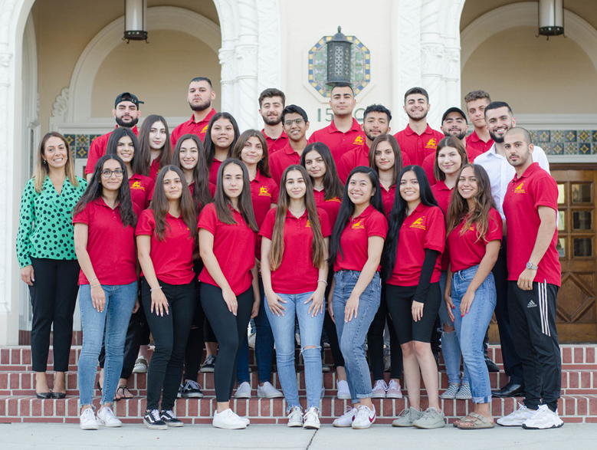
Student Affairs & Student Activities
Develop a Culture of Innovation and Equity:​
Launch the Vaquero Success Center with team of Success Ambassadors ​
Continue to bring students to in-person engagement opportunities​
Develop the 2nd Year Experience in support of the GCC Promise Plus+ program
Promote our Pathways:​
Increase in-reach efforts to engage students not connected through our formal programs, communities, and activities​
Building the Student Experience:​
Ensure as many of our students have a unique and engaging connection as a Vaquero​
Provide opportunities and spaces that bring students to campus and keep them here

Slide 22
Student Outreach Services
Develop a Culture of Innovation and Equity: ​
Hiring ambassadors that speak different languages​
Diverse ambassador groups can connect with incoming students​
Serving students in-person, remote and online simultaneously​
Promote our Pathways:​
High school and community outreach in Glendale, Burbank and Los Angeles​
Promote events and opportunities through social media platforms​
Dual enrollment & jump start programs & our ECAP program for new incoming students​
Make sure GCC's student enrollment guide is current all year long​
​
Building the Student Experience: ​
Being available and ready to help when and how students want to engage with our college​
Welcoming and friendly atmosphere where students feel comfortable​
Virtual and in-person campus tours to prospective students​

Slide 23
Transfer Center
Develop a Culture of Innovation and Equity:​
Ensure that students can access Transfer Center Counselors in person, on Zoom and via telephone. Partner with colleges and universities to provide experiences and activities to expose students to campus life. Bring back in person college tours and trips. ​
Promote our Pathways: ​
Launch and fully utilize Program Mapper to help guide students who have identified transfer as a goal through pathways that leads to transfer. ·Collaborate on a marketing campaign on the Promise Plus by highlighting our transfer successes.​
Building the Student Experience:​
Celebrate the transfer experience. Bring students together with their families and favorite faculty for a "Transfer Cord Ceremony and Graduation".

Slide 24


Slide 25
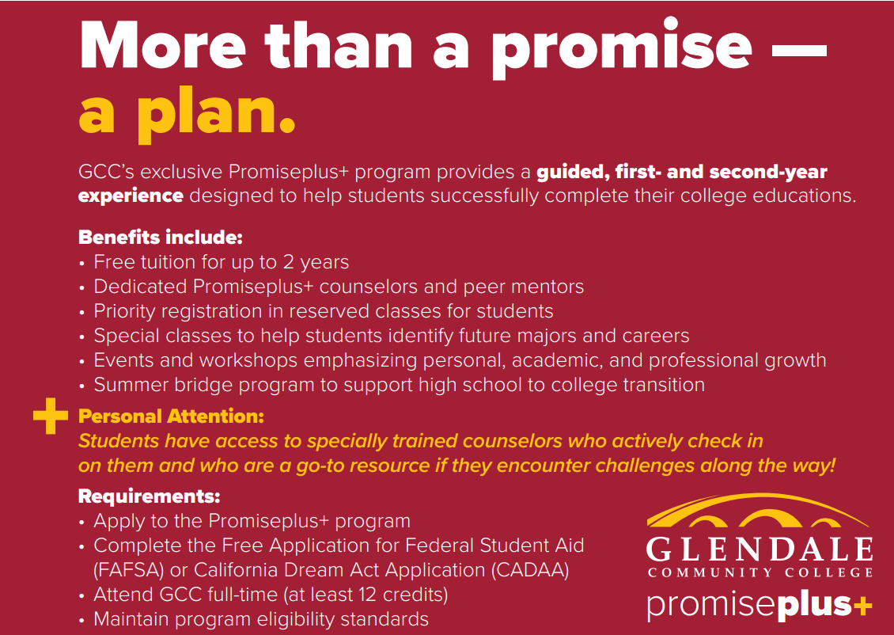

Slide 26

15-minute Break​

Slide 27
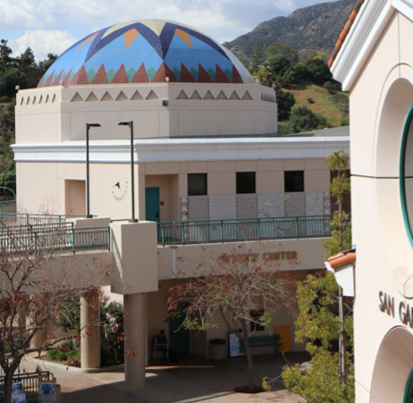
Engagement with Students of Concern​

Slide 28
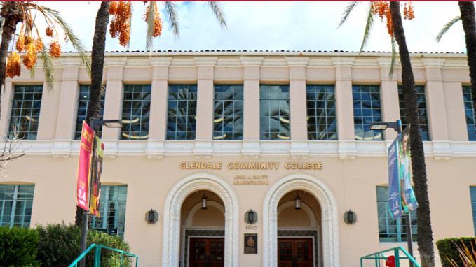
Lunch​

Slide 29
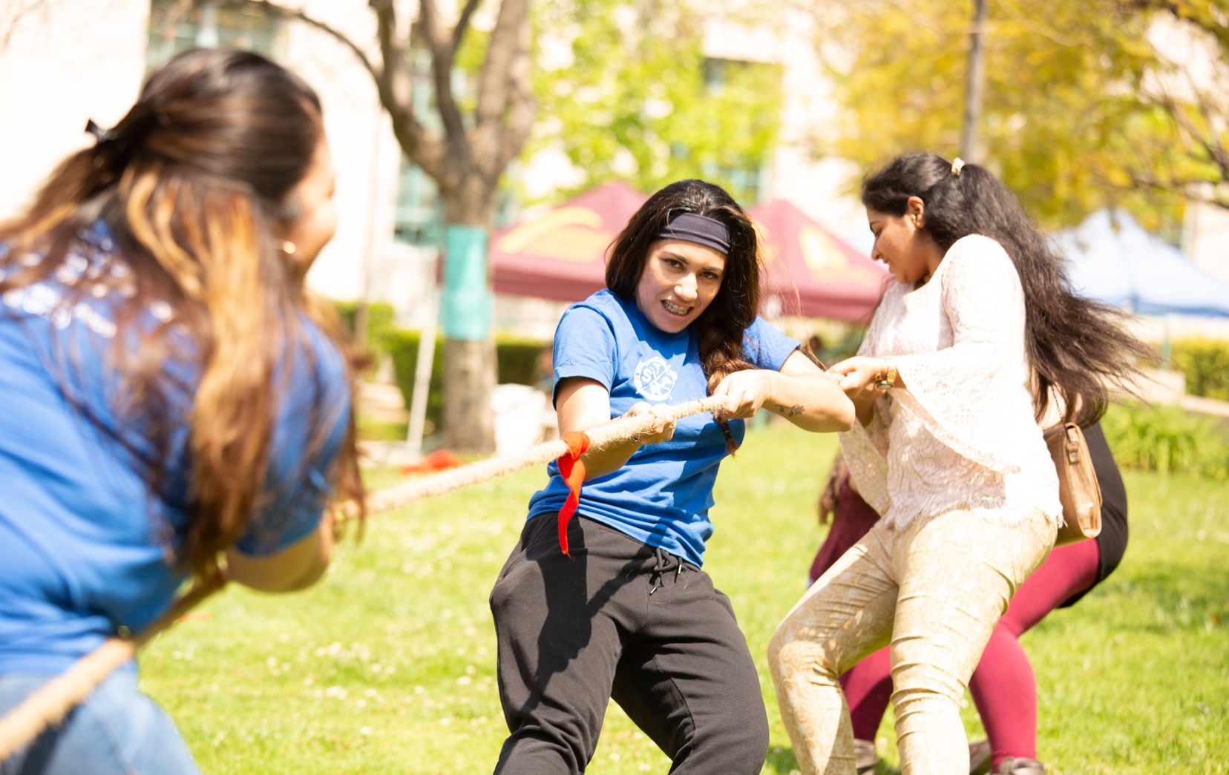
Closing Activities:
Scavenger Hunt
Re-engaging with all Student Services​

