Slide 3

Student Outcomes
Edward Karpp
Dean of Research, Planning & Grants
Team A – May 13, 2022

Slide 4
College Mission
Glendale Community College is a public community college granting certificates and associate degrees. The college serves people from a variety of geographical areas but primarily serves a diverse population of the Greater Los Angeles region that is capable of benefiting from instruction in credit, noncredit, and community education programs.
Glendale Community College exists to ensure students identify their educational goals and needs and successfully accomplish student learning in the following broad educational areas:
Basic skills education to achieve basic foundation skills in reading, writing, mathematics, English as a Second Language, and learning and study skills which are necessary for students to succeed in college-level work.
Lower division post-secondary education to achieve transfer to and success in obtaining a degree at a college or university.
Career and technical education to achieve employment or enhanced career skills for job advancement.
General education to achieve knowledge, skills and attitudes for postsecondary education success, personal enrichment, self-development, and a purposeful and meaningful life as a member of a global community.

Slide 5
Student Outcomes
Student Success Metrics (no more Student Success Scorecard)
Institution-Set Standards
Credit and Noncredit Student Progress

Slide 6
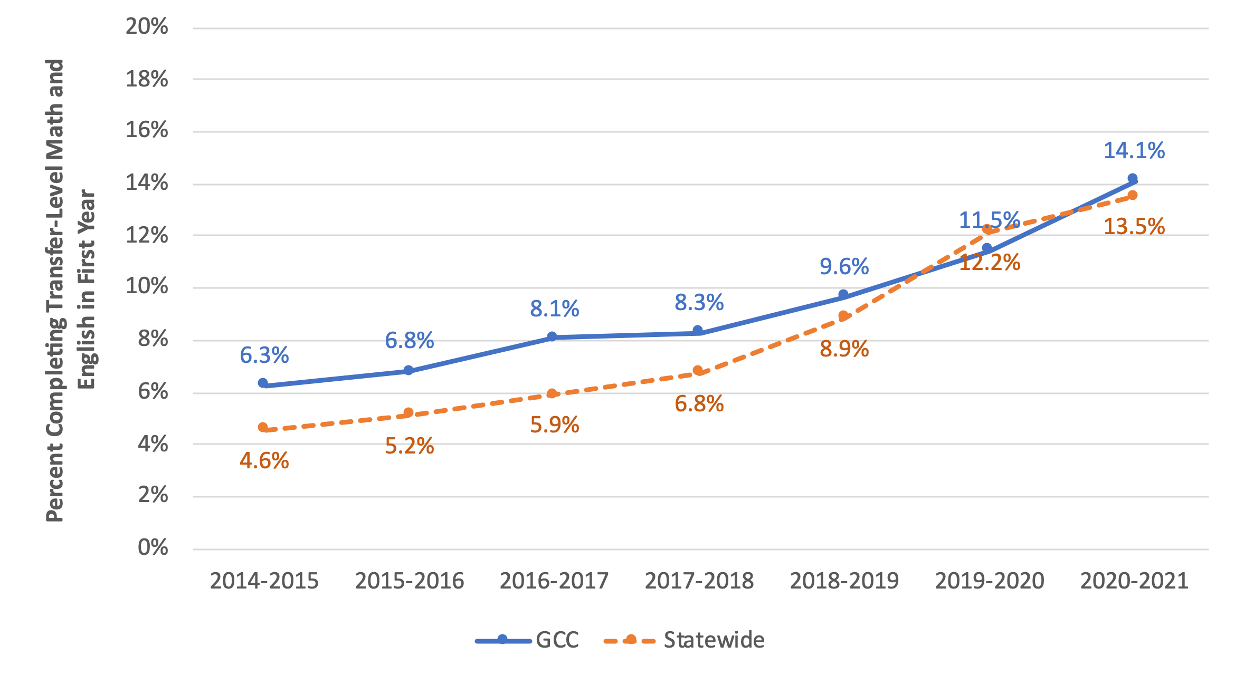
Completed Transfer-Level Math and English
Among all students, the proportion who completed transfer-level math and English in their first academic year of credit enrollment within the district
Student Success Metrics
Mission:
Basic skills education to achieve basic foundation skills in reading, writing, mathematics, English as a Second Language, and learning and study skills which are necessary for students to succeed in college-level work.

Slide 7
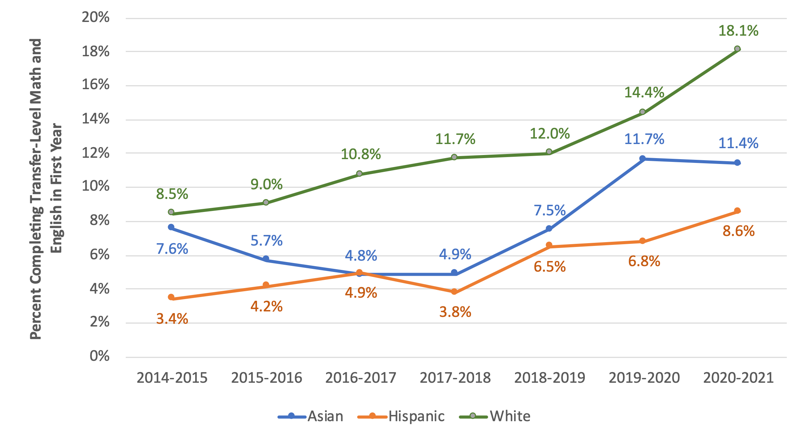
Completed Transfer-Level Math and English
Among all students, the proportion who completed transfer-level math and English in their first academic year of credit enrollment within the district
Student Success Metrics
Mission:
Basic skills education to achieve basic foundation skills in reading, writing, mathematics, English as a Second Language, and learning and study skills which are necessary for students to succeed in college-level work.

Slide 8
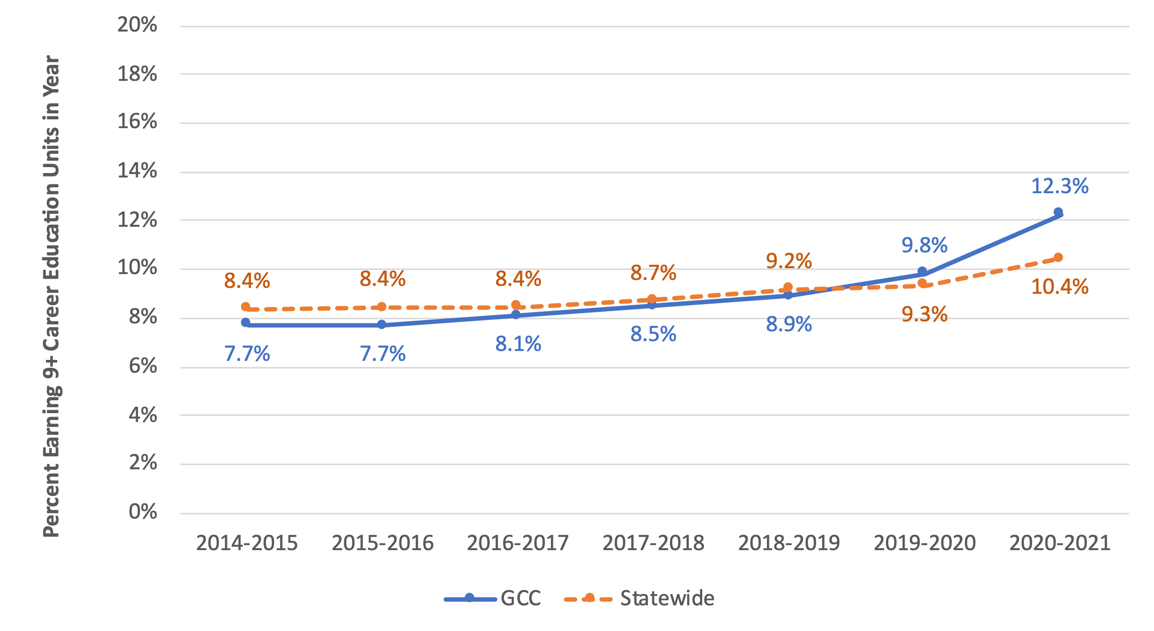
Earned 9+ Career Education Units
Among all students, the proportion who successfully completed nine or more career education units for semester schools, or 13.5 or more career education units for quarter schools, in the selected year within the district
Student Success Metrics
Mission:
Career and technical education to achieve employment or enhanced career skills for job advancement.

Slide 9
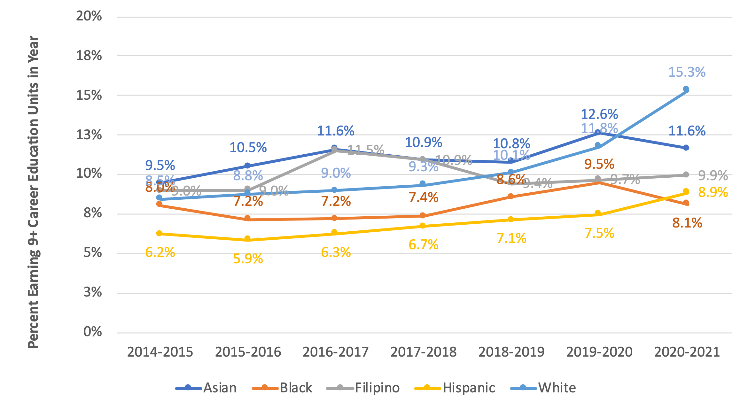
Earned 9+ Career Education Units
Among all students, the proportion who successfully completed nine or more career education units for semester schools, or 13.5 or more career education units for quarter schools, in the selected year within the district
Student Success Metrics
Mission:
Career and technical education to achieve employment or enhanced career skills for job advancement.

Slide 10
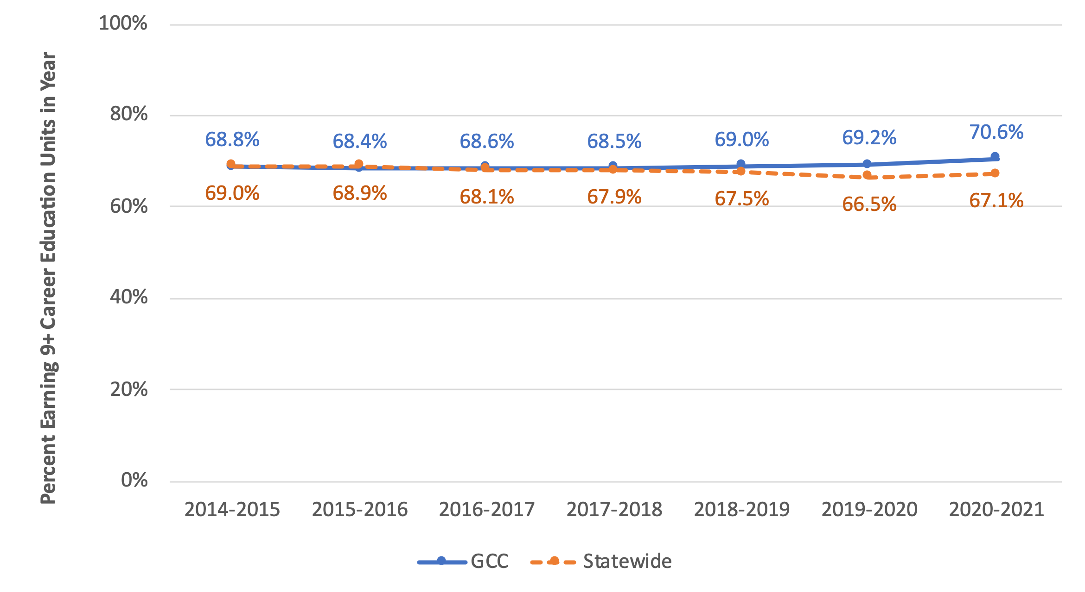
Persisted from Fall to Spring
Among students in selected student journey, the proportion who enrolled in fall and spring terms in the selected year, excluding students who completed an award or transferred to a postsecondary institution
Student Success Metrics
Mission:
Glendale Community College exists to ensure students identify their educational goals and needs and successfully accomplish student learning…

Slide 11
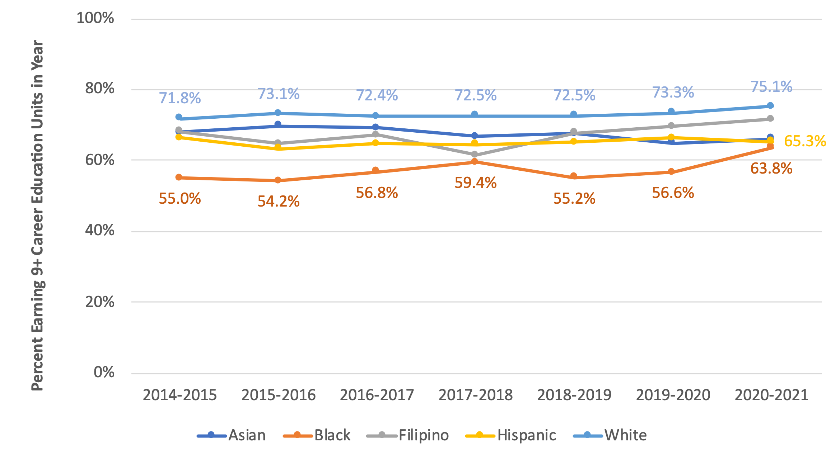
Persisted from Fall to Spring
Among students in selected student journey, the proportion who enrolled in fall and spring terms in the selected year, excluding students who completed an award or transferred to a postsecondary institution
Student Success Metrics
Mission:
Glendale Community College exists to ensure students identify their educational goals and needs and successfully accomplish student learning…

Slide 12
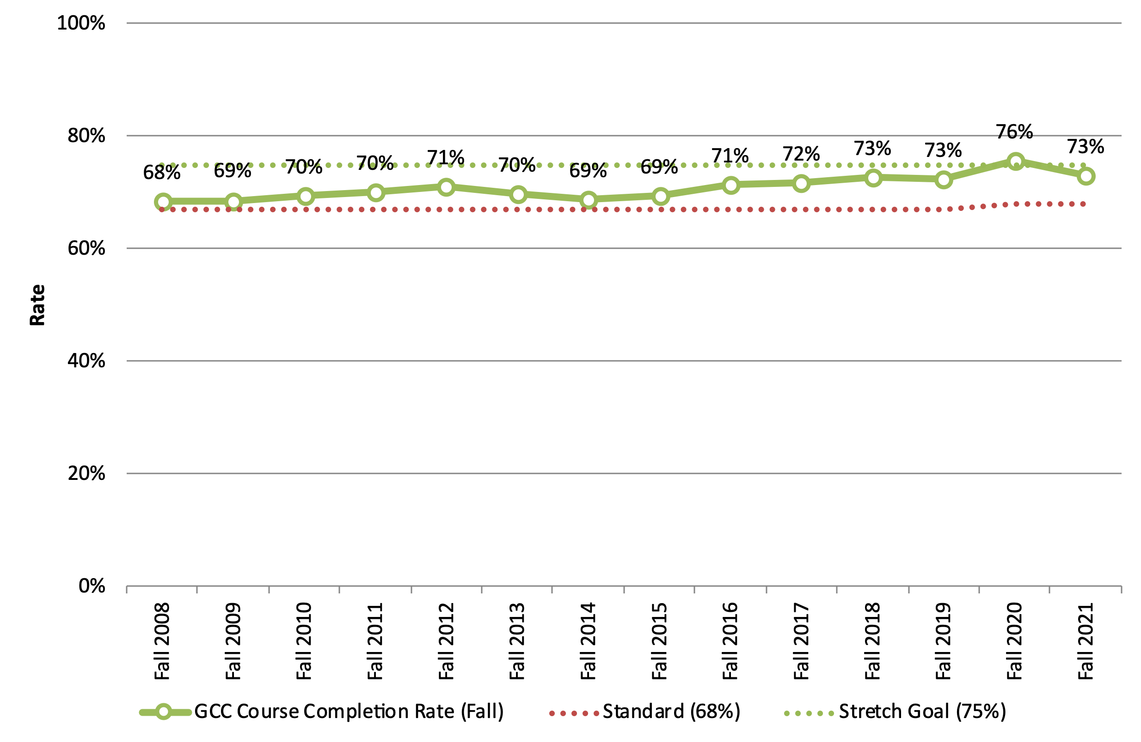
Institution-Set Standards
1. Successful Course Completion Rate
Mission:
Glendale Community College exists to ensure students identify their educational goals and needs and successfully accomplish student learning…

Slide 13
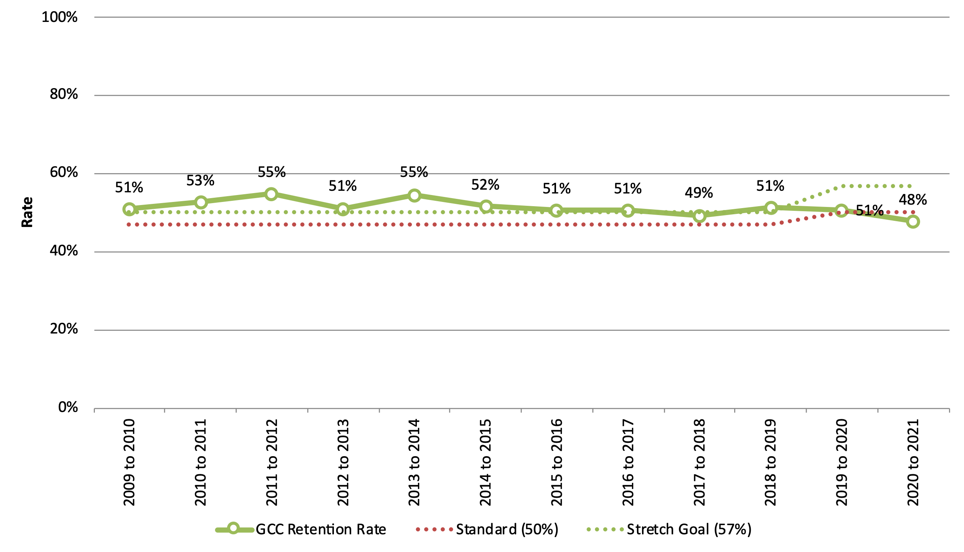
Institution-Set Standards
2. Retention Rate
Mission:
Glendale Community College exists to ensure students identify their educational goals and needs and successfully accomplish student learning…

Slide 14
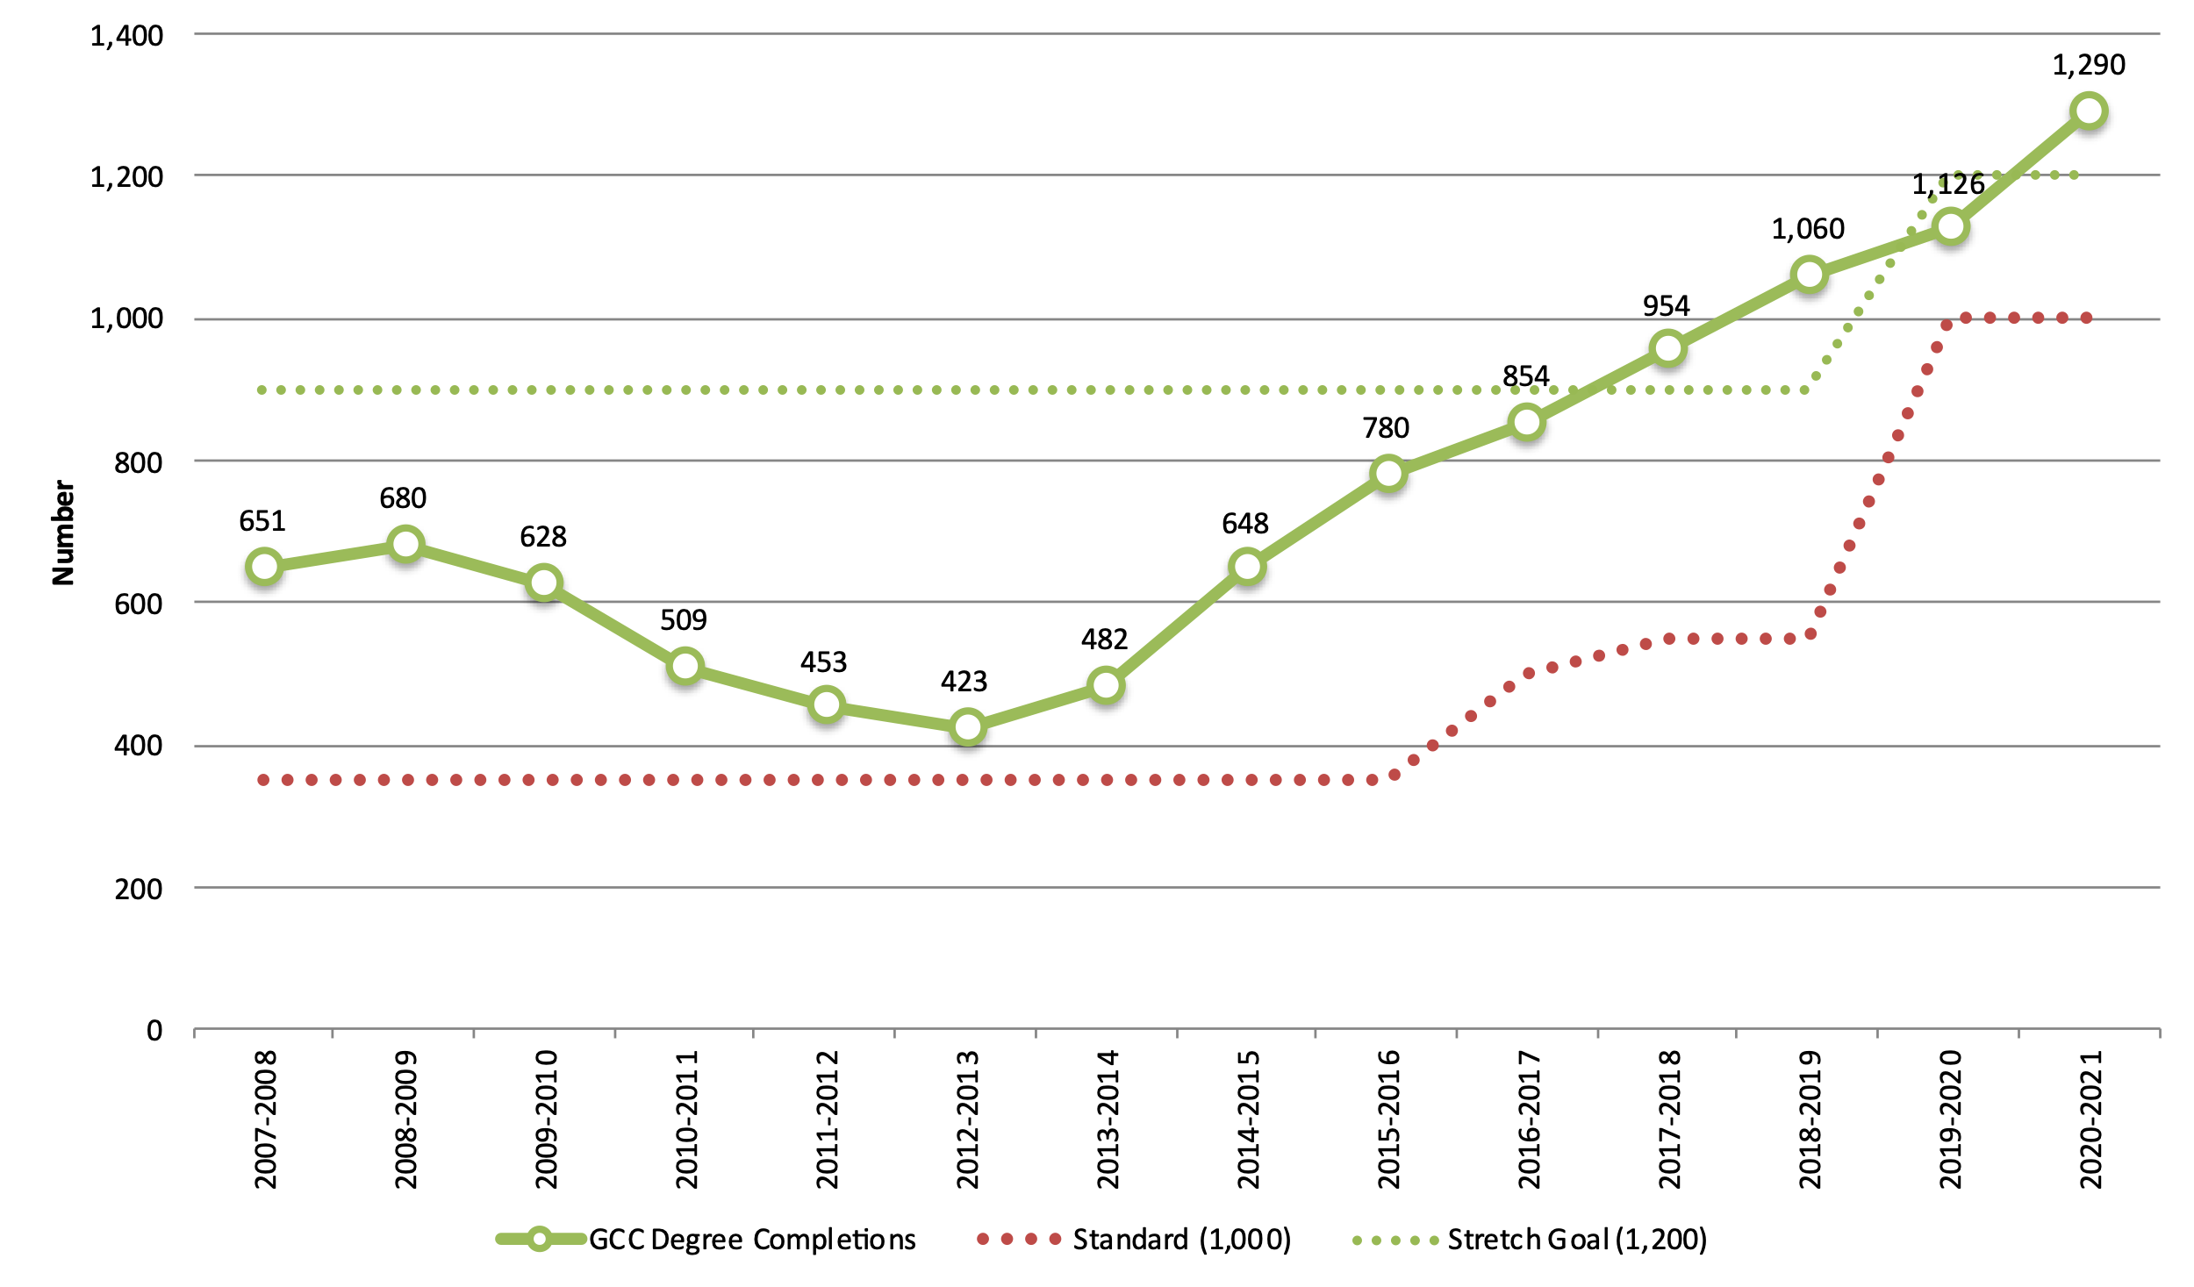
Institution-Set Standards
3. Degree Completion
Mission:
Glendale Community College is a public community college granting certificates and associate degrees.

Slide 15
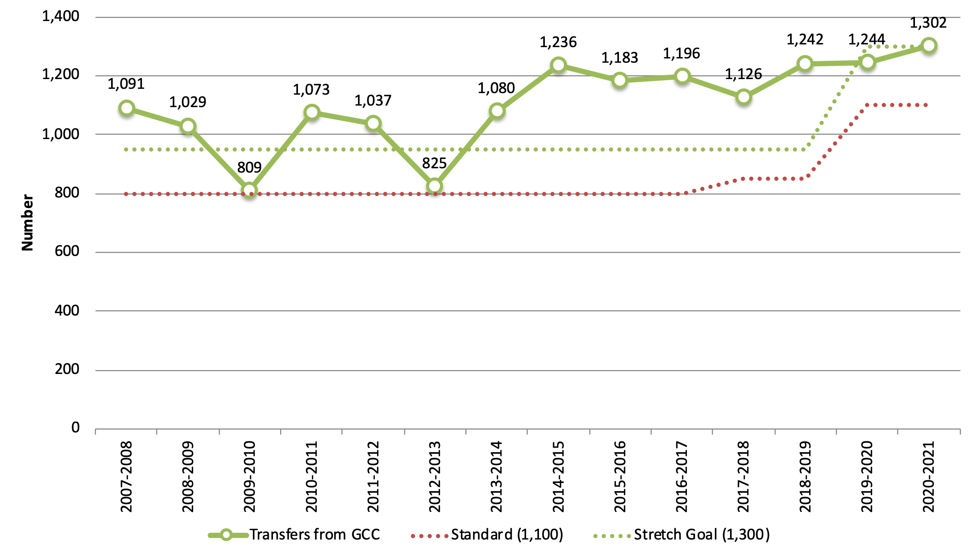
Institution-Set Standards
4. Transfers
Mission:
Glendale Community College is a public community college granting certificates and associate degrees.

Slide 16
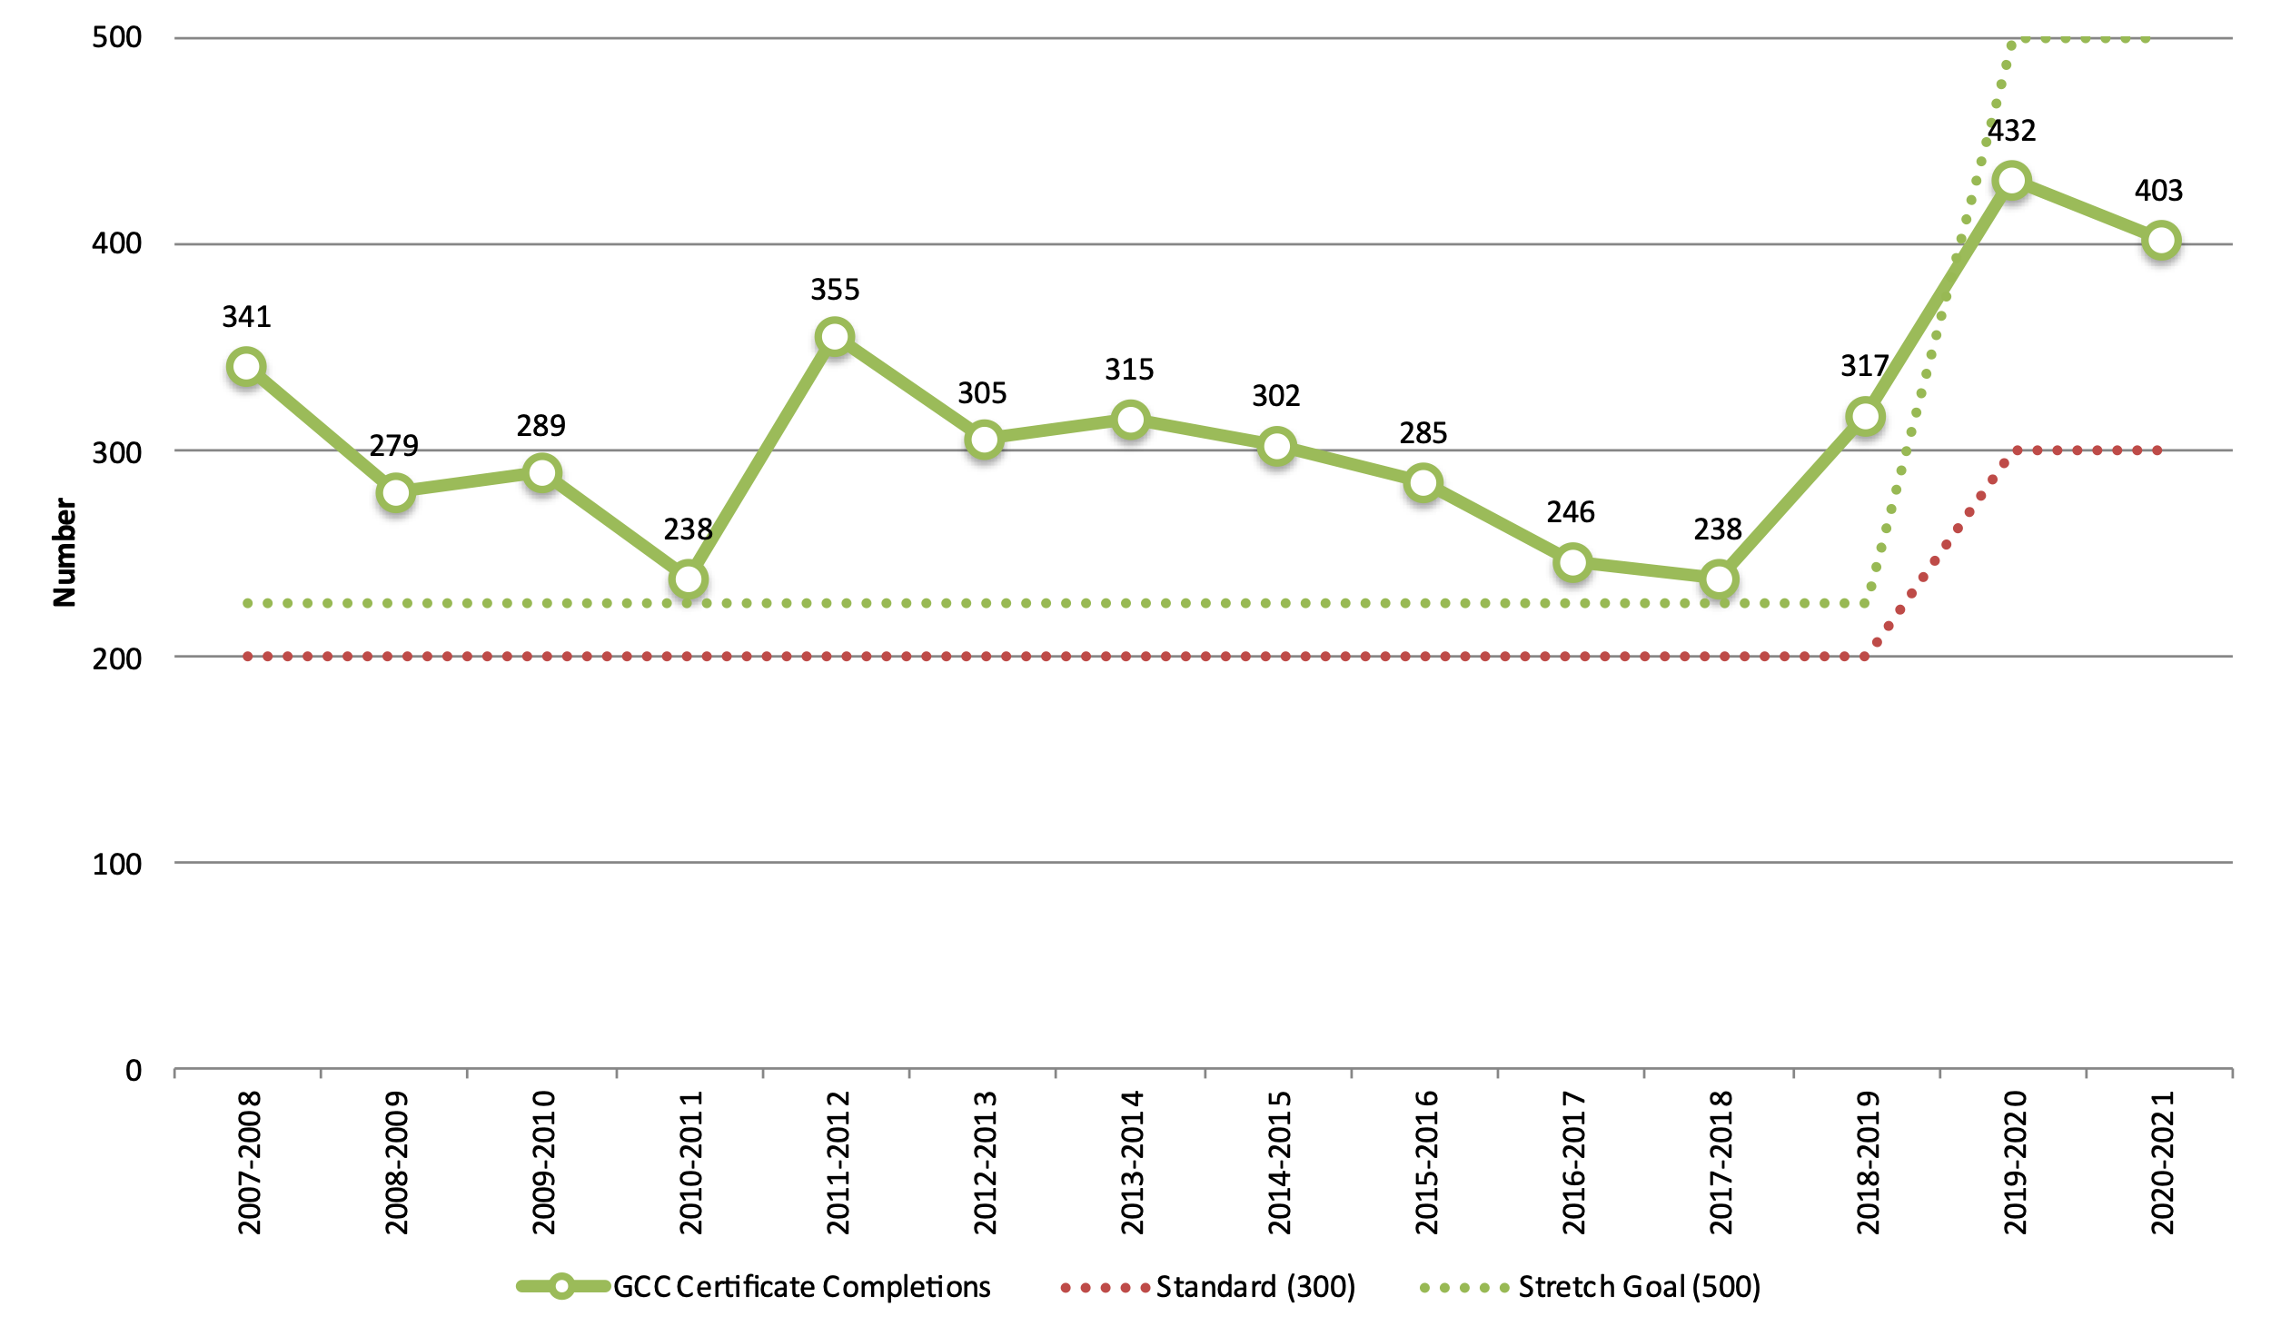
Institution-Set Standards
5. Certificate Completion
Mission:
Glendale Community College is a public community college granting certificates and associate degrees.

Slide 17
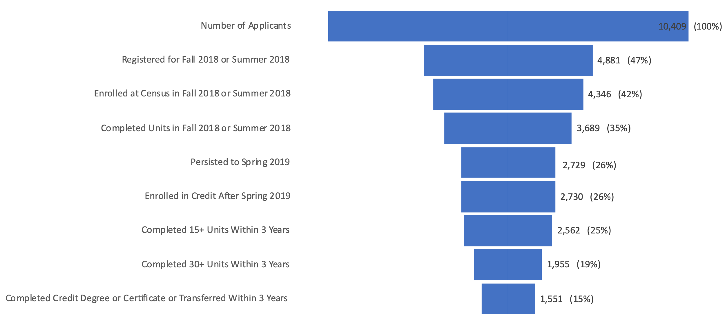
Credit Student Progress
New Credit Applicants, Fall 2018
Mission:
Glendale Community College exists to ensure students identify their educational goals and needs and successfully accomplish student learning…

Slide 18
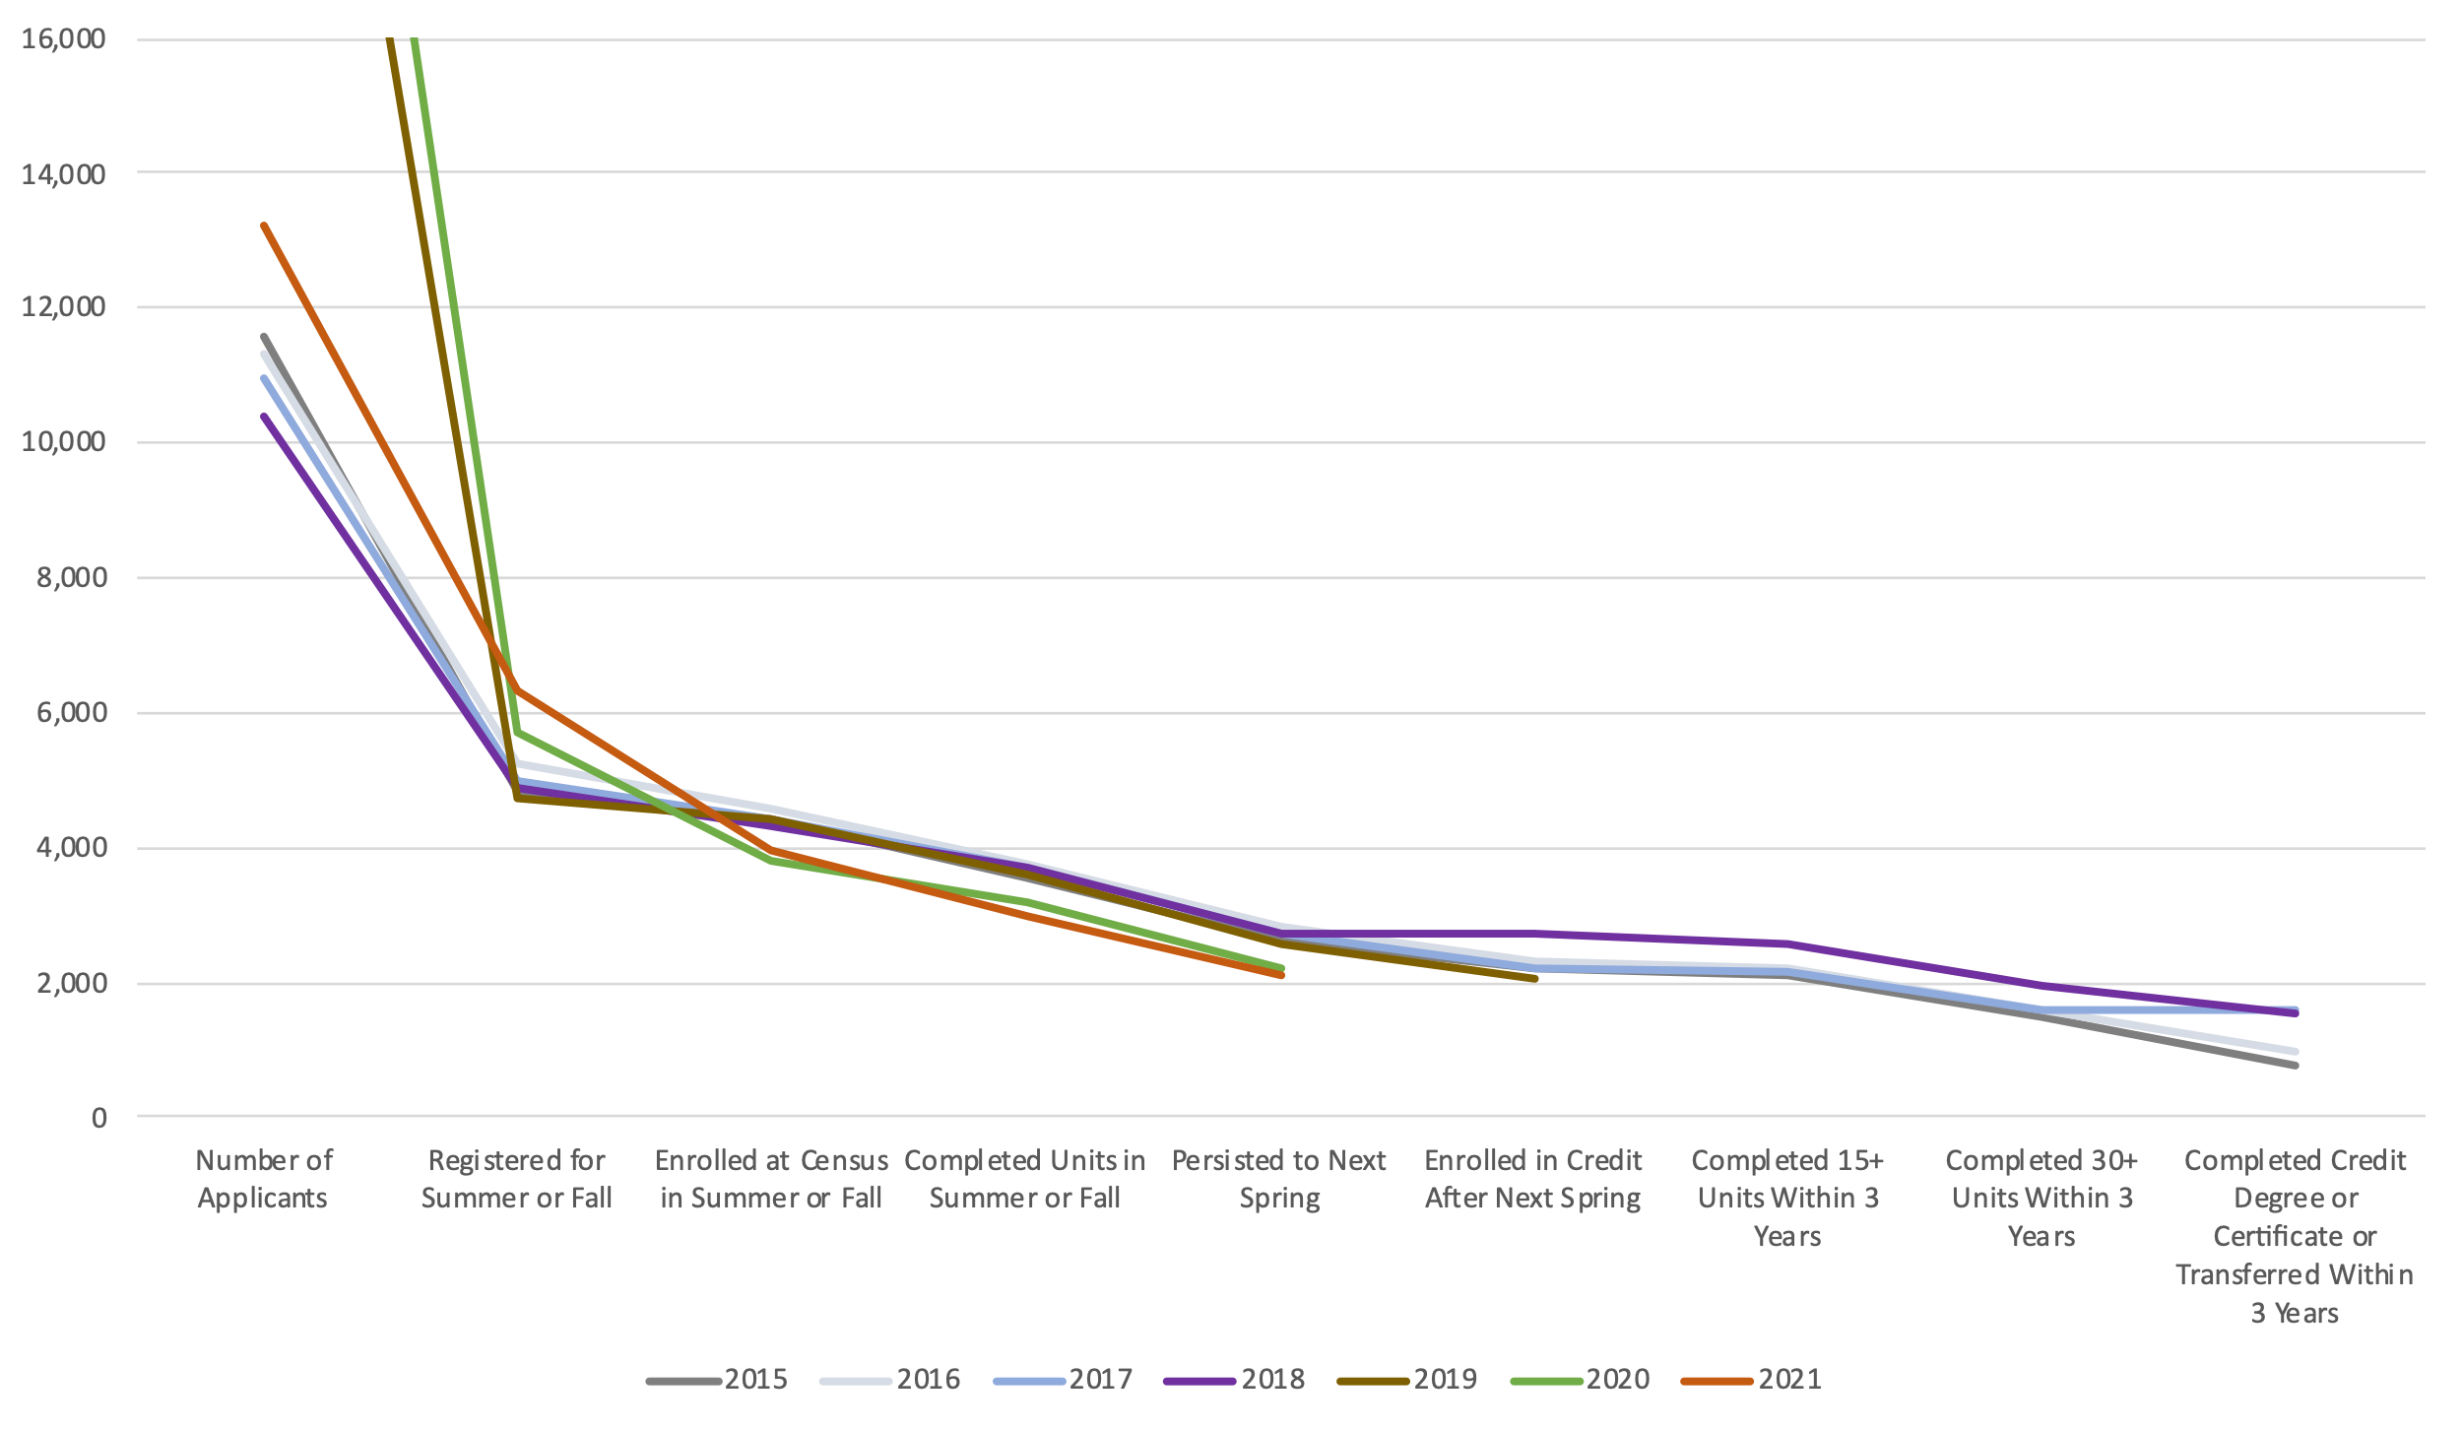
Credit Student Progress
Trends: New Credit Applicants
Mission:
Glendale Community College exists to ensure students identify their educational goals and needs and successfully accomplish student learning…

Slide 19
Noncredit Student Progress
New Noncredit Applicants, Fall 2016
Mission:
Glendale Community College exists to ensure students identify their educational goals and needs and successfully accomplish student learning…

