Slide 1
Citizens’ Bond Oversight Committee
Measure GC Progress Report
Glendale Community College
Project Updates
May 2, 2022
Presented by Fred Parker, Interim Director of Facilities

Slide 2
Measure GC Budget Update
Original Bond Measure
o With Interest
$325M
$328.3M
$357.6M
$ 29.3M
$ 35.3M
$ 5.9M
Total Cost to Complete
Overages due to escalation
Additional Funds
Remaining Balance

Slide 3
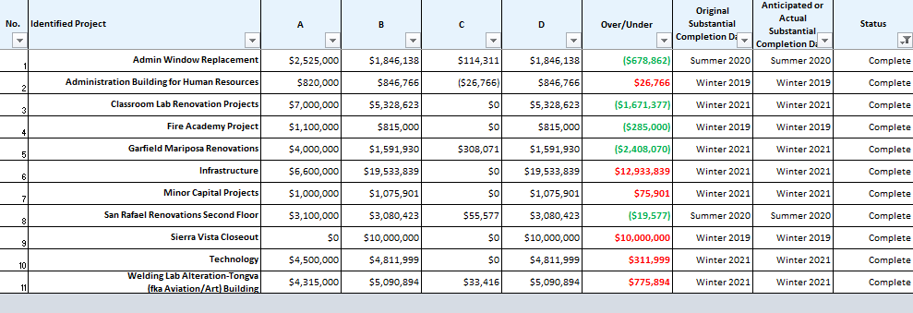
Measure GC & Bond Priorities Report April 2022
Completed Projects

Slide 4
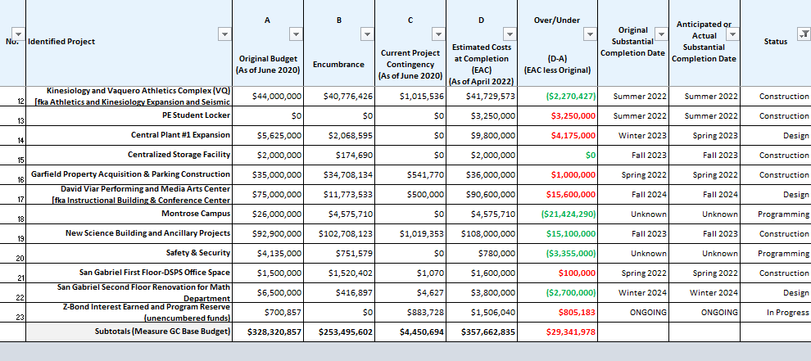
Measure GC & Bond Priorities Report April 2022
Projects In Progress

Slide 5
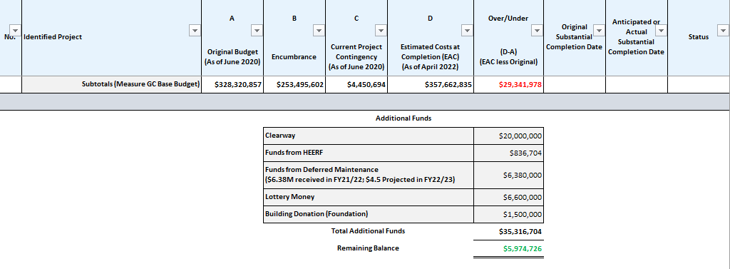
Measure GC & Bond Priorities Report April 2022
Current Financial Status

Slide 6


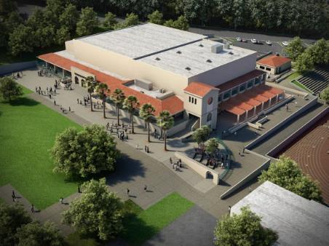
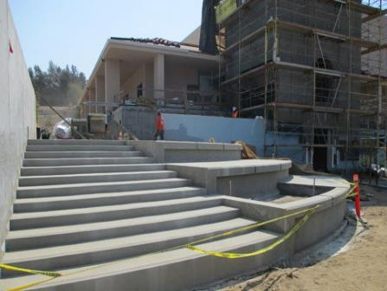

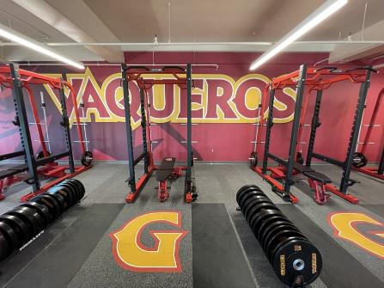

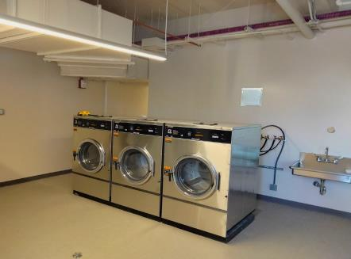
Kinesiology and Vaquero Athletic Complex
(aka Athletics and Kinesiology Expansion and Seismic Retrofitting Physical Education-PE, Verdugo Gym)
Description:
Increment 1: Complete
  Pending DSA Certification
Seismic Upgrade: Complete
  Accelerated Construction Start on 4/13; Completed 12/2020
Increment II: Under Construction
  Renamed Kinesiology and Vaquero Athletic Complex (VQ)
  Verdugo Gym use for sports training as of Oct 15, 2021
  Kinesiology and Vaquero Athletic Complex phased occupancy through Spring 2022 for offices and classes
  Graphics, Furniture, Fixture, Equipment installation in progress
  New scope additions of Women’s Locker Room Conversion and Faculty Locker / Shower Room by Summer 2022
  PE Student Shower/Locker Building started Apr 2022 with anticipated completion Summer 2022
Project Status: Construction

Slide 7

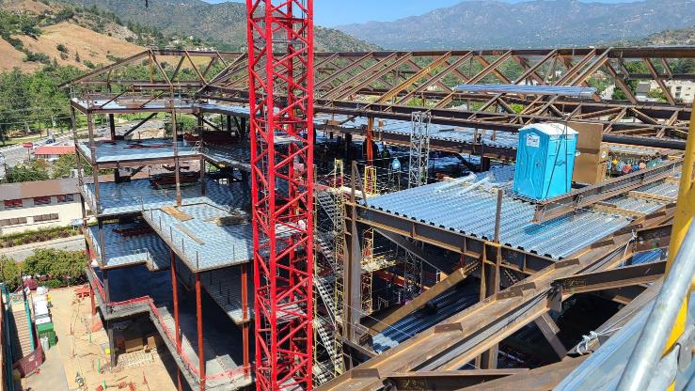

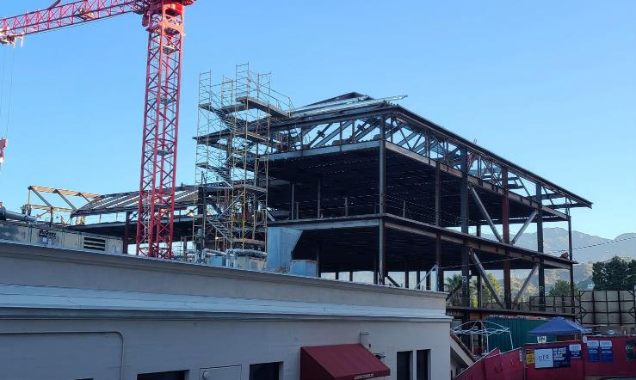
New Science Building (NSB)
Description:
CM Construction Schedule approved with these milestone dates: Construction Start – March 2021
  Substantial completion – Fall 2023
DPR completed Verdugo lane closure & median removal per City permitting
Tower crane installation tested and inspected, and steel erection began 2/1/22
Milestone Topping Out Ceremony scheduled Wed April 27, 2022
Ancillary projects tracked under separate budgets:
Central Plant 1 Upgrade operable by Dec 2022
Centralized Storage Facility incorporated on ground floor
San Gabriel building renovation for Math Department upon completion and occupation of New Science Building
Astronomy Dome installed in permanent location and bolted down
Project Status: Construction

Slide 8

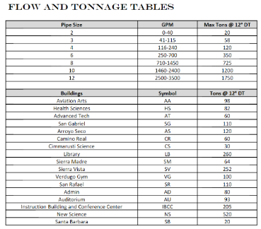

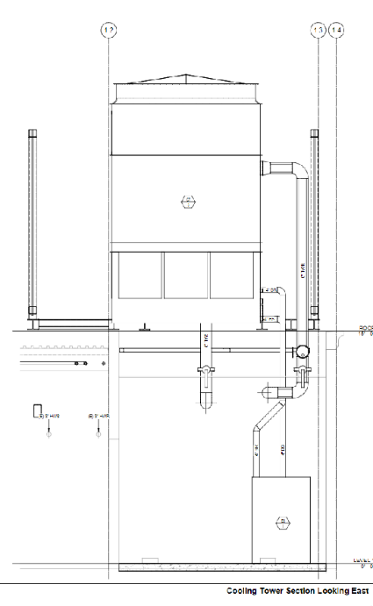

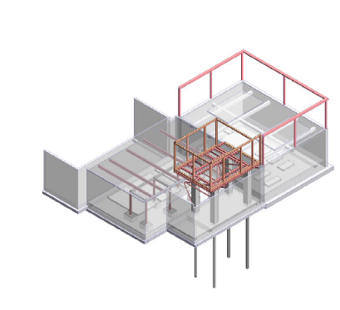
Central Plant #1 Expansion
(New Science Building dependent on Central Plant Upgrade)
Description:
Project Plans & Specs recently DSA Approved: 03-121483
The Board has approved DPR Construction GMP for $7.9M
Tie-in to NSB is Dec 2022 and project completion date is Mar 2023
Supplemental project funding provided by Clearway for expanded CP1 capacity required to support IBCC, CP2 loop tie-in and stand-by Thermal Energy Storage (TES) tank
Project Status: Construction

Slide 9


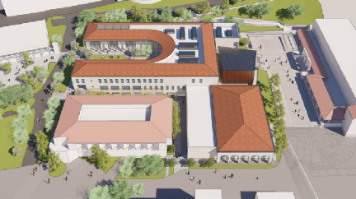
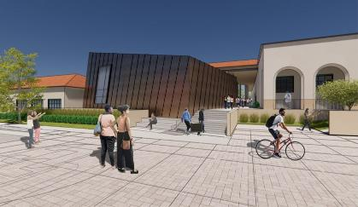

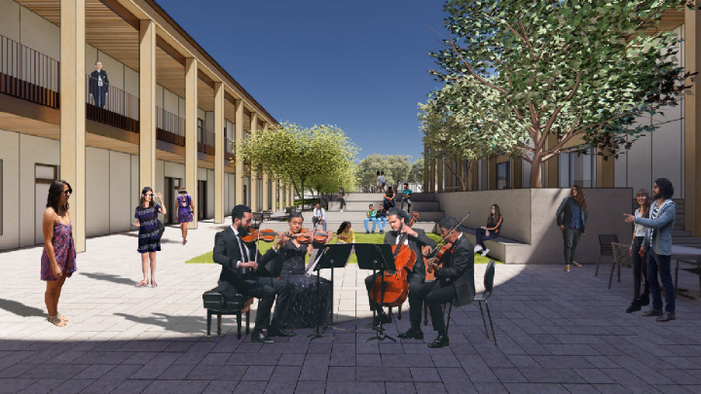
David Viar Performing and Media Arts Center (fka Instructional Building & Conference Center-IBCC)
Description:
Renamed David Viar Performing and Media Arts Center
Construction Documents with DSA pending approval; +/- 5 months
Specialty consultants from Steinberg Hart, Acentech and KeyCode provided sound recording studio design per programming requirements
College signed a 3 year lease for the City of Glendale Civic Auditorium to be used as Swing Space for Dance & GCC Cares; TI work has begun and is currently scheduled to be completed April 2022.
Other temporary swing space accommodations include NC ESL relocation to AT107A and Duplicating to San Gabriel Annex
Project Status: Design

Slide 10

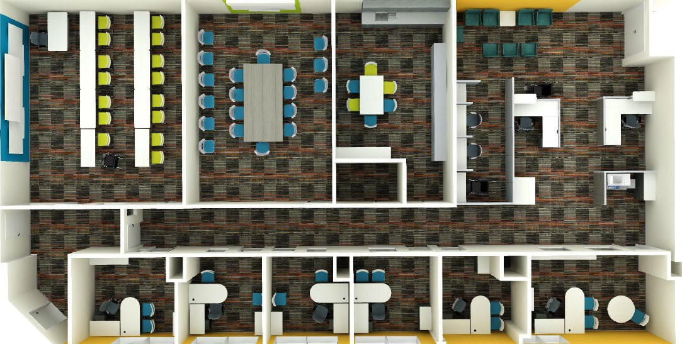
San Gabriel First Floor Renovation Disabled Student Programs and Services (DSPS)
Description:
Convert approximately 3900 sf of vacant space on the first floor of the San Gabriel Building into office and instructional support space for Disabled Student Programs and Services (DSPS)
The project has been awarded to JR Universal and is currently under construction.
MEP Upgrades, FF&E Design and procurement added to scope
Target Completion is late Spring 2022
Project Status: Construction

Slide 11
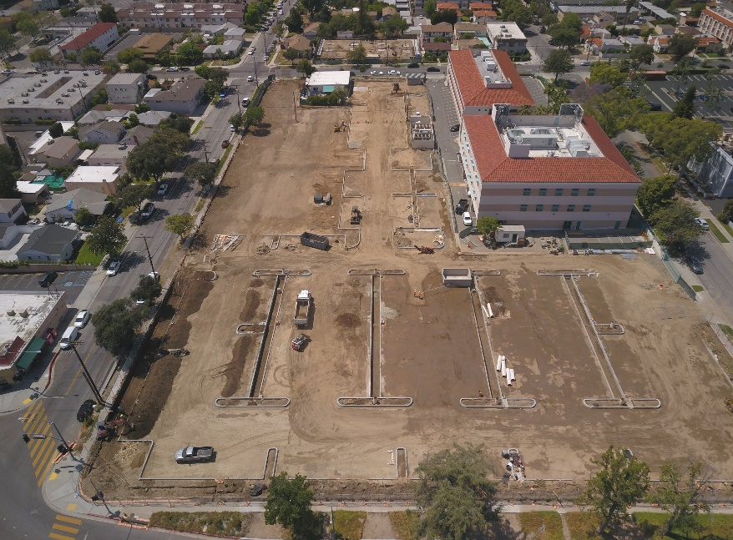

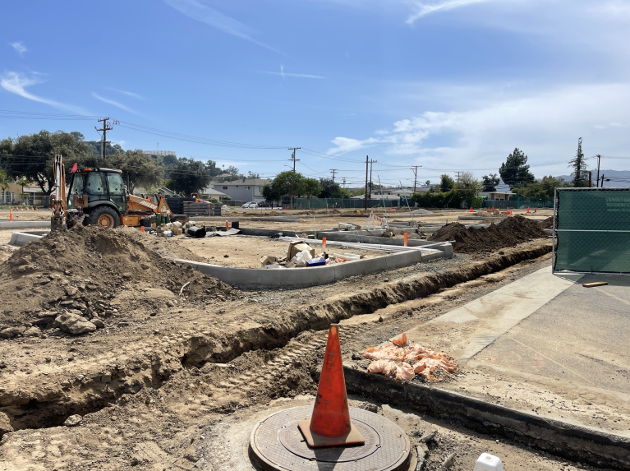
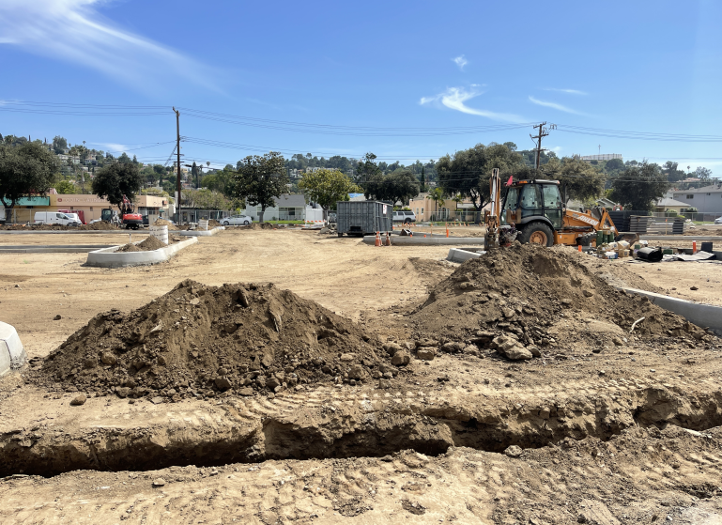
Garfield Campus Property Acquisition, Parking & Landscape Project
Description:
Menemsha + MMA, Design Build Entity (DBE) Project is DSA approved and has begun construction; Project ETC May 2022
Construction over excavation, grading & compaction complete
Allied Heath Modulars expected delivery on site mid-May 2022
Project Status: Construction

Slide 12

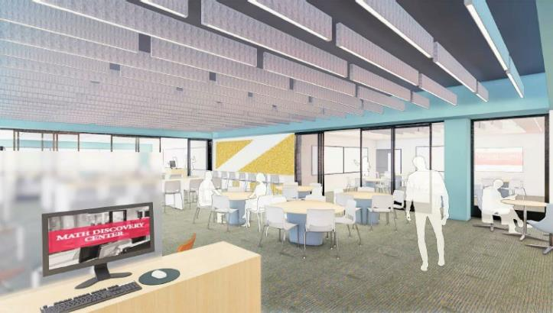

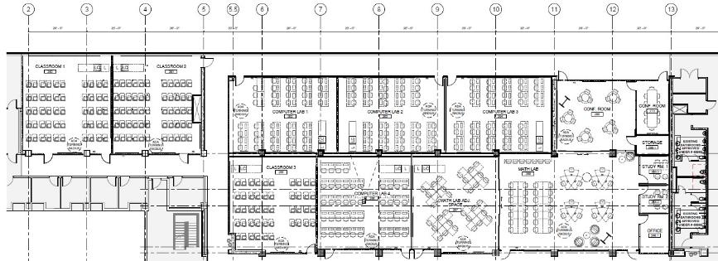
San Gabriel Renovations-Math Department Relocation
Description:
Renovate 2nd floor of San Gabriel Building for Math as part of a secondary effects project to the New Science Building
The project will renovate space that currently houses the Biology Department into state-of-the-art math classrooms and labs, including Math Discovery Center
Completed 90% CD set; Submit to DSA Q3 2022 pending design changes to Wi-Fi beta test
Wireless Computer Lab Beta Test at AT107B to save hardwiring costs and increase space flexibility in Math Labs and campus wide; Beta test completion date is Nov 2021 to incorporate into design
Project Status: Design

Slide 13

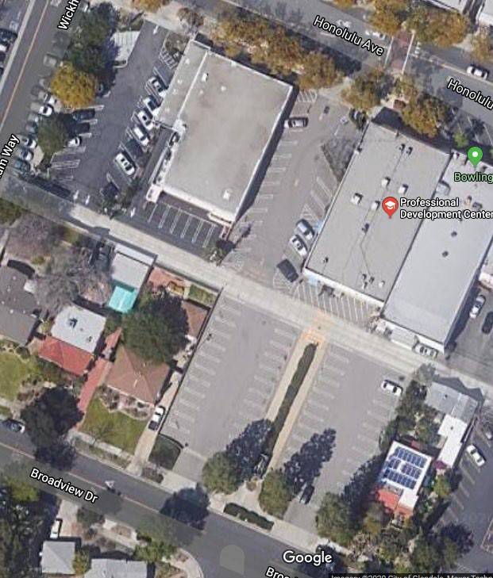
Montrose Campus Enhancements
Description:
Professional Development Center (PDC) Remodel with Electrical, Lighting, Audio Visual Upgrades & New Lobby Furniture of $1M
Educational Needs Assessment conducted by Collaborative Brain Trust (CBT) and reviewed by Academic Leadership serves as a supplement to final programming document prepared by SWA
HAZMAT Surveys completed for both Citibank & PDC buildings
Project on HOLD until project budget funds become available
Project Status: Programming Complete – Project on HOLD

Slide 14

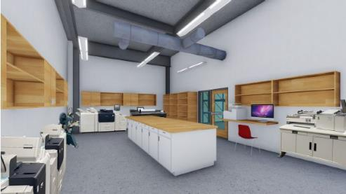

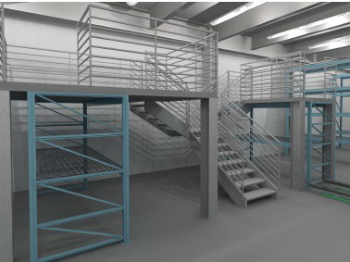

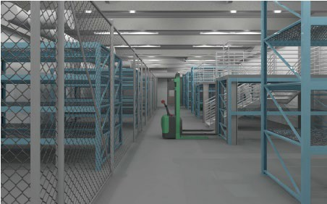
Centralized District Storage Facility (To be included in New Science Building)
Description:
Existing storage space will need to be torn down for construction of the New Science Building (NSB) and the Instructional Building & Conference Center (IBCC)
Containers at South West end of campus emptied and removed to clear way for PE and IBCC project sites
19-Six begins Programming & design of 8,150 sf Centralized District Storage Facility in NSB to replace several storage locations
Permanent home for Duplicating, Facilities and Theatre Arts Show Equipment Storage to replace Santa Anita storage, locations within the Auditorium and CT1 - temporarily stored at Montrose - for Projection, Lighting, & Audio Equipment, Large Scenic Pieces (Steps, Platforms, Doors, Etc.)
Project Status: Design

Slide 15


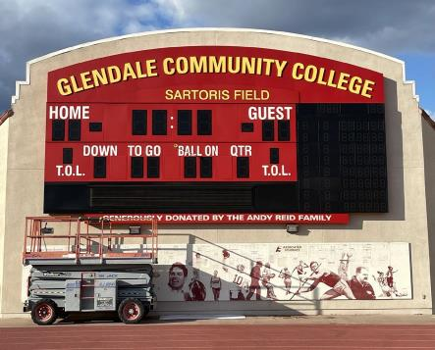
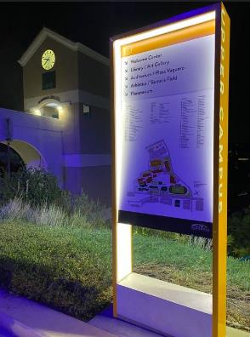

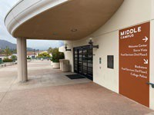

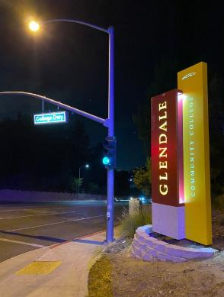
Capital Maintenance Projects (Wayfinding)
Description:
Interior & Exterior Wayfinding project with RSM Design ongoing
Prioritize assessment of Office of Civil Rights ADA Audit requirements as COVID-19 mitigations; otherwise complete upon fund availability
Small renovation projects completed based on available HEERF funds:
  Touchless Door hardware
  Repair deteriorated Tennis Court asphalt
  Add outdoor concrete bench seating and umbrellas
  NBPI-Needlepoint Bipolar Ionization in new projects
  Partition remodel and installation for common use areas
In response to COVID 19, HEERF funds are being used for filming and IT/AV equipment upgrades to facilitate a HyFlex learning environment.
Project Status: Complete

Slide 16


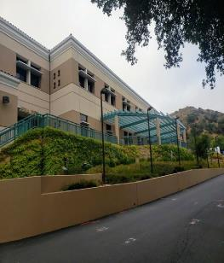
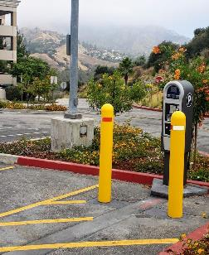

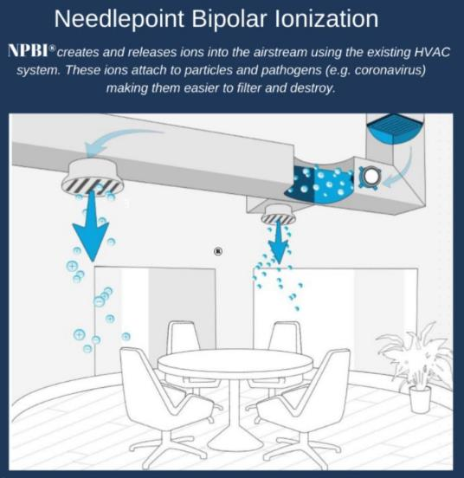
Infrastructure
Description:
Approx. $19M in various Infrastructure Projects District-wide
  NPBI Air Purifier Upgrades to existing HVAC system as COVID mitigation measure
  College-wide Topographic & Underground Utility Surveys complete
  Digitization of College As-Built Plan Room & creating online library
  Electric Charging stations in Lot C to replace Lot G (Displaced by NSB)
  Campus wide Backup Generator replacement, as needed
  Upgrade deteriorating infrastructure systems and spaces on the Verdugo and Garfield campuses.
  Cleared all storm drains and installed stormwater grids
  Conducted a campus-wide power shutdown allowing the performance of essential planned upgrade on electrical switch gears
  Added six new LED lights along Sierra Vista Bldg. at Chaparro Drive
  Additional parking pass machine added to Lot B
Upgrades completed in response to added health & safety measures may be eligible for COVID funding
Project Status: Complete

Slide 17
For more up to date information, please visit:
https://www.glendale.edu/campusprojects
Q & A

