Slide 1
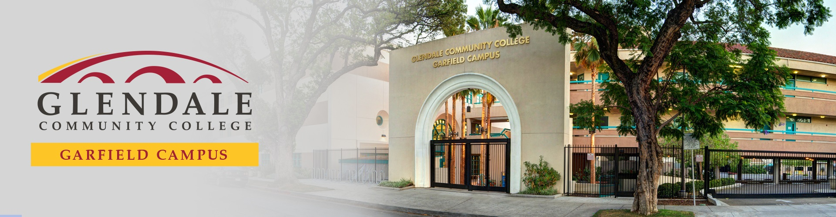
Community & Continuing Education
Noncredit
Student Success Center
Counseling Services
Disabled Students Program & Services (DSPS)
English as a Second Language Classes
Short-Term Vocational (Business, Computers & Medical) Classes
Community Services Education
Garfield.glendale.edu

Slide 2

Student Success Center
We provide FREE quality education and services in the following areas:
  Adult Basic Education
  GED and HiSET preparation and testing
  Adult High School diploma
  Concurrent High School credit recovery and advancement
  Preparation courses/workshops for credit level English and Mathematics
Fully online (with continued online option when facility opens)
Garfield.glendale.edu

Slide 3
Student Success Center – Concurrent High School
Opportunity to make up credits or earn additional credits towards their diploma
Credit Recovery and Advancement
Individualized (self-paced), fully online, and asynchronous
For students who are currently enrolled in any high school
Instructors are available for individual help
  One-on-one or small group instruction
Garfield.glendale.edu

Slide 4
Student Success Center – GED and HiSET Preparation
Small class instruction in all test areas
  Reading/Grammar/Essay, Science, Social Studies, Mathematics)
  Small group instruction in each of the subjects
  Computer software, textbooks, and worksheets to complement the study plan
  On site testing every month (when facility opens):
    HiSET – 3rd week of the month
    GED – 4th week of the month
    Online proctored test through GED or ETS (HiSET)
Garfield.glendale.edu

Slide 5
Student Success Center – Specialized Workshops and Courses
Open entry-open exit year round workshops for college Math and English students
Summer College Writing Workshops
Preparation classes for credit math
Basic Statistics Review course offered Winter and Summer sessions
Basic Algebra Review course offered Winter and Summer sessions
Garfield.glendale.edu

Slide 6
Career Counseling:
  Career Assessments
  Resumes
  Cover Letters
  Interview Preparation
  Job Search
Mental Health Counseling:
  Stress
  Relationships
  Problem Solving
  Resolving Conflict
Community Resource Information:
  Medical, Eye, and Dental Services
  Child Care
  Food and Rental Assistance
  Many More!
Counseling Services – Career & Counseling Center
Academic Counseling:
  Educational Goals
  Educational and Career Pathways
  Classes – Noncredit and Credit
  Student Educational Plans (SEP)
  Services and Resources Referrals
Garfield.glendale.edu

Slide 7

Disabled Students Program & Services (DSPS)
Accommodations
  Extra time on exams
Note Takers
Alternate Media
  Text to Speech
Specialized Counseling
Academic Advisements
Garfield.glendale.edu

Slide 8
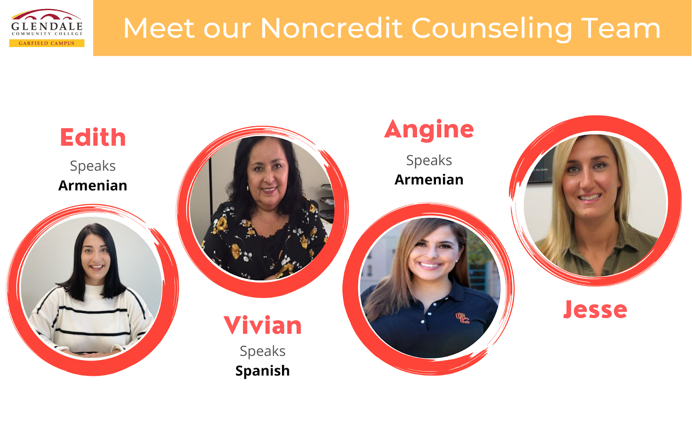
Garfield.glendale.edu

Slide 9
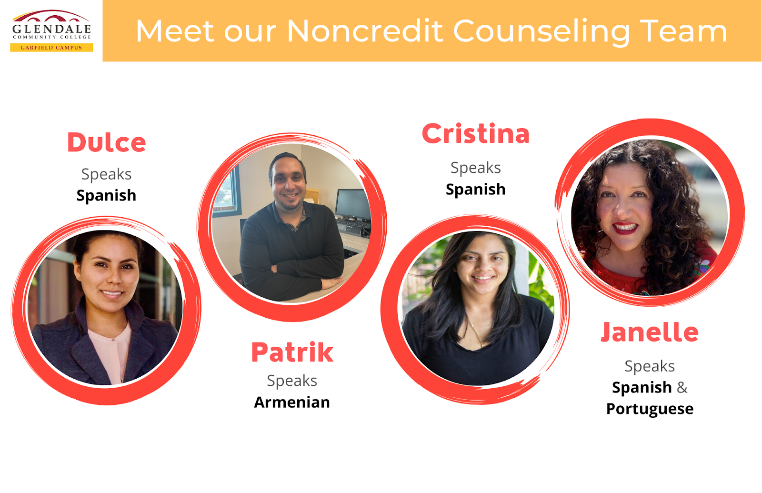
Garfield.glendale.edu

Slide 10
English as a Second Language Classes – FREE!
ESL Classes
  0 – 5 Levels
  Conversation Classes
  Vocational ESL
  College Prep ESL
  Citizenship Classes
Improve English language skills
  Grammar and writing
  Reading and vocabulary
  Listening and speaking
ESL Learning Café
  Tutoring
Leads to completion of certificates
Prepare to transition to credit programs (Verdugo Campus)
Garfield.glendale.edu

Slide 11
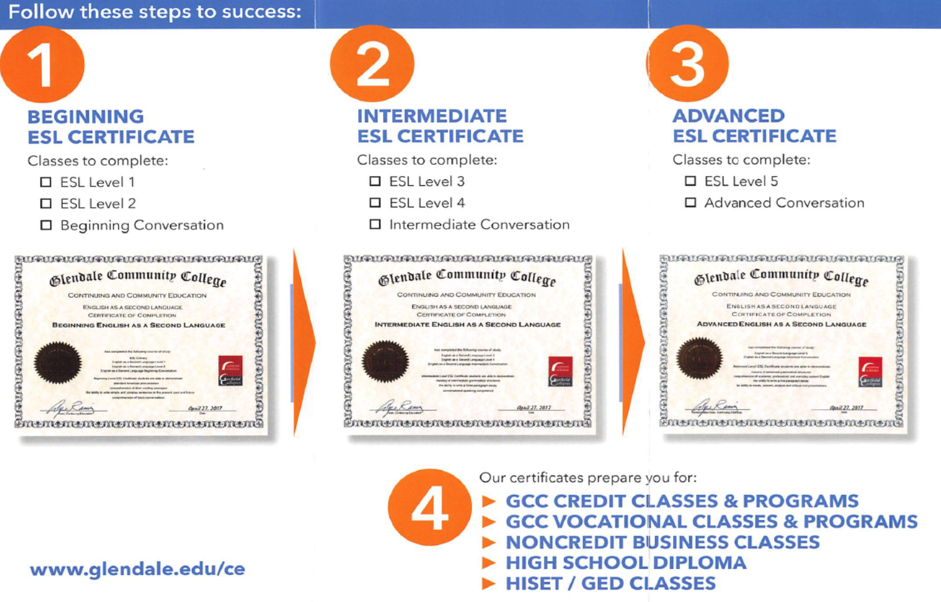
Garfield.glendale.edu

Slide 12
Short-Term Vocational Classes – FREE!
Open entry-open exit classes
Learn new skills:
  Technical skills
  Medical skills
  General Office skills
  Customer Service skills
Lead to completion of certificate programs
Prepare for employment opportunities
Prepare to transition to credit programs (Verdugo campus)
Garfield.glendale.edu

Slide 13
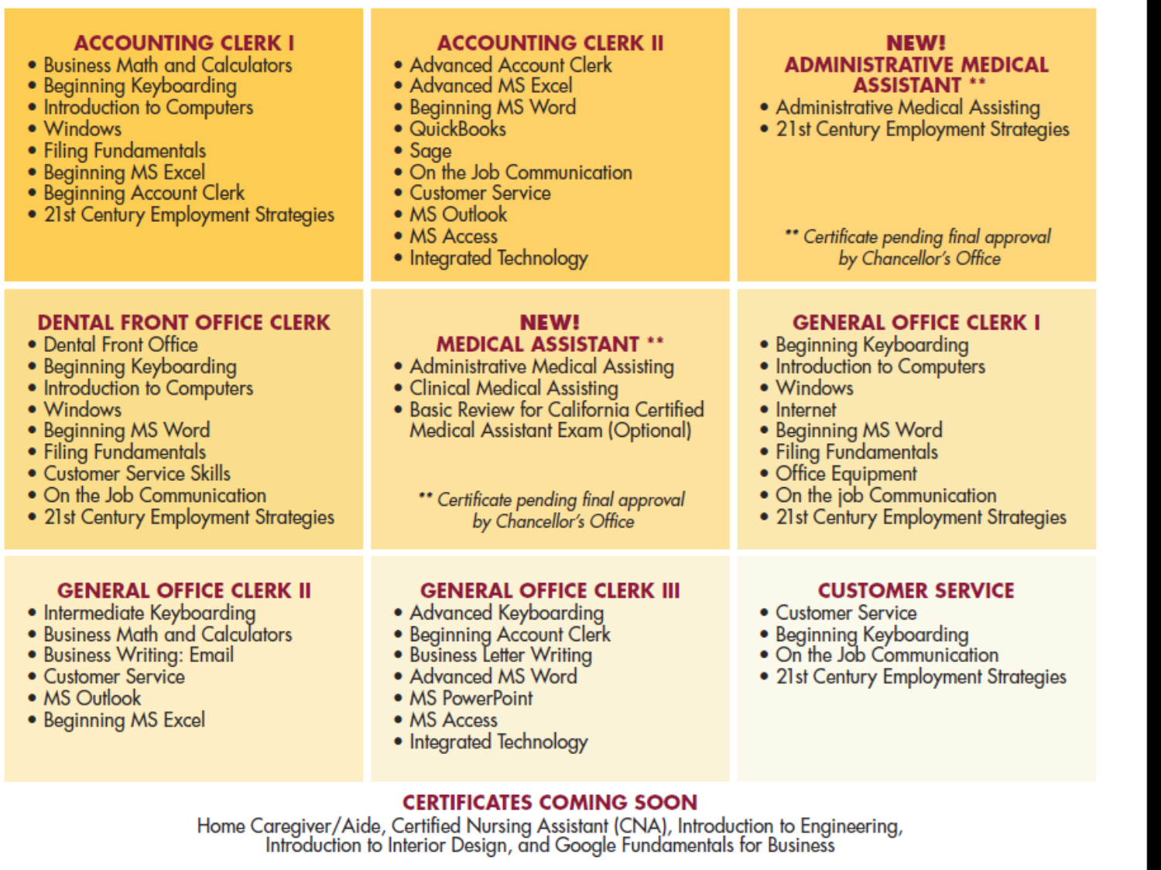
Garfield.glendale.edu

Slide 14
Parent Education & Lifelong Learning Classes – FREE!
Parent Education Classes
  Offered to improve parenting skills
  Provides interaction between parents and their children
    Music
    Dance
    Stories
    Art activities
  Support in resolving parental challenges
Lifelong Learning Classes
  Promotes adult educational engagement
  Learn knowledge in various subject matters:
    History
    Culture
    Art
    Society
  Open to adults of all ages
Garfield.glendale.edu

Slide 15
Community Services Education – Available Online and in Person
Offering hundreds of not-for-credit, FEE-based classes and activities for those who wish to explore personal interests, enhance their professional skills, or train for a new career
Students that receive CalFresh and are not on CalWorks may qualify to have their Tuition waived and textbook fees reimbursed for the following programs:
  Microblading
  Pharmacy Technician
  Certified Phlebotomy Technician
  Veterinary Assistant
  Medical Insurance Billing and Coding
  Please email: FreshSuccess@glendale.edu to determine your eligibility for the program
For course registration and information, please visit: www.Glendale.edu/CSE or contact (818) 240-1000 ext. 5015
Glendale.edu/CSE

