Slide 1
Transfer Center:
Transfer Basics and Services
Transfer Counselor, Destinee Blackmon
Transfer Center
Glendale.edu/TransferCenter

Slide 2
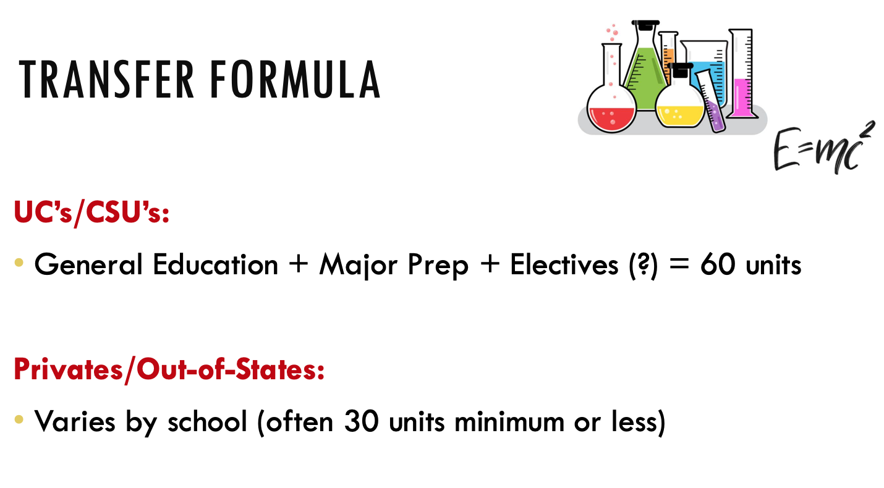
Transfer Center
Glendale.edu/TransferCenter

Slide 3
Strategies to Increase Admission Potential
Do well in classes (transferable and major GPA)
Utilize Transfer Center Resources
Scholars Program
TAG
ADTs
Know about impaction and competitive majors
Complete major prep and Golden 4 courses early on
Be involved (clubs, research, volunteering, jobs, etc.)
Be aware of application dates and deadlines
Visit campuses if you can (virtual or in-person tours)
Transfer Center
Glendale.edu/TransferCenter

Slide 4
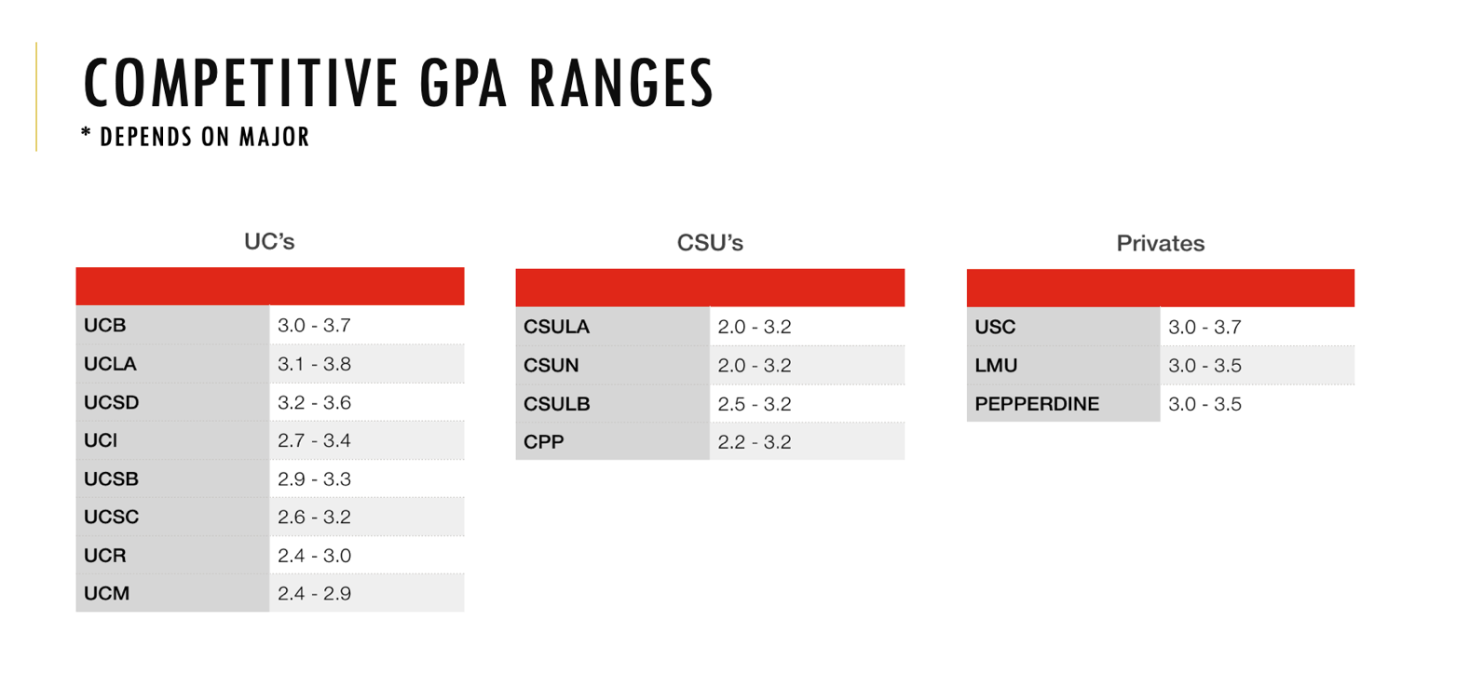
Transfer Center
Glendale.edu/TransferCenter

Slide 5
What does the Transfer Center provide?
Transfer Counseling
Admission Strategies
Transfer Workshops
Application Labs
Personal Statement Assistance
College Fairs
Campus Tours
Transfer Events
Meetings with Campus Representatives
Transfer Center
Glendale.edu/TransferCenter

Slide 6
Transfer Center Information
M-TH: 9am – 7pm
F: 9am – 3pm
818-240-1000 Ext. 5442
transfer@glendale.edu
SV 3rd Floor
Offer online drop-in and appointments, in-person, by phone or online
Transfer Center
Glendale.edu/TransferCenter

Slide 7

Questions?
Transfer Center
Glendale.edu/TransferCenter

