Slide 1
Welcome to Glendale Community College!
Summer 2021
Student Services/Orientation

Slide 2
Today’s Agenda
Making the Transition
Academic Sessions & Tuition/Fees
Financial Aid
Campus Services & Summer Bridge
Exploring your academic options
Next Steps (Course Registration)
Student Services

Slide 3
HOW IS COLLEGE DIFFERENT FROM HIGH SCHOOL?
Personal Differences
Self efficacy
Independence
Responsibility
Time Management
Study Skills
Reputation
Maturity
High School
“They do”
Textbooks & supplies are provided
Counselors place you into classes you need
High school is free
College
“You do”
You must buy your own textbooks & supplies
Counselors are available to assist you with your class schedule
You pay to attend college

Slide 4
WHEN DOES FALL BEGIN?
Event | Date
Check your Fall 2021 Registration Date | May 3rd
Fall Registration Period | May 17th
First Day of Fall 2021 | August 30th
Last Day of Fall 2021 | December 15th

Slide 5
FALL 2021 WITHDRAWAL/DROP DEADLINES
Drop/Withdrawal deadlines vary by length of term (e.g., 16 or 8 week courses). To receive a refund, a course must be dropped within the first 2 weeks of the 16-week course, or within the first week of an 8-week course.
https://www.glendale.edu/students/admissions-records/session-dates-deadlines

Slide 6
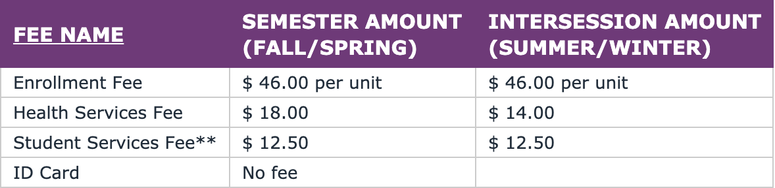

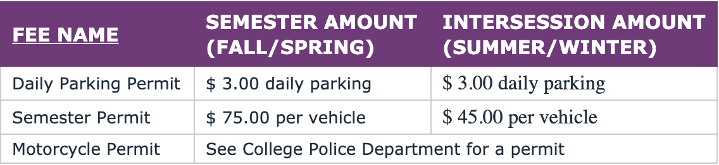
How much does it cost to attend GCC?
***Nonresident tuition + $225 per unit + $225 per unit
Tuition and Fees

Slide 7
HOW CAN I PAY FOR COLLEGE?
FAFSA/ DREAM Act
Must apply each year beginning October 1st
Priority deadline March 2nd
Grants, Loans & Work Study
May need parent or guardian tax info
California College Promise Grant Fee Waiver
Eligible students can get tuition waived
Must have a FAFSA or DREAM Act application on file
GCC Promise
Must be a 1st time, degree seeking, college student
Enrolled in at least 12 units
California resident
Must have a FAFSA or DREAM Act application on file
FINANCIAL AID RESOURCES

Slide 8

WHAT CAMPUS SERVICES ARE AVAILABLE?
Student Services
  Academic Counseling
  Admissions & Records
  Career Services
  Financial Aid
  Scholarship Office
  Placement Center
  Transfer Center
Academic Support
  Center for Academic Success in Athletics (CASA)
  Learning Center
  Library
  Math Discovery Center
STUDENT SERVICES/INSTRUCTIONAL PROGRAMS

Slide 9
WHAT CAMPUS SERVICES ARE AVAILABLE?
Multicultural & Community Engagement Center (MCEC)
  Dream Resource Center
  Pride Center
Support Programs
  Disabled Student Programs & Services (DSPS)
  Extended Opportunity Program & Services (EOPS)
  Scholars Program
  Student Equity Learning Communities
  Veterans Resource Center
Personal Support
  GCC CARES
  Health Center
STUDENT SERVICES PROGRAMS

Slide 10
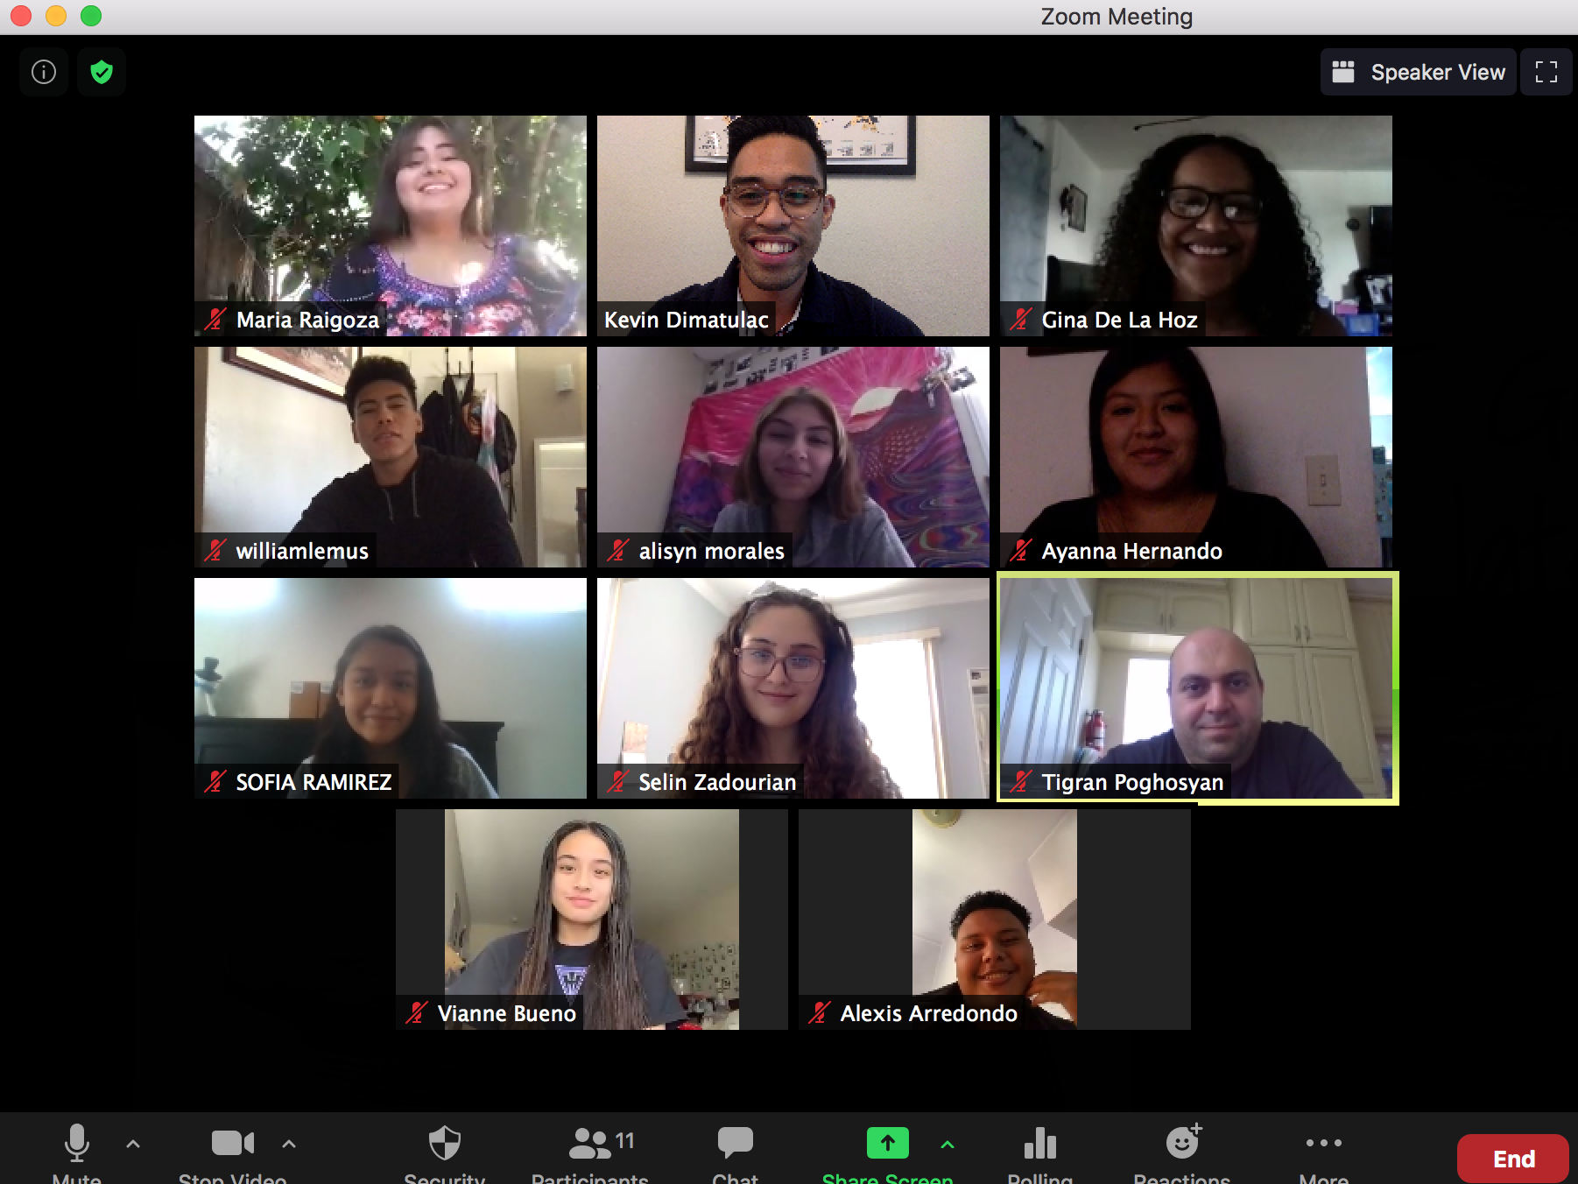
SUMMER BRIDGE PROGRAM
The Summer Bridge Program helps new students transition into GCC and the college environment.
Benefits:
One week student development course
Explore careers & majors
Learn about Financial Aid
Meet other students & build community
Work with SPARK peer mentors
Learn certificates and degrees options
Students who successfully complete Summer Bridge, will receive a $200 bookstore credit for the Fall semester!
Call for more info: (818) 240-1000x 3520 OR virtually at https://zoom.us/j/6635930649
FIRST YEAR EXPERIENCE PROGRAMS

Slide 11



La Comunidad
  Supports Latinx students
Black Scholars
  Supports African American/Black students
Guardian Scholars
  Supports current or former foster
Benefits Of Joining:
Academic and career counseling
Educational goal planning
Social activities & cultural events
University & college tours
Meal & TAP cards/ Parking Permit
Technology & book loans
STUDENT EQUITY PROGRAMS
To Apply:
Check on our website for application deadlines and to apply:
www.glendale.edu/communities

Slide 12
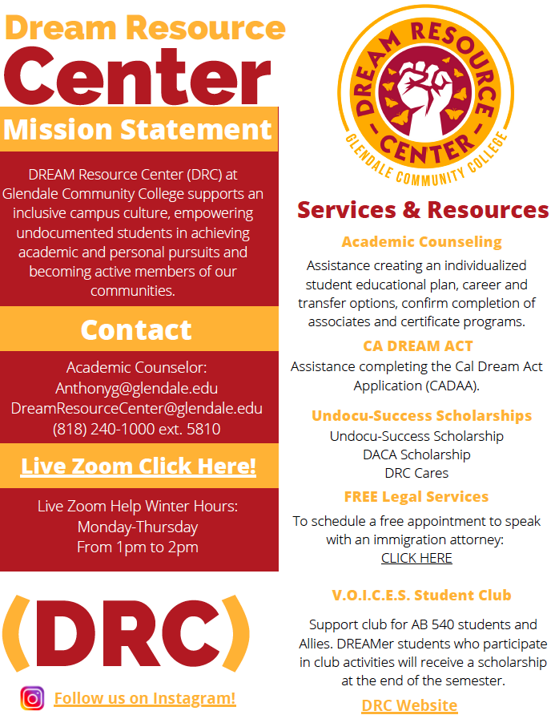

DREAM RESOURCE CENTER

Slide 13

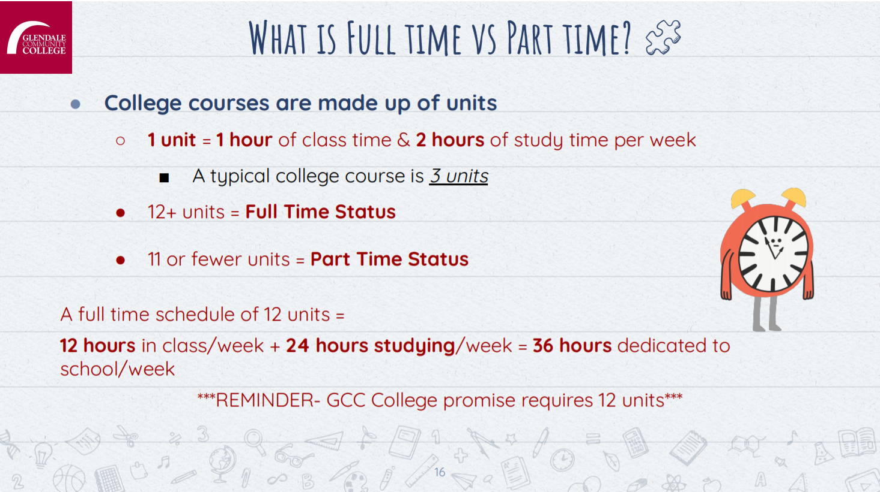
FULL TIME VS PART TIME COURSELOAD

Slide 14
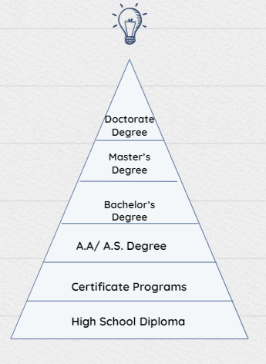
What are you working toward?
Certificate Programs
  Career education programs provide opportunities for students to prepare for a wide variety of careers.
Associate of Arts/Associate of Science
  A degree that is earned once an organized program of study of at least 60 semester units is completed.
Associate of Arts- Transfer/Associate of Science- Transfer
  A degree that is earned once an organized program of study of at least 60 semester units is completed. Also, guarantees admission to a CSU & a 0.1 gpa boost.
Transfer – 60 units for CSU/ UC
  Completion of major & general education requirements for transfer acceptance without an AA/AS degree.

Slide 15
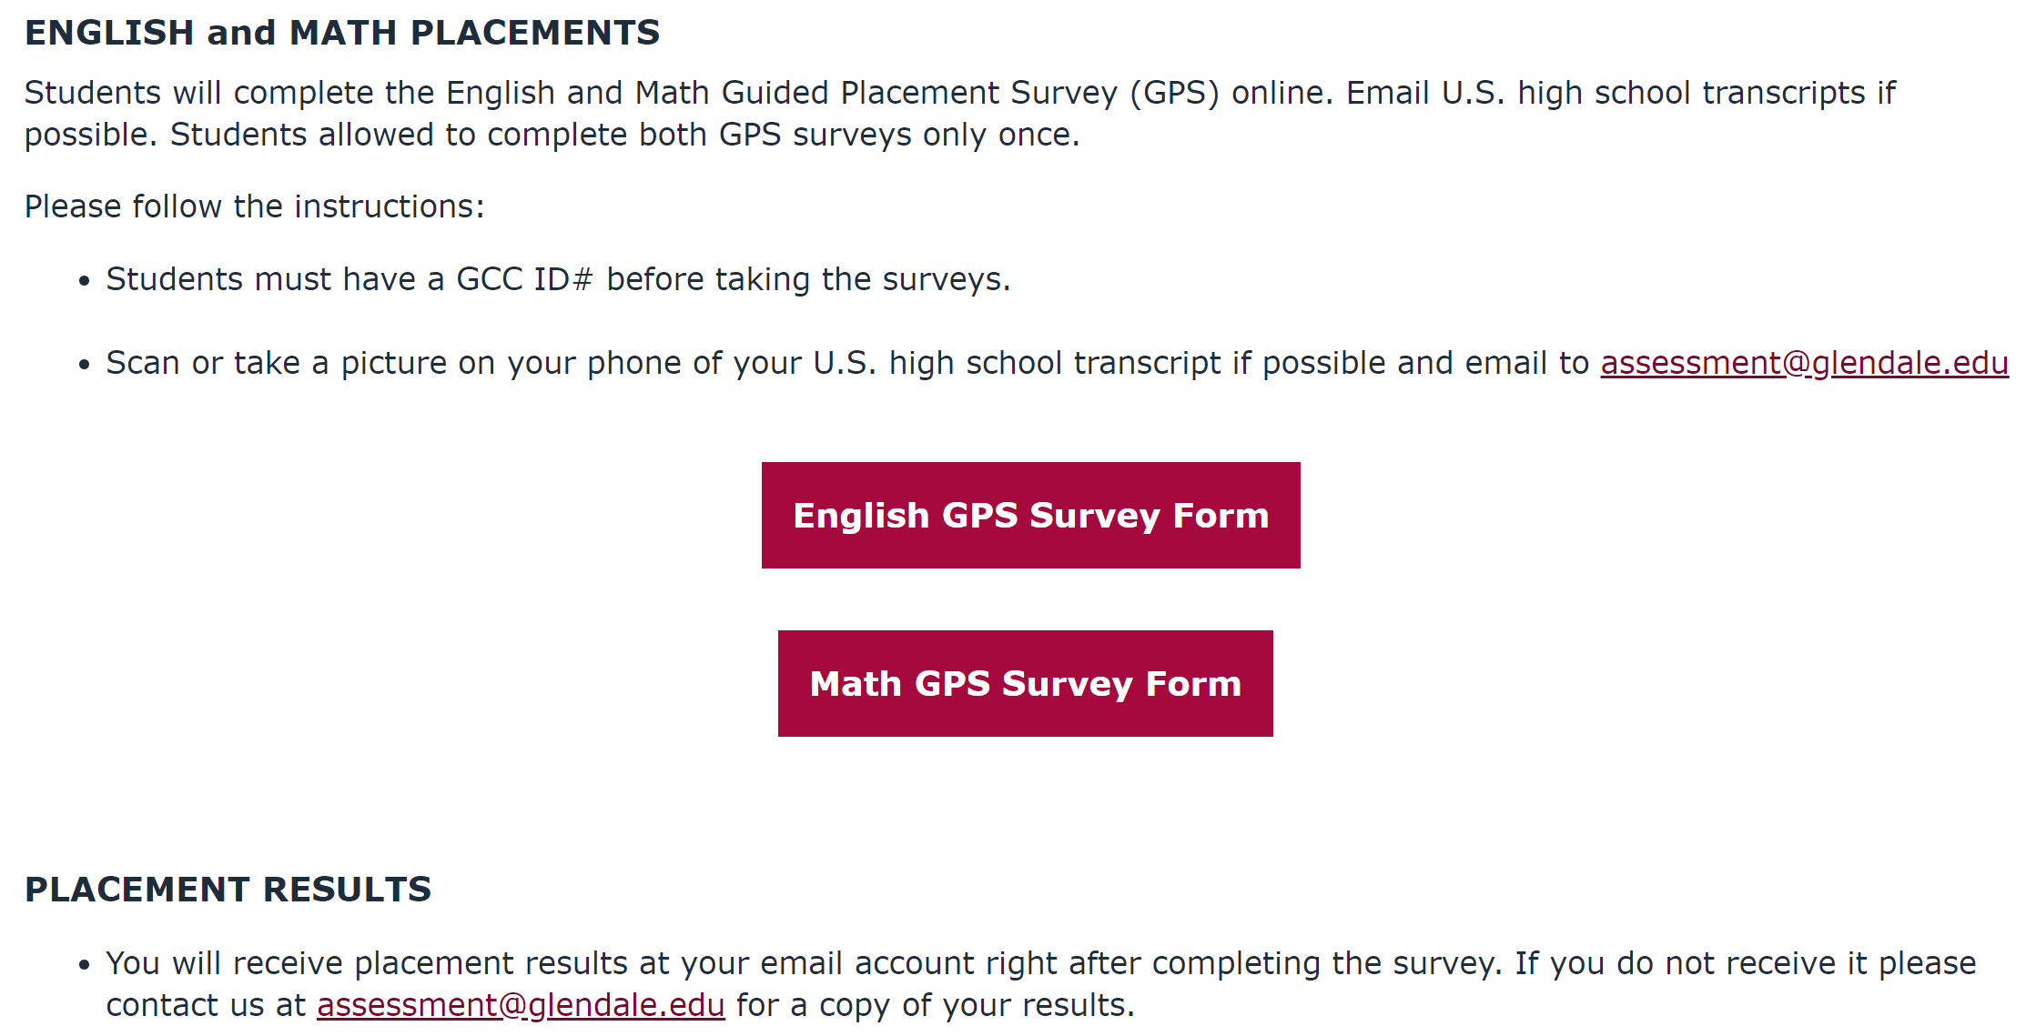
ENGLISH AND MATH GUIDED PLACEMENT
Assessment Center

Slide 16
Know your rights!
What is AB 705 and 1805?
Assembly Bill 705 is a law designed to end the practice of disproportionately funneling minoritized students into remedial math and English classes that did not count towards graduation or a transfer to four-year schools.
Assembly Bill 1805 is law giving community college students the right to start their math (with Intermediate Algebra prerequisite) and English requirements at the transfer level.

Slide 17



NEXT STEPS!
STUDENT SERVICES

Slide 18
Wishing you lots of
success as you begin
your new journey at
Glendale Community College!

