Slide 1


Hiring Committee Training:
Championing Equal Employment Opportunity and GCCD’s Commitment to Diversity

Slide 2

Training Objectives
Ability to define and understand:
  EEO-compliant hiring practices
  Avoiding Unlawful Discrimination
  GCCD’s Commitment to Diversity
  How to Disrupt Implicit Bias
  Importance of Confidentiality
  Accommodating Candidates with Disability
  Various References

Slide 3
What is Equal Employment Opportunity?
“Equal Employment Opportunity” (EEO) requires that workplace employment decisions, including hiring, should not be based on:
  race, color, national origin, religion, sex (including gender identity , sexual orientation or pregnancy), age (40 and over), disability, and genetic information
The federal Equal Employment Opportunity Commission (EEOC) and its state counterpart, the California Department of Fair Employment and Housing, enforce anti-discrimination laws and regulations.

Slide 4
What is Unlawful Discrimination?
Treating individuals differently because of:
A protected class
A perception they are a member of a protected class
Association, or perception of association with a protected class

Slide 5
Unlawful Discrimination in California
California law provides greater employment discrimination
protections. Specifically, California law requires that workplace
decisions, including hiring, should not be based on:
Race, color
Ancestry, national origin, ethnicity
Religion, creed
Age (40 and over)
Disability, mental and physical
Sex, gender (including pregnancy, childbirth, breastfeeding or related medical conditions)
Sexual orientation
Gender identity, gender expression
Medical condition
Genetic information
Marital status
Military or veteran status

Slide 6

GCCD's Commitment to
Diversity: Core Values
Workforce diversity advances GCCD’s educational mission
Differences are embraced and appreciated
Inclusion increases creativity and problem solving
Diversity does not mean lowering standards

Slide 7
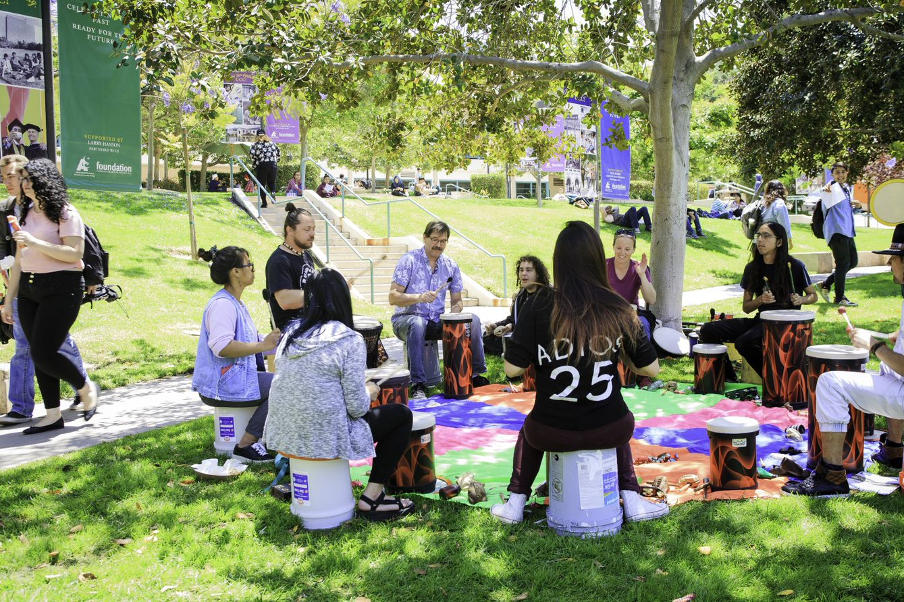
Diversity: Cultural Competence
Recognize own biases and stereotypes
Discount own biases and stereotypes
Appreciate content of contributions
Facilitate productive outcomes
Feel enriched by diverse environments

Slide 8
Diversity: Education Code and Title 5
Education Code and Title 5 require districts to hire faculty and administrators that demonstrate sensitivity to and understanding of the diverse academic, socioeconomic, cultural, disability, and ethnic backgrounds of community college students. (Title 5 section 53024 (a) (2). Ed. Code 87360).
GCCD’s faculty, classified staff, and administrator vacancy announcements reflect this requirement. ​

Slide 9
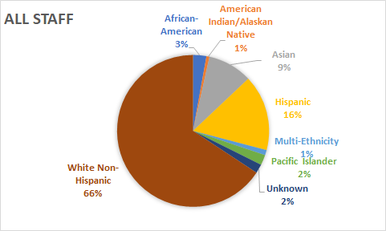
Diversity: GCCD Staff Demographics
2019

Slide 10
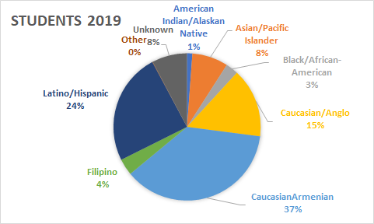
Diversity: GCCD Student Demographics
2019

Slide 11

Anti-Discrimination Law in Action:
Hiring Committee Scenarios

Slide 12

Scenario #1
Kelly is currently employed by the District and has applied for a promotional position. During her interview she mentions that she is pregnant and will be taking some time off in the near future for maternity leave. Although Kelly is highly qualified, the hiring manager tells the committee member he does not want to hire Kelly because she is pregnant and will be taking time off.
Denying Kelly this position because she is pregnant is prohibited under federal and state anti-discrimination laws and is considered unlawful discrimination based on a medical condition.

Slide 13
Scenario #2
Drew is an external applicant who applied for a fulltime faculty position. Although Drew is highly qualified with extensive experience, the committee members and the hiring manager do not want to hire Drew for the position because they believe a female is a better fit for the position.
Denying Drew this position because he is male is prohibited under federal and state anti-discrimination laws and is considered unlawful discrimination under the protected class of gender.

Slide 14
Scenario #3
During deliberations, hiring committee member Albert states that he scored candidate Kelly high in the area of “ability to effectively use technology in the classroom” because he is aware of several online resources that Kelly has developed for her courses at GCCD. Kelly did not mention using technology or developing online courses during her interview. Should Albert reevaluate how he scored this question? Why?
Committee members may not fill in any omissions in any Applicant’s application materials or interview answers with information they may independently know about the candidate, (e.g. bad behavior, or known projects, research or grants that the candidate did not include).​

Slide 15
Disrupting Implicit Bias
A bias is an assumption, tendency or belief that can prevent us from making an objective decision about an applicant or candidate.
A large body of research suggests that each one of us holds implicit biases that can impact our judgment, both professionally and personally.
Biases, whether positive or negative, conscious or unconscious, are shaped by our experiences, culture, and lifestyles. This include campus culture.
The most common forms of bias found in hiring decisions are:
1) Internal candidate bias, 2) confirmation bias (‘like me’), 3) Personal appearance, 4) Expectation bias and 5) Intuition bias (’I had a feeling….’).

Slide 16
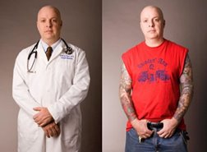




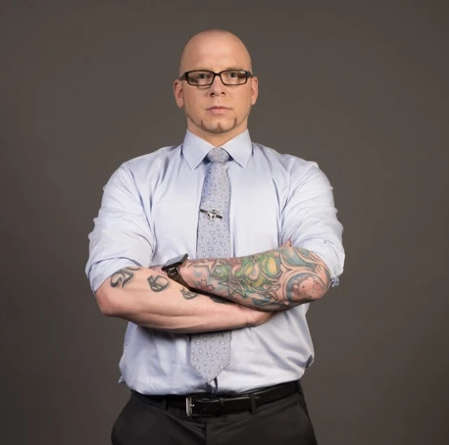
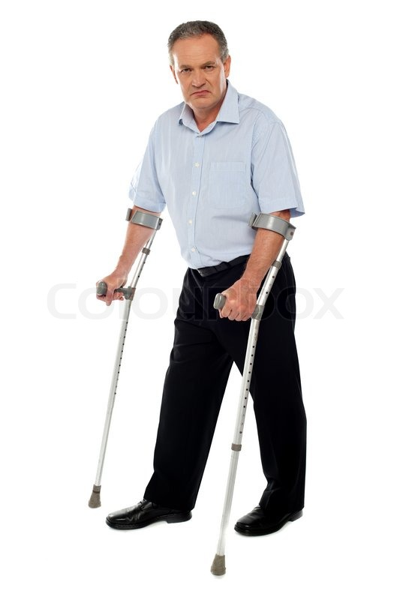


Disrupting Implicit Bias: First Impressions

Slide 17
Disrupting Implicit Bias:
Harvard Implicit Bias Test
Take the Implicit Association Test (IAT) Challenge:
Engage in an individual self-assessment of implicit biases and preferences. The test can be found at:
https://implicit.harvard.edu/implicit/takeatest.html
Suggested Implicit Association Tests: race, age, skin tone, disability and transgender

Slide 18
Confidentiality
Hiring processes are meant to be confidential. To ensure you are promoting confidentiality, avoid:​
  Unofficially contacting college colleagues for information about applicants​
  Answering questions from curious colleagues regarding the pool or the process​
  Divulging information about applicants or committee discussions at any time before, during, or after the process​
  Being a Social media “investigator” ​

Slide 19
Candidates with Disabilities
Discussion of an applicant's disability is not appropriate during the interview process. Any discussion about an applicant’s disability and how it may impact their ability to perform the essential duties of the position will happen after the job offer is made.​

Slide 20
Hiring Committee Interview Tips
Interview questions should be job related, and should include opportunities for the candidate to discuss and provide clear examples of their experiences and approach to equity and diversity in the classroom.
All committee members should actively be encouraged to provide input and perspective when developing interview questions.
All candidates should be asked the same questions.
Evaluate each candidate only on their application and performance during the interview process. Do not share or include outside knowledge or personal experiences involving candidates.

Slide 21
Hiring Committee Interview Tips
Follow up questions are allowed for clarification purposes
but be careful.
Committee members may ask a follow-up question for
clarification if it meets the following criteria:
  The question is directly related in some way to the original
  question
  The follow-up question is directly related to something
  contained in the candidate’s answer
  Teaching demonstrations: hiring committee members posing as students may ask questions related to the candidate's teaching demonstration
Follow up questions should not elicit additional information that
is not required of the other candidates, thereby giving one
candidate an edge over the others.

Slide 22

Hiring Committee Interview Tips
Bystander Intervention – give yourself and other committee members the
ability to actively address a situation you deem problematic.
If committee member… An appropriate Response might be…
Says, “Not a ‘Fit’” What’s the cultural contribution we’re aiming for?
Says, “I couldn’t understand them with What part was unclear?
their accent, so how will our Students be
able to?”
States, “PERSON” was not professional Help us understand what you mean by that
States, “PERSON” does not have Is that requirement going to yield the best candidate
California community college experience for this position? (diversity impact)
Uses Microaggression Are you saying that ________(name the bias)____?
Interrupts Excuse me, please let me/her/them/ finish

Slide 23
Reflection and Improvement
Reflect on a concerning experience you have had on a hiring committee.
Explain: What do you think went wrong? How did the hiring committee respond? What can be done in the future to ensure a different experience for the candidate?

Slide 24

Knowledge Check

Slide 25

Which protected class is incorrect
Race, color
Ancestry, national origin, ethnicity
Religion, creed
Age (30 and over)
Disability, mental and physical
Sex, gender (including pregnancy, childbirth, breastfeeding or related medical conditions)
Sexual orientation
Gender identity, gender expression
Medical condition
Genetic information
Marital status
Military or veteran status

Slide 26

Which protected class is incorrect
Under the law, the protected class for age is people 40 and over.
Race, color
Ancestry, national origin, ethnicity
Religion, creed
Age (30 and over)
Disability, mental and physical
Sex, gender (including pregnancy, childbirth, breastfeeding or related medical conditions)
Sexual orientation
Gender identity, gender expression
Medical condition
Genetic information
Marital status
Military or veteran status

Slide 27
Identify Examples of Discrimination
Not hiring someone because of his or her age.
Only hiring a certain category or people. For example, all employees are male, or of a certain race or religion.
Not hiring a candidate who has children even though he or she is the best candidate for the position.

Slide 28

The following are all examples of discrimination
Not hiring someone because of his or her age.
Only hiring a certain category or people. For example, all employees are male, or of a certain race or religion.
Not hiring a candidate who has children even though he or she is the best candidate for the position.

Slide 29
A bias is an assumption, tendency or belief that can prevent us from making an objective decision about a candidate.
True
False

Slide 30

A bias is an assumption, tendency or belief that can prevent us from making an objective decision about a candidate.
True
False

Slide 31
References – GCCD BP's & AR's
Board Policy 3410 Nondiscrimination and Equal Opportunity Policy
Education Code 87100 A work force that is continually responsive to the needs of a diverse student population may be achieved by ensuring that all persons receive an equal opportunity to compete for employment and promotion within the community college districts and by eliminating barriers to equal employment opportunity.
Board Policy 7100 Commitment to Diversity
The District is committed to employing administrators, faculty, and staff members who are dedicated to student success. The District recognizes that diversity in the academic environment fosters cultural awareness, promotes mutual understanding and respect, and provides suitable role models for all students. The District is committed to hiring and staff development processes that support both equal opportunity and diversity, and provide equal consideration for all candidates as required in federal and state law.

Slide 32
References – California Laws
FEHA (Enforced by DFEH)
CA Ed. Code (Section 200, 210-212.5)
CA Code of Regulations (Sections 80338 and 53001 et seq.)
CA Government Code Section 11135 - 11139.5
CA Labor Code Section 1102.1
CA Proposition 209 (Passed in 1996)

Slide 33
References – Federal Law
Title VII of the Civil Rights Act of 1964 prohibits discrimination on the basis of race, color, religion, sex, pregnancy, or national origin.
Title VI of the Civil Rights Act of 1964 prohibits discrimination on the basis of race, color, or national origin in any program receiving Federal financial assistance.
The Americans With Disabilities Act of 1990 prohibits discrimination against the disabled in employment and public services.
Age Discrimination Act of 1975 prohibits discrimination on the basis of age in programs or activities receiving Federal financial assistance (Age 40 +).
Title IX of the Education Amendments of 1972 prohibits sex (including pregnancy, sexual orientation, and gender identity) discrimination in any education program or activity receiving federal financial assistance.
Section 504 of the Rehabilitation Act of 1973 prohibits discrimination on the basis of disability in programs or activities that receive Federal financial assistance from the U.S. Department of Education.

Slide 34

Questions:
Contact the Human Resources Team
Nicole Hise, HR Generalist
nhise@glendale.edu; x3135
Jennifer Briones, HR Generalist
jbriones@glendale.edu; x5171
Donna Diamond, HR Generalist
ddiamond@glendale.edu; x5167
Maricela Ramon, HR Generalist
mramon@glendale.edu, x5173
Val Dantzler, HR Manager
vdantzler@glendale.edu; x5174
Brittany Grice, Vice President, HR
bgrice@glendale.edu; x5165

Slide 35
Thank you for completing the Hiring Committee Training: Championing Equal Employment Opportunity and GCCD’s Commitment to Diversity

