Slide 1


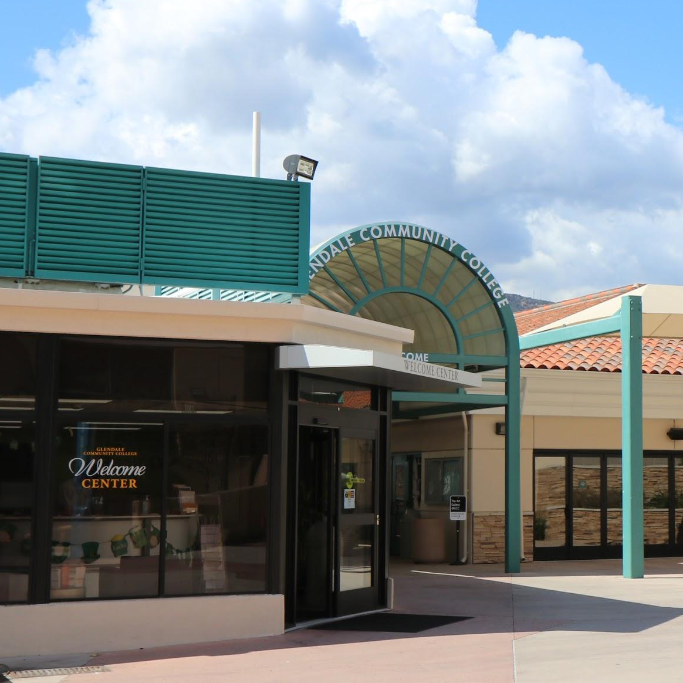


Enroll in Tuition-Free
College Classes
GLENDALE COMMUNITY COLLEGE

Slide 2




Slide 3
What is Dual Enrollment?
www.glendale.edu/DualEnrollment
High school students take college classes
GCC waives tuition and fees for students
Classes are offered Online or Remote
Students receive college credit from GCC
Students can receive high school credit for high school (Check with school)
Notes:
Exposure to a college class, explore majors and careers, start taking classes towards their General Education for college, access to college services

Slide 4
What classes should I enroll in?
 | Jump Start | Dual Enrollment
College Counseling & Support Services | ✔
Tuition Costs | ✔
College Credit | ✔
High School Credit
Textbook Costs | $100 voucher @ Bookstore
Classroom Seats | All GCC Students
Location | Glendale Community College

Slide 5
What classes should I enroll in?
 | Jump Start | Dual Enrollment
College Counseling & Support Services | ✔ | ✔
Tuition Costs | ✔ | ✔
College Credit | ✔ | ✔
High School Credit |  | ✔
Textbook Costs | $100 voucher @ Bookstore | ✔
Classroom Seats | All GCC Students | ✔
Location | Glendale Community College | High School

Slide 6
Support through GCC
Virtual Welcome Center www.glendale.edu/WelcomeCenter
  Monday through Thursday 10:00am-4:00pm
  Friday 10:00am-1:00pm
      Application workshops every Tuesday and Thursday 3-4pm
Live Canvas Help www.glendale.edu/Canvas
iDual Hub - Wednesdays 2:30-3:30pm www.glendale.edu/iDualHub
Dual Counselors available for appointments

Slide 7

Dual Class Offering
www.glendale.edu/Dual

Slide 8
FERPA
FAMILY EDUCATIONAL RIGHTS AND PRIVACY ACT (FERPA) is a federal law that protects the privacy of personally identifiable information contained in a student's educational record.
  Communication in regards to class and grades CAN ONLY happen between the professor and the student.
  Students need to turn in their own forms to enroll in the class.
  Students can access their information (grades, schedule, etc.) through MyGCC, the student portal.
Reference http://www2.ed.gov/policy/gen/guid/fpco/ferpa/index.html

Slide 9
Questions
and Comments?

