Slide 1

Presented by Glendale College Student Outreach Services
Week 2: Supporting High School Seniors, Virtual College Night, Dual

Slide 2
Counselor Cafe Series
Hosted by GCC Student Outreach Services with intent to create conversation, share information and connect with high school counselors.
Thursday, April 16, 2020 2-3pm (Supporting High School Seniors)
Tuesday, April 21st, 2020 2-3pm (Supporting High School Seniors, Virtual College Night, Dual)
Tuesday, April 28, 2020 2-3pm (Concurrent Enrollment: Jump Start and Dual)
Tuesday, May 5th, 2020 2-3pm (Scholars, Athletics)
Tuesday, May 12, 2020 2-3pm
www.glendale.edu/ConnectWithUs

Slide 3
Support Through Glendale College
Virtual Welcome Center www.glendale.edu/WelcomeCenter
K12 Resources www.glendale.edu/K12Resources
LIVE Webchat (Available on the GCC homepage M-F 9am-4pm)
Live Canvas Help www.glendale.edu/Canvas
GCC Virtual College Info Night- Every Thursday 7-8pm
Dual Student Cafe - Wednesdays 2:30-3:30pm
Virtual Tours (Pending)
GCC Promise- 2 Years of Free College Tuition www.glendale.edu/gccpromise
Meet with a GCC Counselor www.glendale.edu/counseling
Instructional Support
Student Services Support
All Services Open Virtually, by phone and email.

Slide 4

Dual Student Cafe www.glendale.edu/ConnectWithUs
Hosted by Martha Cuevas, Dual Enrollment Counselor
  Email: mcuevas@glendale.edu Phone: 818-240-1000 x. 3031
Dual and Jump Start Student Cafe- any student interested in concurrently enrolling in high school and GCC.
Wednesdays 2:30-3:30pm
May 6, 2020 02:30 PM
May 13, 2020 02:30 PM
May 20, 2020 02:30 PM
May 27, 2020 02:30 PM
Jun 3, 2020 02:30 PM
Zoom link: https://cccconfer.zoom.us/j/95656314296
Meeting ID: 956 5631 4296

Slide 5
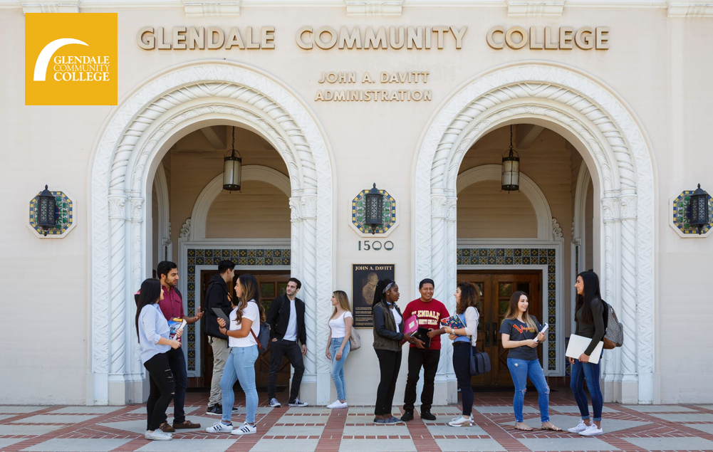
GCC Virtual College Info Night
Virtual College Night
Every Thursday 7-8 PM
Zoom link:
https://zoom.us/j/96814487986

Slide 6
Graduating Senior Updates
GCC Financial Aid- Students should have their Financial Aid award package available to view in their portal by May 1, except students with incomplete files.Please encourage students to check www.glendale.edu/mygcc for communication from Financial Aid.
Assessment-Placement question regarding “Last” class
Scholars Updates www.glendale.edu/scholars
  Requirements https://www.gccscholars.com/requirements.html
Athletics www.glendale.edu/athletics
Virtual ECAP- 320 Students Served
Graduating Seniors- (only applies to students who are applied for summer/fall 2020 and inaccurately indicated they will be in high school. )
  Instead of letters to confirm graduation-Send student name, date of birth to mmora@glendale.edu, confirming student is graduating June 2020

Slide 7
High School Student Updates
Jump Start - Summer School Forms www.glendale.edu/jumpstart
  Summer Registration Begins May 11th, 2020
  Forms can be signed and turned in digitally. Email all forms to ARDocs@glendale.edu
  Additional updates next week regarding forms
Dual Enrollment www.glendale.edu/Dual
  Dual Class updates next week
  New Dual Enrollment class requests https://www.glendale.edu/students/student-services/sos-outreach/high-school-students/dual-enrollment/contact/dual-enrollment-course-request-form

Slide 8
Questions?
What are some of the current questions students have about college?
What are some of the challenges/hurdles?
How can we better connect with students?
What are some of the best practices you and your colleagues have applied to the unique challenges we are facing?

