Slide 1


Infection Control: Breaking the Chain
*Audio Clips onn each slide , press play
Presented by
Zoila Navales, RN
GCC Health Center

Slide 2
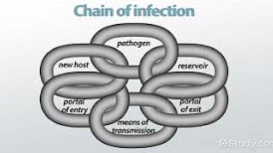
Infection Defined:
(NOUN) the process of infecting or the state of being infected.

Slide 3
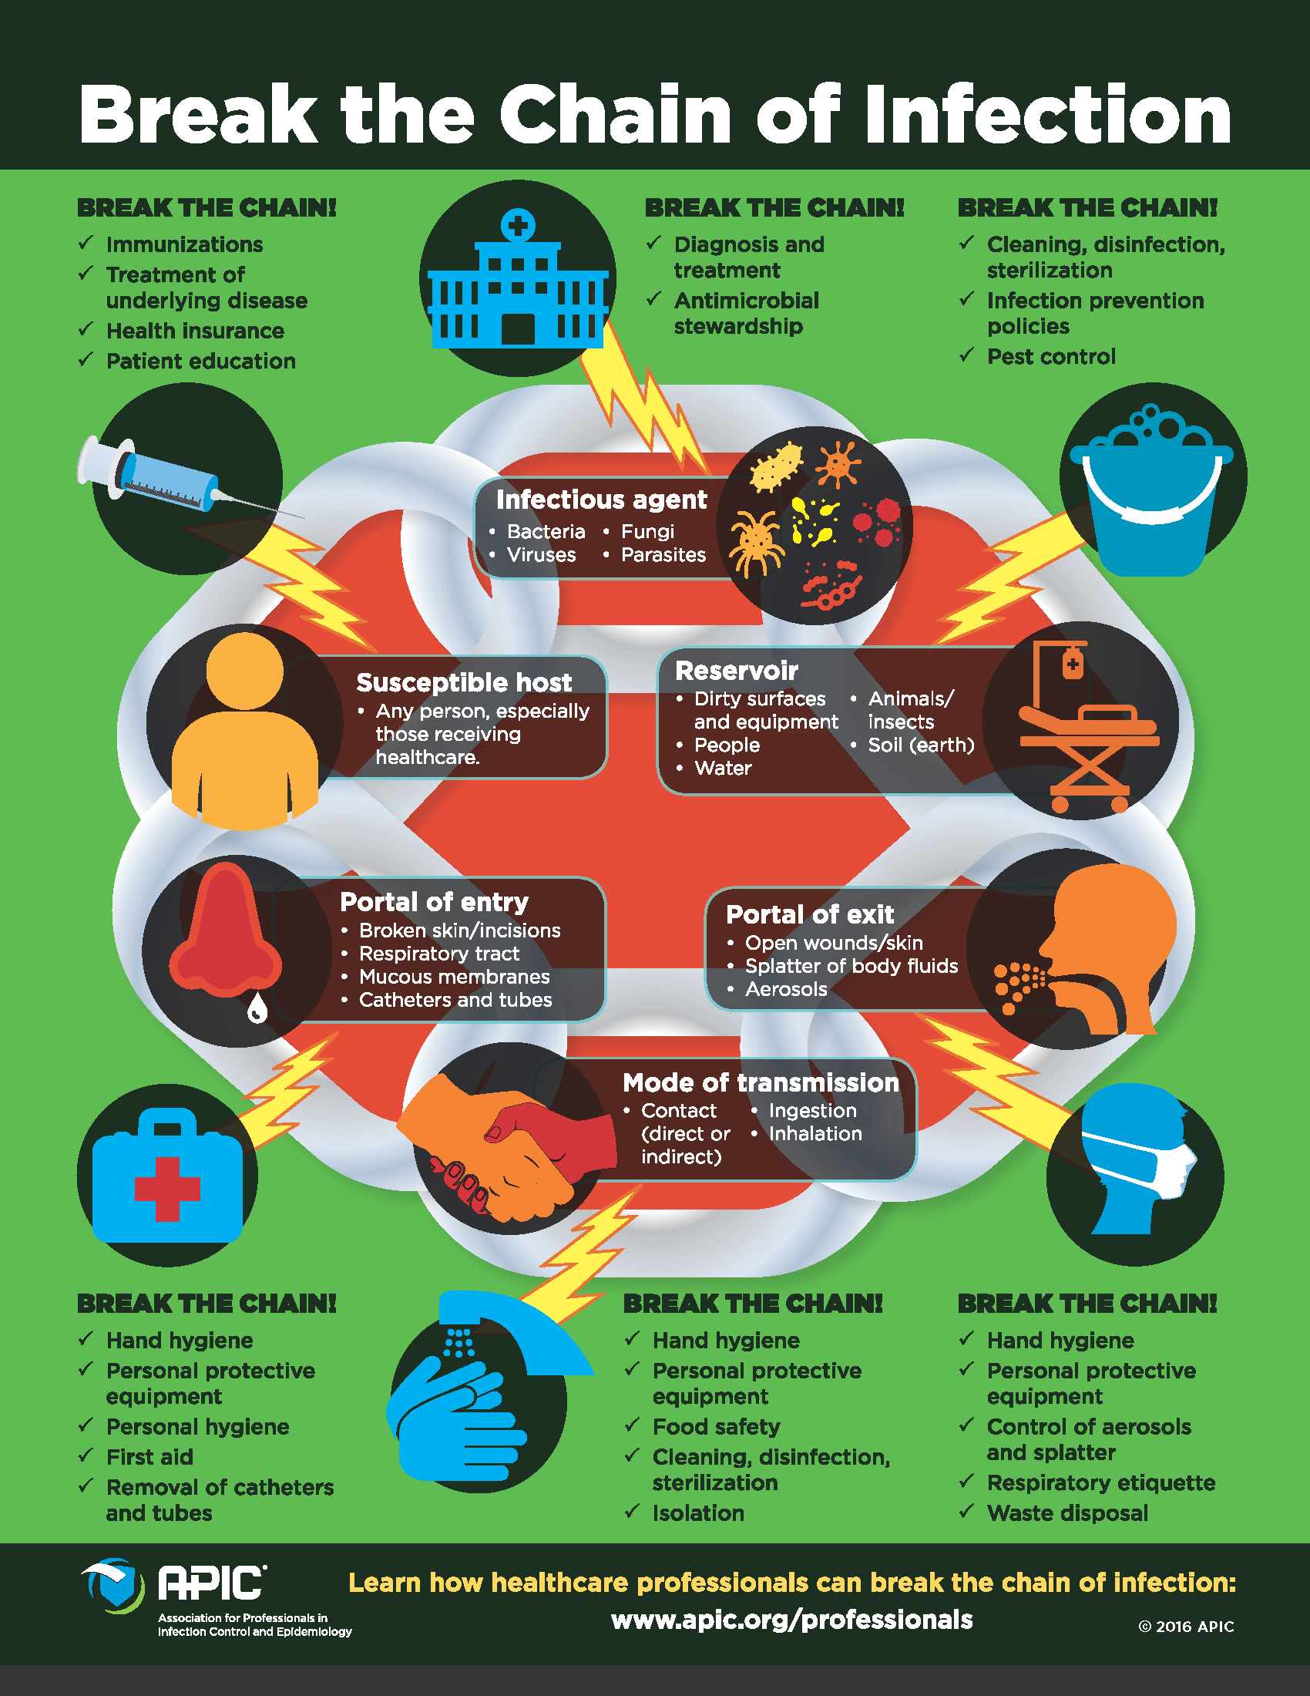
-Break the Links
-Break the Chain
-Stop Spread of Infection

Slide 4

What are the Links in the Chain?
Infectious agent is the pathogen (germ) that causes disease
  Ex: Covid-19, SARS, MRSA
Reservoir includes places in the environment where the pathogen lives
  Ex: People, animals, and insects, medical equipment, and even soil or water.
  Some pathogens can live longer in certain places than other pathogens depending on the surface that they’re on.
Portal of exit is the way the infectious agent leaves the reservoir
  Ex: Open wounds, coughing, sneezing, and saliva

Slide 5
What are the Links in the Chain?
(Continued)
Transmission/Transport are the ways the infectious agent can be passed on
  There are 5 types of Transmission
  Contact: direct skin to skin contact, or skin to soil/vegetation harboring pathogen
  Droplet: Someone coughs or sneezes and those particles fly in the air and into someone’s eyes, mouth, or nose, or it lands on a surface where it can live for a certain amount of time
  Airborne: Unlike droplet, airborne transmission means the particle remains floating in the air. Ex. Tuberculosis
  Vehicle: Something that can indirectly transmit virus or bacteria, ex: food, water, fomites (linen, tables, other inatimate objects)
  Vector: Transmitted by an insect, Ex: flies and mosquitos

Slide 6
What are the Links in the Chain?
(Continued)
Portal of entry is the way the infectious agent can enter a new host
  Ex: Through broken skin, respiratory tract, mucous membranes or, for those in healthcare settings, catheters and IV lines
The host is any carrier of an infection or someone at risk of infection.
  During this time, many believe only the elderly can be a host, this is not true, anyone and everyone can become infected by COVID 19, which is why it is important to try and break the chain of infection
  Not EVERYONE will be symptomatic, but they can still become carriers and infect others.
  People with poor immune symptoms are at a greater risk, but they ARE NOT the only ones who may develop complications from COVID 19

Slide 7
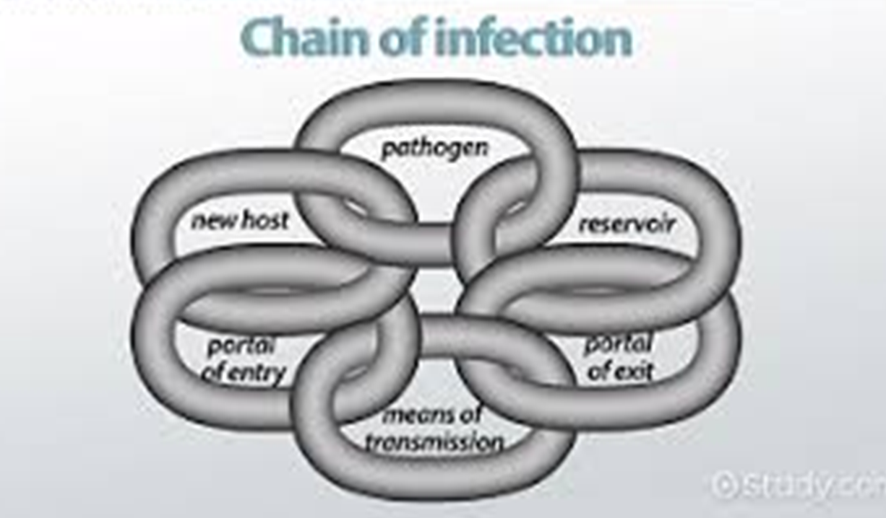

How to break the chain?
Each link is needed in order for infection to occur, if you break at least 1 of the links, the CHAIN of INFECTION will be broken

Slide 8

How to Break the Chain
There are various ways to break the chain, below we will discuss ways to break the chain.
The pathogen (germ) must live in a reservoir, without the germ or the reservoir, the pathogen cannot exist.
Intervention:
  Remove pathogen by cleaning the area
  Sanitizing an area with sanitizers, bleach, or even cleaning with household products can remove the pathogen.
  If the reservoir is a wound, then it is important to keep that site clean and dry to prevent the germ from staying in an environment where they can live and thrive

Slide 9
How to Break the Chain
Portal of Exit
  From the reservoir, the pathogen has to have a DOOR out.
  By closing this door, the germ cannot leave
Mode of Transmission
  In addition to a DOOR, the germ must have a “Vehicle” for transmission
  That can be through contact, droplet, air, common vehicle, or vector
  Sneezing or Coughing into your elbow, wearing a mask if you’re sick, properly using gloves when handling contaminated things like dirt, soiled items, or blood are all ways to stop the portal or exit and/or transmission

Slide 10
How to Break the Chain
Portal Of Entry
  This is the way that the pathogen enters the body
  This is usually through break in skin, mucosa (mouth, nose, eyes)
  Like the portal of Entry, If the DOOR is closed or nonexistent, then the pathogen cannot enter.
  This is where wearing a mask, gloves, or goggles can help pathogens from entering

Slide 11
How to Break the Chain
Susceptible Host
  This is a person who can be infected by the pathogen
  Not every person can be a host, there are circumstances and factors that make someone susceptible (able to be infected)
  Older people or immune compromised people are often the susceptible host, but THEY ARE NOT THE ONLY ONES.
  Staying healthy and having a good immune system can help break this chain, getting properly vaccinated can help build immunity against certain pathogens
    EX: Annual Flu Shot to fight against the flu
    MMR to fight Measles, Mumps and Rubella

Slide 12
Scenario: Breaking the chain of infection from COVID
Scenario:
  Person A was on a cruise and contracted COVID (Pathogen). Patient A is now the reservoir, they start feeling symptoms and was sent home from work. They continue going to stores, parks, and running errands. While standing in line, shoulder to shoulder with the other customers, he coughs into his hands, then grabs his wallet and pays with a card. (Portal of Exit, Transmission) Person B bumps into Person A with her cart, she is a young woman who has seasonal allergies. She pays for her items with a debit card (transmission) on her way to her car, she sneezes into the air because her hands are full. Her eyes are watery, so she rubs them with her hands (port of entry and susceptible host)
  This is a very common and plausible scenario, most people have experienced this at one point and may not have noticed.

Slide 13

Scenario:
Identify the Links
Where you able to Identify the chain links?
  Pathogen: Covid
  Reservoir: Person A
  Portal of Exit: Mouth
  Mode of Transmission: Cough (droplet) and Contact (Credit Card Machine)
  Portal of Entry: Touching her Eyes
  Susceptible Host: Person B and any other person that touches the Credit Card machine

Slide 14

Scenario:
Breaking the Chain of Infection with Covid
What could Person A and B have done to break the chain?
  Person A could have remained home since they are a reservoir and was sent home from work. This takes the PATHOGEN and RESERVOIR out of an environment where they can infect others
  He covered his mouth, but then touched other things. He could have coughed into his elbow, he could have sanitized his hands after he coughed. This knocks out the mode of transmission.
  Person B became a susceptible host because COVID can infect anyone, but not everyone may show symptoms. She could have broken the chain by standing at least 6 feet from him, in case his cough sent particles in the air, she could have sanitized her hands after using the credit card or before she touched her eyes. She could also avoid touching her eyes until after she washed her hands.

Slide 15

Awareness:
There are many ways and opportunities to break the chain of infection, but you have to be aware
In terms of COVID: Practice social distancing, stay home if you’re sick, avoid going out if you don’t have to, cough/sneeze into your elbows, practice handwashing and hand sanitizing properly, avoid touching your face, mouth, eyes, but if you have to, wash or sanitize your hands before you do
Awareness is not the same as being fearful, understand how the chain of infection works for anything will help you become aware and prevent infection from occurring.
REMEMBER you only need to break 1 link to break the chain, but breaking more links doesn’t hurt to do.

Slide 16
References
https://www.nfid.org/2016/10/18/help-break-the-chain-of-infection/
https://www.infectioncontroltoday.com/hand-hygiene/breaking-chain-infection
https://www.cdc.gov/coronavirus/2019-ncov/prepare/transmission.html
If you have any further questions or concerns, please feel free to contact us at the GCC Health Center
  Phone: 818.551.5189
  Email: znavales@Glendale.edu

