Slide 1

Field trip Guidelines
Glendale Community College
Notes:
Are your classroom colors different than what you see in this template? That’s OK! Click on Design -> Variants (the down arrow) -> Pick the color scheme that works for you!
Feel free to change any “You will…” and “I will…” statements to ensure they align with your classroom procedures and rules!

Slide 2
Instructors must know
Field trips shall not be scheduled during the two weeks prior to the start of final examinations each semester if the time of the field trips extend beyond the regular scheduled class period. Field trip forms are available in the Office of Instructional Services (AD-145). The application for Field Trip Form must be completed by the instructor and approved by the Division Chairperson and the appropriate Instructional Dean prior to the trip date. It is suggested to allow 2-3 days for contingencies. | All students attending a field trip shall complete the Field Trip Student Participation and Emergency Form. If the student is under 18, the Permission for Emergency Care must also be completed. Forms should be completed in triplicate with the original being returned to the Office of Instructional Services (AD-145). A copy to be retained by the instructor so that it may accompany the student on the field trip and a copy for the student.

Slide 3
Instructors must know
A Release/Assumption of Risk form should be completed for voluntary participation where appropriate. A single form may be completed for multiple trips during a semester. All dates and locations must be listed on the form. First Aid kits shall be taken on all field trips and shall be the responsibility of the instructor. The instructor should not arrange the transportation . | All students must fill out and bring pages 3, 4 and 5. Page 3 - Have student fill out the emergency contact info; day and evening phone # (they cannot list themselves). Also, list any allergies, medications, or medical conditions students has. If it does not apply to them write “N/A”. Pages 4 and 5 - If student is under 18 years old, have the student and the guardian fill the form. If the student is over 18, have student write “N/A- over 18 years old”. READ OVER THE FULL GUIDELINES FOR MORE DETAILED INFORMATION

Slide 4
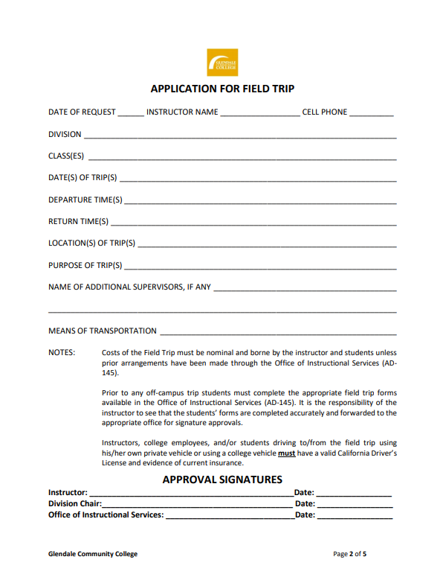
This form is to be completed by the instructor.
Instructor need to:
Print out the form/packet pages 1-5.
Fill out the form pages 2,3, and 5.
Make copies of the packet (pages 1-5) once filled.
Hand out the packet to students attending the field trip.
Have all students fill out their portion of the form.
Take the completed packet to the Duplicating Office and order two copies of the completed packets.
  Original turn in with application
  1St copy for instructor to take to the field trip.
  2nd copy to be given to the student.

Slide 5
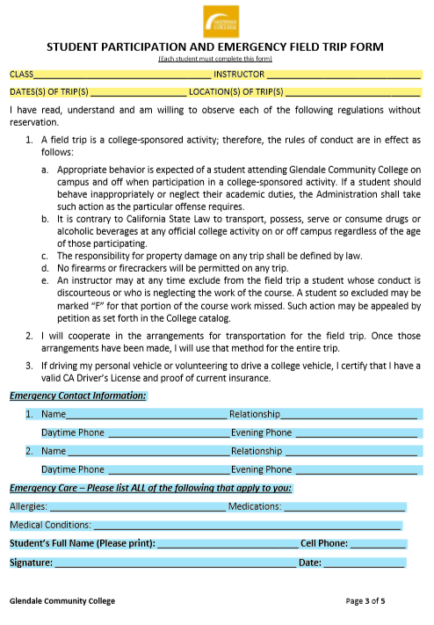
To be fill by instructor
Students cannot list themselves as an emergency contact
Students fills this part out. Write “N/A” if it does not apply to you and sign.

Slide 6
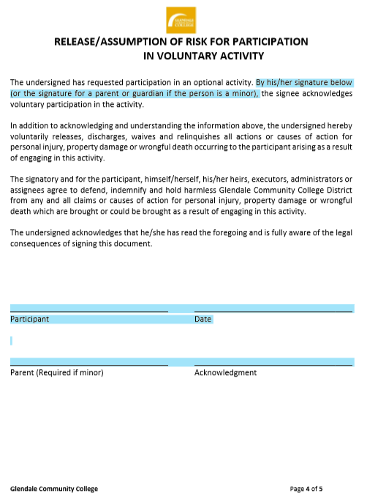
All students must fill this page out
If student is under 18 years old, student and guardian must sign the form.
If students is 18 years old or over write - “ N/A- over 18 years old” on the bottom of the page.

Slide 7
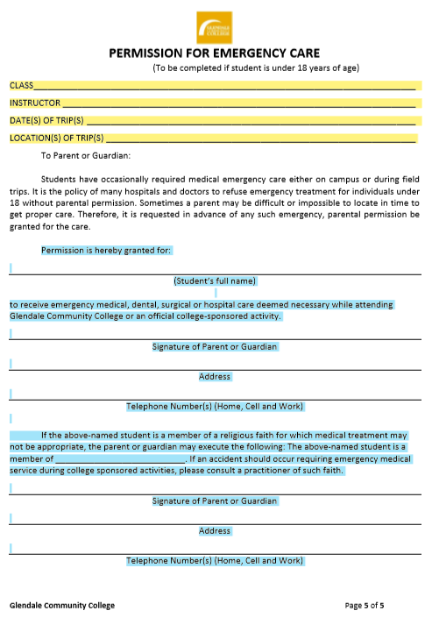
All students must fill this page out
To be fill by instructor
If student is 18 years old or over write - “ N/A- over 18 years old” on the top of the page.
If students is under 18 years old, student and guardian must sign the form.

