Slide 1
Glendale Community College
Dual Enrollment
Taking a FREE college class at my high school

Slide 2
What is Dual Enrollment?
◆ High school students take college classes
◆ College classes are offered at the high school site
◆ Students receive college credit from GCC
◆ Students can receive high school credit
(please check with your school district)
◆ GCC waives all fees for students
◆ Books and supplies are the responsibility of the student. With some classes, books may be provided by the K-12 District.
www.glendale.edu/Dual

Slide 3


Dual Enroll ment is an early college enroll ment opportunity for high school students.
www.g lendale.edu/dual
Turn in paperwork to dua l@g lenda le.edu
(818) 240-1000 Ext. 4767

Slide 4
Class offerings at High Schools
Find class listings at
www.Glendale.edu/dual
◆ (note: Students need a 2.0 cumulative high school GPA to enroll except for
classes with an asterisk*)

Slide 5
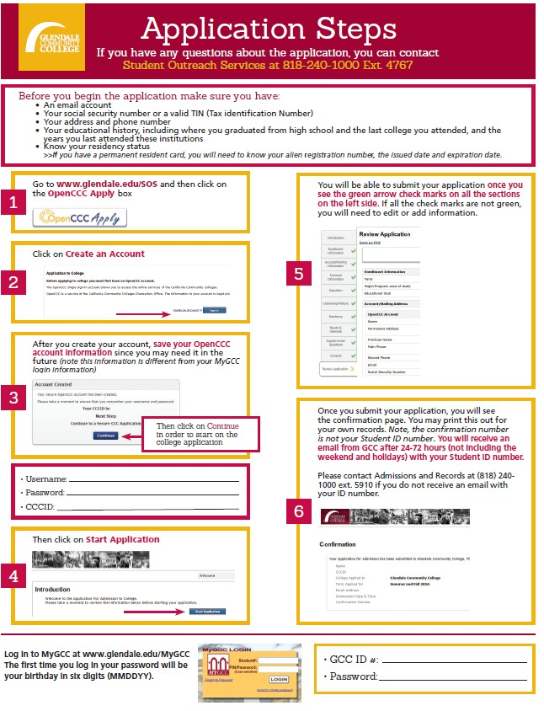
STEP 1:
GCC
Application

Slide 6
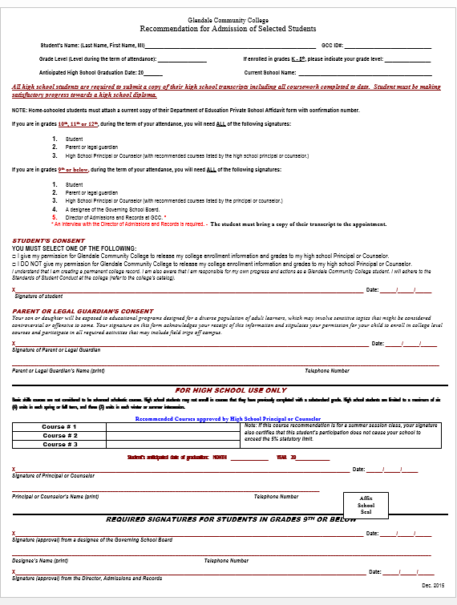


STEP 2:
FORMS
FORM #1
Recommendation for Admission of Selected Students

Slide 7
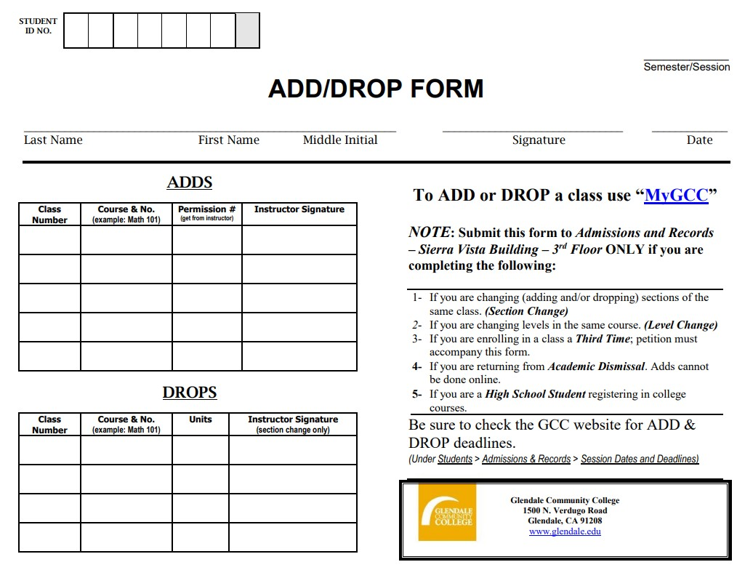
FORM #2
ADD
FORM
NOTE: Add forms will be given to students at the information session and on the first day of class only if you have a completed application packet.

Slide 8
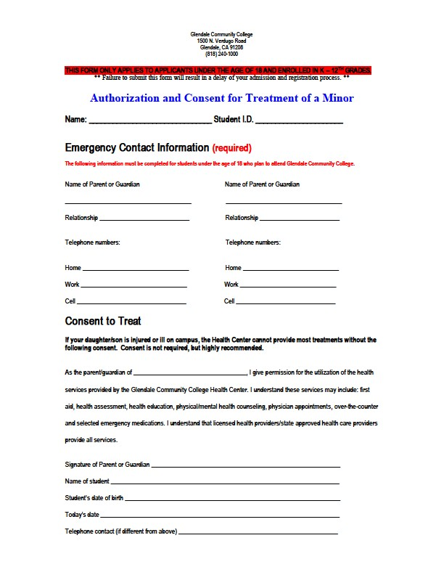
FORM #3
Authorization and Consent for Treatment of a Minor

Slide 9
FORM #4
High School Transcript
reflecting cumulative GPA
(from high school counselor)

Slide 10
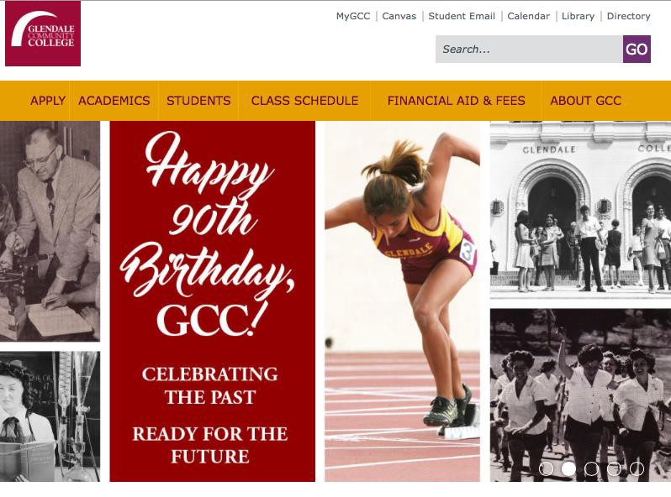
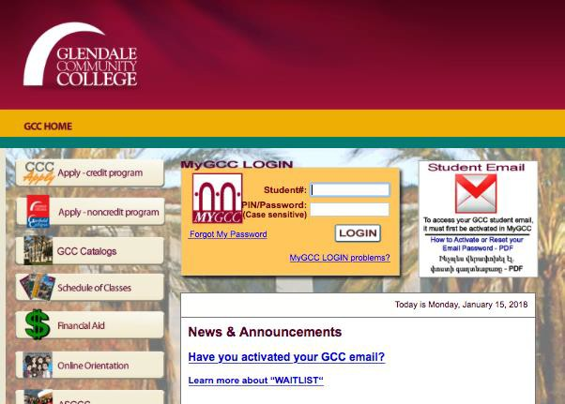
ACTIVATE
MyGCC --Student Portal
◆ www.Glendale.edu
◆ Log in with your ID number.
The first time you log in, you will use your birthday as 6-digits

Slide 11


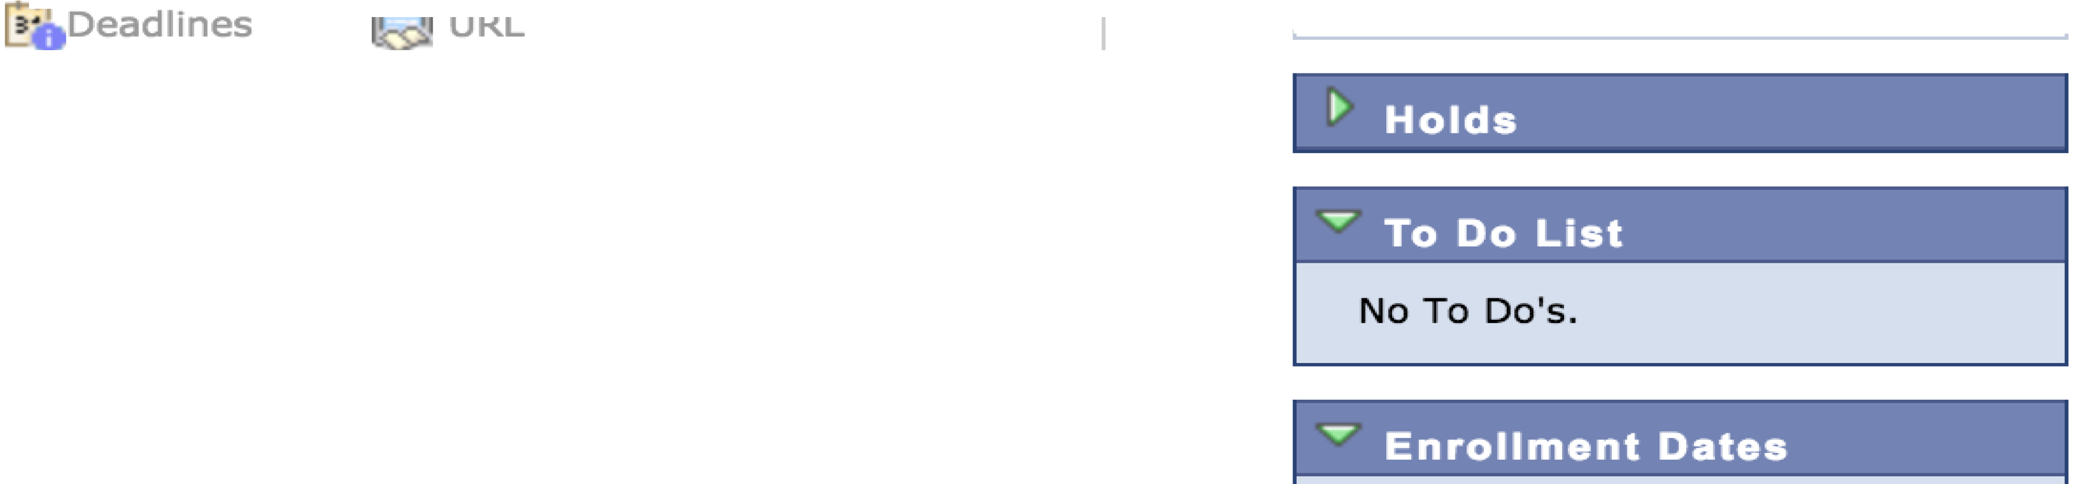



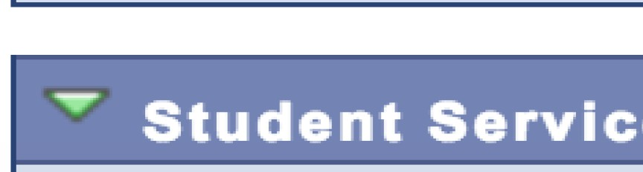
Favo....r. ites
Main...M.. enu >
Student Center
- - - - - - --,
SEARCH FOR CLASSES
..... Academi
I
Search MyPlanner Enroll
My Academics
MYGCC Schedule Planner
Spring 2018 Schedule
Schedule
Tu 1:40PM - 2: 45PM
San Rafael - 112
Th 1:40PM - 2:30PM
San Rafae l - 112
J
ST DV 141-40
LEC (2320)
other academic...
weekly schedule •
enrollment shopping cart •
Open Enrollment Dates
Finances
Personal Information
Financial Aid Forms MOODLE
GCC News Release
Main Campus Garfield Campus This Week's Events
GCC Student E-Mail Orientation

Slide 12
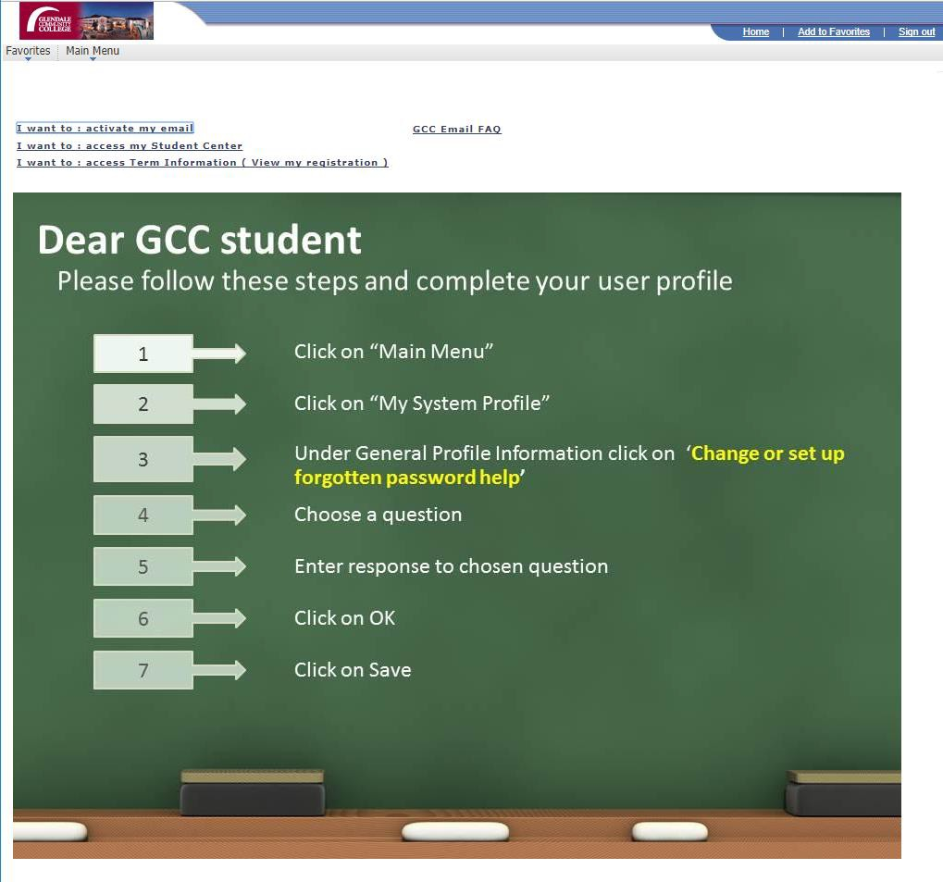
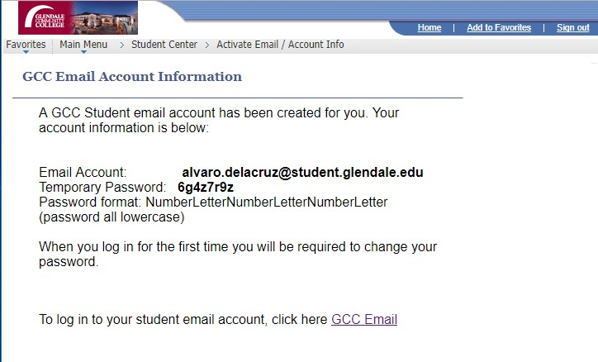
ACTIVATE
GCC EMAIL
◆ www.Glendale.edu/MyGCC
◆ Log in with your ID number.
The first time you log in, you will use your birthday as 6-digits
◆ You Can:
◆ Drop classes
◆ Access your grades
◆ Plan classes for the future

Slide 13
FERPA
◆ FAMILY EDUCATIONAL RIGHTS AND PRIVACY ACT (FERPA) is a
federal law that protects the privacy of personally identifiable information contained in a student's educational record.
◆ Communication in regards to class and grades CAN ONLY happen
between the professor and the student.
◆ Students need to turn in their own forms to enroll in the class.
◆ Students can access their information (grades, schedule, etc.) through MyGCC, the student portal.
Reference http://www2.ed.gov/policy/gen/guid/fpco/ferpa/index.html

Slide 14
Glendale College Student
Conduct Policy
◆ Class Syllabus is a students contract
◆ The syllabus will outline course expectations and instructor’s policies in regards to conduct, classroom behavior and academic honesty.
◆ Please be respectful of classroom, as we are borrowing a teacher’s classroom after school. All incidents will be reported by instructor.
◆ This is a Glendale College class, all student conduct rules apply.
Please refer to GCC’s student conduct policy at http://www.glendale.edu/studentconduct

Slide 15
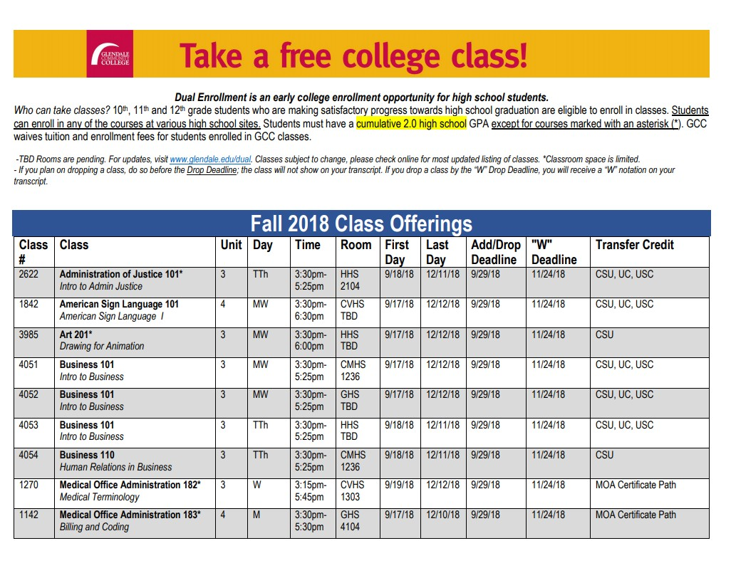
Drop Deadlines
◆ Be aware of deadlines to DROP your college
class
◆ Drop Deadline for class (Listed on Flyer and on MyGCC)
◆ Withdraw deadline
(Listed on Flyer and on MyGCC)
◆ What does it means to get a “W”?

Slide 16
Questions and
Comments?
(818) 240-1000 x4767
Dual@Glendale.edu

