Slide 1
Teaching Math 136
Statistics
Part 2
Glendale Community College
Kim Foong Chong
2019

Slide 2
Technology at GCC
Statcrunch – requires code ($13) and computer classroom (maybe),
very intuitive, handles large datasets with ease.
Ti Calculator – GCC rents Ti’s ($20) or purchase ($20 plus) or use online simulator, no special classroom required, not so intuitive, logistically cannot use large datasets.
Excel – requires computer classroom, installed on GCC computers, off-campus use free online versions, can use imported large datasets.
Technology not supported needs to be accessible and reasonable for students.

Slide 3
GAISE Guidelines
Updated Guidelines
https://magazine.amstat.org/blog/2017/09/01/gaisecollegereport/
Guideline focus on problem solving, critical thinking and conceptual understanding.
Guidelines emphasize active learning, integrating real datasets and using technology to explore and analyze data.
They suggest that algebra is not the focus of statistics.

Slide 4
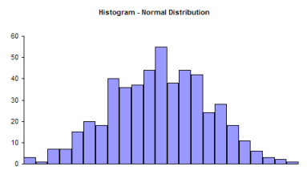
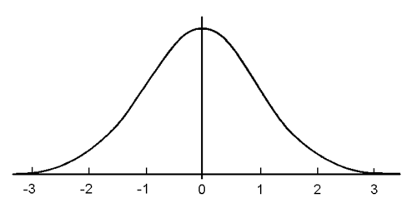
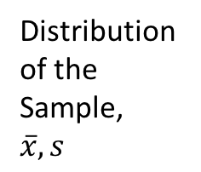
Distributions of Populations--Curves
The model of the shape of the histogram is a curve.
Distribution of the Sample, $\overline{x}, s$
Model is Normal Curve
Histogram is bell shaped
We model the population distribution with appropriate parameters μ, σ, or p by a curve.

Slide 5
Basic Distributions
Distributions-Normal, Binomial, Chi-Squared, Student T, and F.
Area under the curve is 1.00.
Areas under the curve give probabilities and are related to values on x-axis.
The Normal Curve, N(μ, σ).
a) Center is μ, standard deviation is σ.
b) All normal curves have the same bell shape (follow the Empirical Rule or 68-95-99.7 Rule ).

Slide 6
Example: Using Normal Distribution
Adults spend on average 2.35 hours per day watching TV with a standard deviation of 1.93 hours. Assume the time is normally distributed.
Find the probabilities that a randomly chosen adult spends…
a) …more that 3 hours watching TV.
b) …between 2 and 4.5 hours.
c) Find the 90th percentile of time spent watching TV.
Using Charts vs Statcrunch Calculators.

Slide 7
Path to Inference
Sampling Distribution
Probability
Inference
Distributions

Slide 8
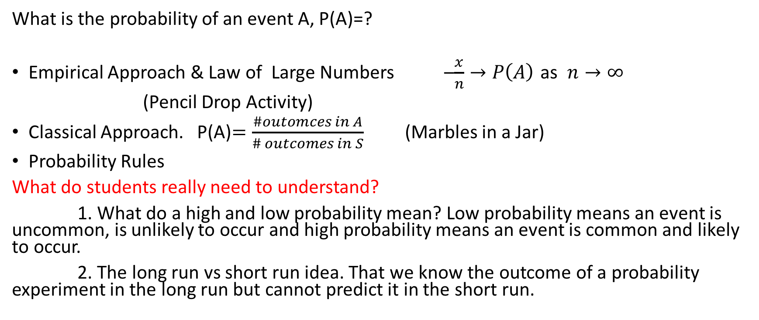
Probability
What is the probability of an event A, P(A)=?
Empirical Approach & Law of Large Numbers –$\frac{x}{n}→P\left(A\right)$ as $n→∞$
(Pencil Drop Activity)
Classical Approach. P(A)$=\frac{\#outomces in A}{\# outcomes in S}$ (Marbles in a Jar)
Probability Rules
What do students really need to understand?
1. What do a high and low probability mean? Low probability means an event is uncommon, is unlikely to occur and high probability means an event is common and likely to occur.
2. The long run vs short run idea. That we know the outcome of a probability experiment in the long run but cannot predict it in the short run.

Slide 9
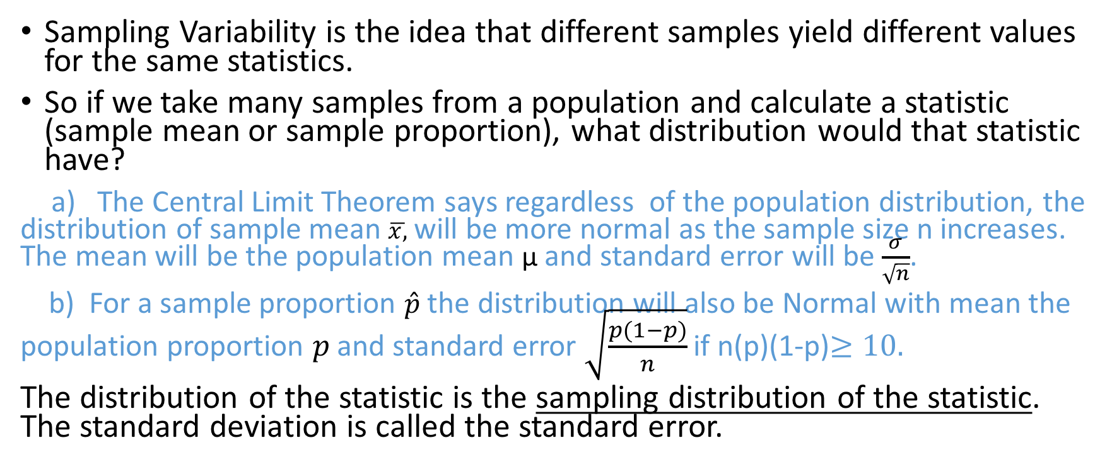
Sampling Distributions
Sampling Variability is the idea that different samples yield different values for the same statistics.
So if we take many samples from a population and calculate a statistic (sample mean or sample proportion), what distribution would that statistic have?
a) The Central Limit Theorem says regardless of the population distribution, the distribution of sample mean $\overline{x,}$ will be more normal as the sample size n increases. The mean will be the population mean μ and standard error will be $\frac{σ}{\sqrt{n}}$.
b) For a sample proportion $\hat{p}$the distribution will also be Normal with mean the population proportion $p$and standard error $\sqrt{\frac{p(1−p)}{n}}$ if n(p)(1-p)$≥10.$
The distribution of the statistic is the sampling distribution of the statistic. The standard deviation is called the standard error.

Slide 10
Inference
We make inference about parameters not statistics. We use statistics to do this.
Inference answers two basic questions.
1. What are possible values of a parameter? Use Confidence Intervals.
2. Is a value of a parameter plausible? Use Hypothesis Tests.
Inference relies on the statistic from a single sample, the sampling distribution of that statistic, and probability.

Slide 11
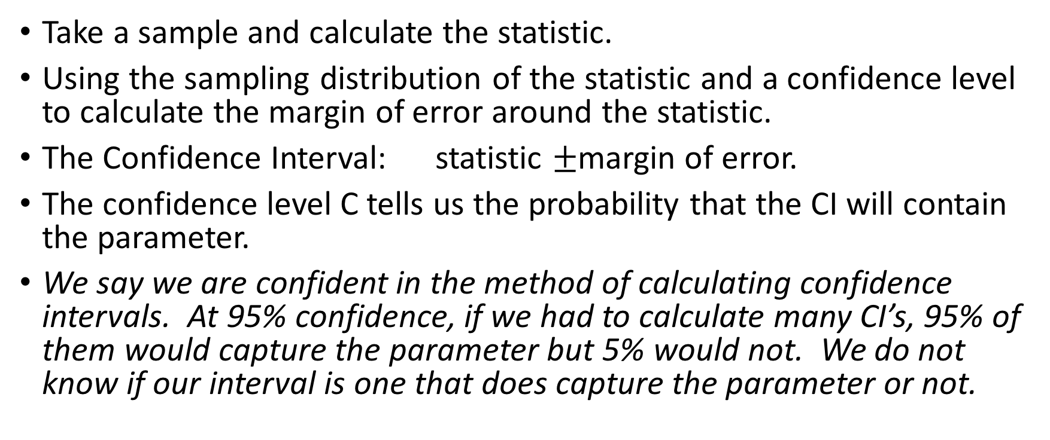
C-level Confidence Interval
Take a sample and calculate the statistic.
Using the sampling distribution of the statistic and a confidence level to calculate the margin of error around the statistic.
The Confidence Interval: statistic $±$margin of error.
The confidence level C tells us the probability that the CI will contain the parameter.
We say we are confident in the method of calculating confidence intervals. At 95% confidence, if we had to calculate many CI’s, 95% of them would capture the parameter but 5% would not. We do not know if our interval is one that does capture the parameter or not.

Slide 12
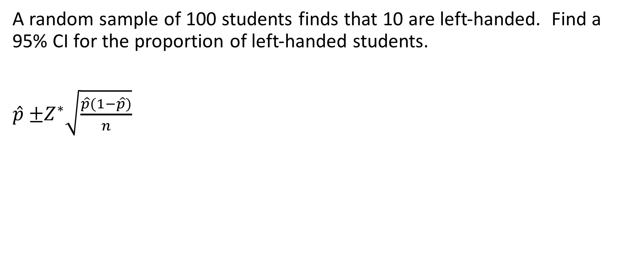
Calculating a Confidence Interval for p
A random sample of 100 students finds that 10 are left-handed. Find a 95% CI for the proportion of left-handed students.
$\hat{p}$ $±Z^{∗}\sqrt{\frac{\hat{p}(1−\hat{p})}{n}}$

Slide 13
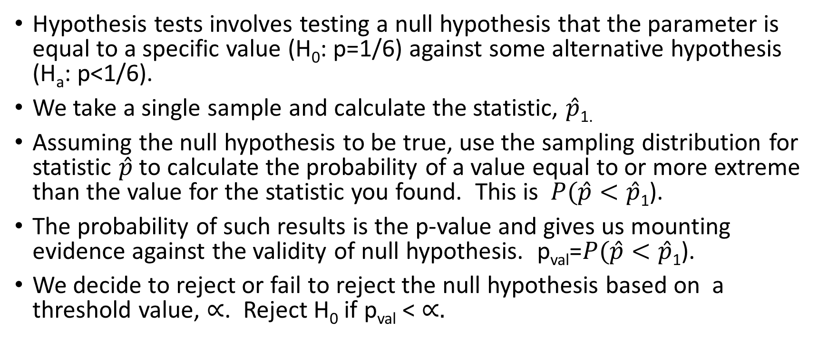
Hypothesis Test (for a population proportion)
Hypothesis tests involves testing a null hypothesis that the parameter is equal to a specific value (H₀: p=1/6) against some alternative hypothesis (H_{a}: p<1/6).
We take a single sample and calculate the statistic, $\hat{p}$_{1.}
Assuming the null hypothesis to be true, use the sampling distribution for statistic $\hat{p}$ to calculate the probability of a value equal to or more extreme than the value for the statistic you found. This is $P(\hat{p}<\hat{p}$₁).
The probability of such results is the p-value and gives us mounting evidence against the validity of null hypothesis. p_{val}=$P(\hat{p}<\hat{p}$₁).
We decide to reject or fail to reject the null hypothesis based on a threshold value, $∝$. Reject H₀ if p_{val} < $∝.$

Slide 14
Can gamblers change the odd?
The game of craps involves tossing two 6-sided dice. If one can reduce the chance of throwing a 7 the expected winnings will be in the player’s favor.
Suppose a gambler throws 6 sevens out of 80 tosses. Is there evidence that she throws less 7’s than normal?

