Slide 1

Gluten Free, Is It For Me?
By:
Merissa Martinez, BS, DTR
Cal Poly Pomona, Dietetic Intern
2015-2016

Slide 2
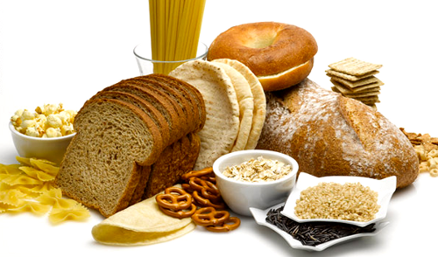
What is Gluten anyway?
Gluten: a protein complex made of the proteins gliadin and glutenin. Gluten is naturally found in wheat, barley, and rye.

Slide 3
Foods Containing Gluten
Barley
Rye
Triticale
Brewer’s yeast
Dextrin
Modified food starch
Oats (if not labeled GF)
Starch
Enriched flour
Farina
Semolina Flour
White Flour
Self-rising Flour
Wheat
Spelt
Kamut
Wheat Bran
Wheat Germ
Cracked Wheat
Hydrolyzed Wheat Protein
Beer
Ake
Malt Beverages
Soy Sauce
Pasta
Bread
Baked goods
Cereals
Sauces

Slide 4

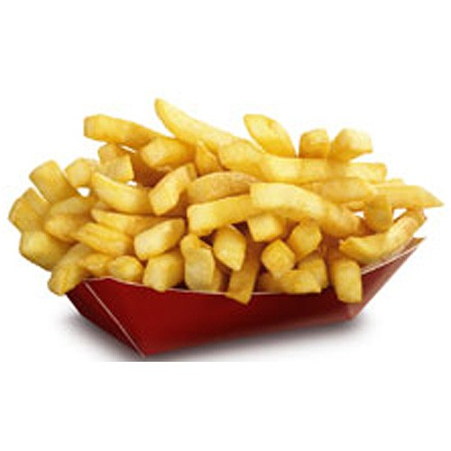
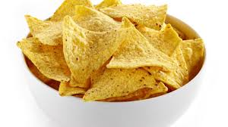
What Foods Have Hidden Gluten?
Bouillon Cubes
Candy
Chewing Gum
Chips/ Potato Chips
Cold cuts
Hotdogs, Sausage
French fries
Imitation fish
Matzo
Soups
Seasoned tortilla chips

Slide 5
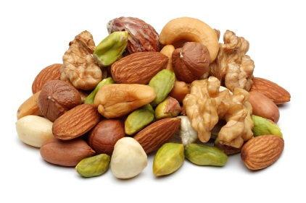

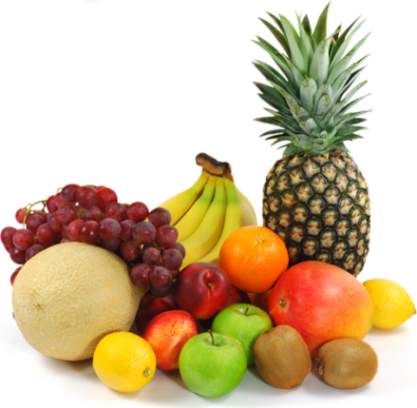
Foods That Naturally Do Not Contain Gluten
Fruits
Vegetables
Legumes
Lentils
Quinoa
Rice
Tapioca
Corn
Cassava
Flax
Nuts
Millet
Potatoes
Sago
Soy
Wild rice
Yucca
Oats (labeled GF)

Slide 6
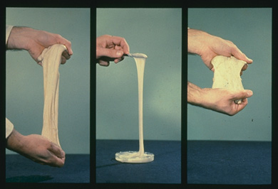
What is Glutens Role in Bread?
Gluten is important for the structure of baked items. Kneading increases gluten strength by expanding and stretching gluten. During the temperature rise from baking, steam and carbon dioxide & ethanol gases rise and cause gluten to expand more helping the item to form its structure.
Notes:
Picture:
Left: glutenin is elastic
Middle: gliadin is fluid and sticky
Right: glutenin + gliadin= gluten

Slide 7

What is a gluten free diet?
Who is the GF diet for?
People with Celiac Disease, Non-Celiac Gluten Sensitivity,
Gluten Intolerance
Gluten is safe to eat if you do not have these conditions
A gluten free diet is a diet that excludes all foods that contain gluten.

Slide 8
Video: When You Tell People You Can’t Eat Gluten
https://www.youtube.com/watch?v=XMZIAlKFRY4

Slide 9
Celiac Disease
Symptoms:
Nausea
Abdominal Cramping
Diarrhea
Anemia
Vitamin D and K deficiency
Poor Calcium Absorption
Delayed growth, puberty and underweight
Genetic autoimmune disease that damages the small intestine and interferes with the absorption of nutrients when gluten is ingested.

Slide 10
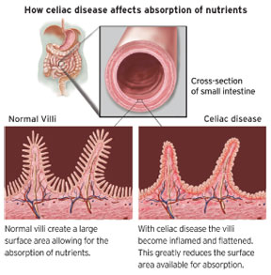
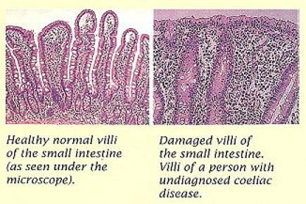
Celiac Disease

Slide 11
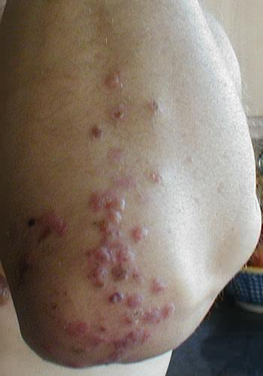
CD & Dermatitis Herpetiformis
The “skin manifestation” of Celiac Disease.
Itchy blistery rash usually on the elbows, knees, buttocks, abdomen, neck or scalp.
People with DH often do not have the digestive symptoms of CD.
More common in men
95% of cases are misdiagnosed as eczema.
Treated with antibiotics and a GF diet

Slide 12
How to Test for Celiac Disease
Family history and symptoms
Blood test: Check for certain antibodies in the blood. Blood tests are 90-99% sensitive to the antibodies. If blood tests are normal but symptoms are present IgA levels are checked.
Intestinal biopsy is the gold standard, but is expensive and invasive.

Slide 13
Treatment
The only treatment for Celiac Disease is a gluten free diet.
After following a GF diet for 5 days the surface cells of the mucosa are replaced.
  Swelling of the cells is reduced within 14 days.
  Villi improve within 6 months to 5 years.
  Symptoms can change over time so following up with a physician and a RD is important.

Slide 14

Gluten Sensitivity
Gluten Intolerance
Recognized as less severe than Celiac Disease
Causes possible, but minimal, intestinal damage
Non-specific symptoms: abdominal pain, fatigue, headaches, tingling/numbness, “foggy brain”
No immune response like in CD
People that have specific symptoms. May or may not be CD
Note: Symptoms for both can be : nausea, abdominal cramps, or diarrhea after consuming gluten.

Slide 15
Do Not Diagnose Yourself
Gluten may not be the issue
Being on a GF diet for a long period of time will make it challenging to diagnose CD
Eating a GF diet can be expensive and restrictive

Slide 16
To Be or Not to Be Gluten Free
Eat healthier
To lose weight
Diagnose myself
Just because a food is GF does not mean it’s healthier. An apple is GF and so is a GF cupcake.
Weight loss comes from expending more calories than you consume, not from gluten. Physical activity & diet go hand in hand.
It may not be CD!

Slide 17
Preventing Gluten Contamination
If you are going to follow a GF diet:
Keep a separate toaster handy
Be cautious at buffets. Serving utensils may have been used for another food item. Ordering off the menu may be safer
Wipe down your food prep space before & after
Read the ingredients on nutrition labels
Be cautious with deep fried foods, they may have been cooked in recycled oil that once fried breaded meats or French fries

Slide 18




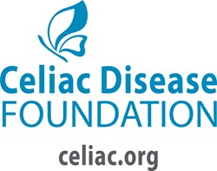
Resources

Slide 19
References
http://www.niddk.nih.gov/health-information/health-topics/digestive-diseases/celiac-disease/Pages/facts.aspx
https://celiac.org/
http://www.mayoclinic.org/healthy-lifestyle/nutrition-and-healthy-eating/in-depth/gluten-free-diet/art-20048530
http://health.clevelandclinic.org/2014/04/the-surprising-truth-about-gluten-free-food-and-weight-loss/
http://celiac.nih.gov/Dermatitis.aspx
Mahan, K.L., Escott-Stump, S., Raymond, J,L. (2012). Krause’s Food and the Nutrition Care Process. St. Louis, MO: Elsevier Saunders

