Slide 1
Teaching Math 136
Statistics
Part 1
Glendale Community College
Kim Foong Chong
2019

Slide 2
Why Teach Statistics?
It is the most useful math course in understanding our modern world.
It is a complete course.
It is fun to teach.
Job Opportunities and AB705

Slide 3
What is Statistics?
Statistics is the science of collecting, organizing, summarizing and analyzing information to draw conclusions or answer questions. In addition, Statistics is about providing a measure of confidence in any conclusions.
Statistics is a different way to think about our world that uses data, mathematics, and probability to make inferences about populations.
Statistics are numbers that come from data.

Slide 4

The Big Picture
Population
Parameters (μ, σ, p,…)
Sampling Method
Sample
Data
Statistics

Slide 5

The Big Picture
Population
Parameters (μ, σ, p, N…)
Inference
Sample
Data
Statistics ($\overline{x}$, s, $\hat{p}$ n,…)

Slide 6
What is the Truth?
Parameters values are THE TRUTH. If we knew these there would be no Statistics.
Statistics are our versions of the Truth but…
we may be wrong!!
So with every Truth we state, we give a measure of our confidence in it.

Slide 7
Variables
Variables are the characteristics of individuals (i.e. height, eye color, etc.) The values of the characteristics are the data we gather (i.e. 5’6”, brown, etc.) Values differ from individual to individual.
QUANTITATIVE variables tell us “how much” while QUALITATIVE (Categorical) variables tell us “which category.”
Whether the data comes from Quantitative variables or Qualitative variables determines the statistics, graphs, distributions and ultimately inference we use.

Slide 8
Quantitative vs Qualitative
Quantitative Variable
e.g. Height
Graphs – histograms, boxplots, dotplots, stem leaf, …
Statistics – mean, standard deviation, 5 number summary
Distributions – Normal, T
Inference for μ, σ
Qualitative Variable
e.g. Eye Color
Graphs – Bar Chart, Pie Chart
Statistics – frequency, relative frequency
Distribution – Binomial,
Inference for p

Slide 9
Statcrunch and Pearson’s MyLab
Create a course in Pearson’s MyLab. https://www.pearsonmylabandmastering.com/northamerica/
Enrolling as a student. Just need course id: foongchong12333. You can also send instructions pdf.
You get the eText and Statcrunch for 2 weeks so you can begin using it immediately.
After free trial period students need to buy a text bundle or online access.

Slide 10
Statcrunch
Data – loads and manipulates data
Graph – graphs all kinds of graphs of data
Stat – calculates numbers (statistics) from the data
It’s not a real spreadsheet
Loading data from anywhere is a snap

Slide 11
Data Tables
Load Statcrunch dataset “SPRING 2019 SURVEY (ch2.2)”
Load Statcrunch dataset “NFL Players 2017”
Load Statcrunch dataset “Responses to MTH 220 Spring 2019 Student Data Survey”
Tip* If you find a good dataset, save it to MyData and describe its application in the title for later reference e.g. “Heights (outliers)”.

Slide 12
Descriptive Statistics
Data is always described by graphs and statistics
Different graphs highlight different aspects of the data i.e. skewedness, outliers, etc.
Some graphs may be obsolete.
Statistics describe the data by numerical summaries.
Statistics like the mean and standard deviation are not robust and can be influenced by skewedness and outliers. Sometimes other statistics like the median and inter-quartile range are more appropriate.
Some calculations of statistics may no longer be necessary.

Slide 13
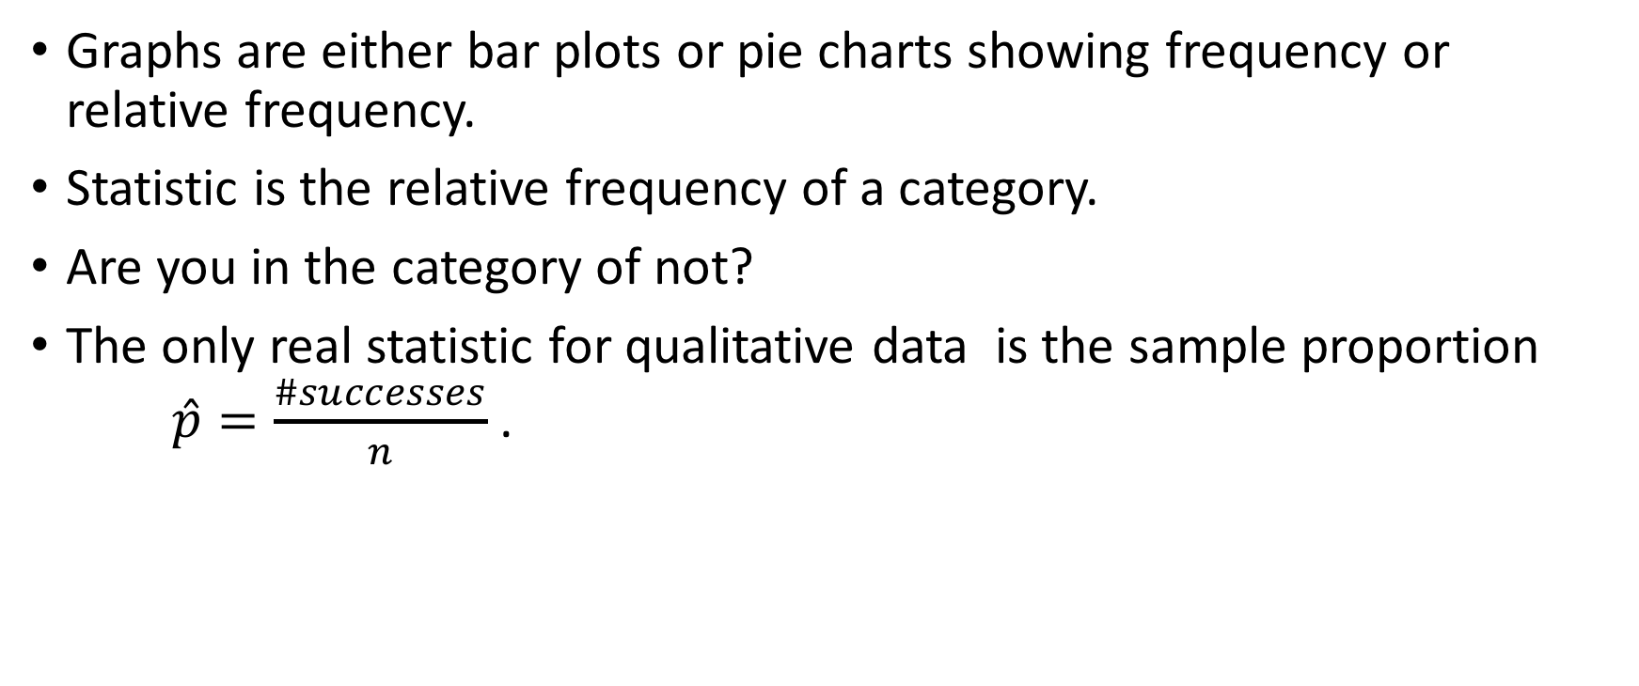
Describing Qualitative Data
Graphs are either bar plots or pie charts showing frequency or relative frequency.
Statistic is the relative frequency of a category.
Are you in the category of not?
The only real statistic for qualitative data is the sample proportion $\hat{p}=\frac{\#successes}{n}$ .

Slide 14
Describing Quantitative Data
Graphs show the distribution of the data along the number line.
Graphs are described by shape, symmetry, outliers, center and spread.
Are graphs the Distribution? Only if they look like it.
Statistics give measures of center (mean and median), position (percentiles, standardized scores) and dispersion (standard deviation, variance, IQR).
Statistics may not be robust to skewedness and/or outliers.
Statistics cannot show the entire distribution that is why we also look as graphs.
We mostly use mean and standard deviation.

Slide 15
The Unsinkable Titanic
Load Statcrunch dataset “Titanic.xlsx.”
Was there any discrimination against the lower class passengers?

Slide 16
Whole Foods vs Target
Load Statcrunch dataset, “organic food price comparison fall 2011”
a) Who has higher prices?
b) How can you tell?

Slide 17
Technology vs Mathematics
To what extent will you use technology?
Statistics is a Mathematics course but computation should not hindering doing Statistics.
GCC requires that technology like Statcrunch, Excel, or TI’s are used and students work with large datasets.
We are preparing students to do Statistics in the real world. This will require the use of statistical software.
The balance is ultimately up to you.

Slide 18
Supported Technology at GCC
Statcrunch – requires code ($13) and computer classroom (maybe),
very intuitive, handles large datasets with ease.
Ti Calculator – GCC rents Ti’s ($20) or purchase ($20 plus) or use online simulator, no special classroom required, not so intuitive, logistically cannot use large datasets.
Excel – requires computer classroom, installed on GCC computers, not free for individual off-campus use, can use imported large datasets.
Technology not supported needs to be accessible and reasonable for students.

Slide 19
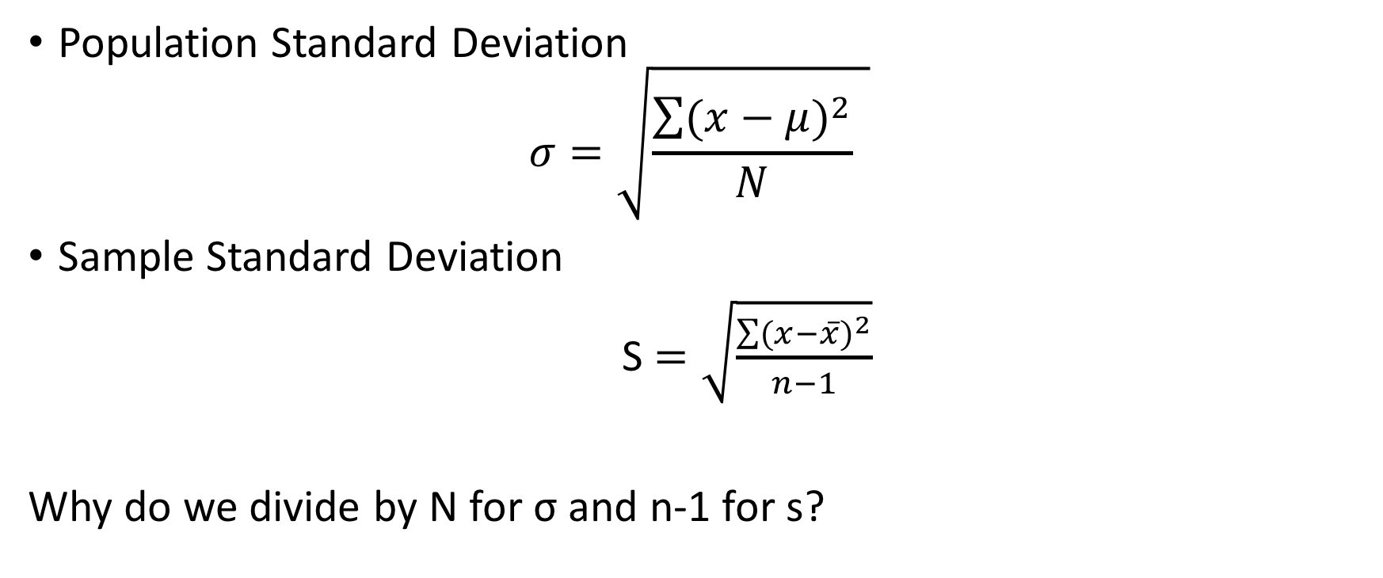
Algebra in Statistics:
Standard Deviation & Degrees of Freedom
Population Standard Deviation
$$σ=\sqrt{\frac{\sum{{(x−μ)}^{2}}}{N} }$$
Sample Standard Deviation
S $=\sqrt{\frac{\sum{{(x−\overline{x})}^{2}}}{n−1}}$
Why do we divide by N for σ and n-1 for s?

Slide 20
Resources
Pearsen website https://www.pearsonmylabandmastering.com/northamerica/
Canvas - Math 136 Canvas Shell
Statcrunch Users Forum and videos
Online search “finding ….using Statcrunch”
Myself - kfoong@glendale.edu
Statistics Course Coordinator- Sandra Romero sromero@glendale.edu

