Slide 1
Glendale College
Early College Academy

Slide 3
IGETC PATHWAY
Three year program (10th – 12th grade)
60 students in cohort
The pathway is built into high school master schedule
Students will complete 45 units in the program
Students have the opportunity to complete beyond the 45 units through summer sessions, winter session, or through after-school dual enrollment program
  This student could be transfer-ready
  This could lead to an AA/AS Transfer degree
A-G and high school graduations requirements are still being met

Slide 4
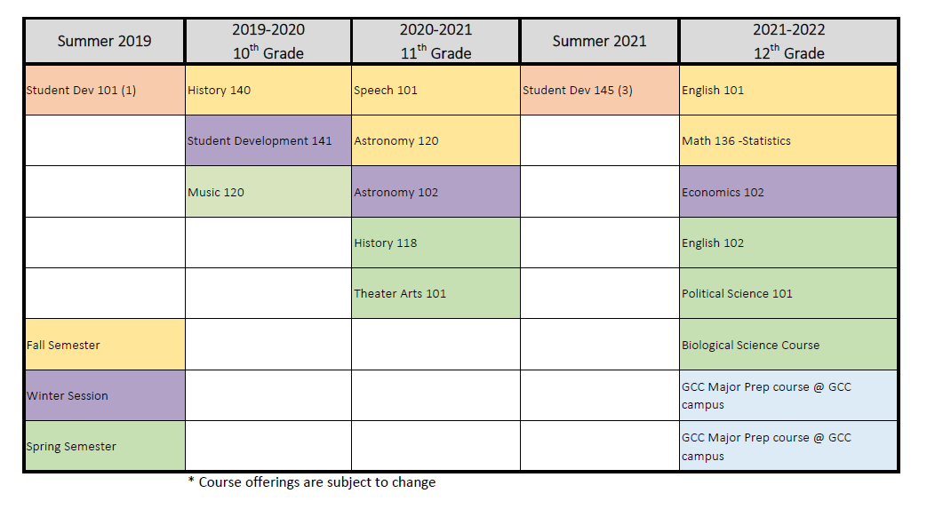
PATHWAY MODEL

Slide 5
SUPPORT
Built in student development course
Students in the program will always have access to a GCC Counselor
Study-hall will be built into the program schedule
Supplemental Instruction will be available
All GCC services and programs will be available students

Slide 6
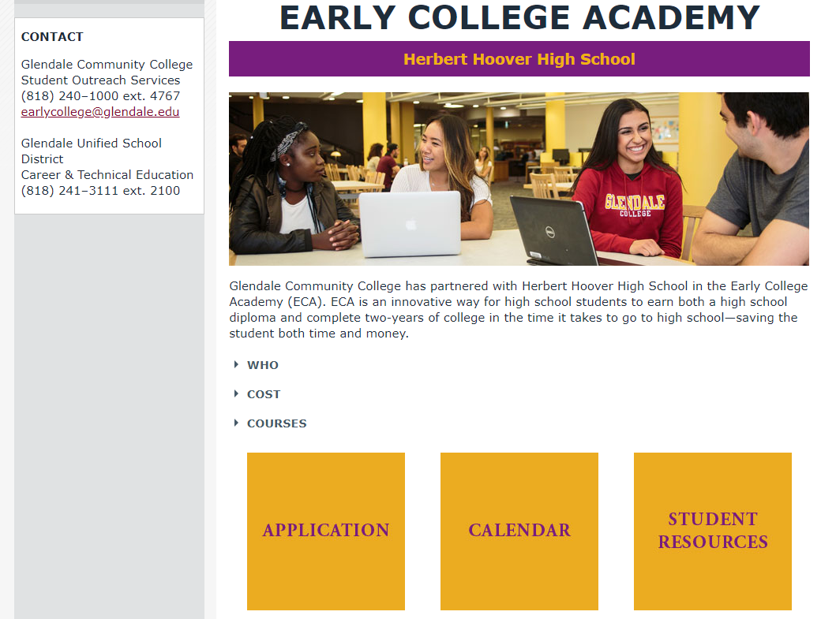
WEBSITE: www.Glendale.edu/EarlyCollege

Slide 7
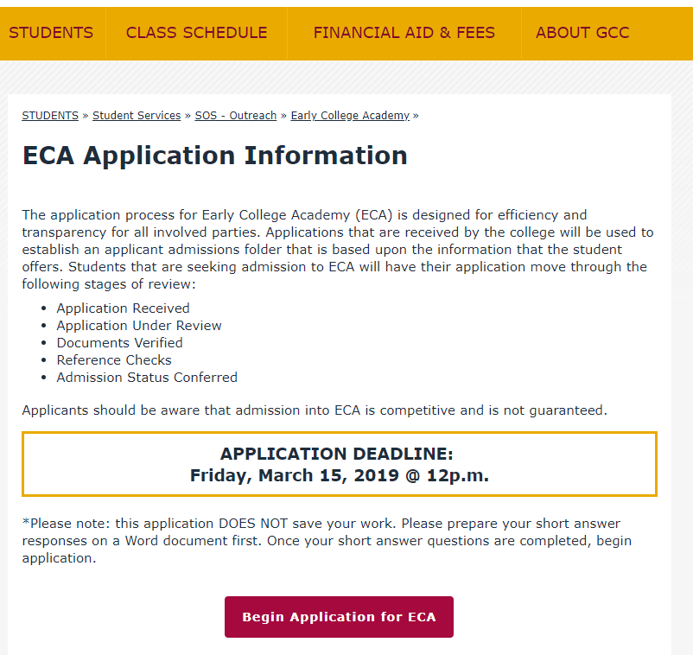
APPLICATION
MARCH 15, 2019
12 Noon

Slide 8
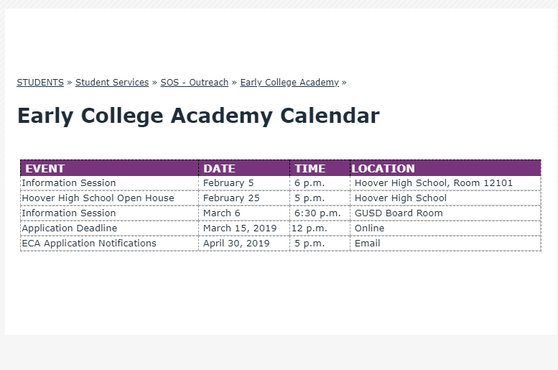
CALENDAR

Slide 10
Application Deadline: March 15

