Slide 1
Heidi Jenkins
Erin Calderone
Nutrition Apps and Coaching
Find what works for you and get the most out of it!

Slide 2

Diets typically don’t work… but why?
Adherence
Short-term vs. Lifestyle change
One-size-fits-all
Too restrictive
What happens when you’re done?
Social support?

Slide 3
Lifestyle Change
Simple, not easy
Successful strategies have common themes:
  Social support
  Self-monitoring
  Cognitive + behavioral tools
  Positive reinforcement
  Consistency and patience

Slide 4
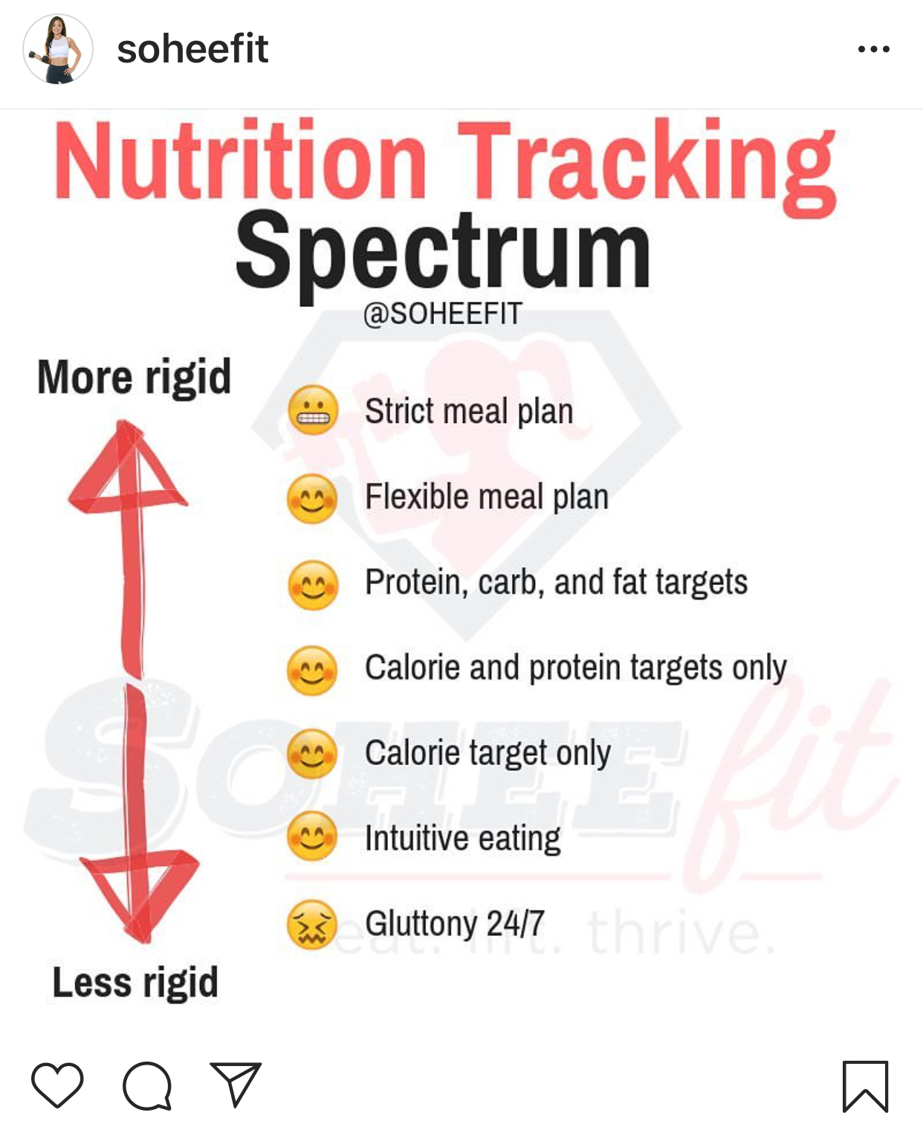
Self-monitoring for Fat Loss
Diet and exercise is far more successful than diet or exercise alone
How rigid you are depends on your own needs and goals

Slide 5
Calorie and Macro Goals
Most apps will set this for you
An evidence-based resource: NIDDK Body Weight Planner https://www.niddk.nih.gov/bwp
A typical weight-loss plan will create a deficit of 500-1000 calories (average each day) with both diet and exercise
Protein requirements = 0.8g/kg/day (sedentary) to 1.2-1.8g/kg/day (active, exerciser) ~10-30% of total calories
Very low carb or very low fat diets can work, but can be difficult to maintain long-term

Slide 6
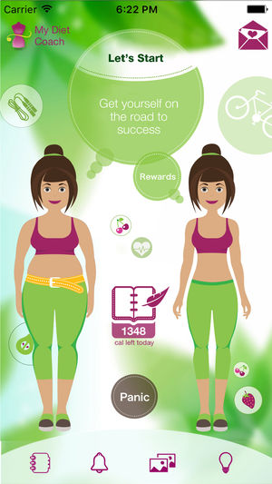

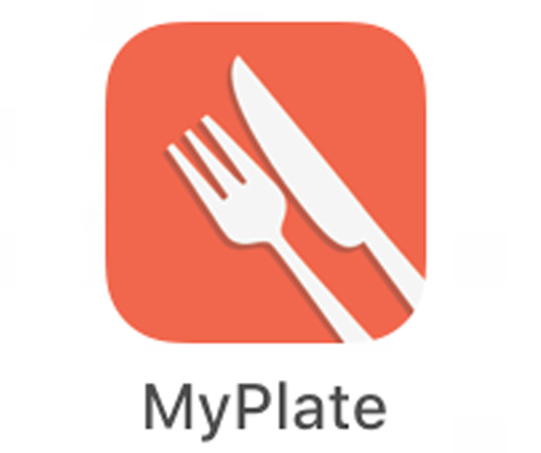


Free Apps
Notes:
Most free apps will also have advertisements, a social media/networking option and blogs with recommendations or recipes (articles are not always scientifically factual!)
Most of them will also have an upgrade option that provides you with more detailed information or easier app usage.

Slide 7
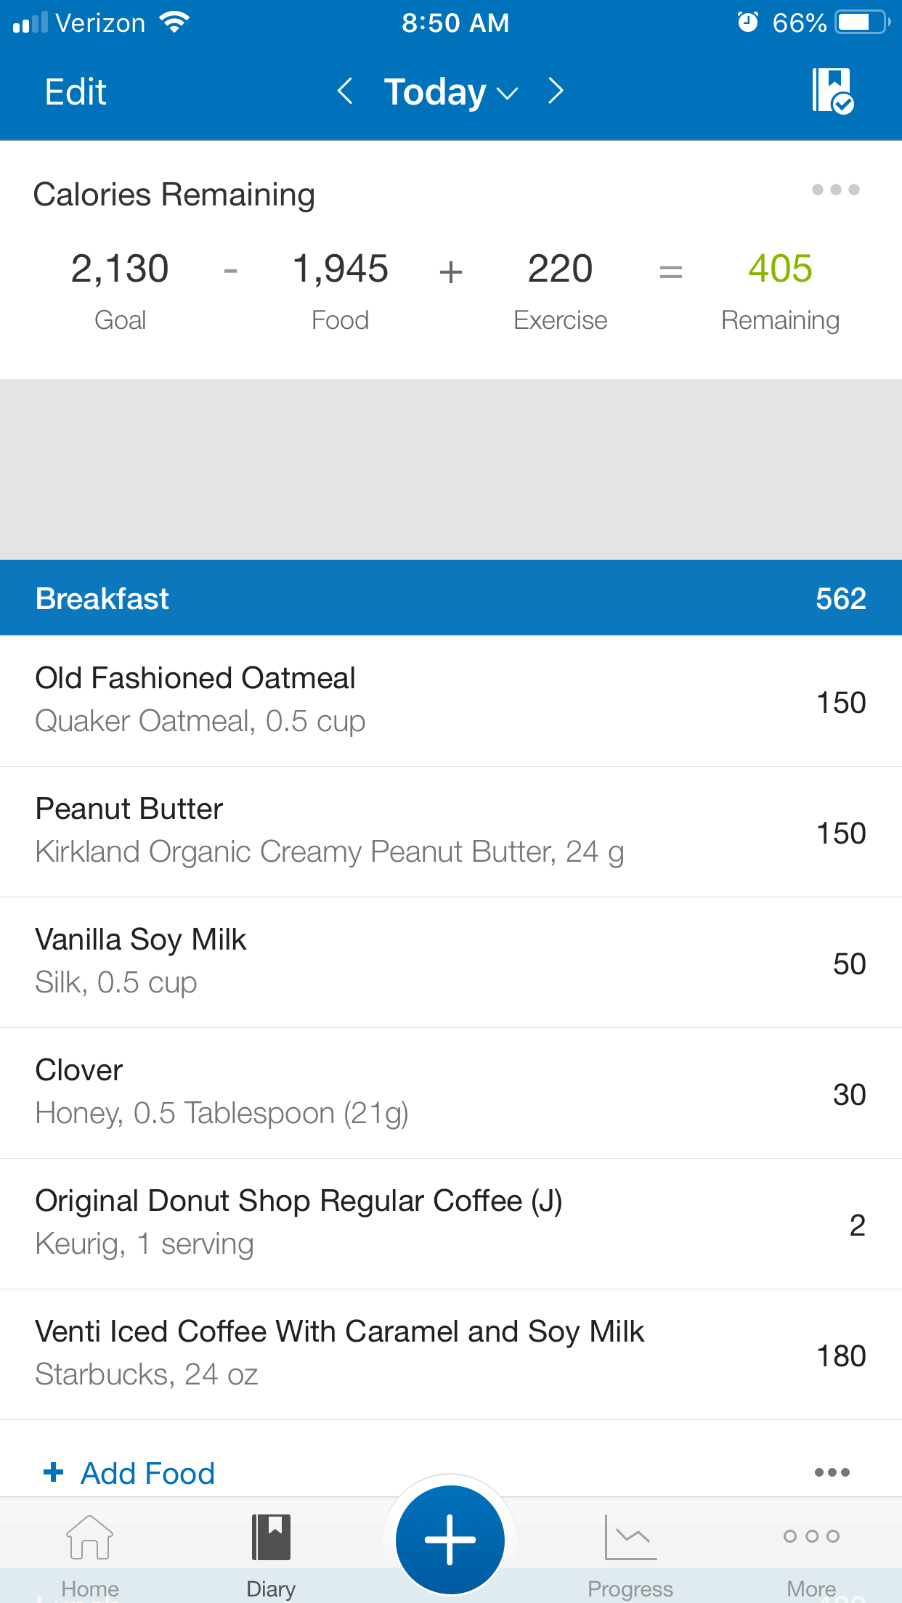
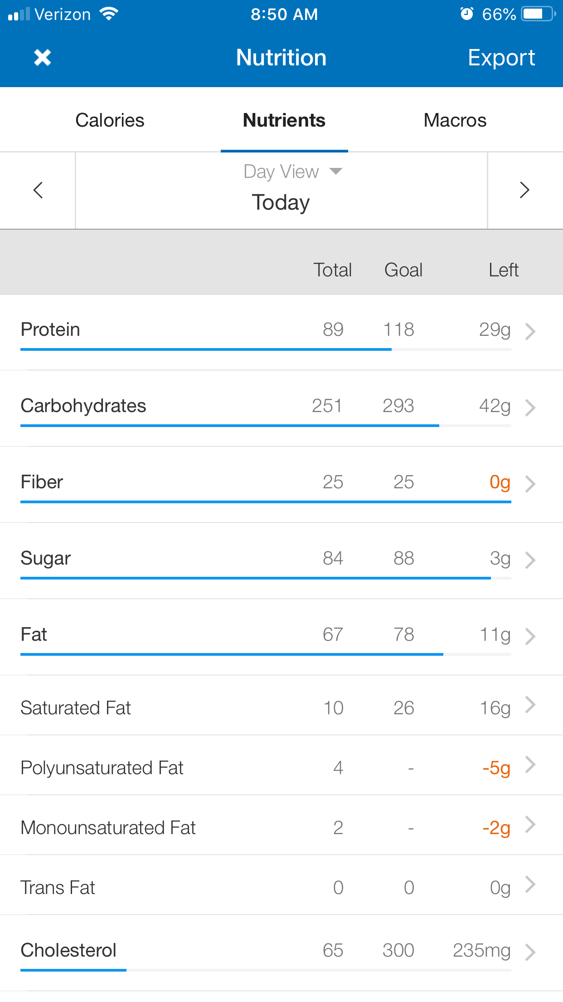
Notes:
MyFitnessPal *my favorite but only because I am the most familiar with it!*
Simple design, not a whole lot of pictures or graphics
Interfaces well with other apps including UA powered like MapMyRun/Walk/Fitness (and MYZONE via Health App)
Large food database, lots of verified foods
Barcode scanner
Nutritional breakdown includes macros (protein, carbs, fat) sugars, fiber, several vitamins and minerals. Allows you to set individual macro goals.
Email newsletters and blog postings with recipes, etc.

Slide 8
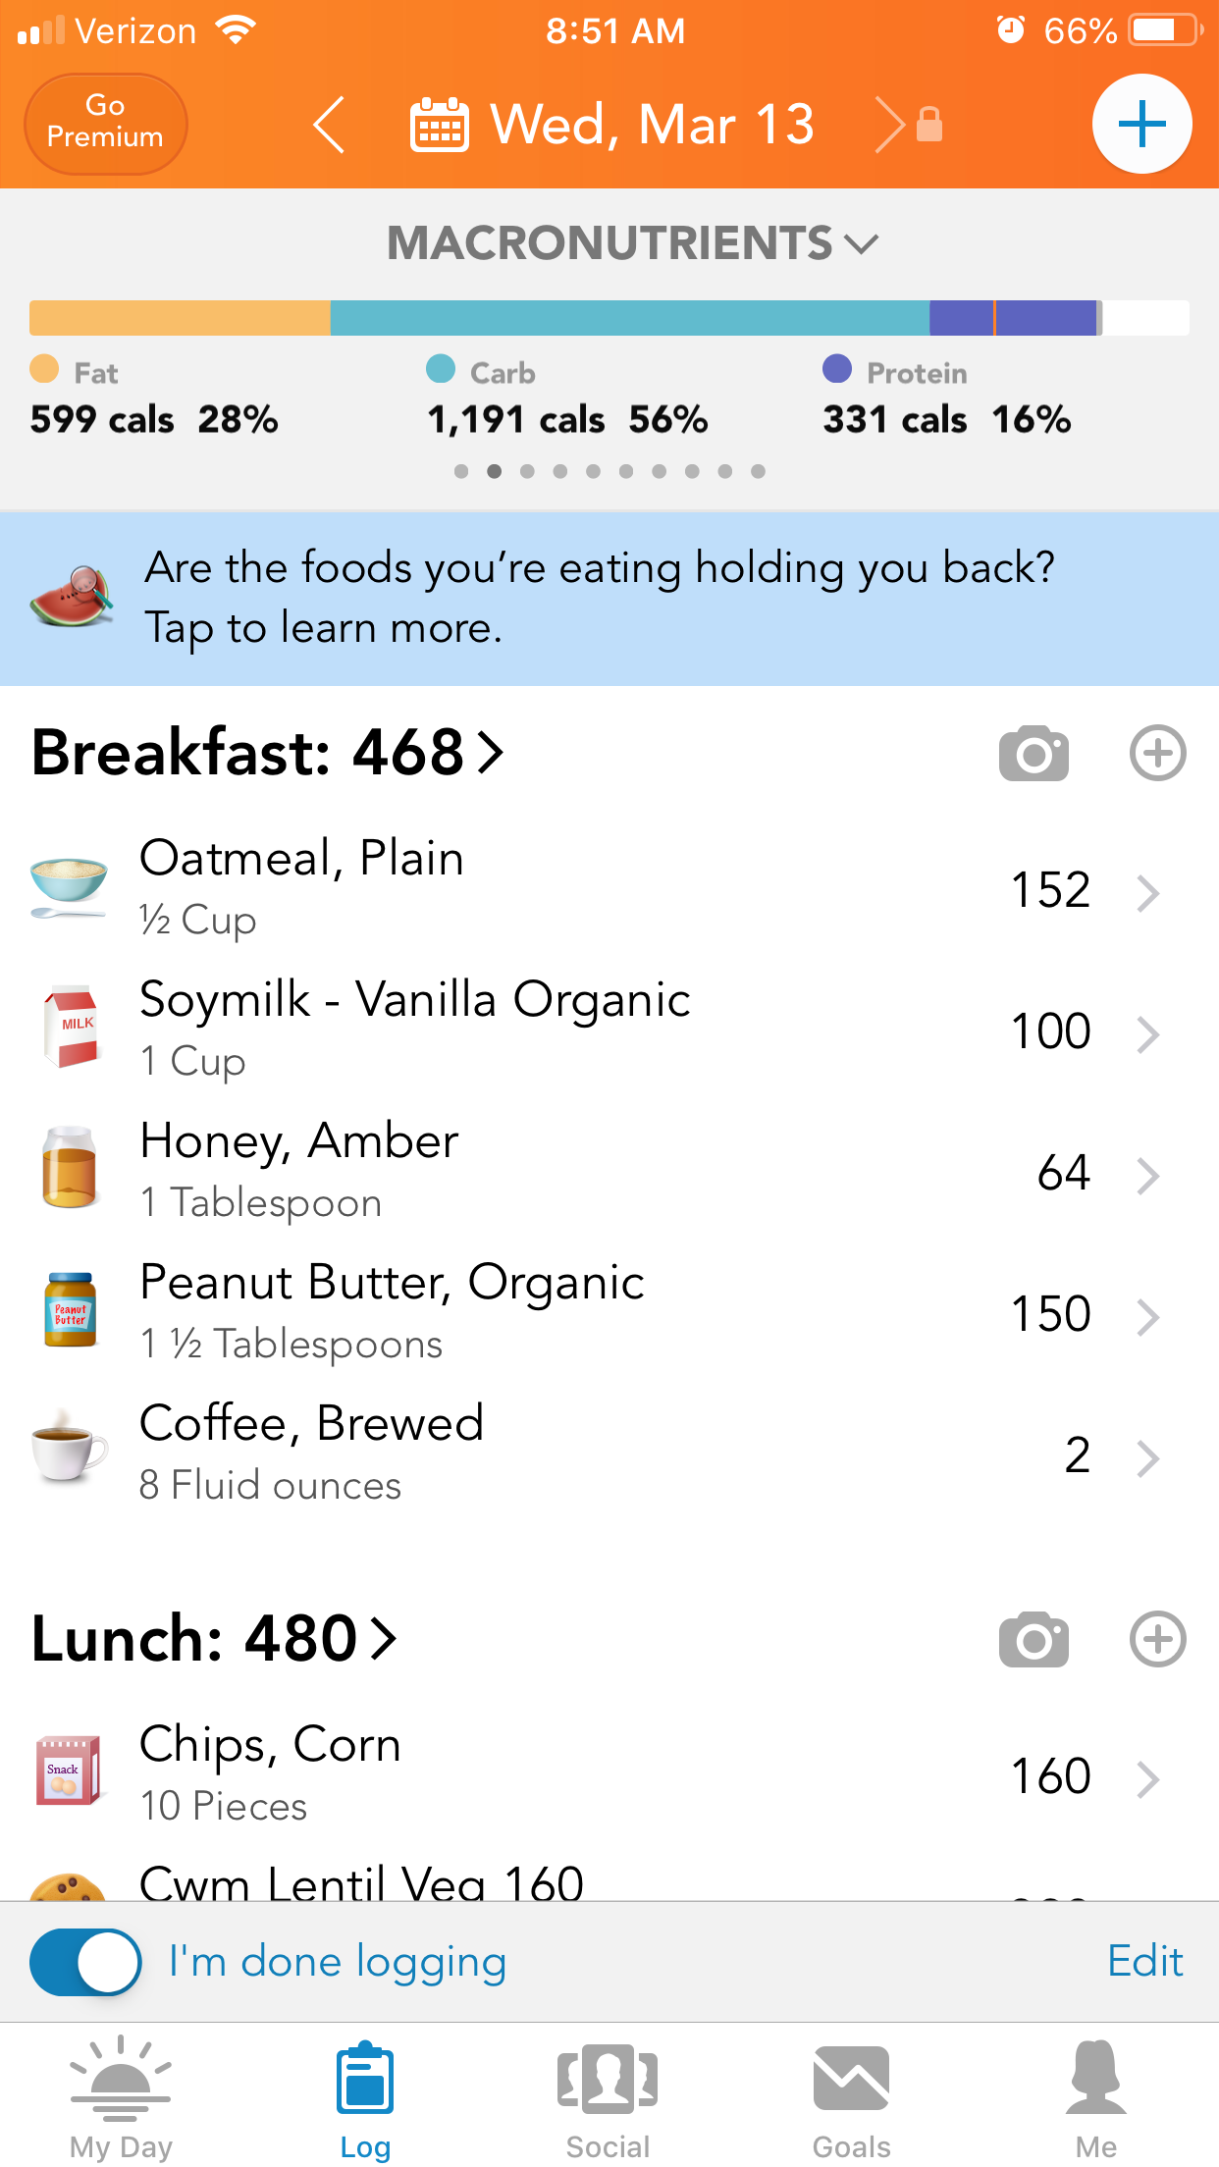
Notes:
LoseIt
Interfaces with FitBit (and MYZONE via Health App)
Large food database, lots of verified foods
Barcode scanner
Breakdown of macro/calorie goals and progress
Badges as rewards

Slide 9
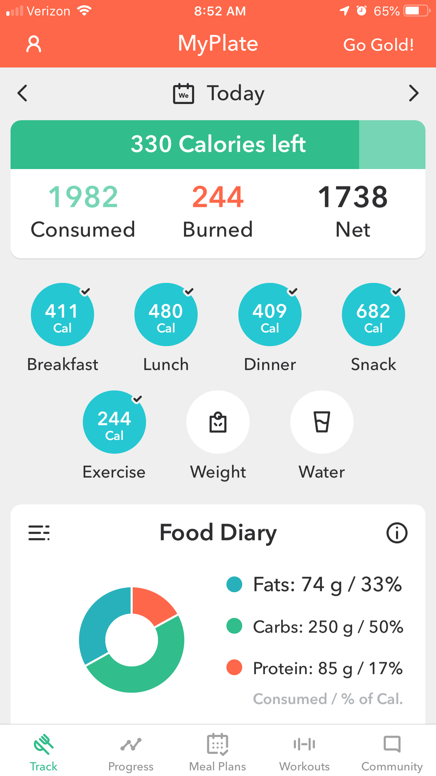
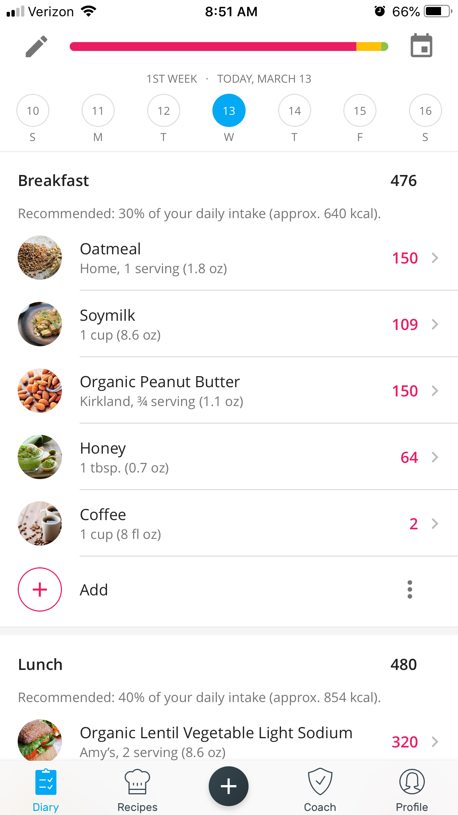
Notes:
MyPlate
Interfaces with Health App
Large food database, lots of verified foods
Barcode scanner
Charts macros (protein, carbs, fat) sugars, cholesterol, sodium and fiber.
Mealplan email list starts each Monday
Yazio
Smaller database
Interfaces with Health App
Provides categories and recommendations of food

Slide 10
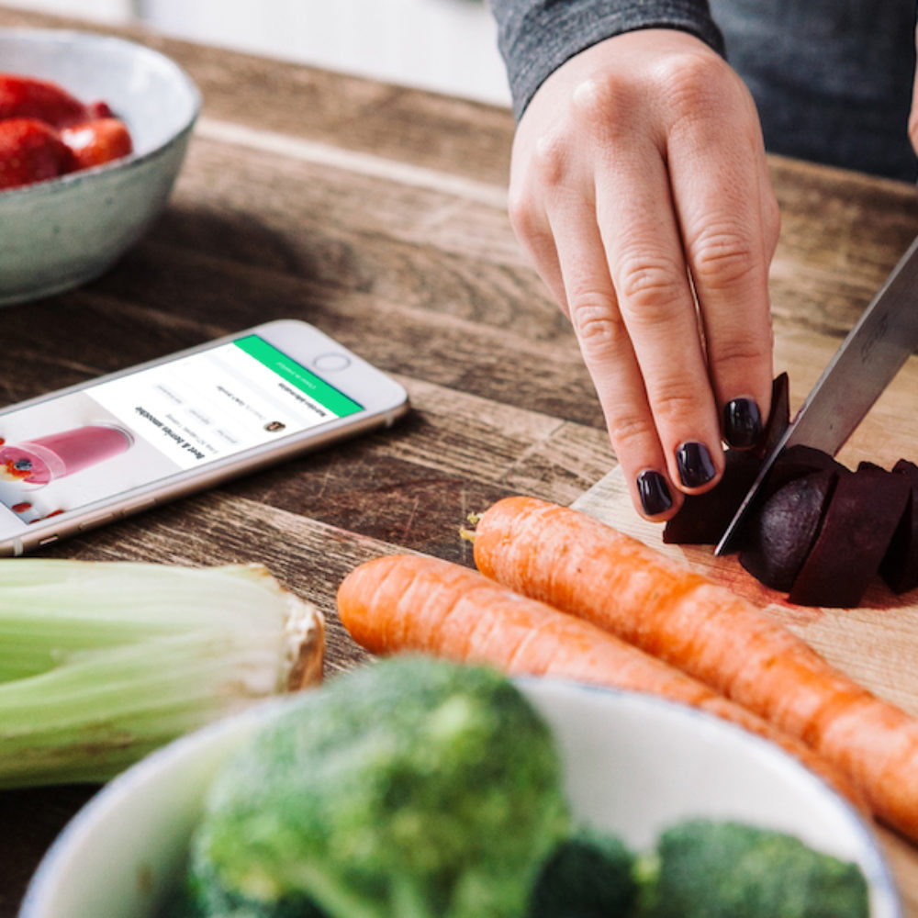
Apps work best when…
You track consistently (and honestly!)
You input accurate foods and serving sizes
You have a relatively consistent pattern of eating
You don’t make a lot of your own foods or cook meals with complex recipes
Numbers and graphs are motivating to you
You already use apps to track your exercise
Notes:
Accuracy is where most people tend to fail with an app – in my health class a lot of times students report consuming much less than they probably do, mostly because they don’t check what the serving size is compared to what they are eating. An easy way to check without measuring is to use your hand. A thumb is ~ a serving of fats, a cupped hand ~ serving of carbs, fist ~ serving of vegetables, palm ~ a serving of protein.
Apps tend to NOT work as well for people who:
Need more social support, accountability and guidance
Don’t like the structure of tracking what they eat – want to enjoy food as food ☺
Are gourmet cooks or love to create their own complex recipes or specialty foods
Have other health goals related to food such as allergies, intolerances, gut health, inflammation etc.

Slide 11
Diabetes Prevention Programs
Solera is a covered benefit from Blue Shield for Diabetes Prevention
9 different programs are offered, including:
  Weight Watchers
  PlateJoy
  Betr Health
  And more!

Slide 12
Betr Health
Wellness program focused on gut health
  Coaching
  Education/information
  Dietary protocol

Slide 13
How it works
https://betrhealth.com/testimonials/
https://youtu.be/Ib7KBEIQlRw

Slide 14
Cost
You might qualify for full-to-partial coverage under insurance
Membership = $99/month
  Online resources (and smartphone app) and diet protocol, insta-chat coaching and gut health nutrient kit
  Jumpstart coaching 50% discount for GCC employees
    $100/1 month or /$50 for 2 weeks
    Individual phone coaching

Slide 15
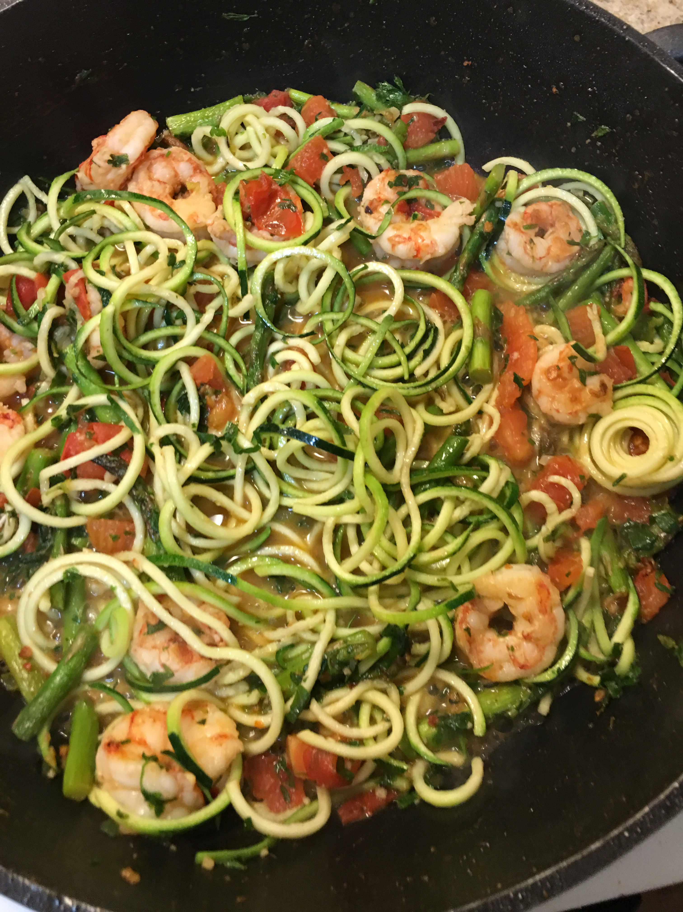
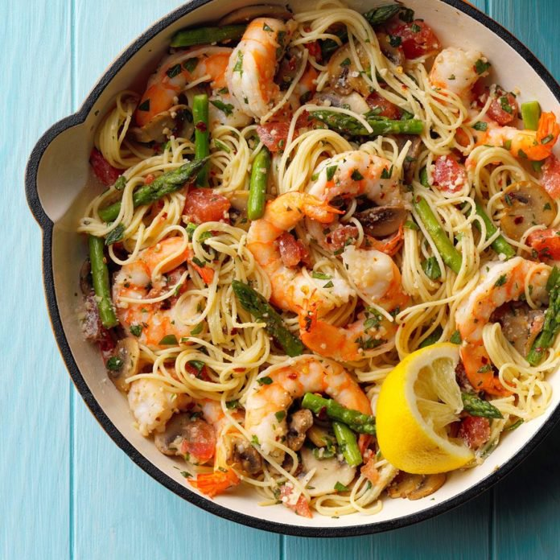
Striking out on your own!
Vacations/holidays
Level 3 eating and exercise (80%)
Maintaining on your own

Slide 16
What are other options?
GCC employees have LOTS of resources and discounts through insurance
Solera
Kaiser Permanente – Healthy Balance
  https://healthy.kaiserpermanente.org/health-wellness/healthy-lifestyle-programs
  www.kp.org/centerforhealthyliving
  www.kp.org/healthybalance
Cigna discounts
3Wins: http://3winsfitness.com/dpp/
OUR Wellness

