Slide 1
Glendale Community College Dual Enrollment
Taking a FREE college class at my high school
Fall 2018

Slide 2
What is Dual Enrollment?
High school students take college classes
College classes are offered at the high school site
Students receive college credit from GCC
Students can receive high school credit
(please check with your school district)
GCC waives all fees for students
Books and supplies are the responsibility of the student. With some classes, books may be provided by the K-12 District.
www.glendale.edu/DualEnrollment

Slide 4
Fall 2018 Class offerings at High Schools
Find class listings at www.Glendale.edu/dual
(note: Students need a 2.0 cumulative high school GPA to enroll except for classes with an asterisk*)

Slide 5
STEP 1:
GCC Application

Slide 6
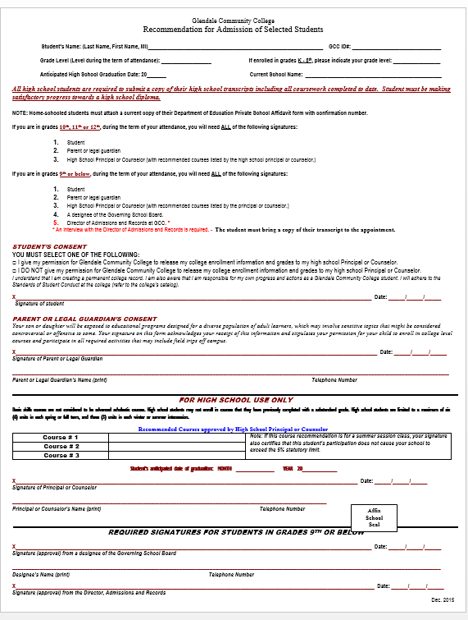
STEP 2:
FORMS
FORM #1 Recommendation for Admission of Selected Students

Slide 7
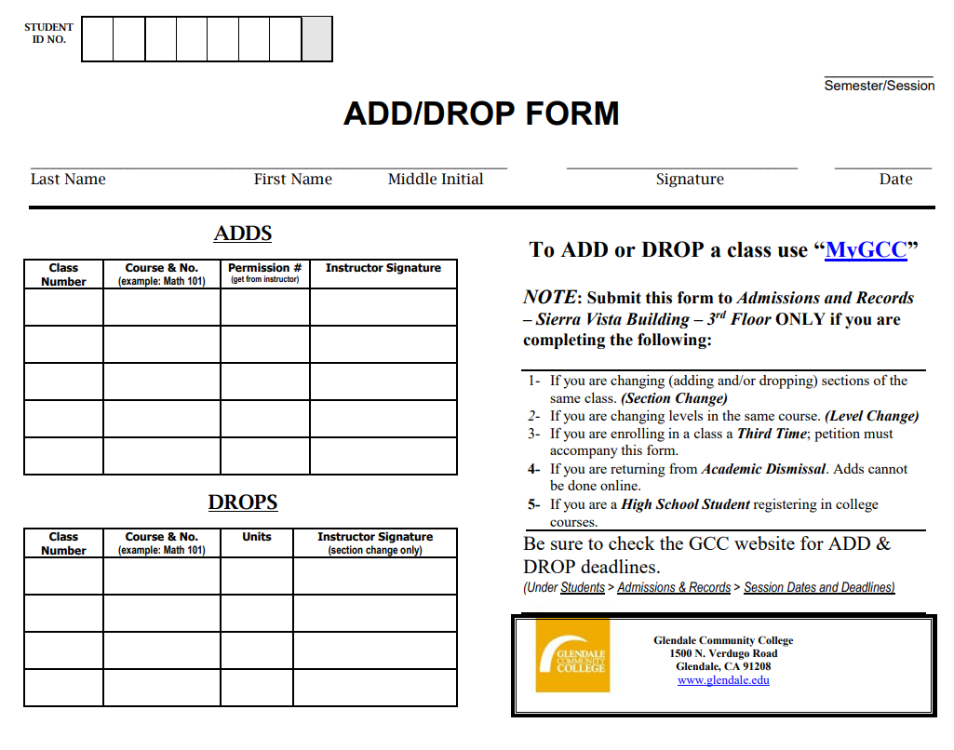
FORM #2
ADD FORM
NOTE: Add forms will be given to students at the information session and on the first day of class only if you have a completed application packet.

Slide 8
FORM #3
Authorization and Consent for Treatment of a Minor

Slide 9
FORM #4
High School Transcript reflecting cumulative GPA
(from high school counselor)

Slide 10

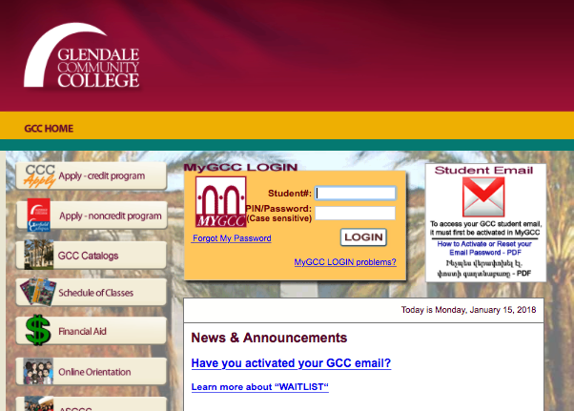
ACTIVATE
MyGCC --Student Portal
www.Glendale.edu
Log in with your ID number. The first time you log in, you will use your birthday as 6-digits

Slide 11
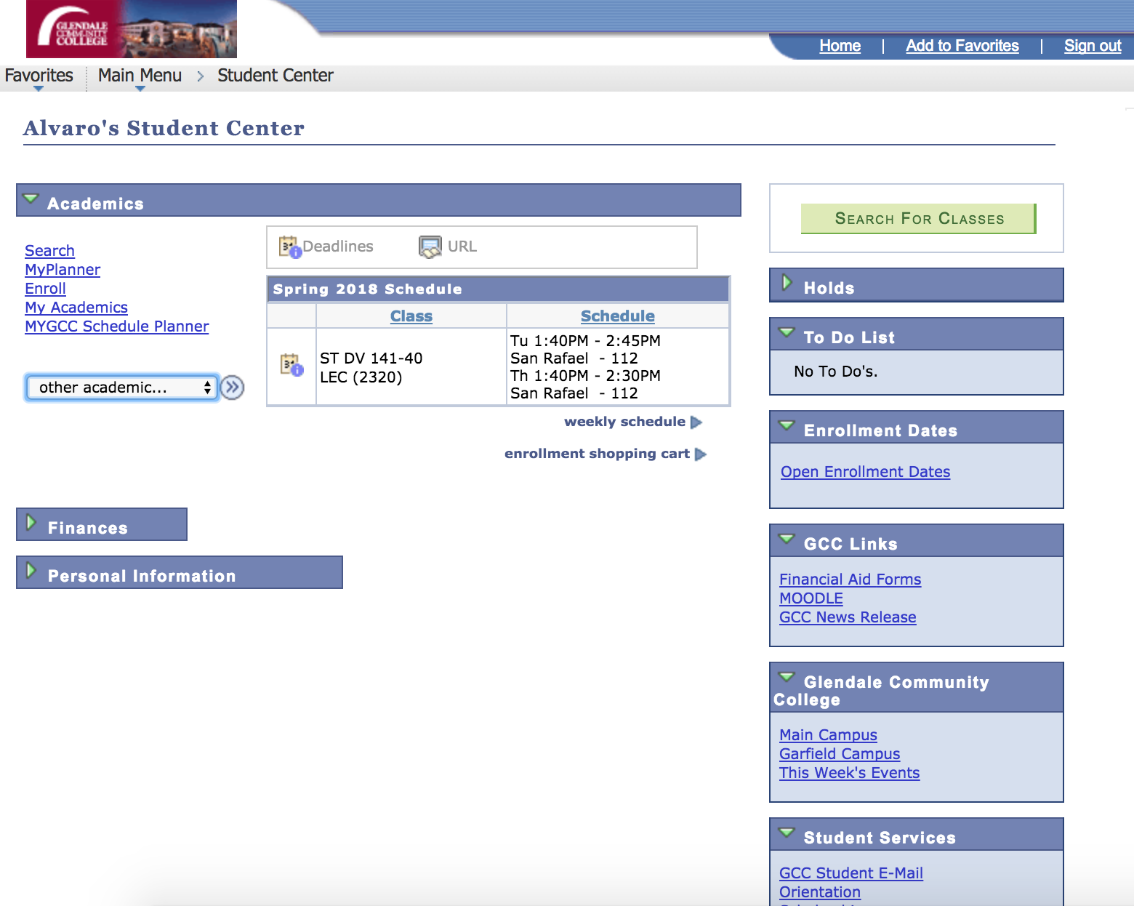

Slide 12
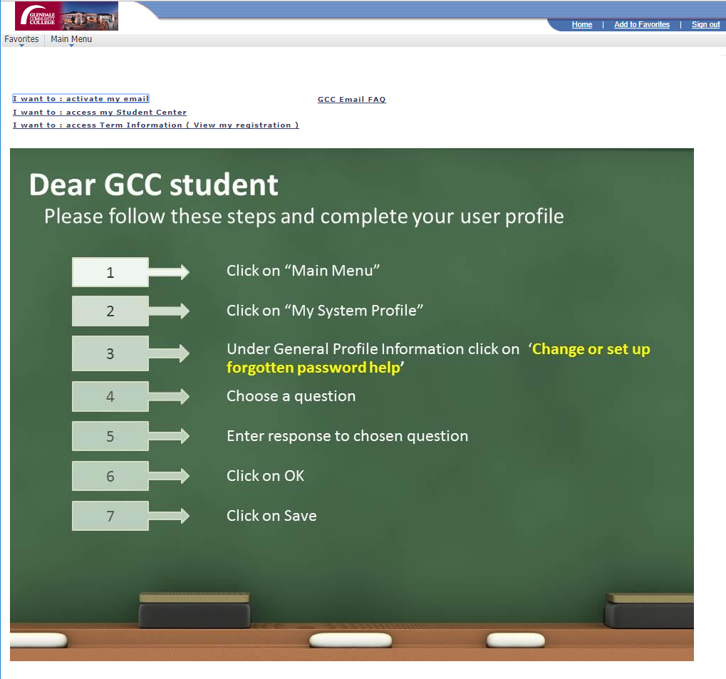
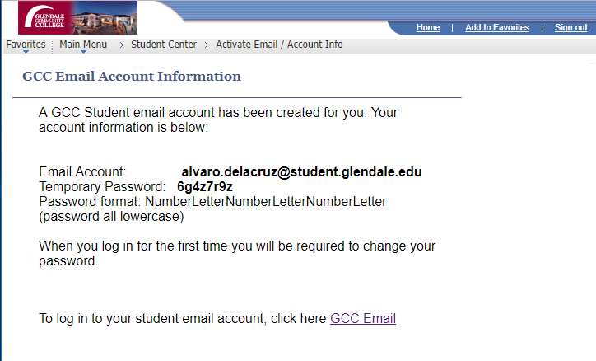
ACTIVATE
GCC EMAIL
www.Glendale.edu/MyGCC
Log in with your ID number. The first time you log in, you will use your birthday as 6-digits
You Can:
  Drop classes
  Access your grades
  Plan classes for the future

Slide 13
FERPA
FAMILY EDUCATIONAL RIGHTS AND PRIVACY ACT (FERPA) is a federal law that protects the privacy of personally identifiable information contained in a student's educational record.
Communication in regards to class and grades CAN ONLY happen between the professor and the student.
Students need to turn in their own forms to enroll in the class.
Students can access their information (grades, schedule, etc.) through MyGCC, the student portal.
Reference http://www2.ed.gov/policy/gen/guid/fpco/ferpa/index.html

Slide 14
Glendale College Student Conduct Policy
Class Syllabus is a students contract
The syllabus will outline course expectations and instructor’s policies in regards to conduct, classroom behavior and academic honesty.
Please be respectful of classroom, as we are borrowing a teacher’s classroom after school. All incidents will be reported by instructor.
This is a Glendale College class, all student conduct rules apply.
Please refer to GCC’s student conduct policy at http://www.glendale.edu/studentconduct

Slide 15
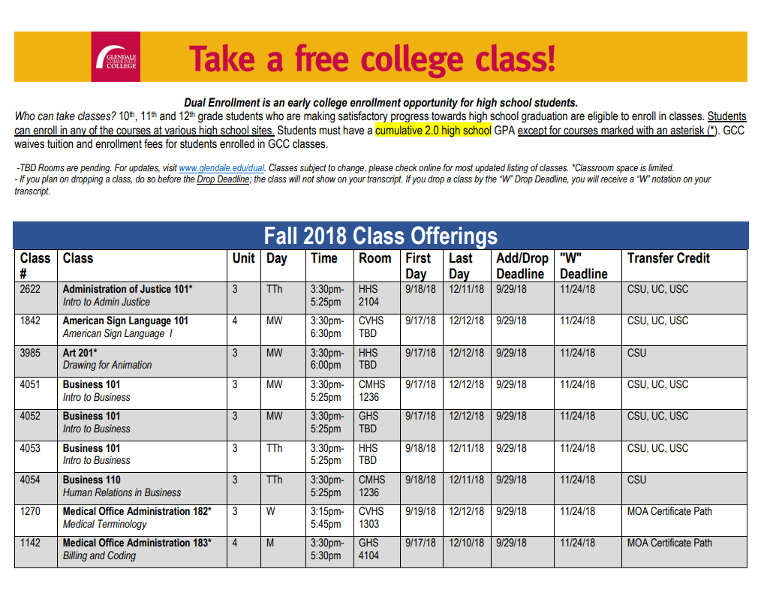
Drop Deadlines
Be aware of deadlines to
DROP your college
class
  Drop Deadline for class
  (Listed on Flyer and online)
  Withdraw deadline
  (Listed on Flyer and online))
  What does it means to
  get a “W”?

Slide 16
Questions and Comments?
(818) 240-1000 x4767
Dual@Glendale.edu

