Slide 1

Student Success Scorecard 2017
Edward Karpp
Dean of Research, Planning & Grants
Board of Trustees Retreat – August 7, 2017

Slide 2
Scorecard Metrics for 2017
Basic Skills Metrics
  Remedial/ESL
  Transfer Level Achievement (new)
Completion Metrics
  Persistence
  30 Units
  Degree/Transfer Completion
CTE (Career Technical Education) Metrics
  CTE Rate
  Skills Builders (new)
CDCP (Career Development and College Preparation) Rate

Slide 3
Comparisons
Statewide Average
Peer Group Average (New Peer Group for 2017)
  American River, Cabrillo, College of the Canyons, Coastline, Glendale, Lake Tahoe, Monterey, Napa, San Diego City, San Jose City, Santa Rosa, Santiago Canyon, College of the Siskiyous (13 colleges)
Region 7 Average
  Compton, East LA, El Camino, Glendale, LA City, LA Harbor, LA Mission, LA Pierce, LA Southwest, LA Trade Tech, LA Valley, Pasadena, Santa Monica, West LA (14 colleges)

Slide 4
Remedial / ESL Metrics: Definitions
Percentage of basic skills Math/English/ESL students who pass college-level courses
Attempted Math course 2-4 levels below transfer
Passed transferable or associate degree applicable Math course
Attempted English course 1-4 levels below transfer
Passed transferable or associate degree applicable English course
Attempted ESL course
below transfer
Passed associate degree applicable English course
Entry
6 Years

Slide 5
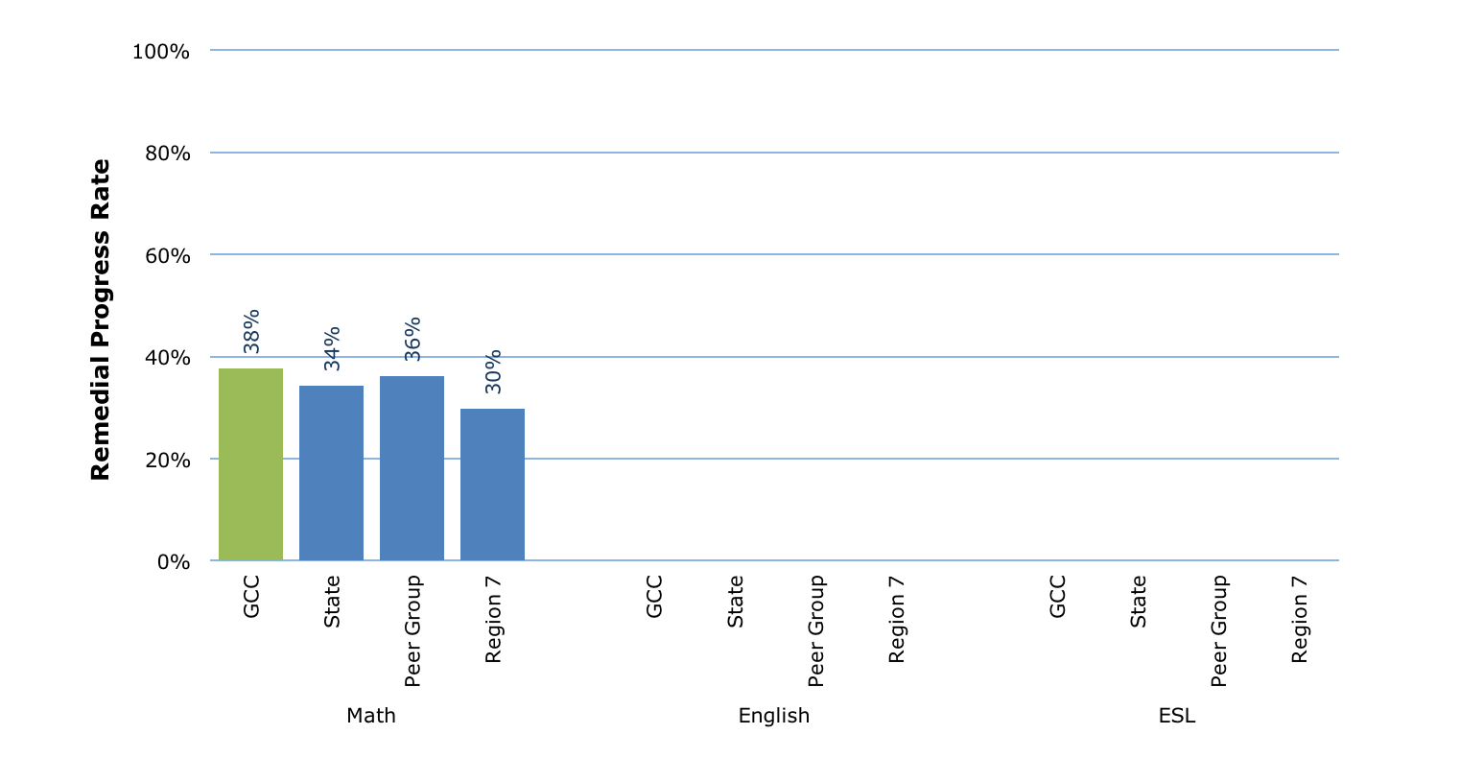
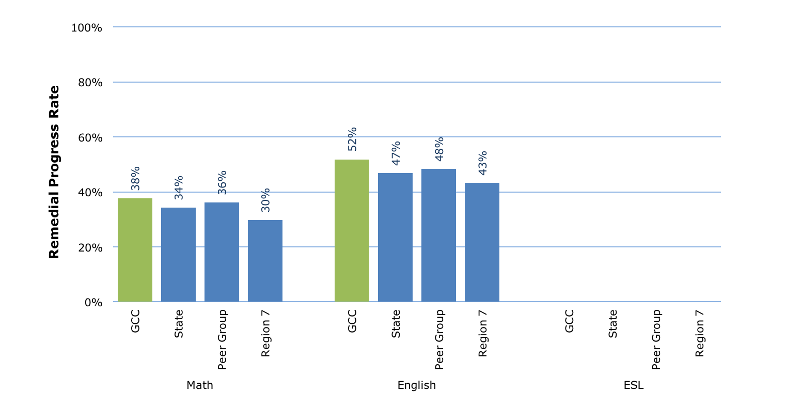
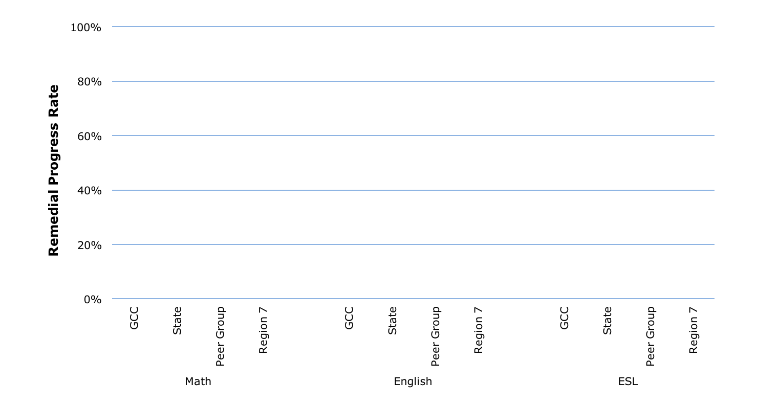
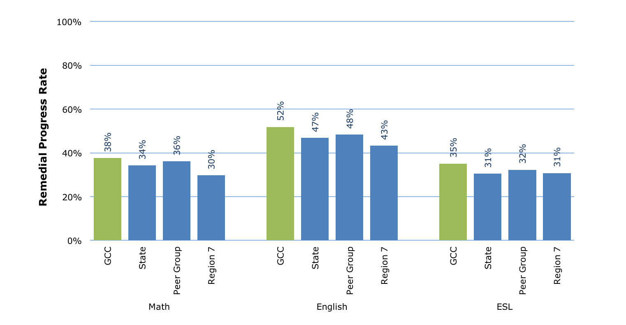
Remedial / ESL Metrics: 2010-11 Cohort
37th in State
3rd in Region
7th in Peer Group
29th in State
3rd in Region
4th in Peer Group
28th in State
6th in Region
4th in Peer Group

Slide 6
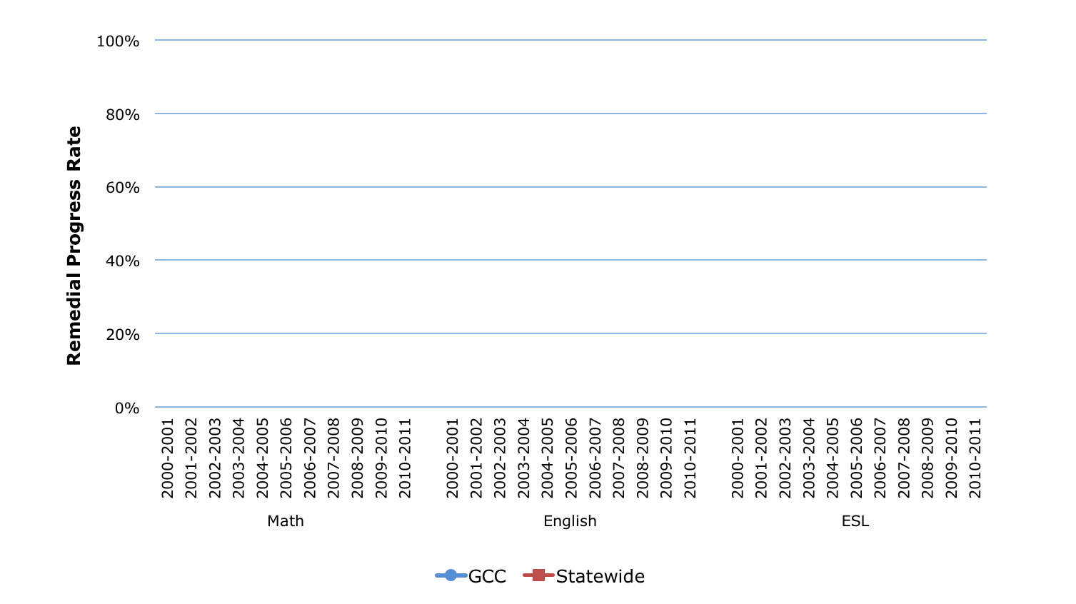
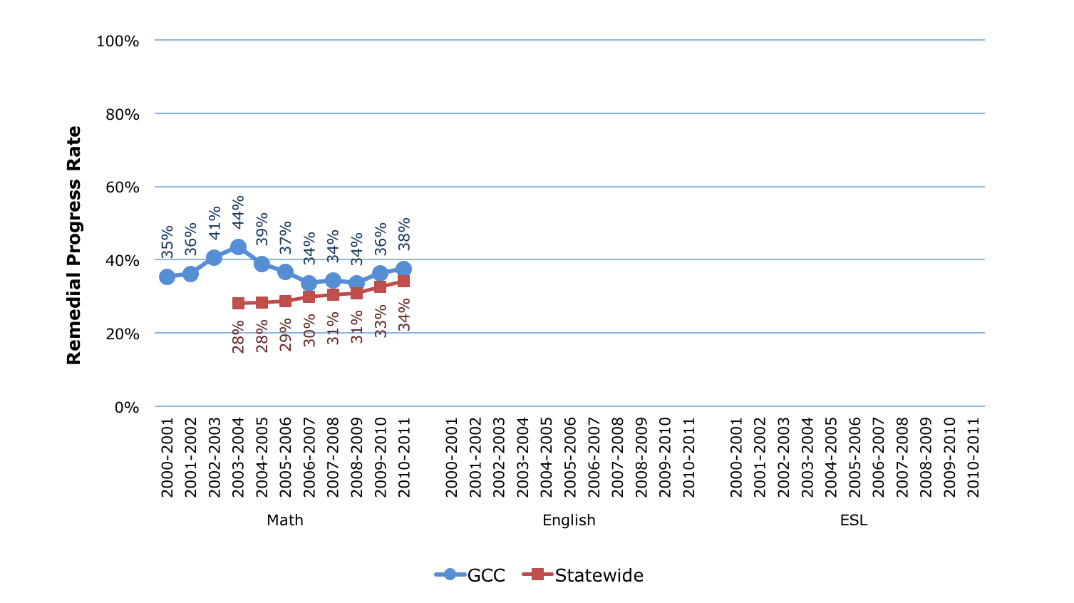
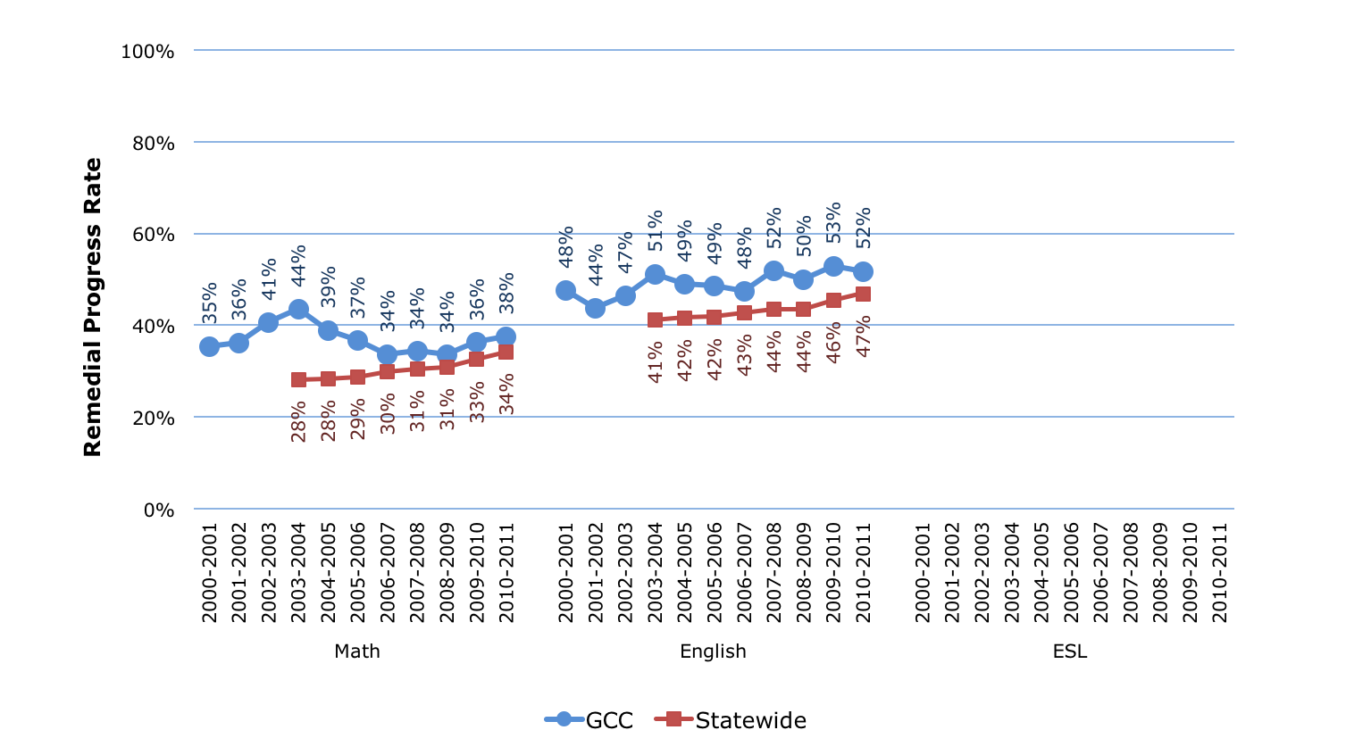
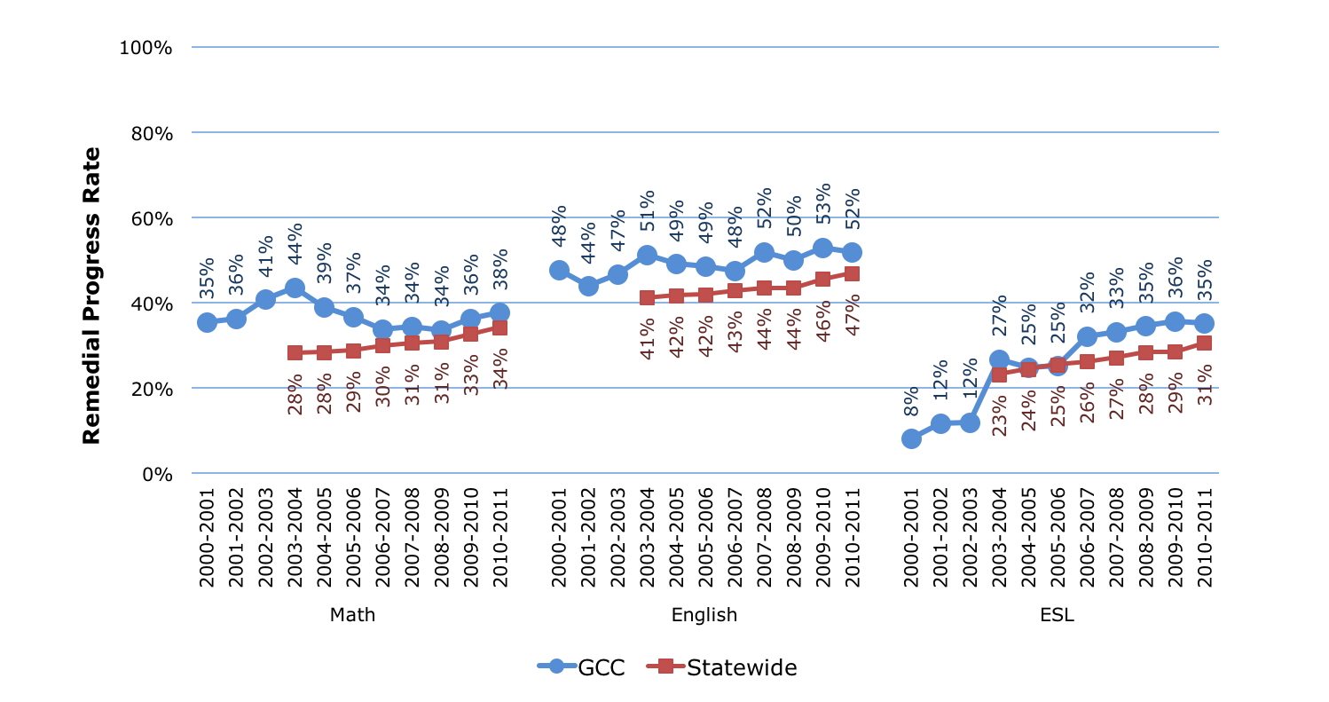
Remedial / ESL Metrics: Trends

Slide 7
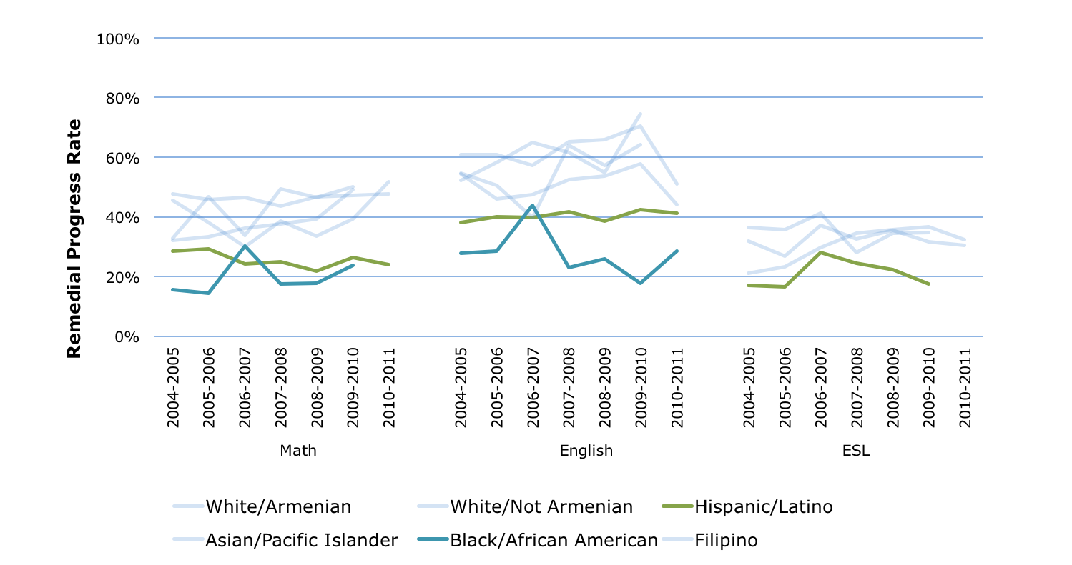
Remedial / ESL Metrics: Gaps
Note: Only data cells with 20 or more students are shown

Slide 8
Transfer Level Achievement: Definitions
Percentage of new students who pass transferable Math and English courses
First-time college students earning 6+ units in first 3 years and attempting Math and English in first year
Passed transferable Math course
Passed transferable English course
Entry
1 Year
2 Years

Slide 9
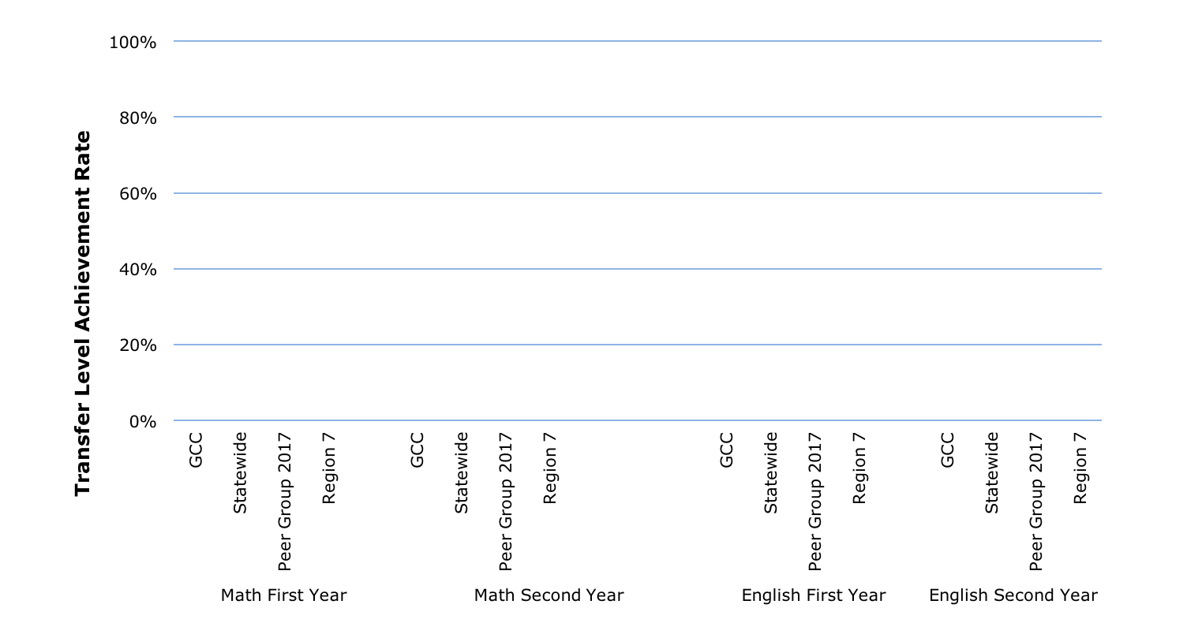
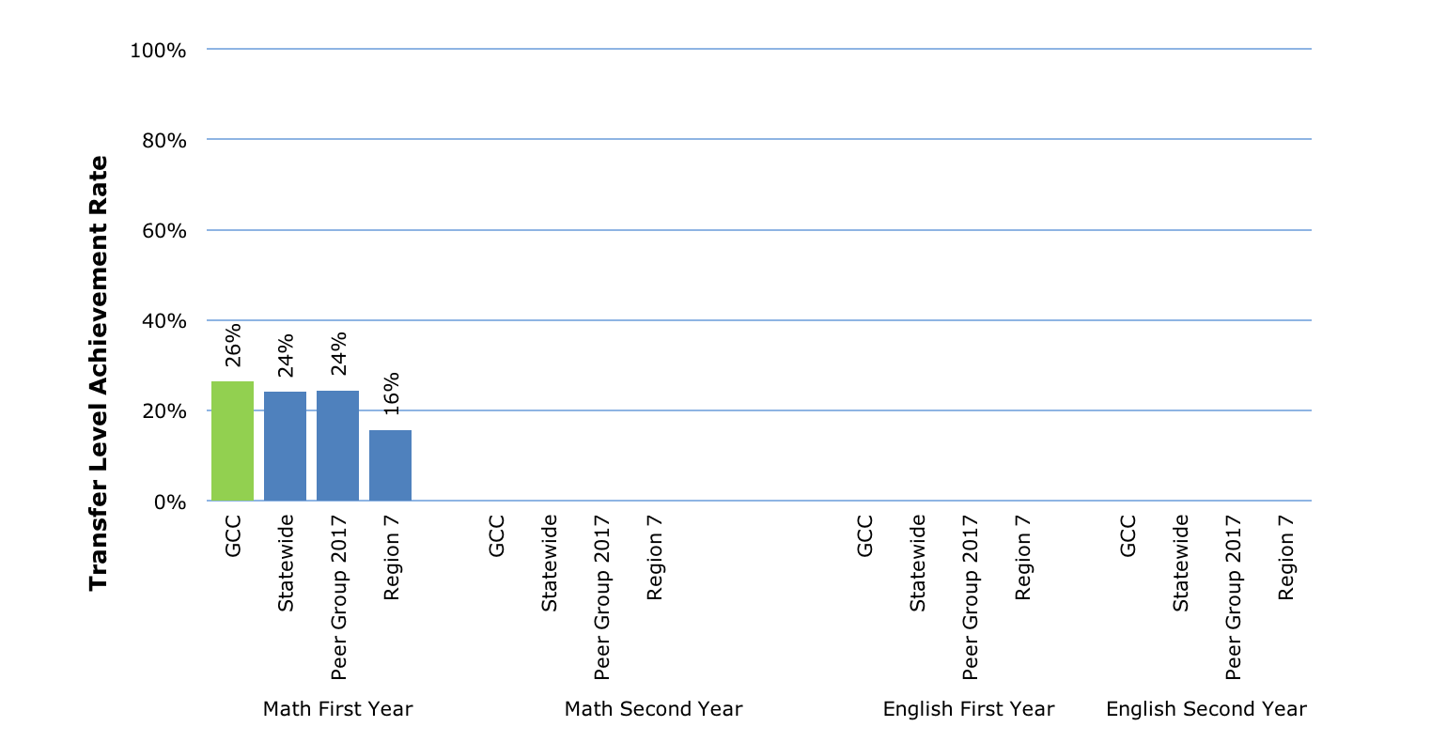
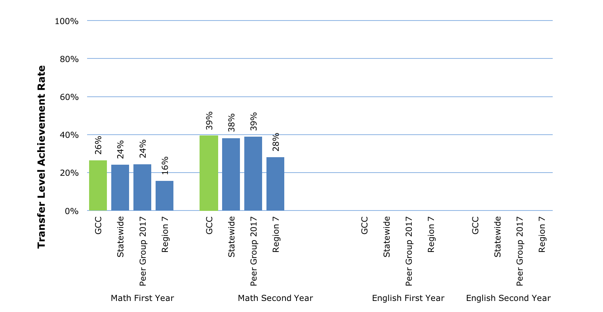
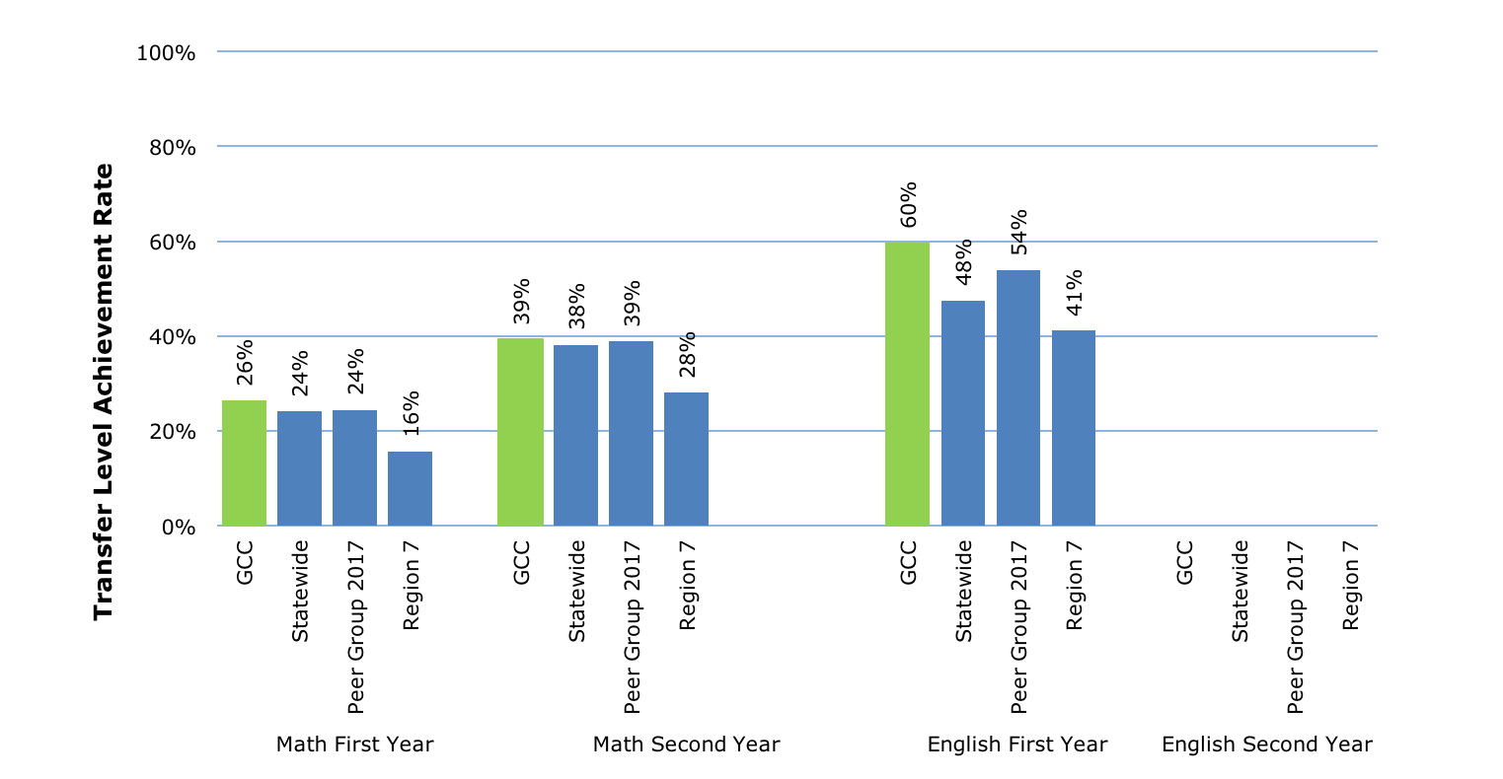
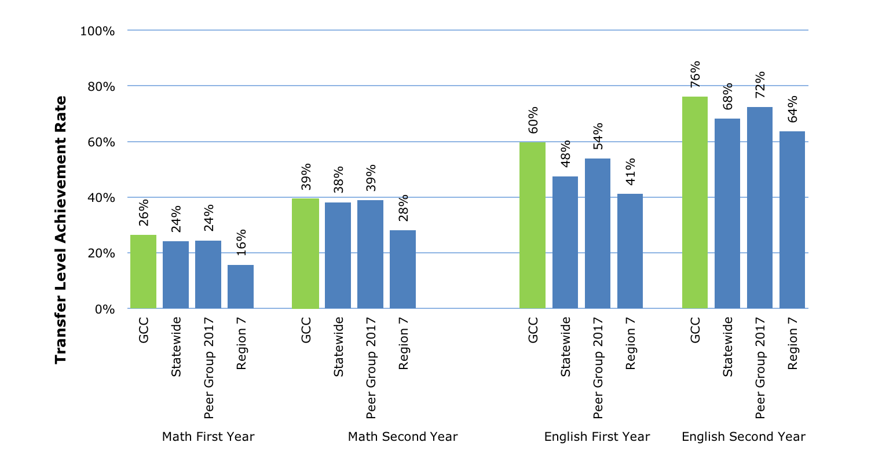
Transfer Level Achievement: 2014-15 Cohort
42nd in State
2nd in Region
7th in Peer Group
49th in State
3rd in Region
7th in Peer Group
22nd in State
2nd in Region
6th in Peer Group
27th in State
3rd in Region
5th in Peer Group

Slide 10
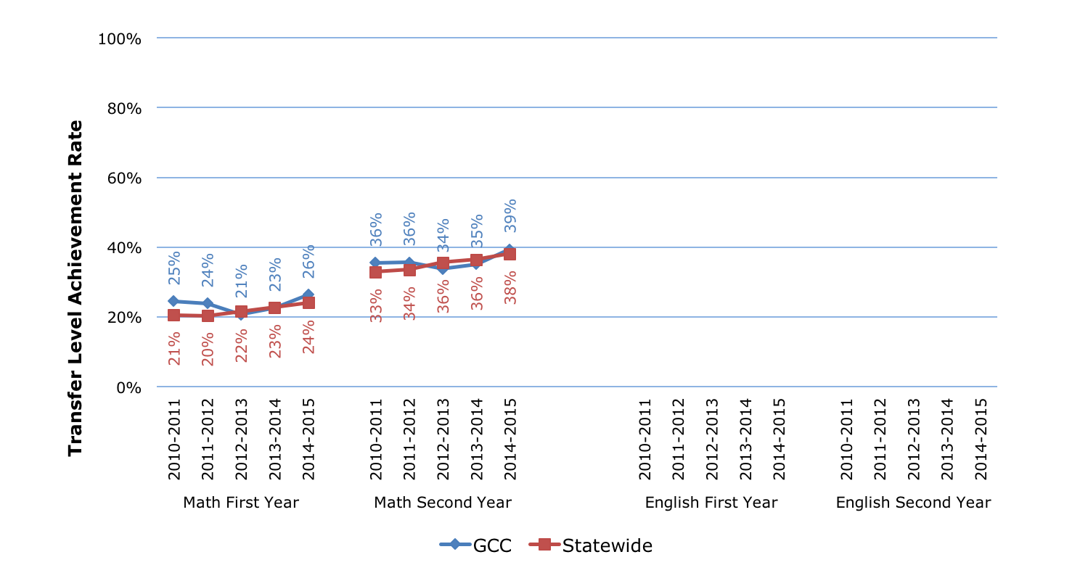
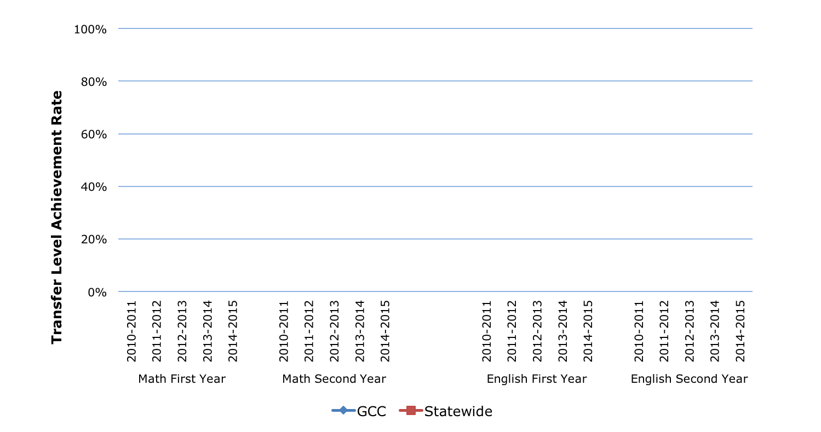
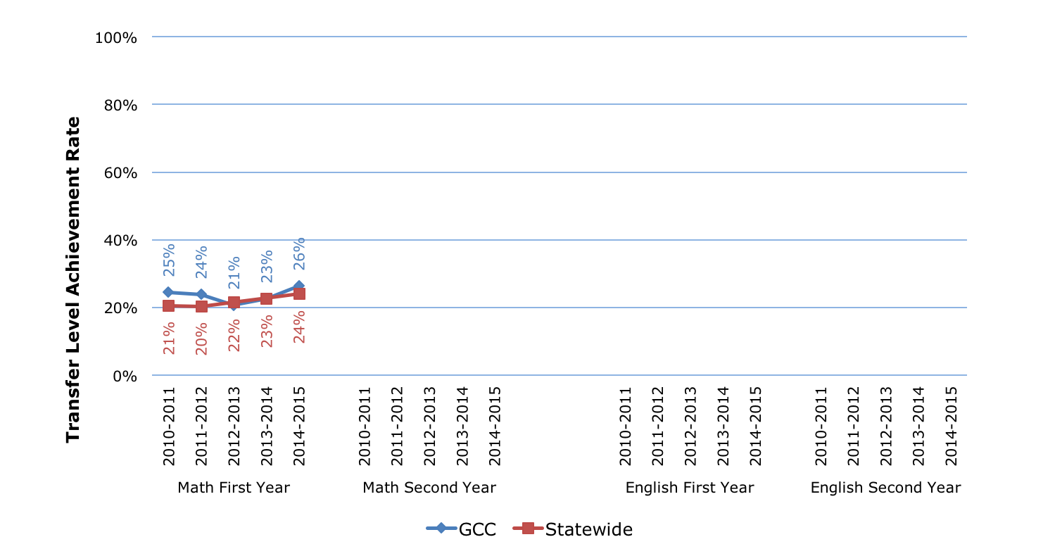
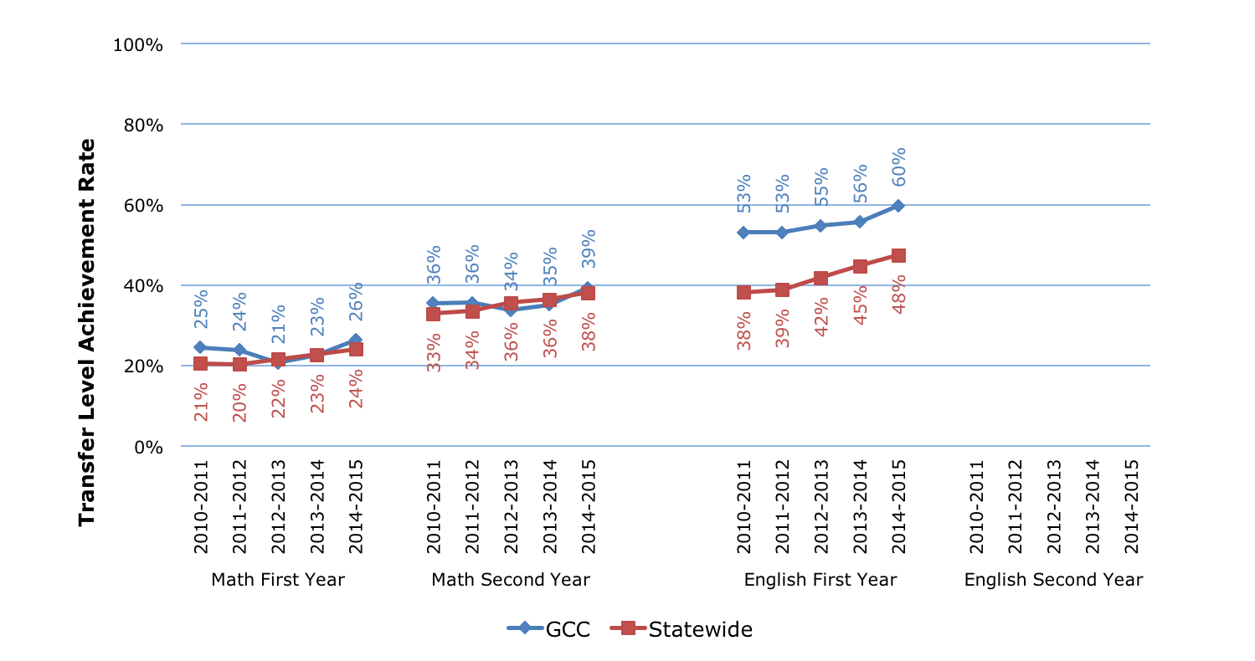
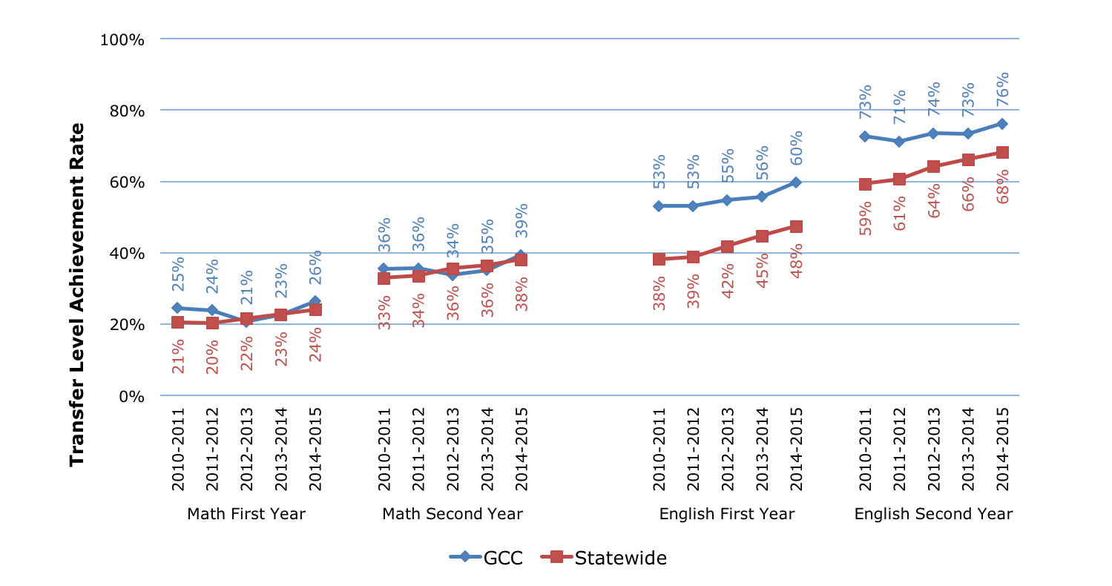
Transfer Level Achievement: Trends

Slide 11
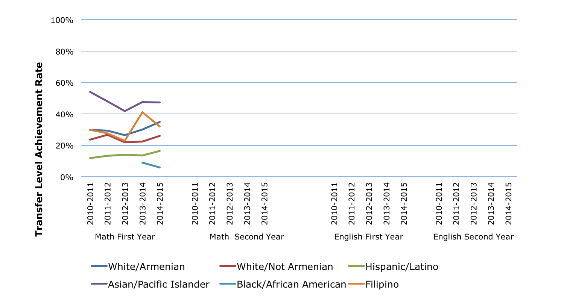
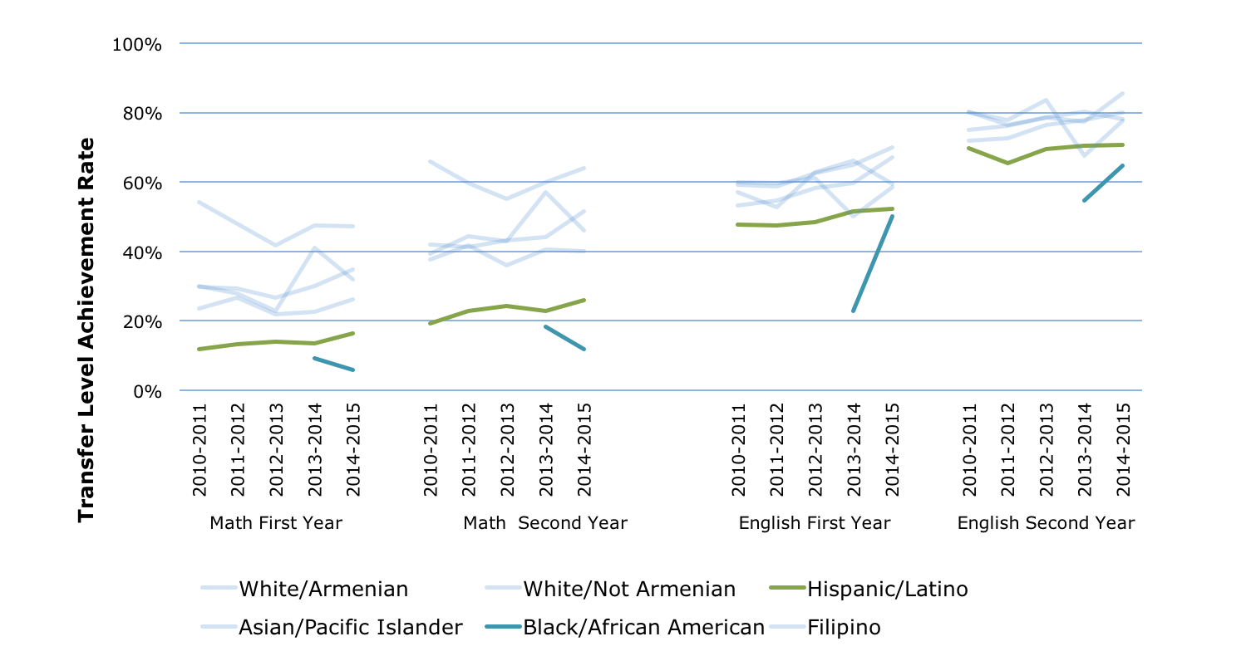
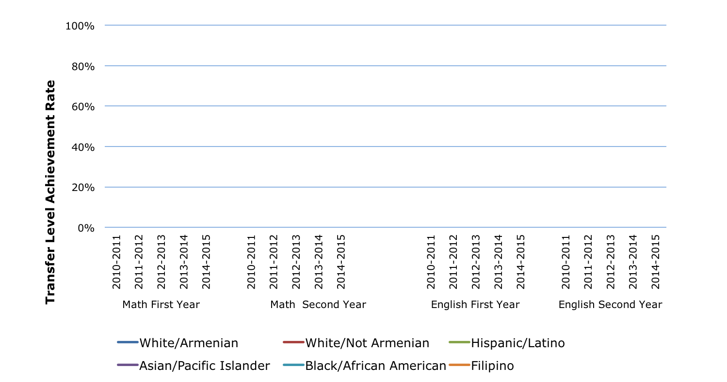
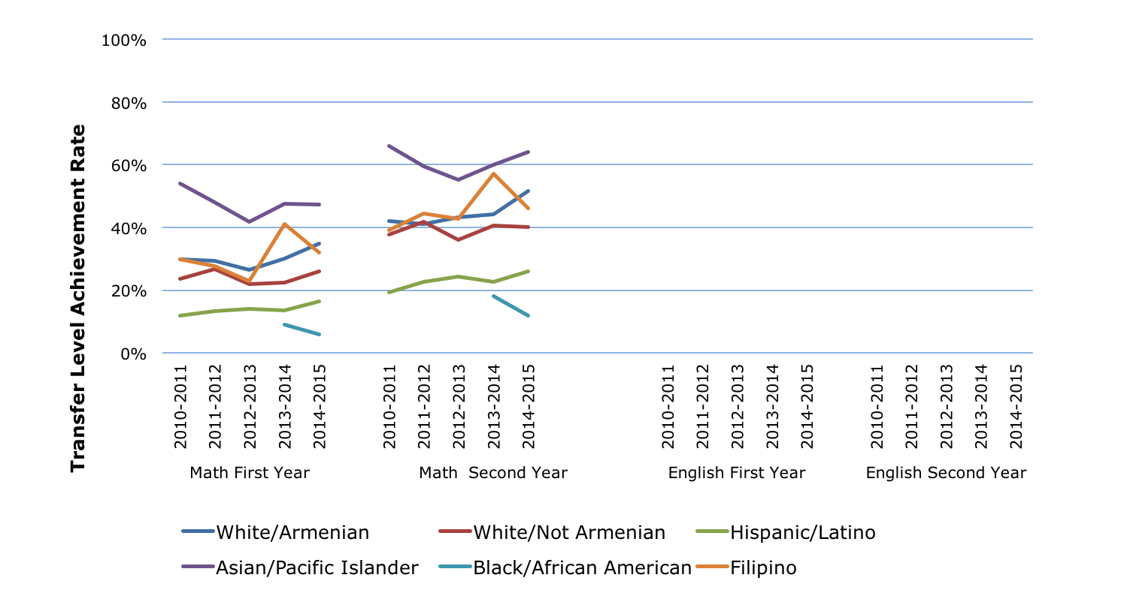
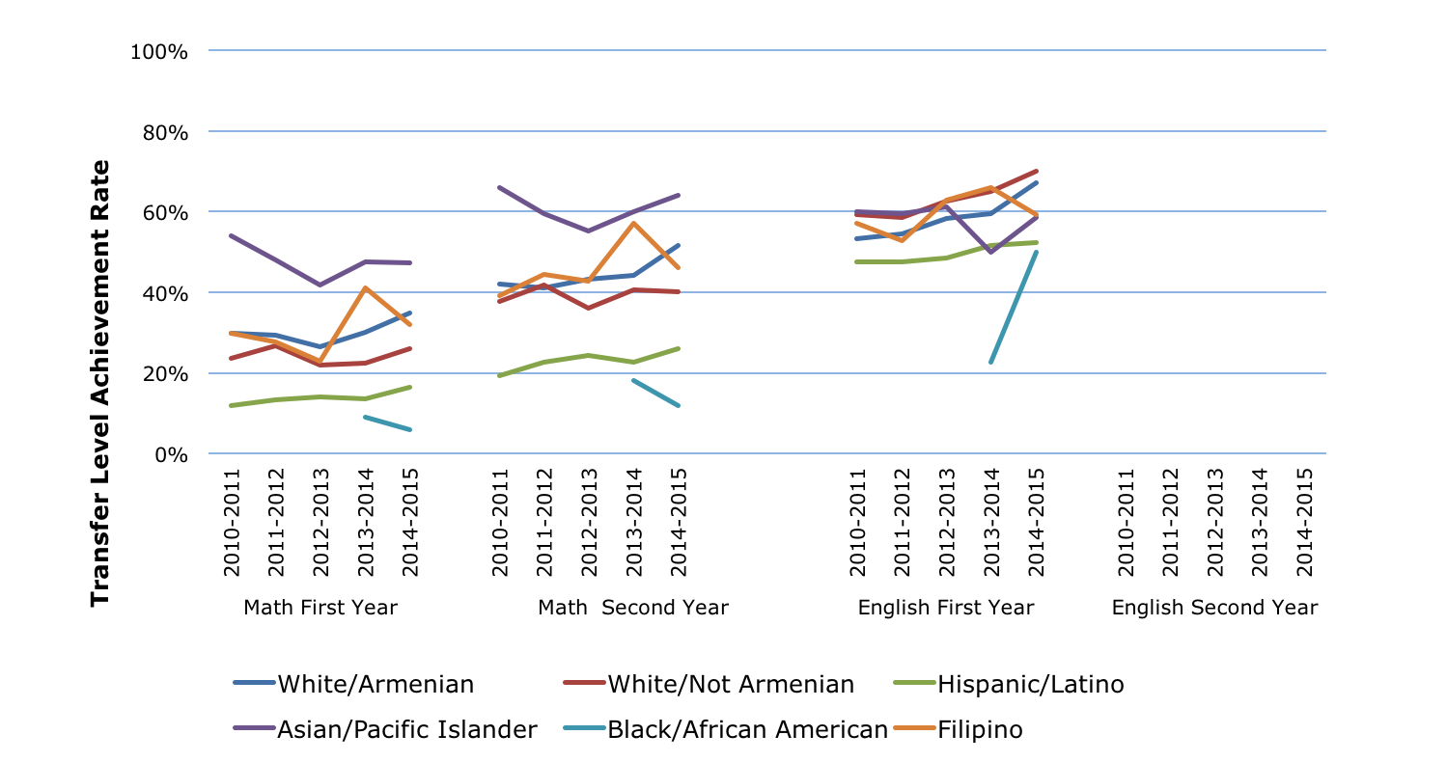
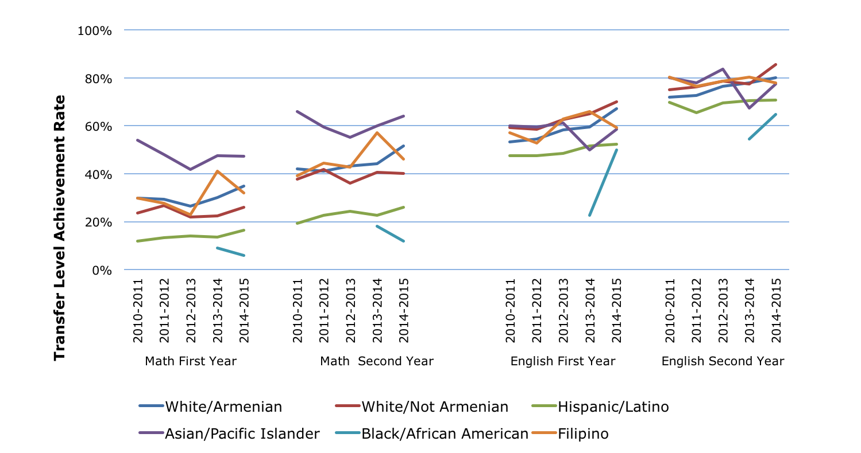
Transfer Level Achievement: Gaps
Note: Only data cells with 20 or more students are shown

Slide 12
Persistence Rate: Definition
Percentage of new students enrolled in three consecutive semesters
First-time college students earning 6+ units in first 3 years and attempting Math or English in first 3 years
Overall
Prepared Students*
Unprepared Students*
Enrolled in credit course during three consecutive primary terms (Fall/Spring)
Entry
3 Semesters
* Prepared students’ first English course was transferable and first Math course was transferable or associate degree applicable.

Slide 13
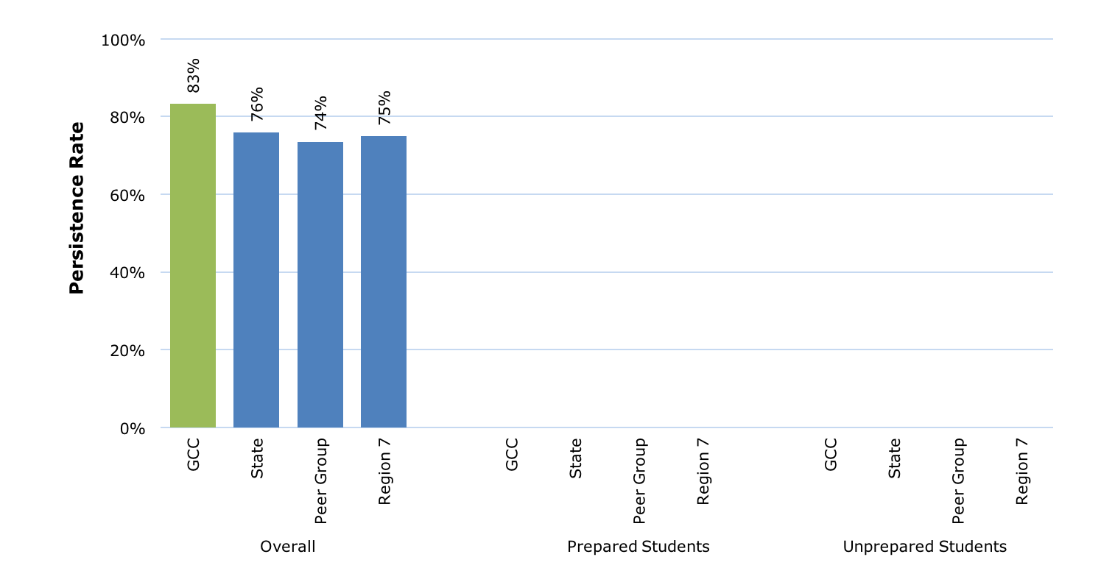
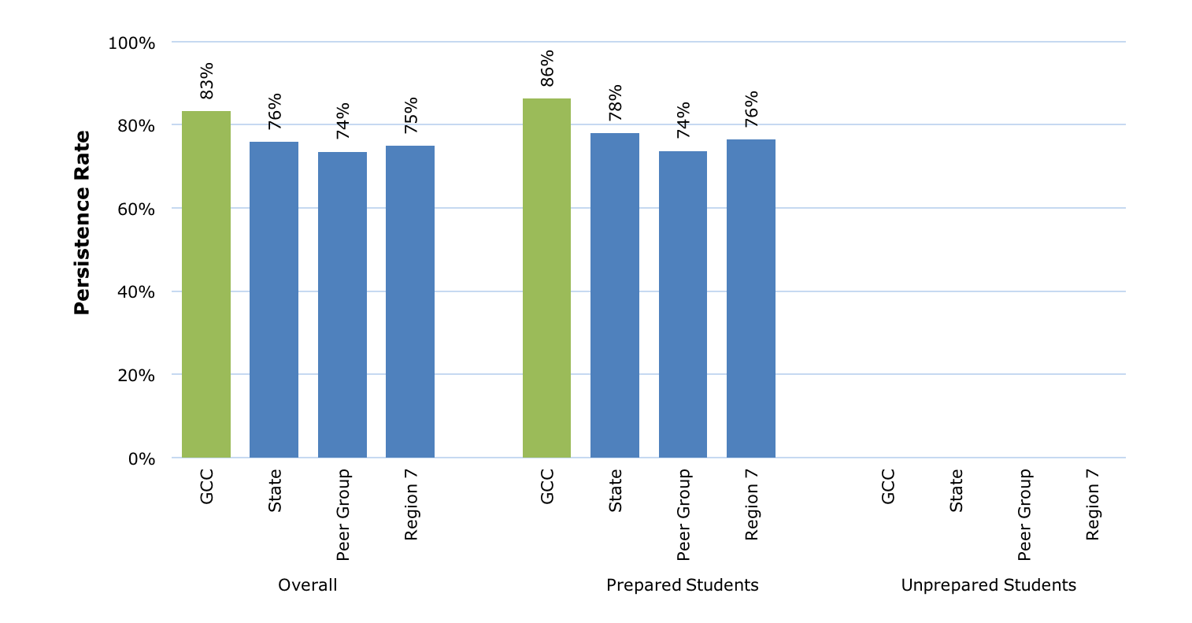
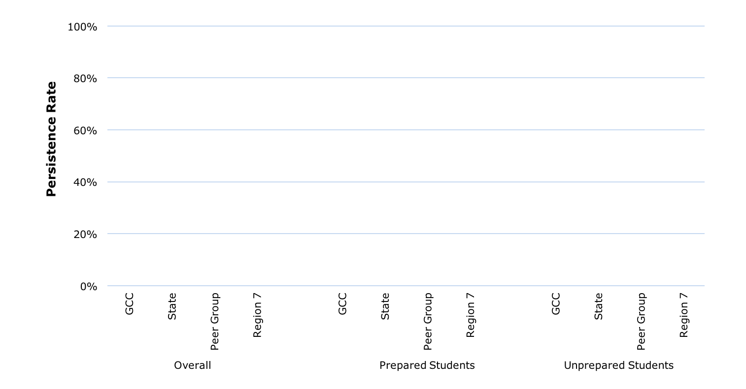
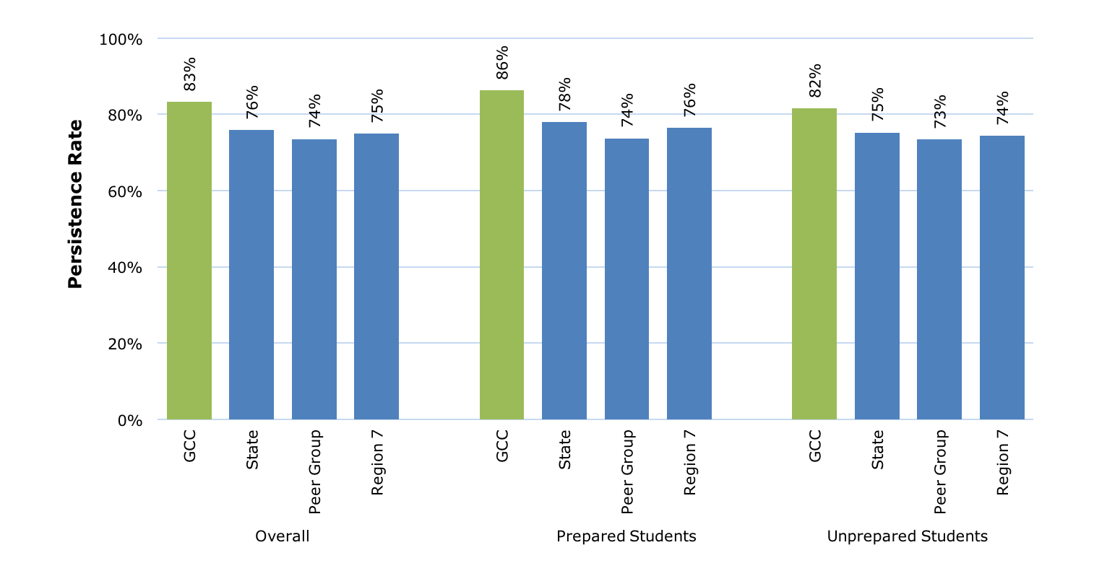
Persistence Rate: 2010-11 Cohort
6th in State
2nd in Region
1st in Peer Group
5th in State
2nd in Region
1st in Peer Group
8th in State
2nd in Region
1st in Peer Group

Slide 14
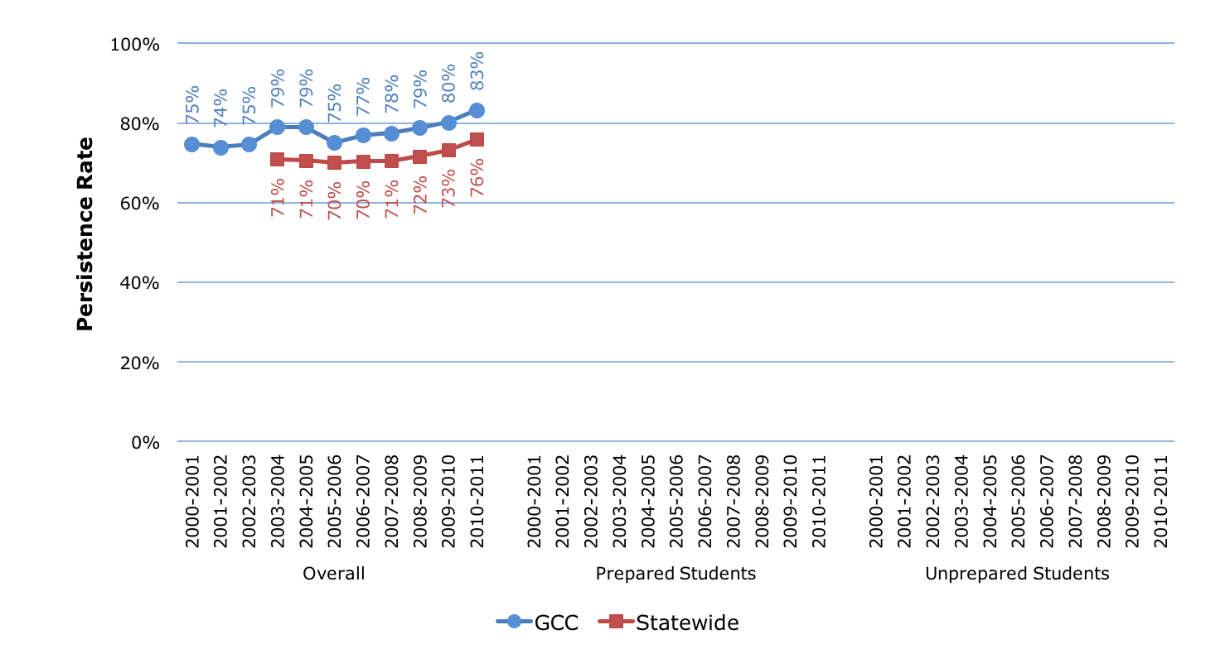
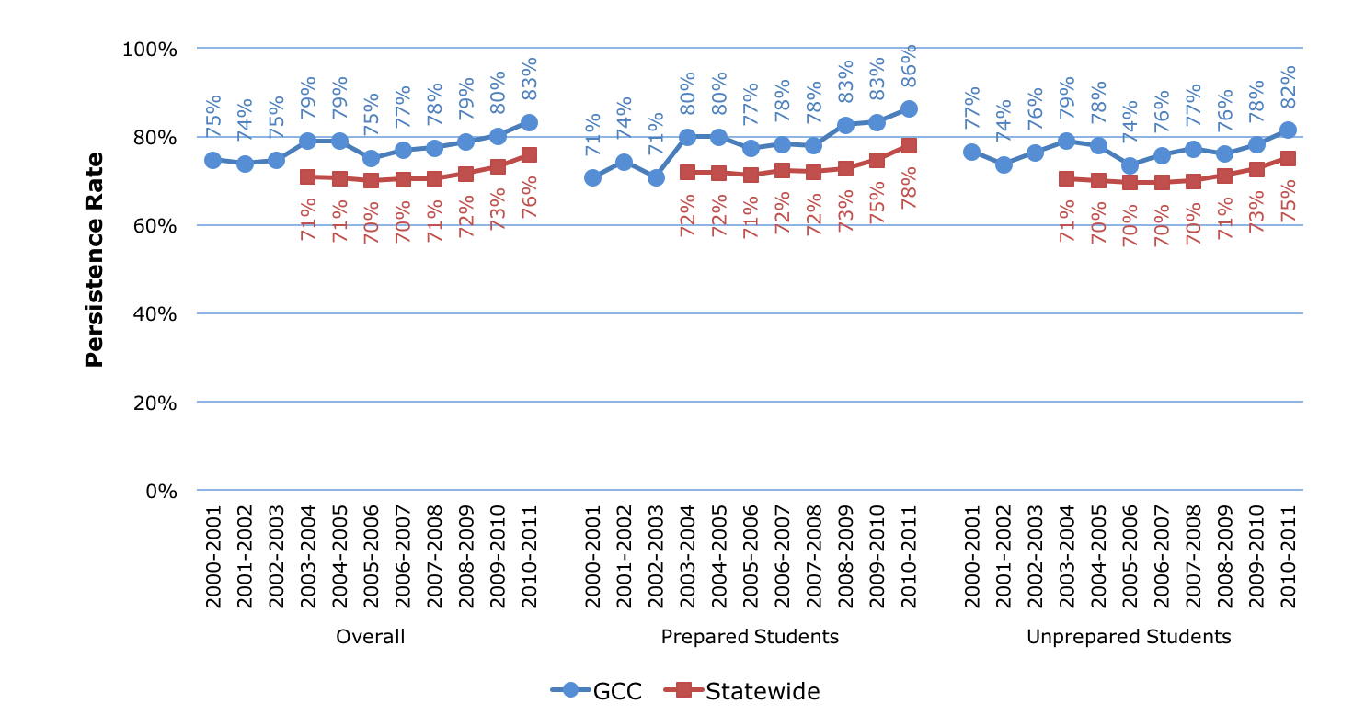
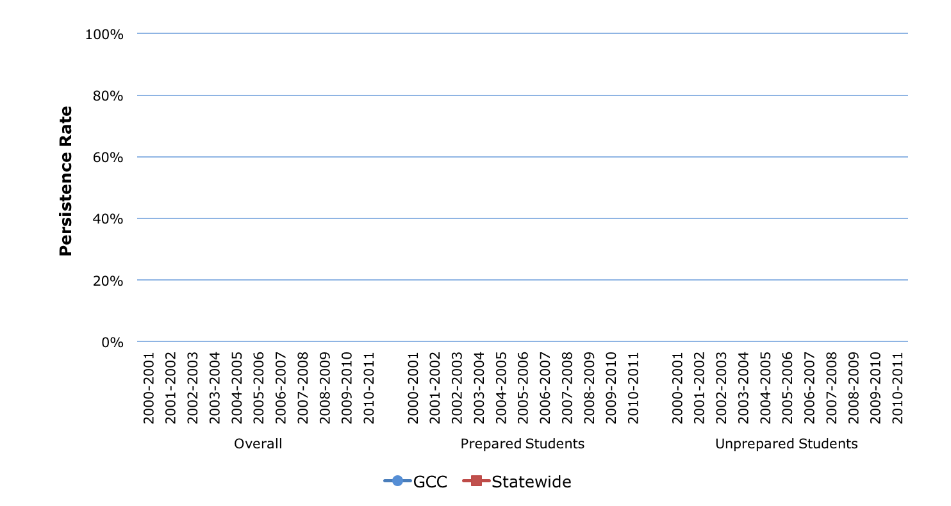
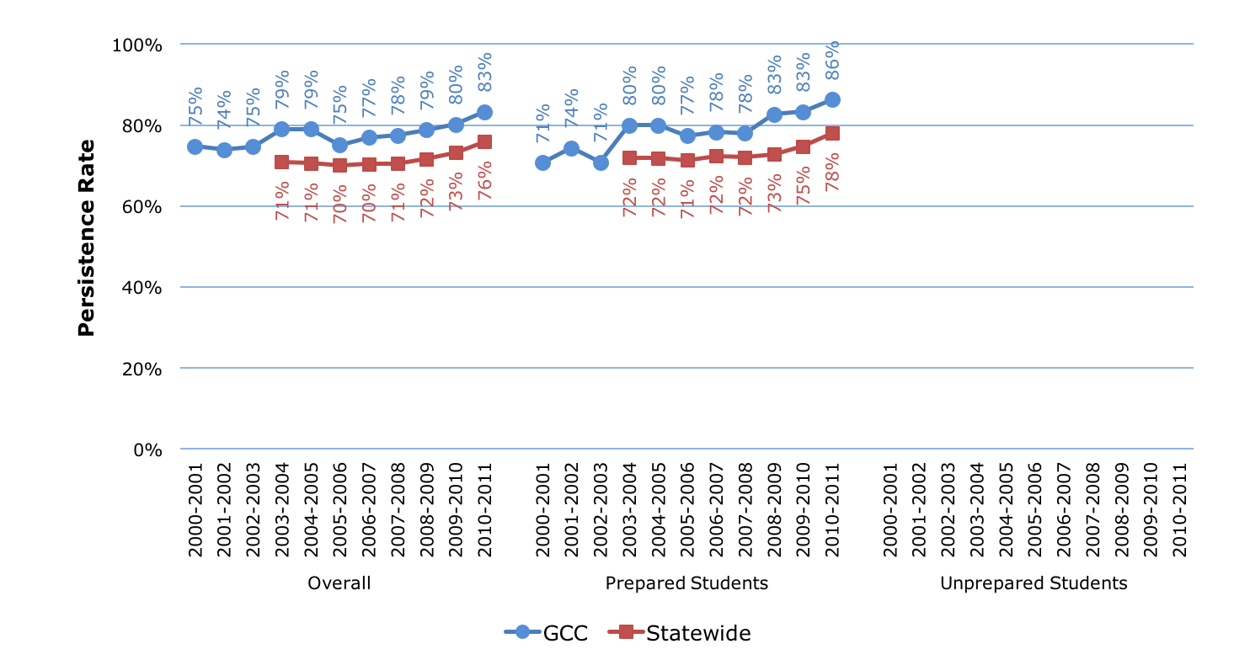
Persistence Rate: Trends

Slide 15
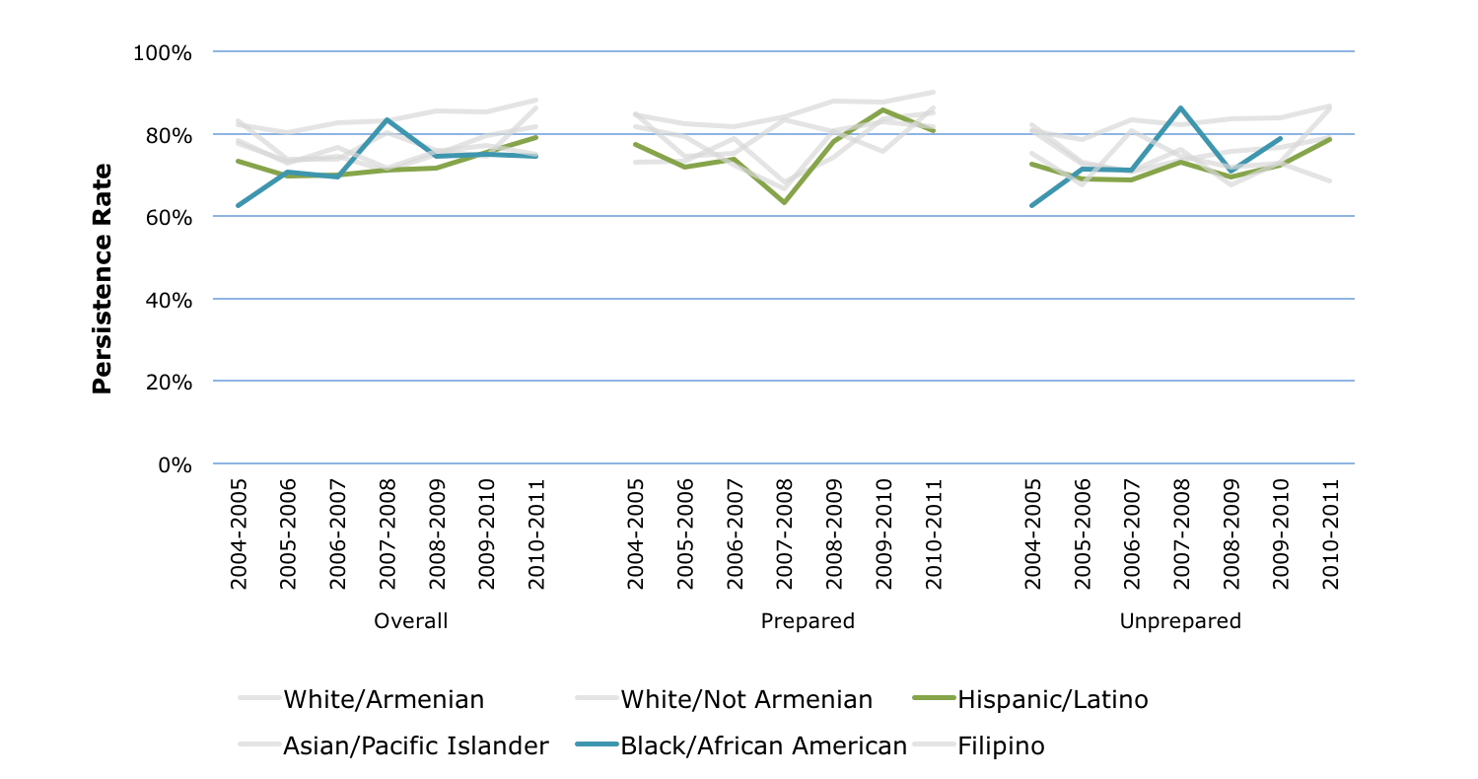
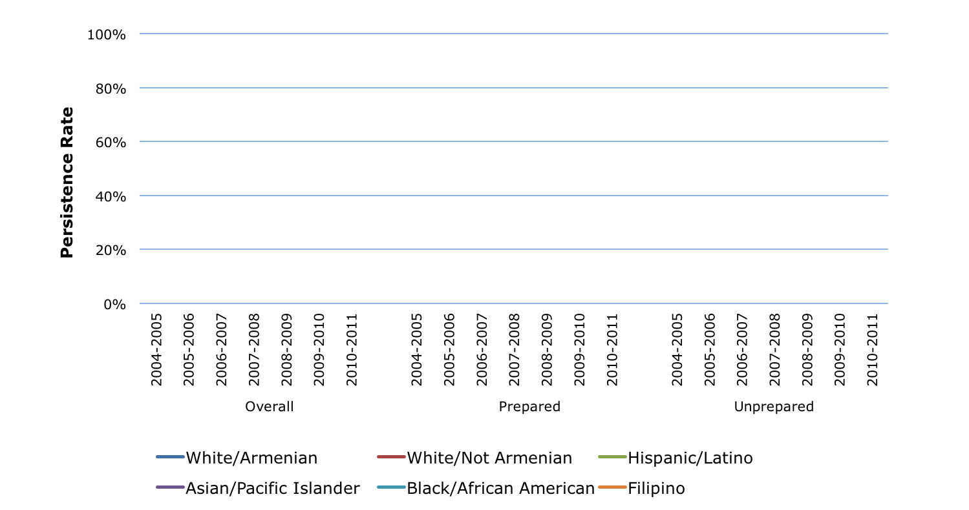
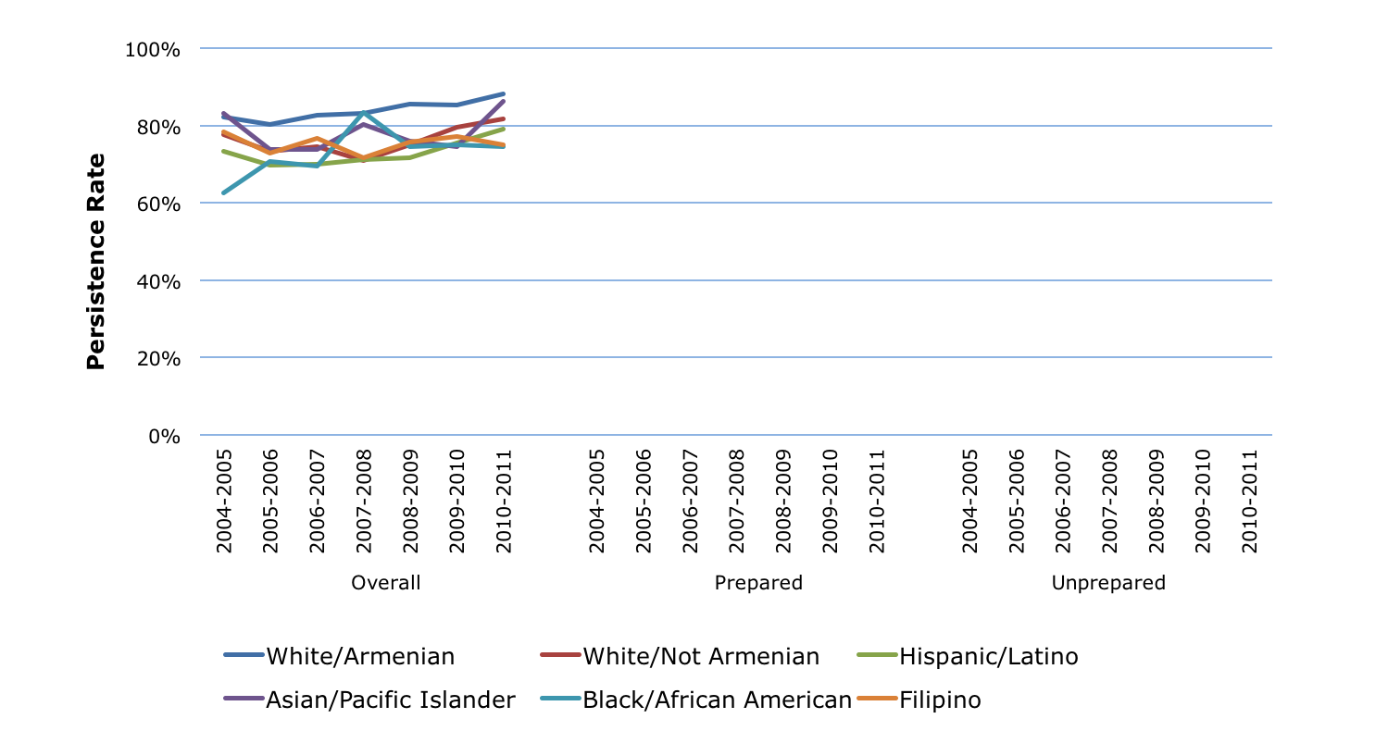
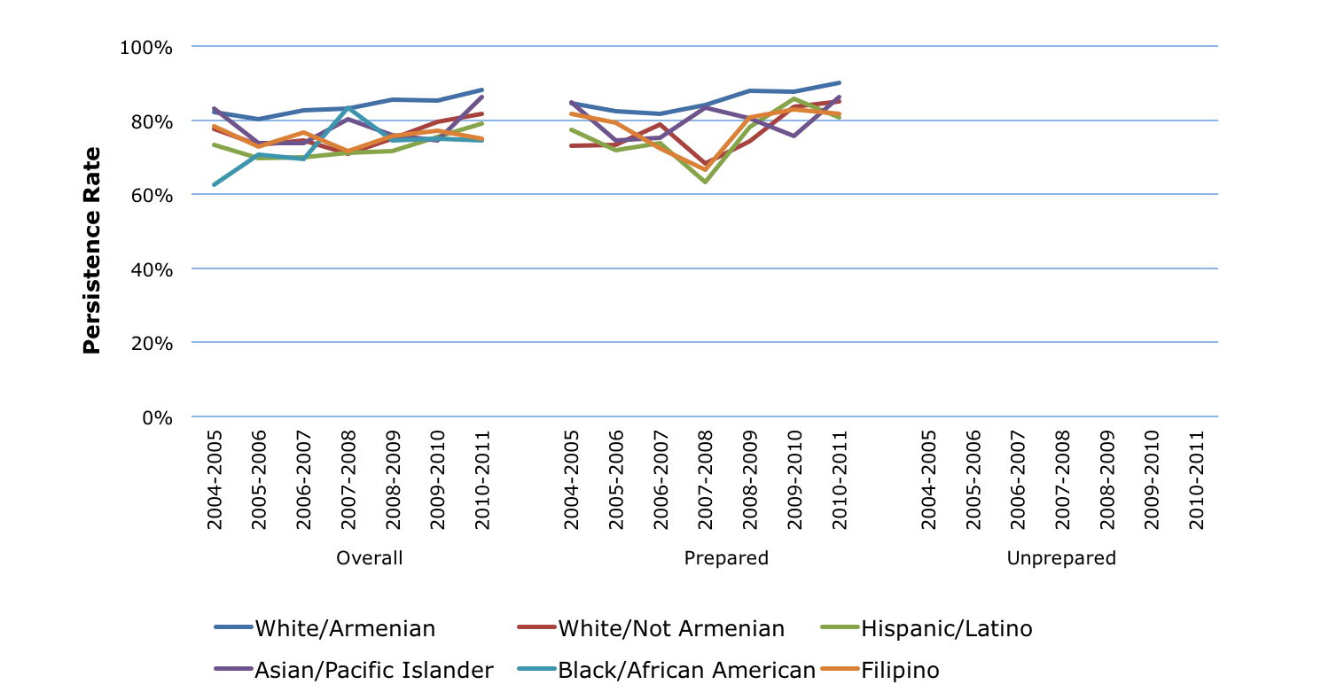
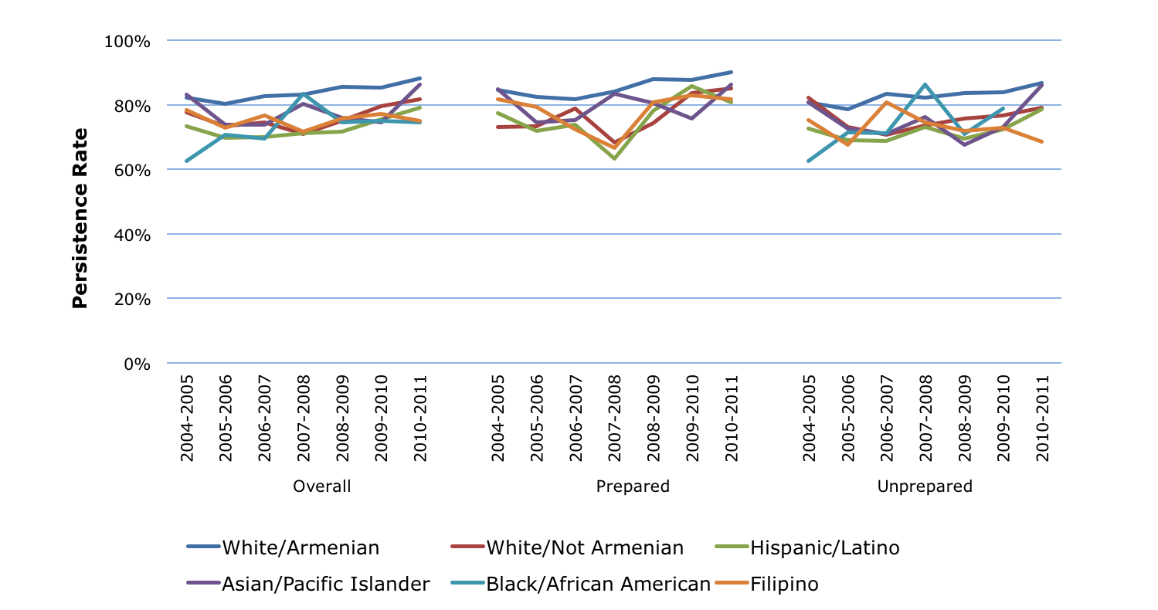
Persistence Rate: Gaps
Note: Only data cells with 20 or more students are shown

Slide 16
30 Unit Rate: Definition
Percentage of new students who earn 30 or more units
First-time college students earning 6+ units in first 3 years and attempting Math or English in first 3 years
Overall
Prepared Students*
Unprepared Students*
Earned 30+ units in California community college system
Entry
6 Years
* Prepared students’ first English course was transferable and first Math course was transferable or associate degree applicable.

Slide 17
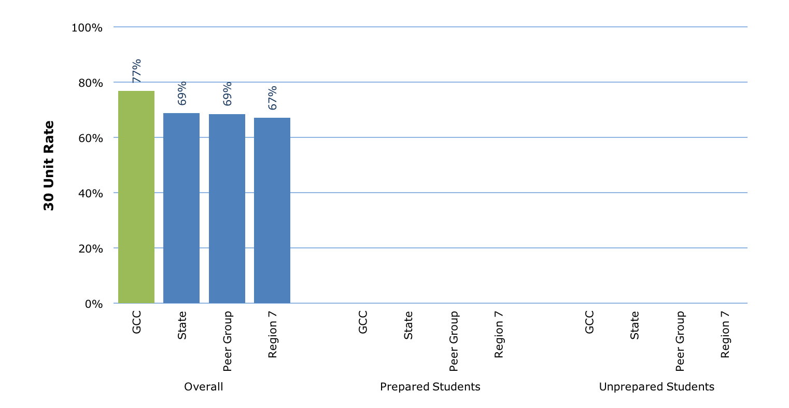
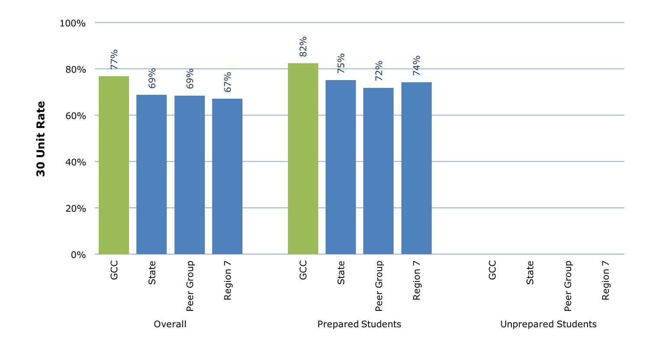
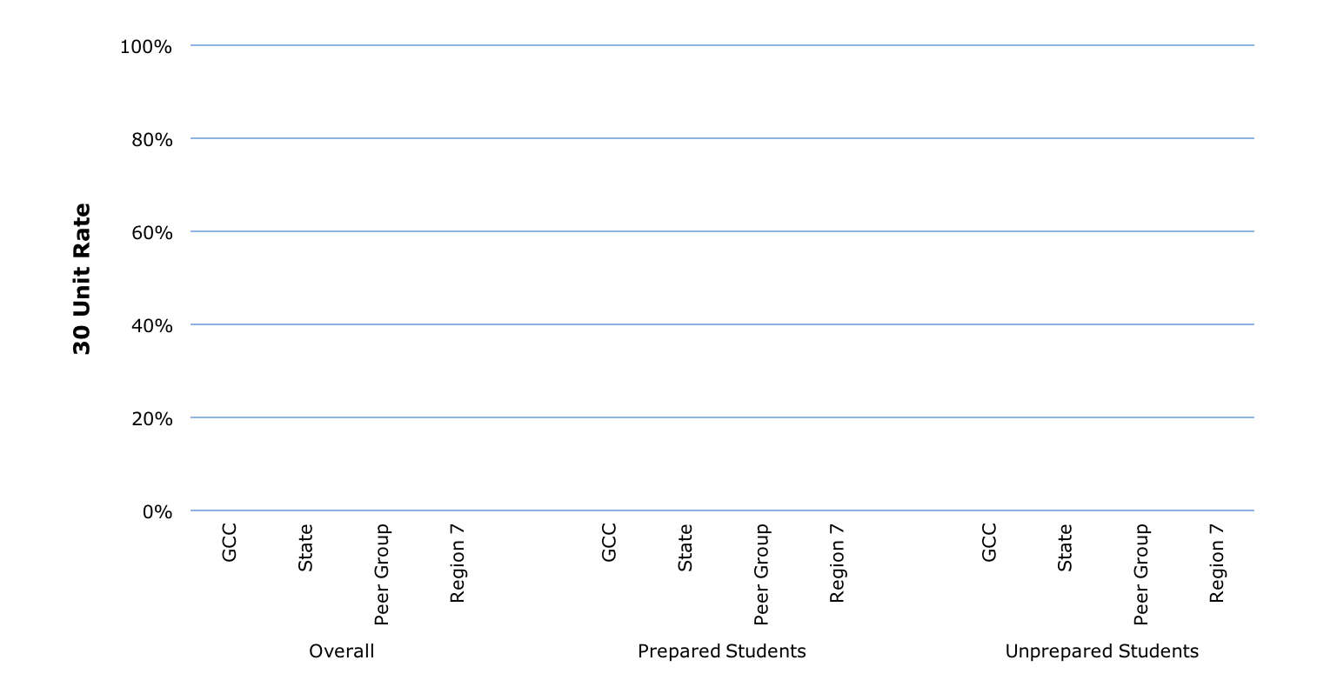
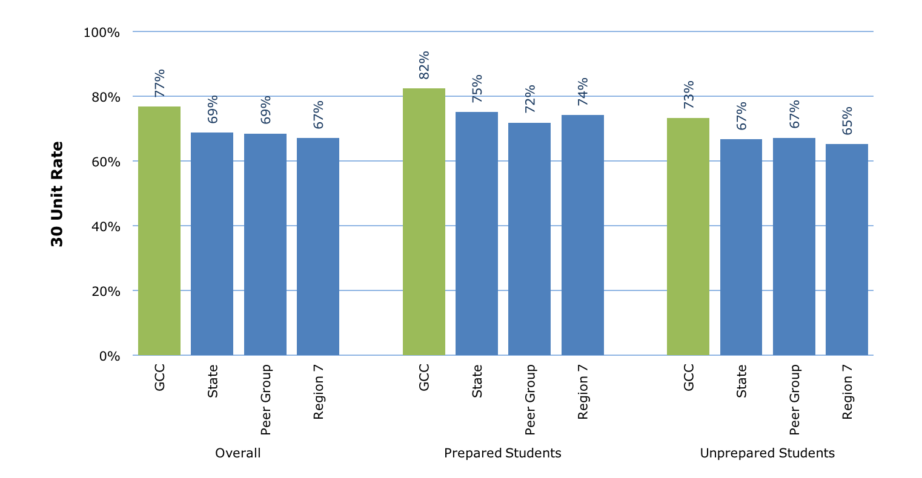
30 Unit Rate: 2010-11 Cohort
7th in State
2nd in Region
2nd in Peer Group
5th in State
2nd in Region
2nd in Peer Group
12th in State
3rd in Region
2nd in Peer Group

Slide 18
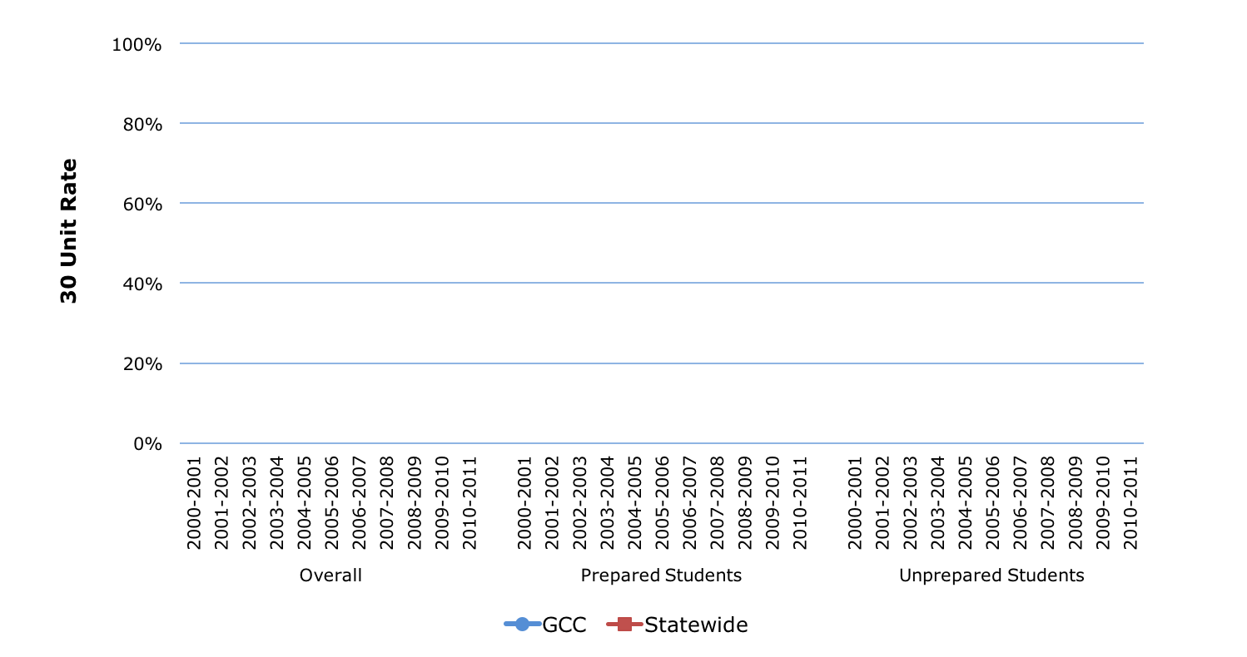
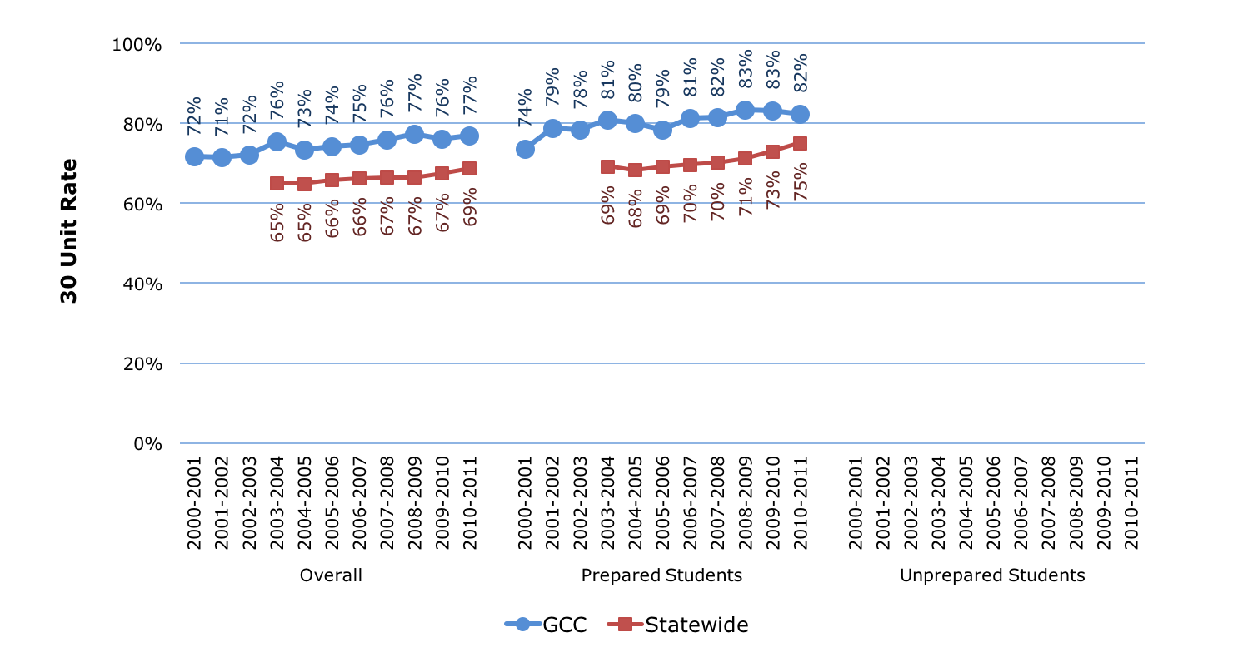
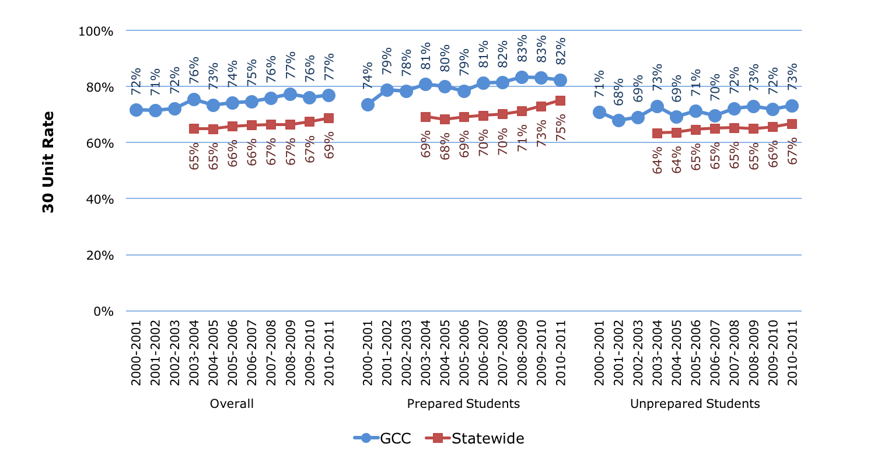
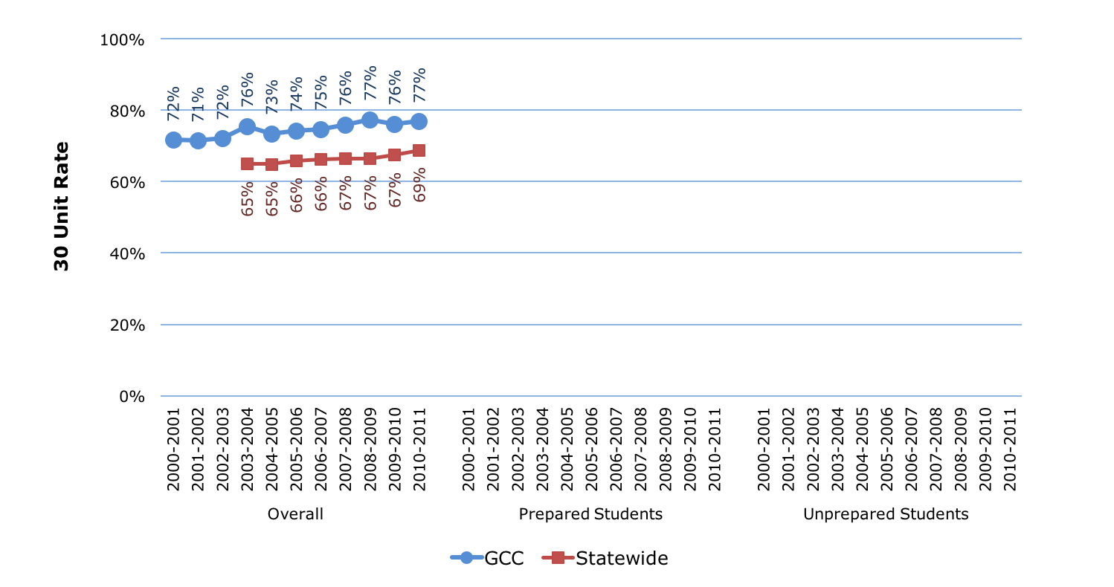
30 Unit Rate: Trends

Slide 19
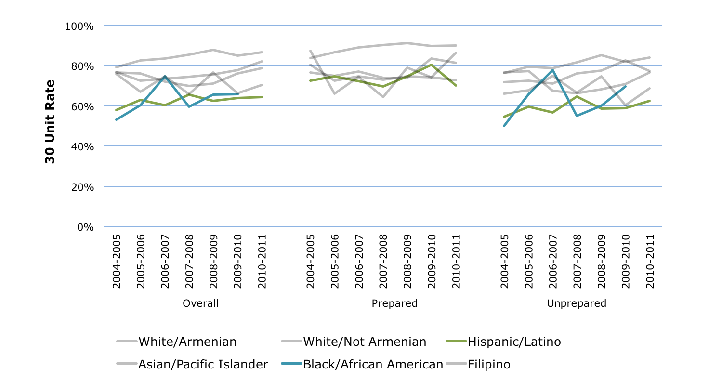
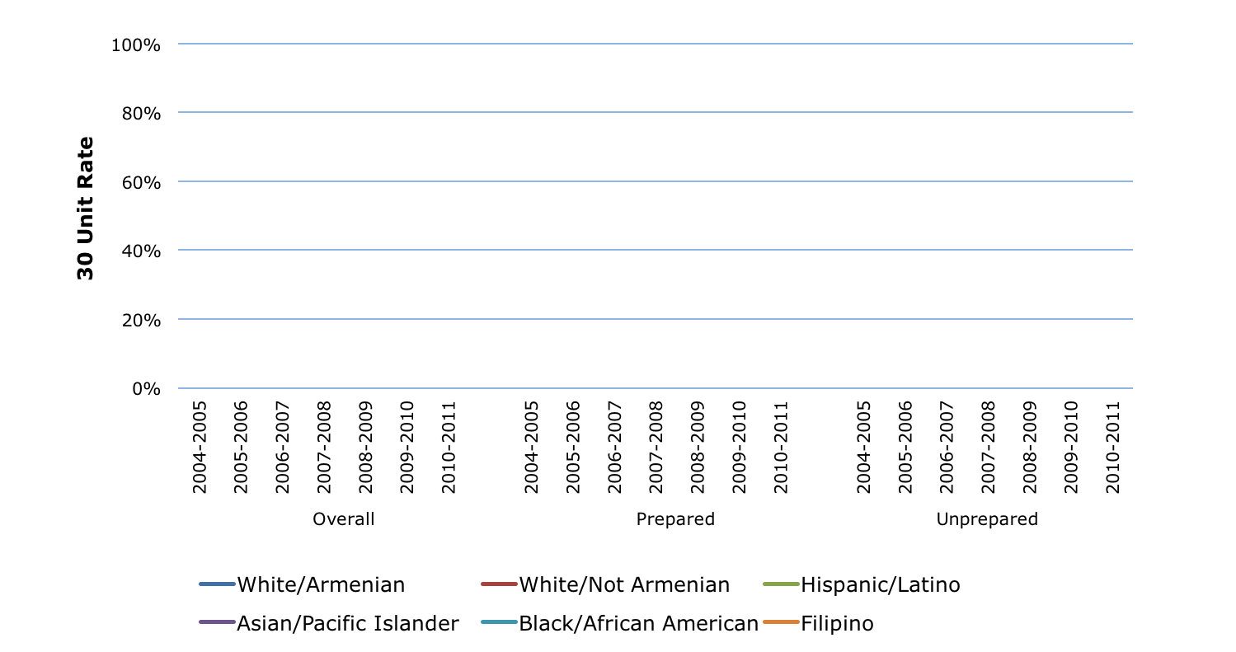
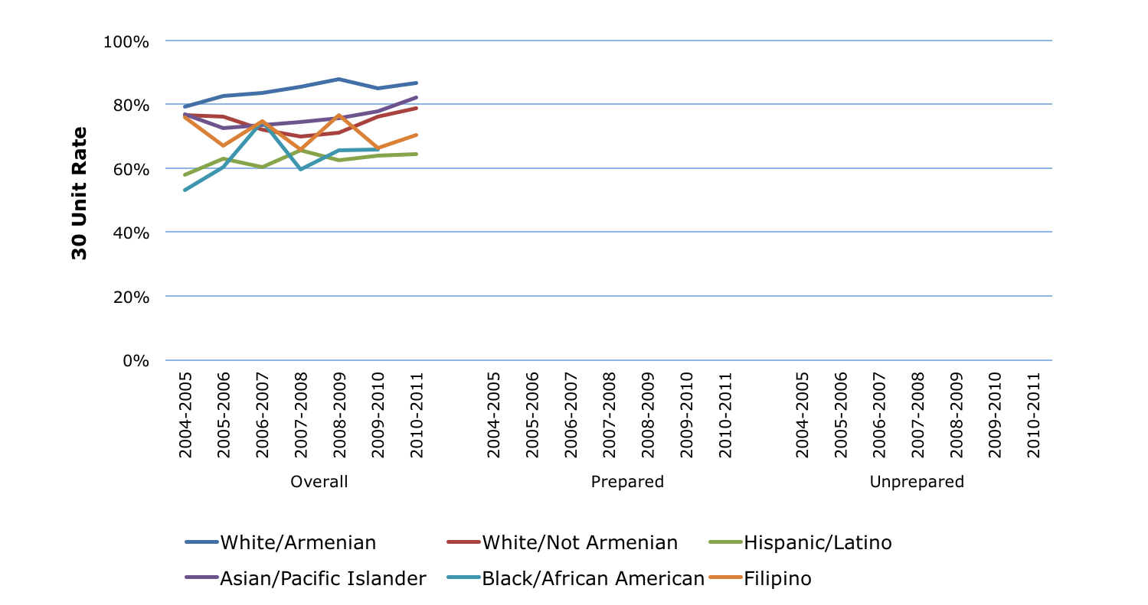
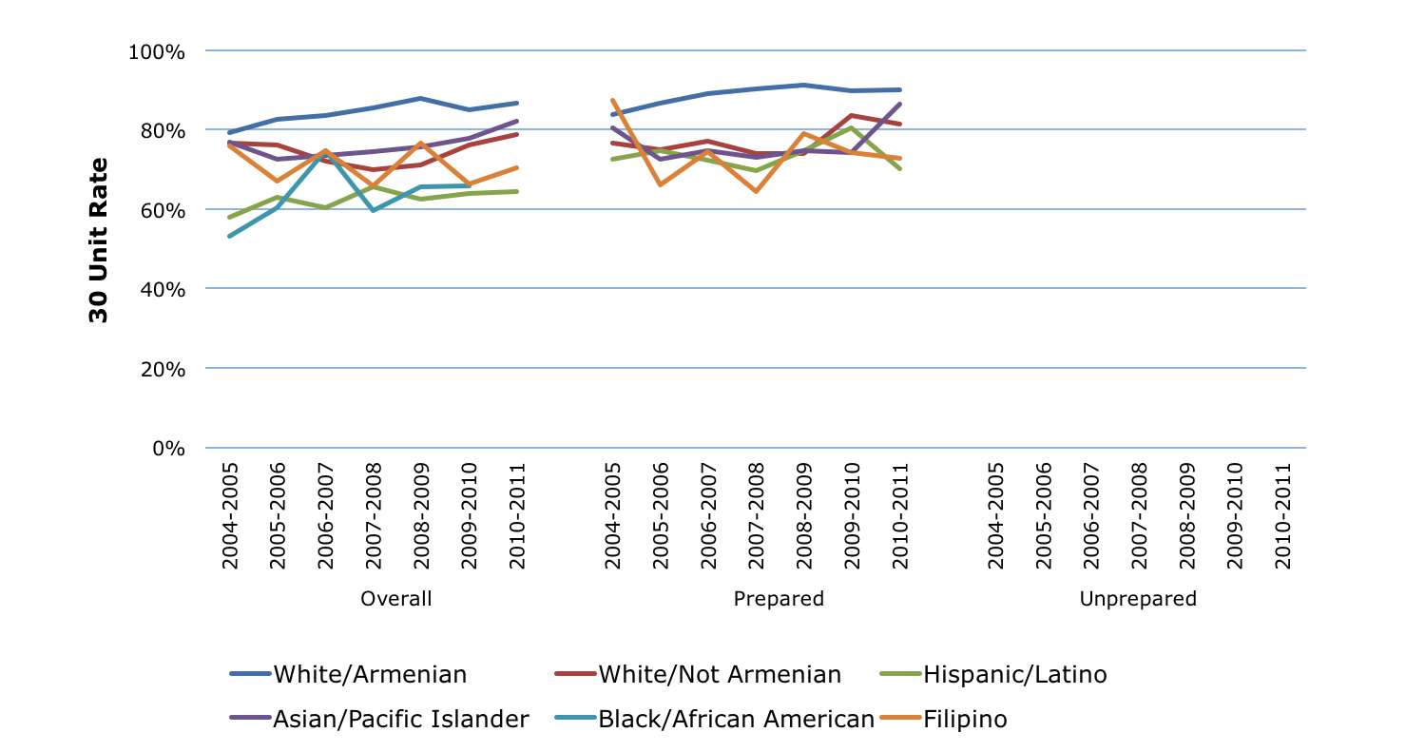

30 Unit Rate: Gaps
Note: Only data cells with 20 or more students are shown

Slide 20
Completion Rate: Definition
Percentage of new students who complete a degree or certificate, or transfer
First-time college students earning 6+ units in first 3 years and attempting Math or English in first 3 years
Overall
Prepared Students*
Unprepared Students*
Completed degree or certificate, transferred, or became transfer prepared (60+ transferable units with GPA of 2.0+)
Entry
6 Years
* Prepared students’ first English course was transferable and first Math course was transferable or associate degree applicable.

Slide 21




Completion Rate: 2010-11 Cohort
17th in State
1st in Region
2nd in Peer Group
23rd in State
3rd in Region
3rd in Peer Group
34th in State
3rd in Region
6th in Peer Group

Slide 22




Completion Rate: Trends

Slide 23





Completion Rate: Gaps
Note: Only data cells with 20 or more students are shown

Slide 24
CTE Rate: Definition
Percentage of CTE students who complete with a degree or certificate, or transfer
Students enrolling in a CTE course and completing 8 or more units in the same discipline within 3 years
Completed degree or certificate, transferred, or became transfer prepared (60+ transferable units with GPA of 2.0+)
CTE
6 Years

Slide 25
CTE Rate: 2010-11 Cohort
28th in State
5th in Region
4th in Peer Group

Slide 26
CTE Rate: Trends

Slide 27


CTE Rate: Gaps
Note: Only data cells with 20 or more students are shown

Slide 28
Skills Builders: Definition
Change in wages for students completing CTE courses but not completing
Students passing higher-level CTE coursework in one academic year who did not return the following year or complete a degree or certificate or transfer
Median change in wages
CTE
1 Year

Slide 29
Skills Builders: 2013-2014 Students
67th in State
9th in Region
4th in Peer Group

Slide 30
Skills Builders: Trends

Slide 31
CDCP Rate: Definition
Completion of Career Development and College Preparation (CDCP) noncredit students
Students attempting 2 or more CDCP noncredit courses, completing 4 or more attendance hours in each, within 3 years
Completed a CDCP certificate, a credit degree or certificate, transferred, or became transfer prepared (60+ transferable units with GPA of 2.0+)
Entry
6 Years

Slide 32
CDCP Rate: 2010-2011 Cohort
14th in State
2nd in Region
2nd in Peer Group

Slide 33
CDCP Rate: Trends

Slide 34


CDCP Rate: Gaps
Note: Only data cells with 20 or more students are shown

