Slide 1
Work fit
How you can Get Moving to improve your health, fitness and focus at work and beyond!
Erin Calderone
Kinesiology Instructor
erinc@glendale.edu
x5644
Notes:
Hi everyone! I’d like to thank Wendy and the Classified Council for inviting me here today. Fitness is a passion of mine and I am excited and honored to have the opportunity to share it with you today.

Slide 2
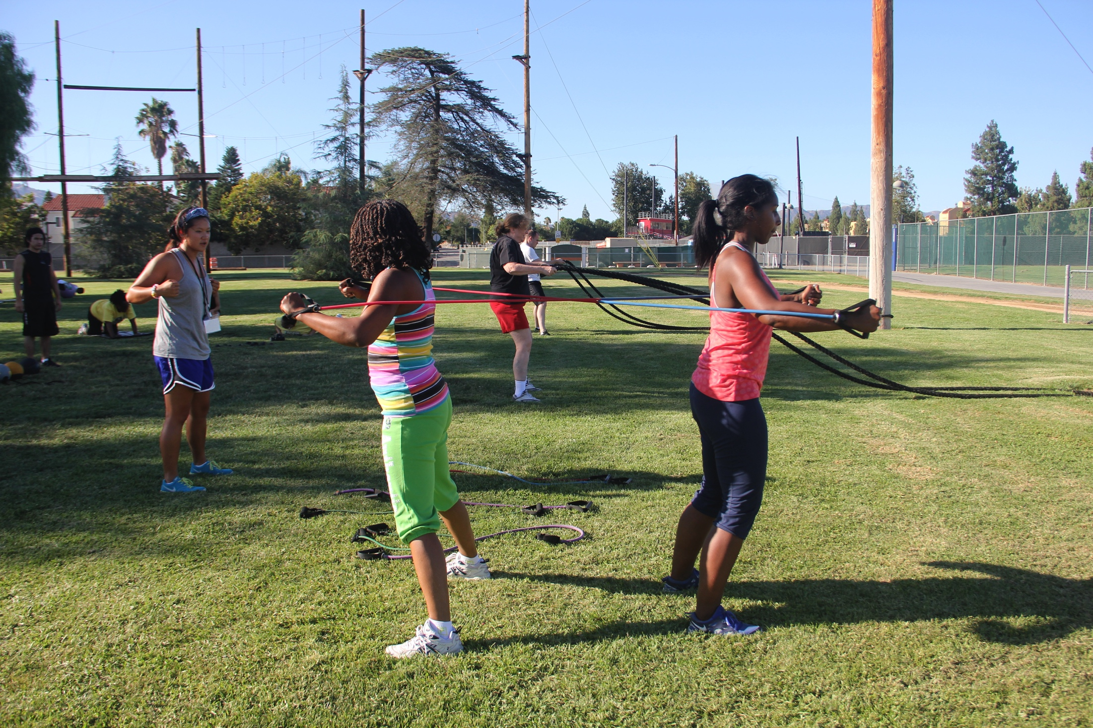
Kinesiology = the study of movement
Notes:
So like Wendy said, I teach in the kinesiology division here at GCC. The term kinesiology comes from the Greek word Kinesis, which means human movement. Now what I love about this picture is that it demonstrates the need to work together as a team to improve fitness. This was taken during the staff/faculty wellness program at CSUN called “Commit to Be Fit” - which is still active today. One of the biggest things I learned through this program – and what you can see in this picture – is that fitness requires, and promotes healthy teamwork. The muscles and joints of the human body work together to create balance, endurance and strength, and these participants are working together to help each other improve their fitness. The woman on the left is one of the Kinesiology students leading the exercise, the woman in the striped shirt is a staff member at CSUN and the girl on the right is her daughter who was off of school for the summer and joined us for the exercise.
The health of a community is the sum of the health of each of its members. My goal today is to show how we can create a healthy and fit GCC community: starting with you and I. And I have a feeling all we need to do is Get Moving.

Slide 3
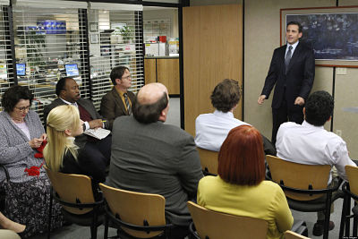
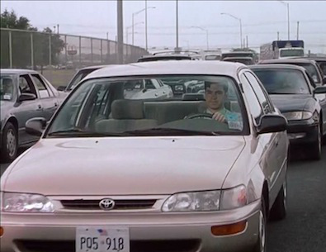
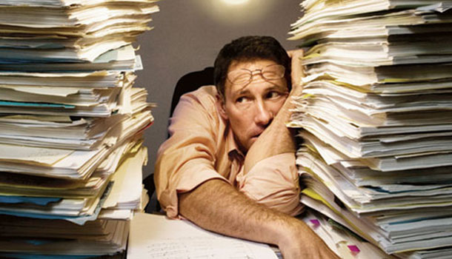
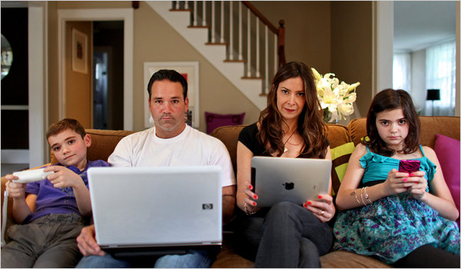
Notes:
Here’s the problem that most of us face today when it comes to staying healthy at work – most of us don’t move. Think about all the time we spend with our bodies inactive. Nowadays we expect our minds to do most of the work, and our bodies are just along for the ride. Advances in technology have made our lives less and less active – think about communication, for example. What if I need to send someone across campus a form? Do I print it out, put it in an envelope and walk it down to their mailbox? No way! I simply attach it to an email and poof! I’ve saved myself 5 minutes of movement. Now, I’m not saying technology is BAD – ok? We have cut down on tons of paper waste by converting to electronic documents and email. And even though technology may be one of the things that is keeping us sedentary (not physically active) – I believe it can also be part of the solution for this health issue.

Slide 4
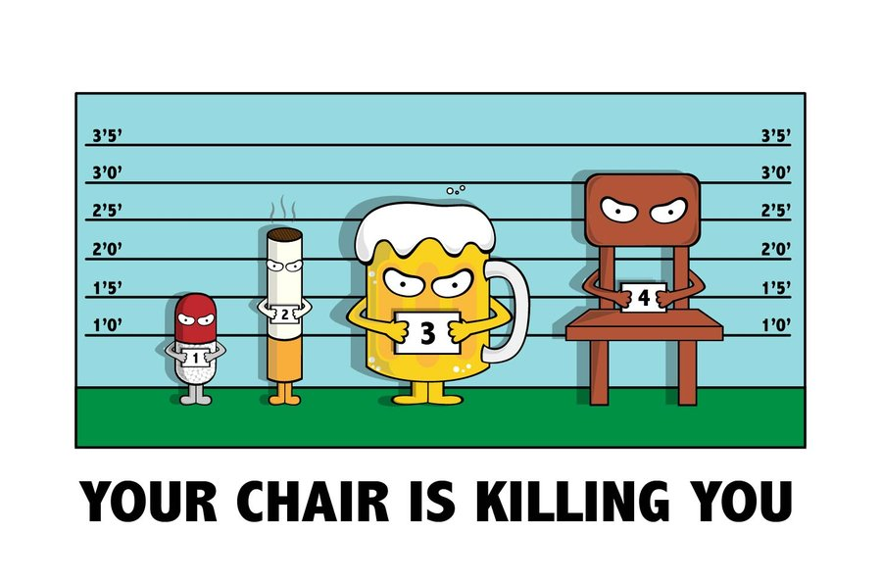
The Problem: SittingSitting Calculator - juststand.org
http://wwings.deviantart.com/art/Your-Chair-is-Killing-you-coloured-289547140
Notes:
Here’s our nemesis – the chair. According to the most recent data: a sedentary lifestyle (or one which you are sitting for most of your day and not being physically active) is actually a greater public health danger than smoking. You might be surprised by this – isn’t smoking the biggest behavior we could change to save the most lives? But the truth is that far more Americans sit than smoke. Studies indicate that on average, we sit about 7.7 hours per day, and some people may sit up to 15 hours per day! If you take a minute to think about all the time that you have spent sitting today it might make you want to get up and walk out of here, huh? Wait- not yet!
I actually have a link here to a calculator at juststand.org.

Slide 5
Sitting more = moving less
Increased risk of heart disease
Increased risk of diabetes
Increased risk of cancer
Increased risk of obesity
Low back pain, neck pain, wrist pain
Depression, lower energy, trouble focusing, lost productivity
http://www.cdc.gov/chronicdisease/resources/publications/aag/workplace-health.htm
Notes:
I think sitting itself isn’t necessarily the problem – it’s what we’re NOT doing when we’re sitting: we’re not moving! And not moving becomes a significant source of problems when it comes to our health. Low physical activity is associated with many chronic diseases (which by the way are the top causes of death in America): things like heart disease, diabetes, high blood pressure, several types of cancer, and of course obesity – which affects over 1/3 of American adults today. In addition, prolonged sitting – especially using a computer – is associated with many workplace injuries such as low back pain, neck and upper back pain, wrist pain and carpal tunnel syndrome. This can cost companies time and money – not just in worker’s comp claims either: it is estimated that productivity losses due to employees missing work tallies up to over $1600 per employee per year! Interestingly enough though, the most common workplace complaint is not a physical one: it’s STRESS! And it’s no surprise: if you have to deal with work-related stress on top of all of these other health issues, stress will merely compound itself. Physical activity has been shown to reduce stress as well as all of these other health issues. Now of course I’m going to encourage everyone here to exercise, because that’s what I do! The CDC recommends that every adult gets a minimum of 30 minutes of moderate exercise on at least 5 days per week. That could be as easy as taking your dog on a walk or visiting the Lifestyle Fitness Center during your lunch break. But much smarter people than I have even better ideas.

Slide 6
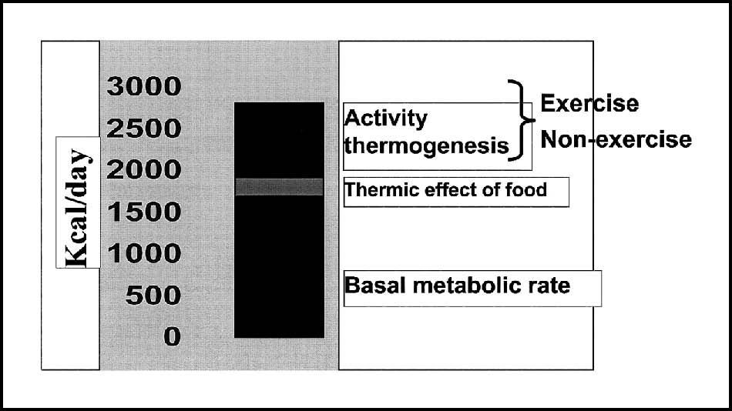
THE DIFFERENCE IS N.E.A.T.
Levine, JA. "Non-Exercise Activity Thermogenesis (NEAT)." Nutrition Reviews 62.7 part 2 (2004): S82-97. CINAHL Complete. Web. 13 Aug. 2015.
Notes:
Dr. James A. Levine has published a plethora of research on the subject of obesity and physical activity. He is currently a co-director of the Mayo Clinic and Professor of Endocrinology at ASU. Recently, he published a book that Susie Chin recommended I read this summer: called “Get Up – How your chair is killing you and what you can do about it” which I thoroughly enjoyed. One of the main points of the book is that we can increase our calorie expenditure, ward off obesity, high blood pressure, heart disease and diabetes simply by SITTING LESS. The difference, Dr. Levine says, is not necessarily exercise: it’s what he calls Non-Exercise Activity Thermogenesis – or NEAT. Basically these are the calories we spend throughout the day by doing things like standing up, walking to the water cooler, fidgeting, giving someone a hug, going shopping… in other words these are “doing life” calories!

Slide 7
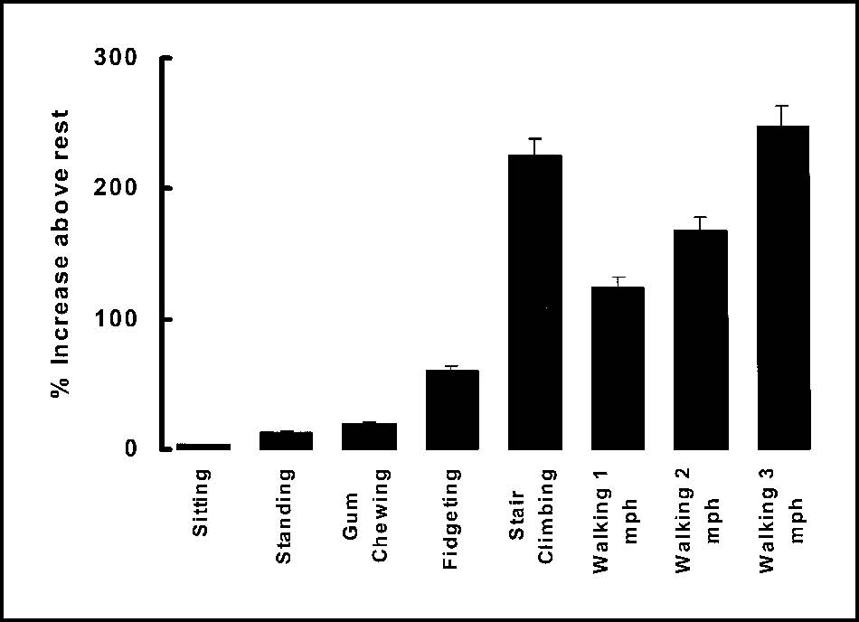
Examples of neat
Notes:
Here are some examples of how even small activities can increase our calorie expenditure throughout the day. And yes they did actually do a study on whether or not chewing gum burns calories! But the more we sit in our chairs, the less NEAT we are getting throughout the day, and the higher our health risk becomes.

Slide 8
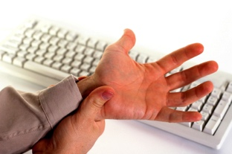
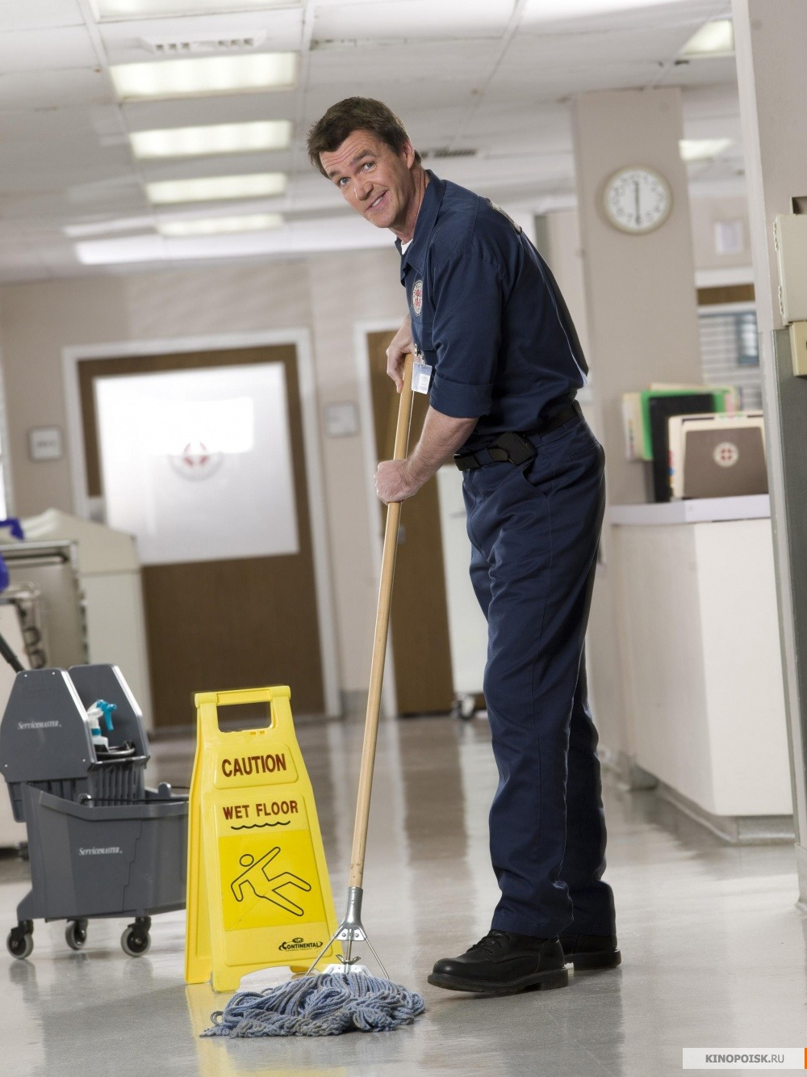
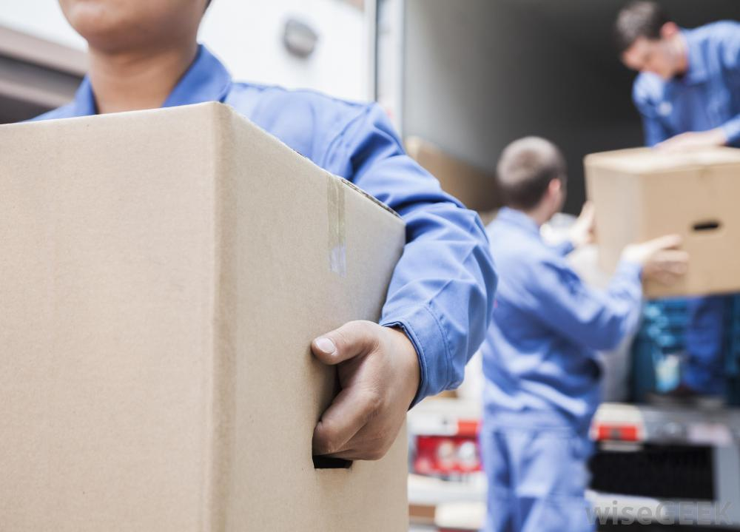
The problem: Repetitive movement
Notes:
Now some of us get more movement throughout the day but are plagued by other issues. One issue that is quite common in the workplace is repetitive movement. Our athletic trainers at GCC – Jose and Claudia – know quite well that repetitive movements can lead to chronic injuries in sports. Think about the baseball pitcher who whips his arm through the air at high speeds hundreds of times per day. Or the runner whose feet strike the ground thousands of times during a long distance race. But what about the worker who lifts and carries boxes, moves furniture or mops floors, or types and clicks the mouse a thousand times over a workday? Similar chronic injuries could be suffered by these workers as well as those athletes. But how many times do you think about physically training or recovering for your job like an athlete?

Slide 9
Repetitive movement/prolonged posture = too much stress
Notes:
Here’s the thing: repetitive movement – doing the same movement in the same way over and over, will cause high stress on our joints. After months to years of millions of repetitions of that stress, something has to give! Typing and using the mouse can cause pain in the wrists, shoulders, neck and upper back. Pushing and pulling or sitting can cause pain and chronic issues in the low back. Repeatedly lifting and moving objects can cause issues for the low back, knees and other joints. I’m going to focus on one of these problem areas that seems to be one of the biggest sources of discomfort– the low back. Statistics indicate that approximately 80% of Americans will experience some kind of low back pain in their lifetime. It’s one of the most common workplace complaints and it’s the 2nd most likely reason people visit the doctor. This graph represents how many low back disorders occur, from repeated stresses like lifting boxes or prolonged stress like poor sitting posture, that eventually break down the tissues in the back until they fail. This failure causes an injury that could occur doing something seemingly simple – like picking up a pencil off the floor! The truth is is that the injury wasn’t from the pencil though, it was built up by months to years of stress and reached the crucial tipping point on that day. Fortunately, there are a lot of things we can do day-to-day that can help protect your back from excessive stress like this and keep it healthy for a long time.

Slide 10
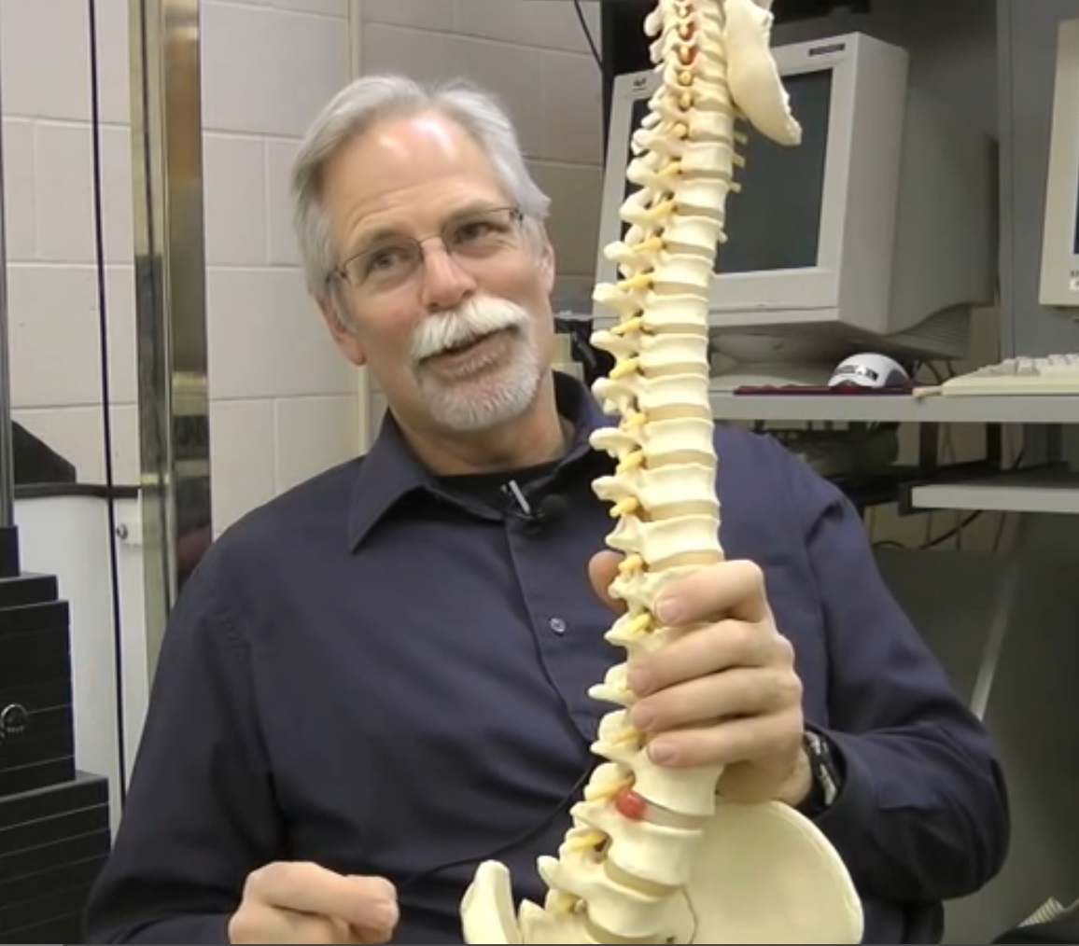
“Dr. Spine”
Dr. Stuart McGill
University of Waterloo, Canada
www.backfitpro.com
Notes:
Recently I got to interview an expert on the subject, Dr. Stuart McGill, a leading spine biomechanics professor and researcher at the University of Waterloo. He has been researching the spine and low back health since the late 80’s, and published hundreds of papers as well as 4 books on the subject. He said something that surprised me: even people who exercise regularly can be at risk for low back pain from a bulging disk, especially if they sit at a desk the rest of the day.

Slide 11

Low back health
Bending the spine (rounding low back) + compressing discs is a common cause of disc bulging ➔herniation
  Poor form x 1000s of movements or prolonged postures (i.e. sitting)
Stretching the lower back may cause a pain/spasm cycle
Strengthening one side of the trunk (i.e. crunches for your abs) just makes for an imbalanced core
Discs swell at night – reducing range of movement in the morning
Notes:
Here are the key facts I learned from Dr. McGill. First, one of the ways we can begin the bulging disc process is by bending the spine and compressing the disks. This can cause painful disc bulging and eventually lead to disk herniation – which is an even more serious injury. How do we do this? Bending the spine thousands of times throughout the day or by having a slouched posture for a long period of time will put stress on the disc, and then we can compress it by doing exercises like lifting weights or running. So even if you exercise like I encourage everyone to do, sitting at your desk for the rest of the day might be ruining your back.
A few other fun facts I found out:
Stretching the low back doesn’t always help – in fact, stretching the low back can often cause a pain spasm cycle that simply makes it worse.
Strengthening one side of the trunk (i.e. doing a bunch of crunches for your abs) can cause a muscle imbalance that can make it worse.
And, there’s a higher risk of injury in the morning, because the disks swell with water overnight, causing a smaller, stiffer range of movement in the morning.

Slide 12
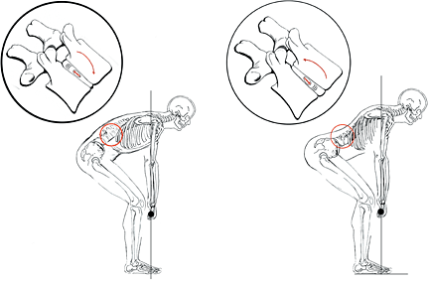
It Doesn’t take much!
Notes:
In other words – it doesn’t take much to really injure your lower back. Just take this example of picking up an object. The skeleton guy on the left is bending his spine, asking the muscles of the lower back to take on much of the weight and compressing one side of his lumbar disks. Even if the box he is lifting is light, if he does it a hundred times over the next couple of weeks that can cause the disc to bulge backwards. The skeleton guy on the right has a much better position that is protecting his spine. Additionally, if you sit at a desk all day, the discs, ligaments and tendons tend to “creep” into that position that we see on the left – putting you at a higher risk when you stand up and pick up that pencil. Dr. McGill recommends that after you’ve been sitting for a long time, you should stand and stretch, reaching the arms up overhead and gently extending the spine, for a couple minutes before lifting anything. This helps to get the tissues back into their normal, neutral position before you lift.

Slide 13
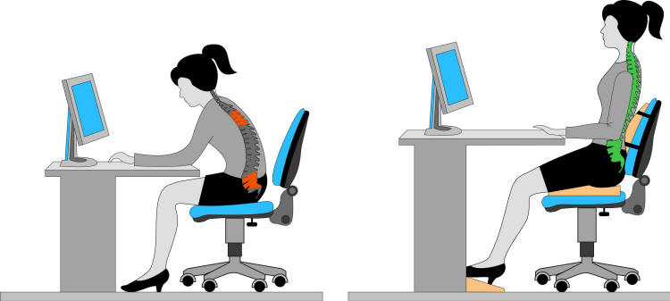
Even the “perfect” posture is not good for you all day…
Notes:
Here’s another thing that surprised me about low back health – even the “best” posture is not good for us all day long. Hopefully you know by now that sitting with a slouched posture and bending that spine is really dangerous and can be quite painful, but even if you had perfect posture all day like the image on the right: sitting with the knees below the hips, the spine in neutral and the arms and wrists at or below the waist - even sitting this way for 7.7 hours in the same position would still put stress on your spine, and reduce your NEAT calories throughout the day.
So how do we fix the chair problem?

Slide 14
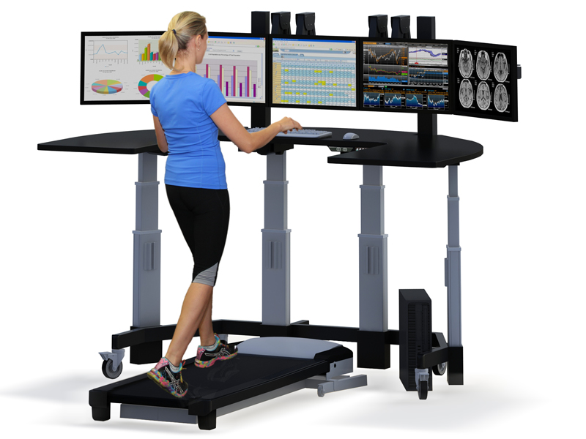
Great idea… but how practicaL?
Notes:
Well, here’s one idea. A treadmill desk would help out a lot… but let’s be honest, who hast the $ for this? And certainly walking the same way all day could be just as stressful to your body as sitting all day. So before the administrators start glaring at me (yikes!) let me propose some other solutions. Real life might look something more like this:

Slide 15
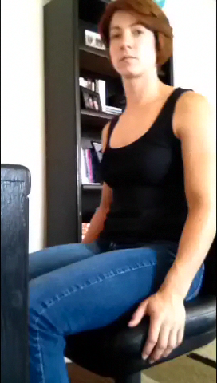
Real life:
Notes:
In real life, just moving more – changing position, standing occasionally, walking every now and then, doing some stretches when you get up – might be the best plan. If you were that kid who could never sit still – here’s good news! Being a squirmy Sammy is good for your health!

Slide 16
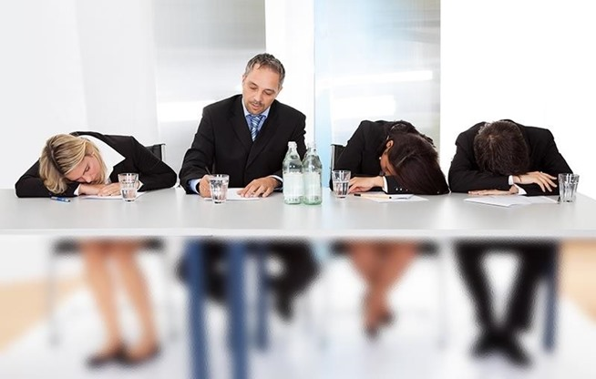
Moving more doesn’t mean being less productive!
A 2015 study in Spanish university office employees found that those who were more physically active:
  Sat less at work and on the weekends
  Had LESS lost productivity time
  Reported higher mental well-being!
Notes:
I know some of you may be concerned about this prospect because much of your job is done at your desk. But moving more throughout the day doesn’t have to mean being less productive at work. In a recent study of Spanish university office employees, the researchers found that those who had more physically active lifestyles tended to sit less both at work and on the weekends, had less lost productivity time, and reported higher states of mental well-being! Now obviously we don’t know which comes first – feeling good or being more active – but certainly we know that adopting one healthy behavior can often lead to more healthy behaviors. Physical activity is a great tool for stress-management too – something I think we all can use. You may find that you are actually MORE focused and productive when you are LESS sedentary… so basically: Get Moving everybody!

Slide 17
Work-fit: simple strategies @ work
Change your position every 15-20 minutes
Stand occasionally (ex: every time you are on the phone)
Walk occasionally (ex: on breaks)
Rest breaks = opposite movement
Stretch, take deep breaths, fidget!
Sitting ➔ Stand (few minutes) before LIFTING
Switch the hand you use the mouse/phone/coffee cup etc.
Reorganize office to encourage movement
Pick a parking spot far away
Notes:
So one of the ways we can get more NEAT into our day, be nice to our spines and maybe even help our brains is simply: to sit still less. Here are some examples of ways to get more NEAT into your day both at work and at home.
Change your sitting position every 150-20 minutes.
Stand occasionally, for example whenever you are on the phone.
Walk occasionally, for example when you have a break or during your lunchtime.
When you take a rest break from your work, what you do should be opposite to what you’ve been doing all day. So if you sit in an office all day, your rest should be walking around. If you are active all day for work, your rest break should be sitting or even lying down and stretching.
Before you lift anything – stand up and stretch! If you’re feeling bogged down and sleepy – do a little movement and wake up your brain!
Switch up how you move – (I’ll talk about this more in a minute.)
Put your printer/filing cabinet etc. on the other side of your office so that you have to move to retrieve or file documents.
Or pick the farther parking spot – I know some of us don’t get a choice on this depending on when you get here in the morning, but that might be a good thing actually!

Slide 18
Solution: simple strategies
@ home
Exercise for at least 30 minutes/day (can be 3, 10 min walks)
Limit screen time at home
While watching TV: sit on the floor, fold laundry or do housework
Do something physically active with the family
Stand or walk while watching your kids' sports practice/dance class/piano lesson
Use technology (iPhone, pedometer, FitBit etc.) to track your steps and motivate you
Notes:
Exercise for at least 30 minutes/day (this could be split up into 3, 10 min walks)
Limit screen time at home for leisure activities. This might mean picking up a new hobby!
While watching TV: sit on the floor, fold laundry or do housework
Do something physically active with your family or friends. Social connectedness is one of the biggest reasons that people stay in a physical activity program.
Stand or walk while watching your kids’s sports practice/dance class/piano lesson
Use technology (iPhone, pedometer, FitBit etc.) to track your steps and motivate you. There are some really great (and free) apps out there for smartphones like MyFitnessPal and MapMyWalk, but you don’t even need something that fancy – a simple pedometer costs $5.

Slide 19
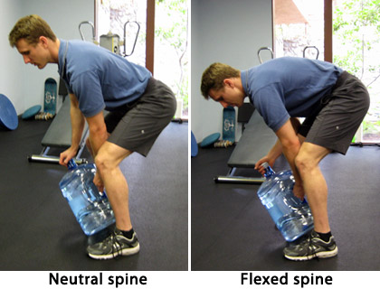
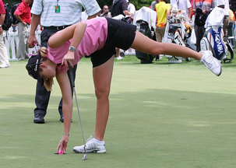
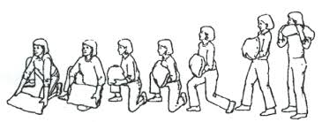
Solution: change the way you move
✕
Practice makes permanent!
Notes:
Here’s the thing: you don’t have to stop doing these necessary work activities in order to save your body pain and injury – you just have to change the way you do them to put as little stress on the joints as possible. Here are some examples.
In general, when lifting heavy objects, try to keep your spine in it’s natural, neutral position. You can tighten up your core (not hold in your stomach) a practice we kinesiologists call “bracing”, which just means stiffening your abdominals and your sides a little. Also, you can see that the man in the picture is keeping the weight as close to his body and center of gravity as possible. This puts the lowest amount of stress on the spine, and allows the muscles to do all the work.
For lifting light objects off of the ground, it might be more energy and back-saving to do the golfer’s lift – see how this golfer uses her other leg and the golf club to counterbalance her body and keep her back relatively straight.
For objects that are more awkward to pick up, consider using other parts of your body to help out, like the image on the bottom shows. This person is transferring a bag of sand to her knee before lunging up to a standing position. This puts the least amount of strain on her back possible.
In the end, remember this: how you move will get ingrained in your brain and muscle memory. As our coaches will tell you: practice doesn’t make perfect – practice makes permanent.

Slide 20
Get moving @ gcc
Weekly walks on campus or through Verdugo Park
Track your steps every workday with a pedometer or smartphone
GCC Lifestyle Fitness Center is open
  M-F 7:30am-1:30pm
  M-Th 5-8pm
  Sat 8am-12pm
GCC Weight Room is open
  M-Th 8am-1:30pm, 5-8pm
  Fri 9:10am-1:30pm
(Sign in at front desk)
IDEAS? Let’s talk!
Notes:
Here at GCC we have a lot of options to be physically active. The outside lanes of the track around Sartoris field is usually open in the mornings during the semester. One lap is approximately ¼ of a mile – so if you do 4 you’ve gone ~1mile.
I’m also working with Frankie and the Classified Council to perhaps lead a weekly 20-30 min walk during the fall, so I will be sure to send everyone information on that.
Additionally our Lifestyle Fitness Center is open for the PE classes, but if you go during a time of day that it isn’t so crowded, you can sign in with the staff at the front desk and get in a quick workout during a break or maybe after work.
And if anyone has ideas, let’s talk! I think there are a lot of things that we can do to encourage each other to Get Moving!

Slide 21
Thank-you!
Notes:
With the time we have left, I would like to lead those of you who are interested on a short walk around campus, ending at the student center for lunch. If you have any questions or ideas, please feel free to ask me while we’re walking or up at the student center, or to give me a call or email during the semester. Also if you would like a list of resources from this presentation please let me know. Thank-you one and all for having me!

Slide 22
REFERENCES/RESOURCES:
Levine, JA. "Non-Exercise Activity Thermogenesis (NEAT)." Nutrition Reviews 62.7 part 2 (2004): S82-97. CINAHL Complete. Web. 13 Aug. 2015.
Levine, James A.. Get Up!: Why Your Chair Is Killing You and What You Can Do About It. First edition. New York, NY: Palgrave Macmillan, 2014.
McGill, Stuart. Low Back Disorders: Evidence-based Prevention and Rehabilitation. Champaign, IL: Human Kinetics, 2007. Print.
Puig-Ribera, Anna, et al. "Self-Reported Sitting Time and Physical Activity: Interactive Associations with Mental Well-being and Productivity in Office Employees." BMC Public Health 15 (2015)ProQuest. Web. 14 Aug. 2015.

