Slide 1
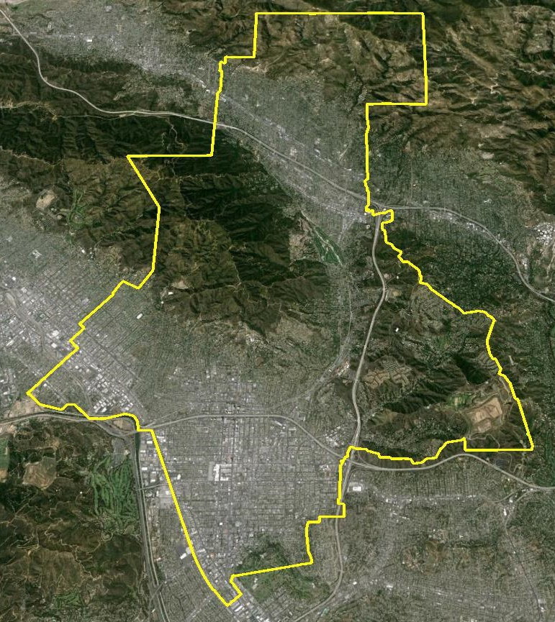
Glendale Community College District
Demographics & Districting
Douglas Johnson, President

Slide 2

Schedule
Date | Action
Oct. 21, 2014 | Board approves Resolution and timeline
Nov. 18, 2014 | Legal & Demographic presentations
Dec. 12, 2014 | Initial public & consultant draft trustee area plans publicly released
Jan. 27, 2015 | Board meeting presentation and public comment on draft plans; possible Board direction for tests/modifications
Feb. 17, 2015 | Board hearing on draft plans; possible Board direction for tests/modifications
March 17, 2015 | 2nd Board hearing on draft plans; Board vote or direction for additional tests/modifications
May – July 2015 | State Board of Governor review
April 4, 2017 | First election using new trustee areas

Slide 3

GCCD Demographics

Slide 4
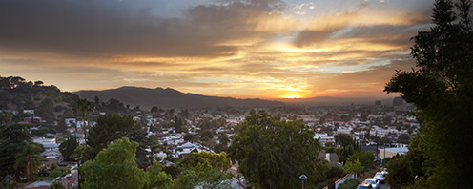
Defining Communities
Voting Rights Act is focused on race, ethnicity and language
Many other ways to define communities
Best way to define a neighborhood remains to hear from the people
who live there

Slide 5
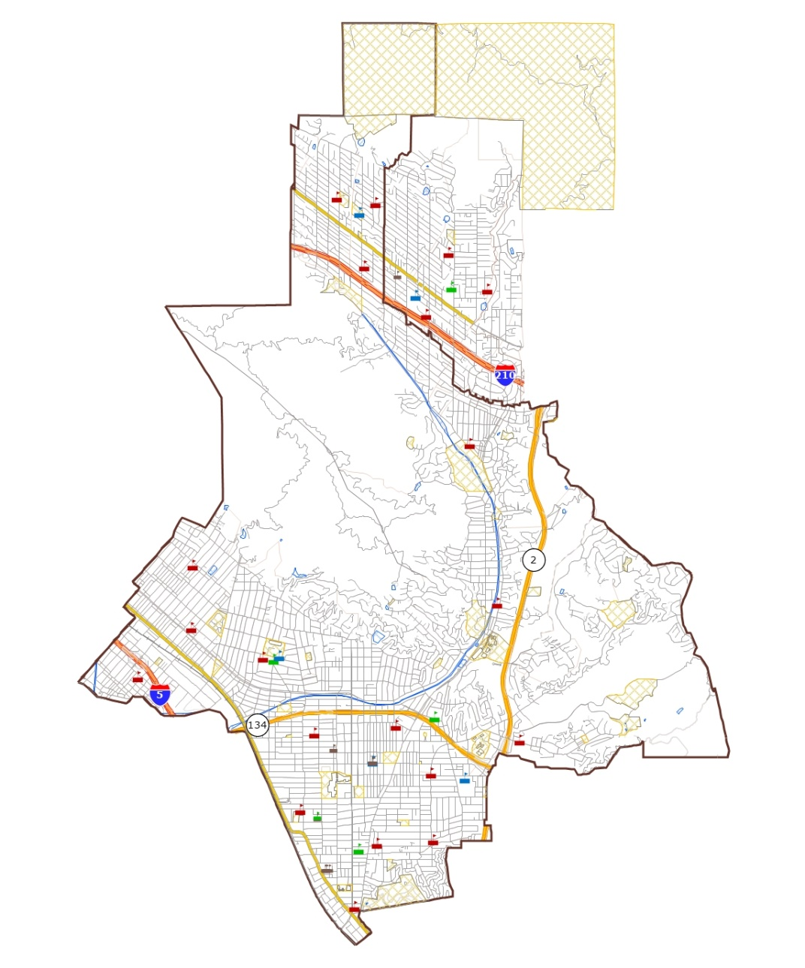
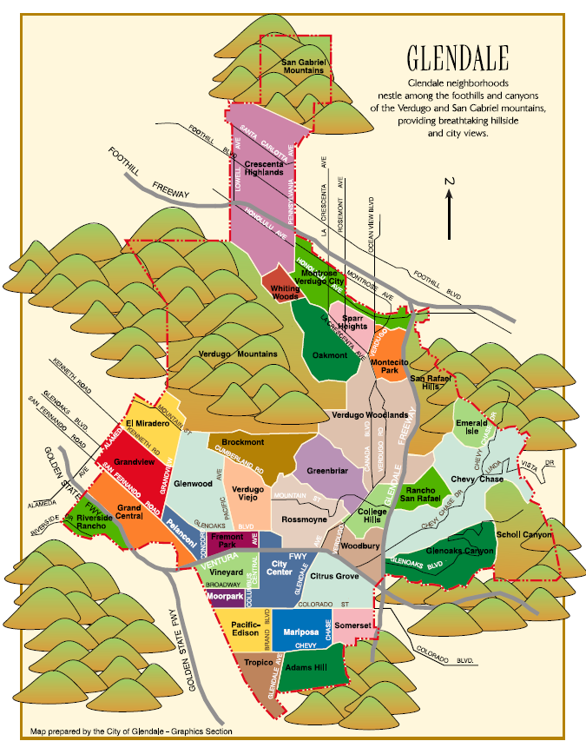
GUSD Schools & Neighborhoods

Slide 6
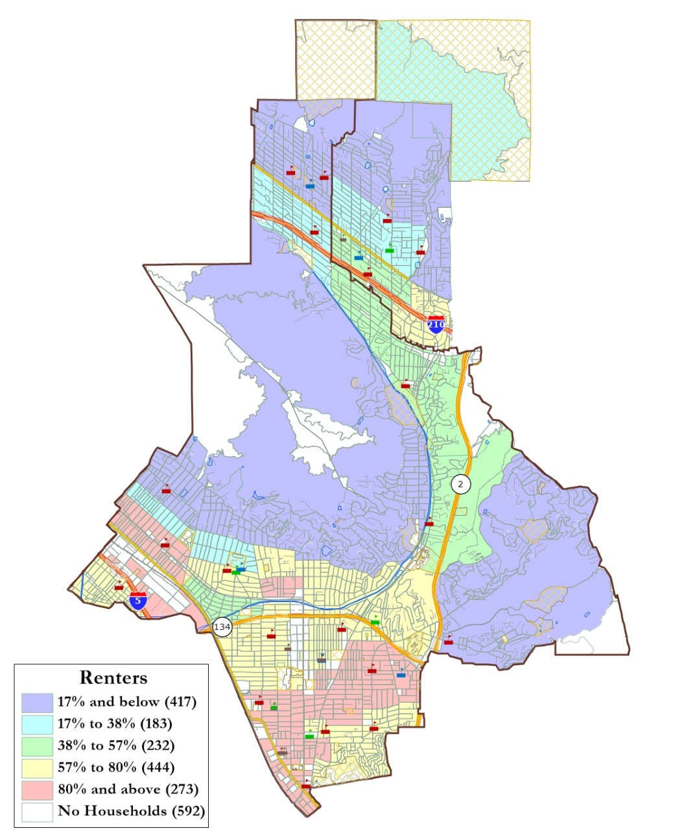
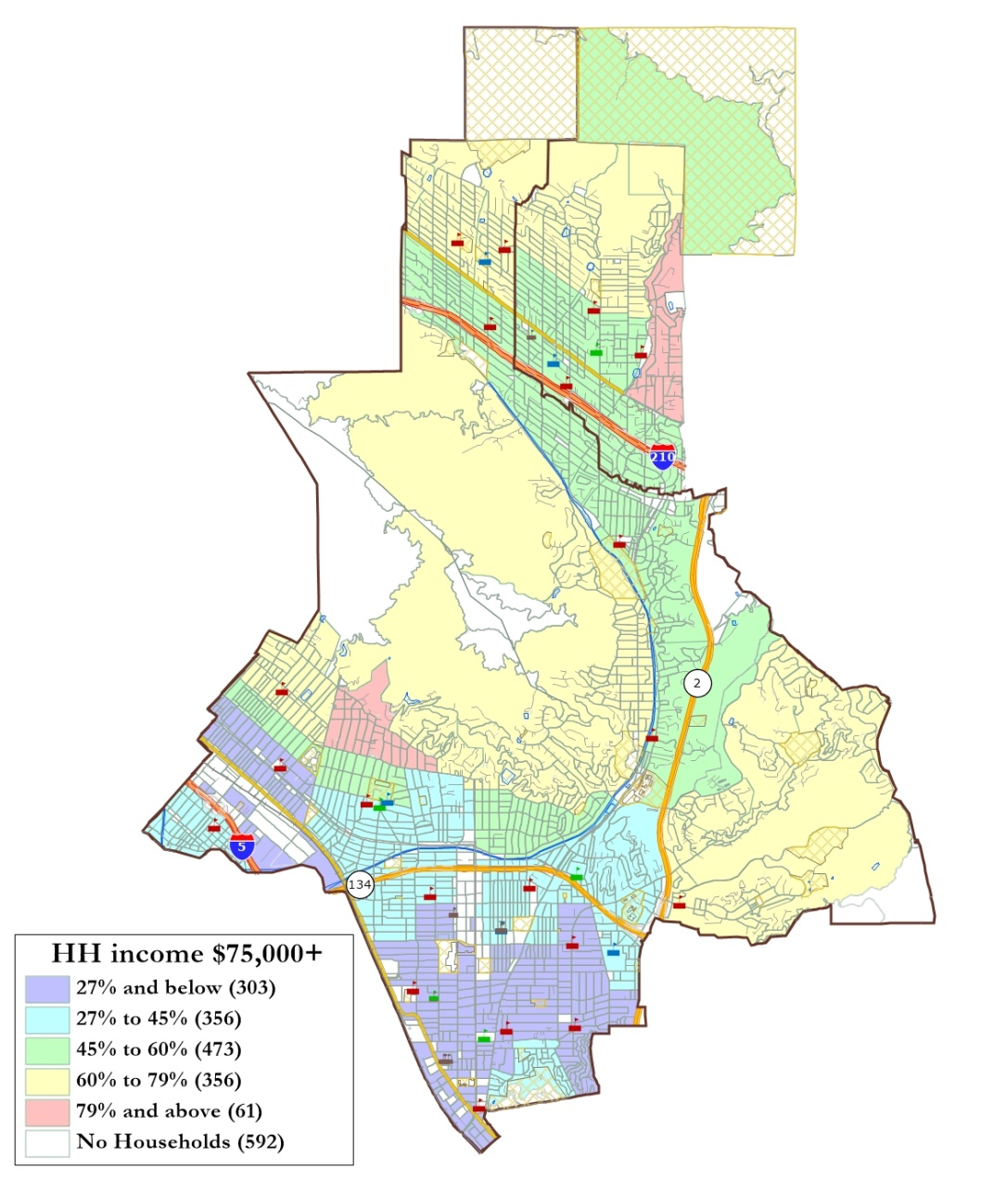
Renters & Income

Slide 7
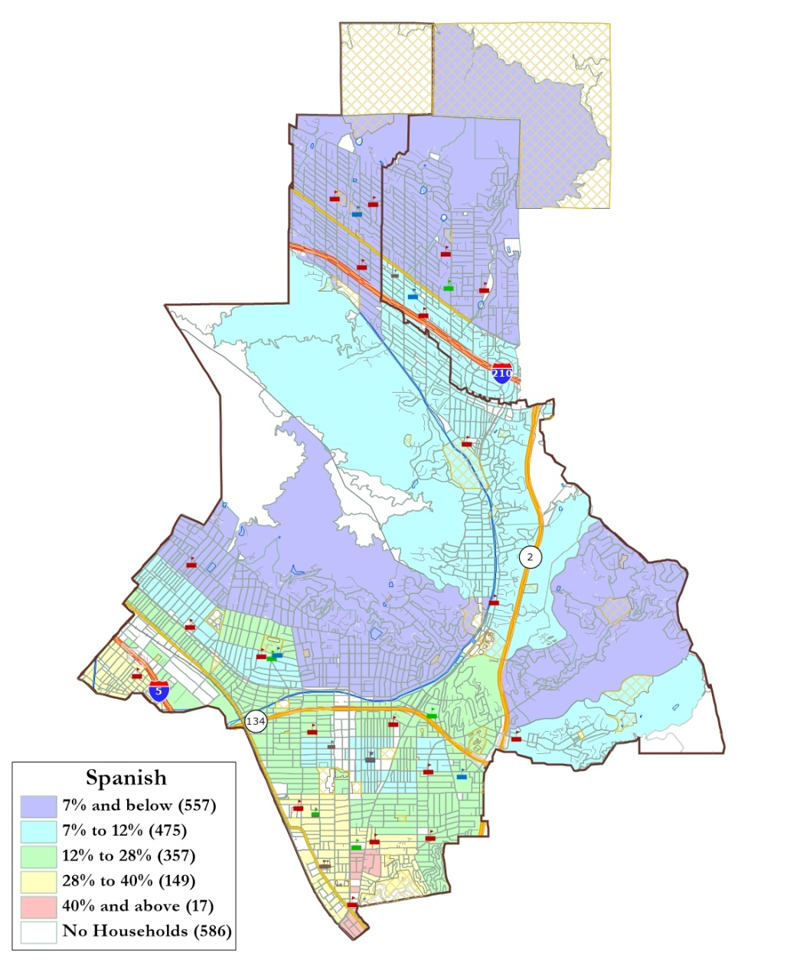
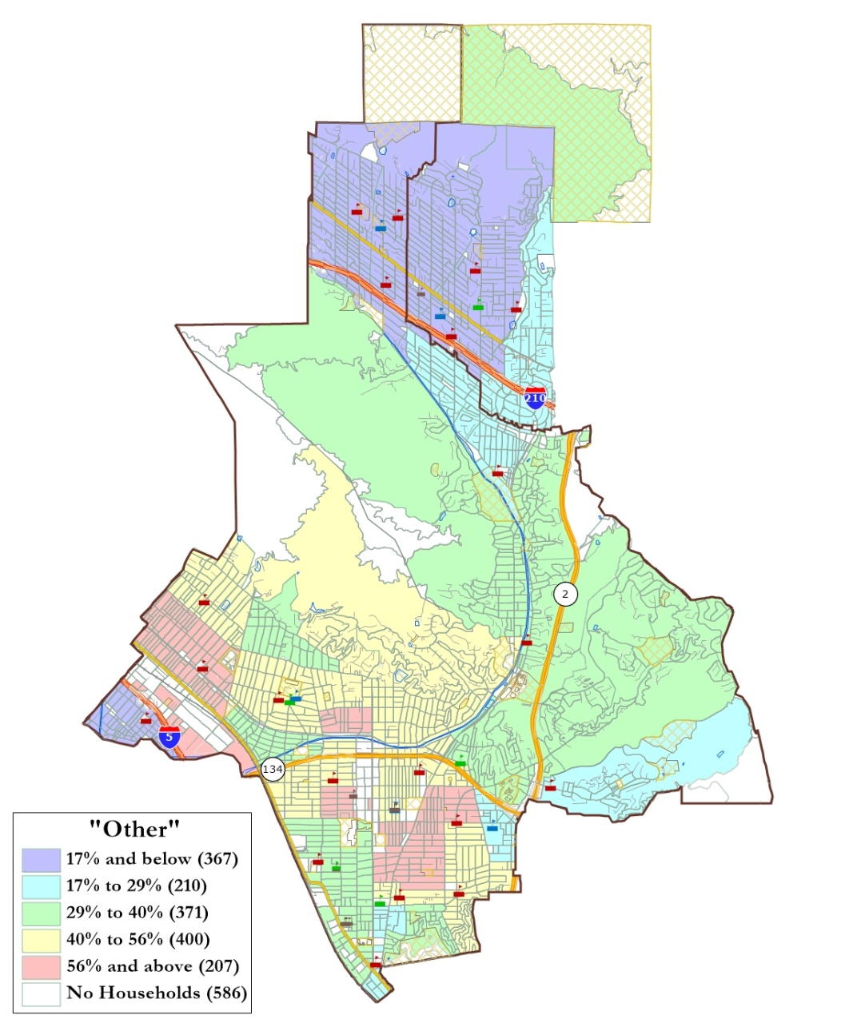
Spanish & Armenian Spoken at Home

Slide 8
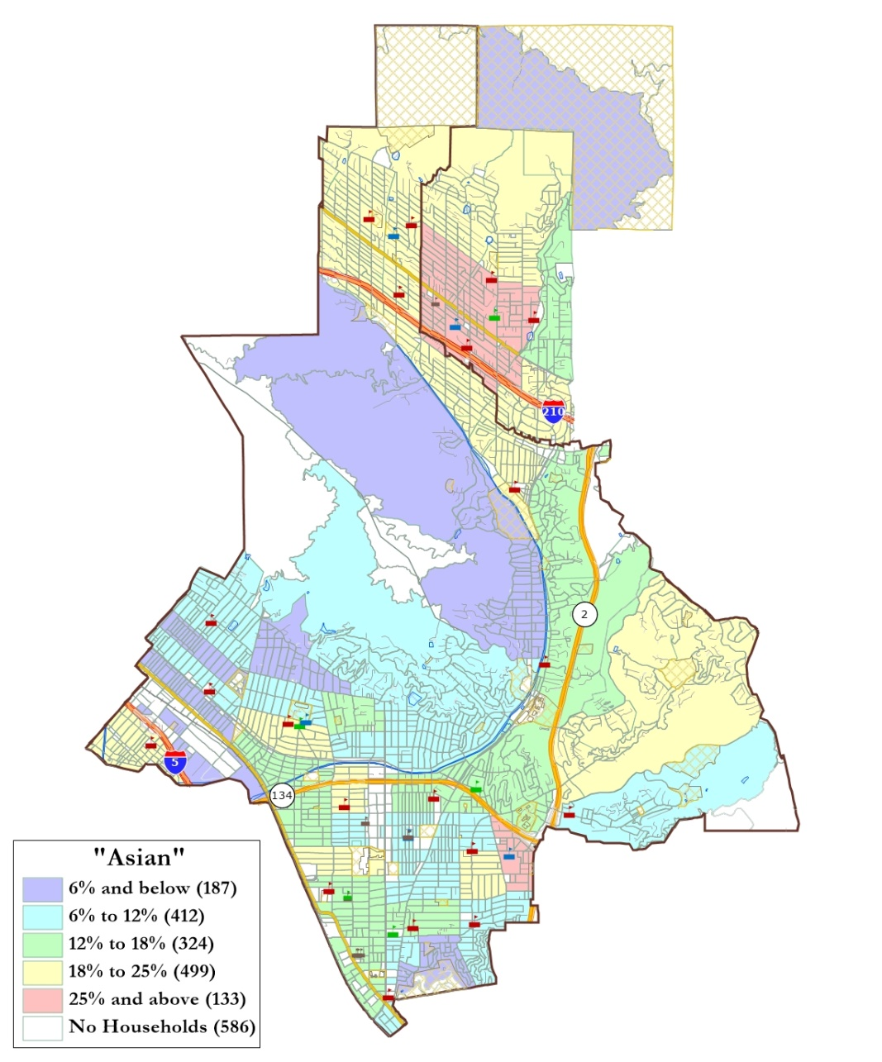
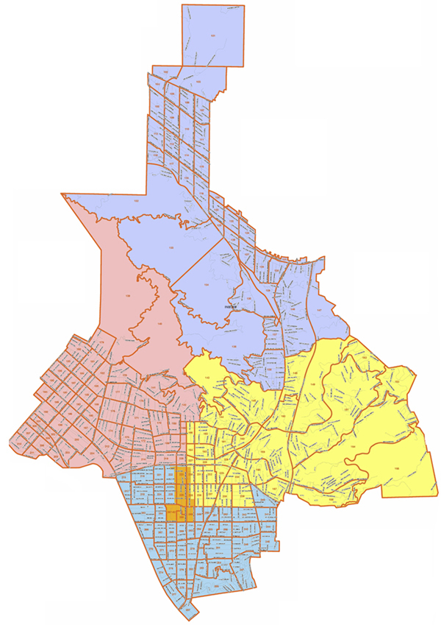
Korean Spoken & Police Commands

Slide 9
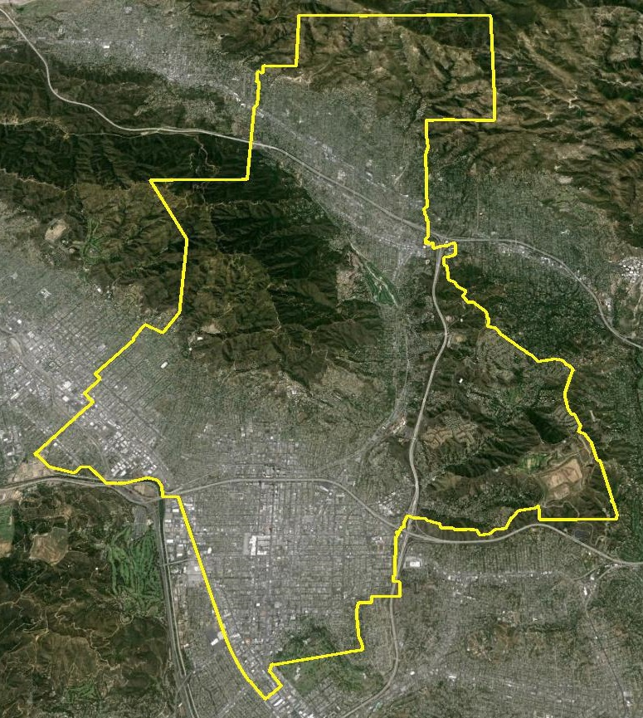
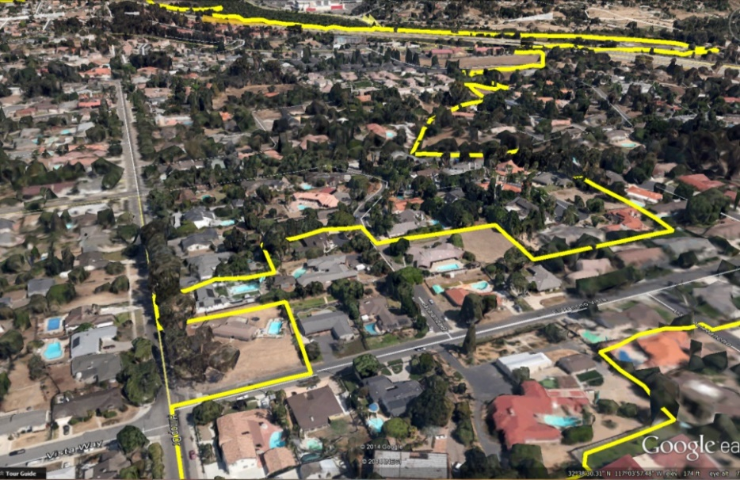
Google Earth

Slide 10
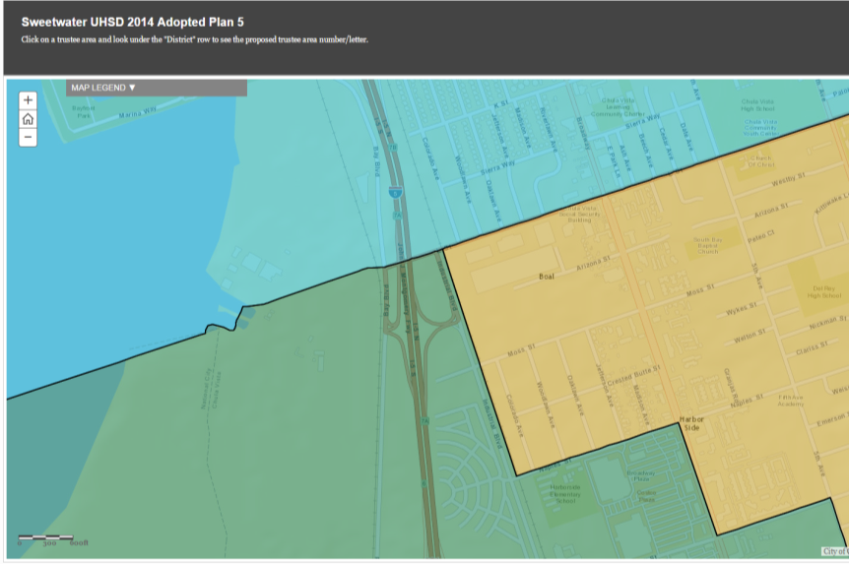
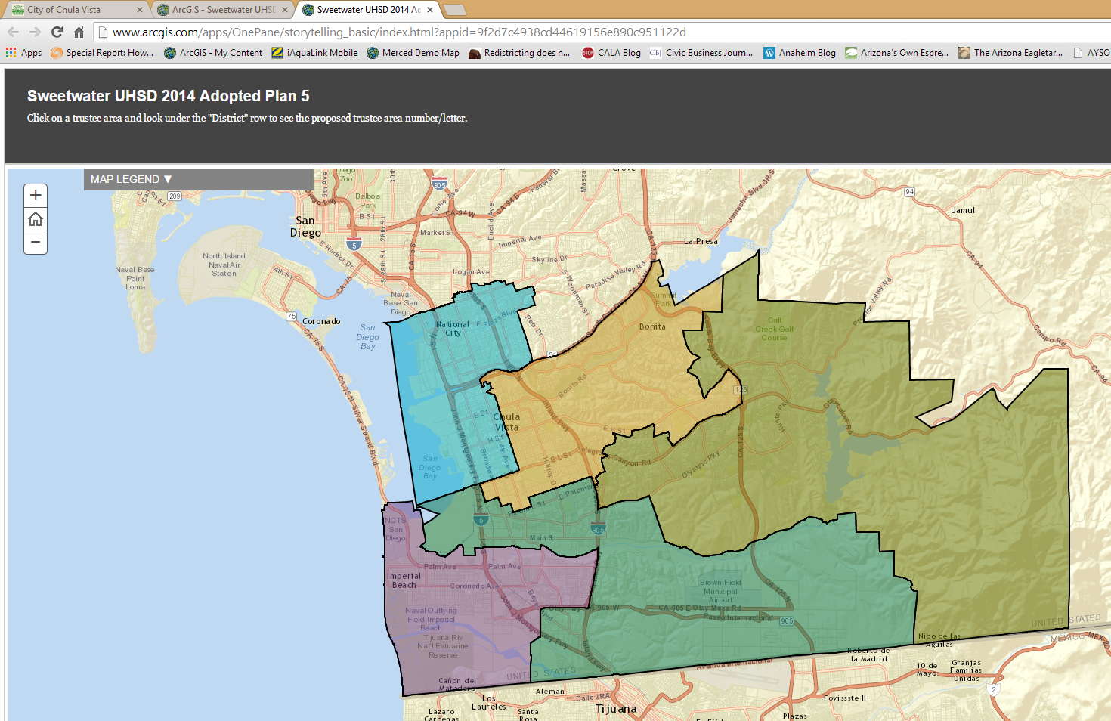
ArcGIS Online

Slide 11
Reminder: Key Dates
Now - Dec. 8 Submit comments before draft plan release
Dec. 12 Release of draft plans
Jan. 27 Presentation of draft plans and public comment
Feb. 17 Board hearing
March 17 Board hearing and potential vote

