Slide 1
Welcome to the Noncredit ESL 2013 Retreat !

Slide 2
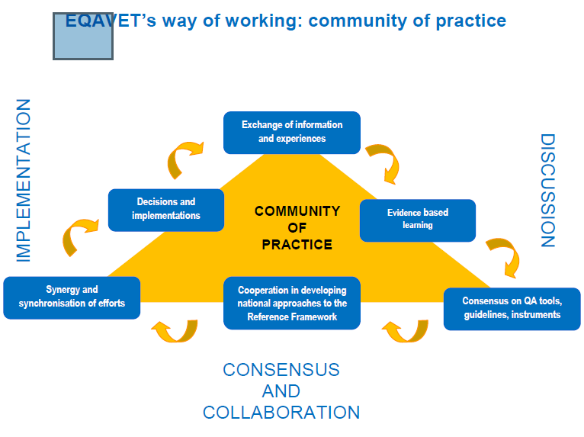

Slide 3
PROGRAM DATA:
2011-12: 65.8% (4083) students got SP or P
52 Certificates awarded
The number of GCC credit students who have previously taken Noncredit ESL has increased steadily over the past four terms, from 10.8% to 12.5%.
The number of GCC credit ESL students who have previously taken Noncredit ESL has increased steadily over the past four terms, from 41.9% to 49.9%
These data show that 20% of GCC A.S. degree-earners started out in NC ESL, and 11.4% of A.A. degree earners started out in Noncredit ESL. These data show that one out of every five A.S. completers used the NC ESL division as the starting point/entryway to their successful academic career at GCC.

Slide 4
CASAS Data
36% have under 6 years of education
36% have 12+ years of education
15% decrease in completions starting in Level 3.

Slide 5
STUDENT SATISFACTION DATA:
http://www.glendale.edu/modules/showdocument.aspx?documentid=18686

Slide 6
Retreat 2012 Data
Learning Trends in Writing
• Spelling
• Syntax, Word Order, Sentence Structure
• Capitals
• Punctuation
Recommendations
Norming and Best Practices Sessions for Instructors
Use of Model Paragraphs
Increase student reading with use of literature sets

Slide 7
2012 Recommendations
Program Trends
Retention issues
Placement Tests – incl. writing, Literacy/Level 1
Inconsistent grading of writing amongst teachers
Need for tutors
Trying to teach too many things to students with a variety of goals
Recommendations
Update/Revise placement tests not done
Norming/grading workshops
Advanced student/ESL Certificate holding tutors
Reflective teaching practices: peer observing, weekly debrief
Help students identify their goals and design support for them doing

Slide 8
TWO THEMES that emerged as areas to improve overall in our program were:
1. COMMUNICATION
2. RETENTION
Seat time demand? Curriculum? External issues (family, job, etc)? Other?
Remedy?
Staff Development/Pathways – attaching learning to goals

