Slide 1
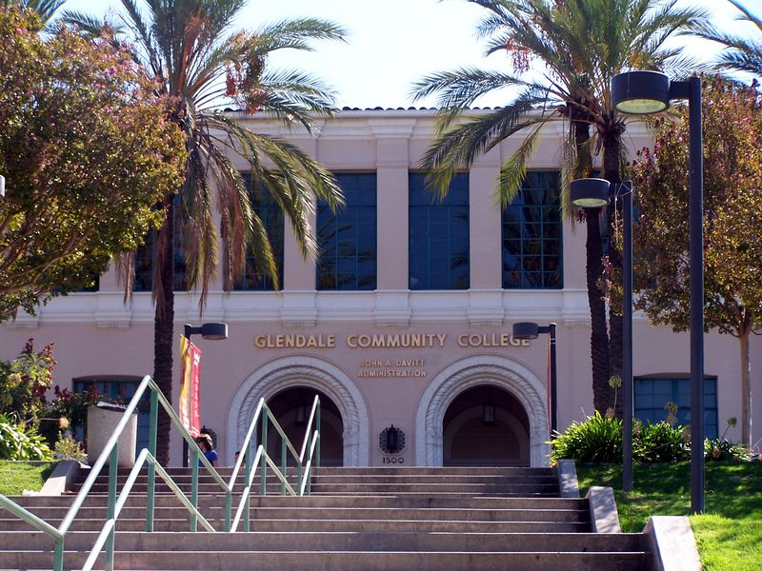
ENERGY CONSERVATION & MODERNIZATION FOR GLENDALE COMMUNITY COLLEGE
July 15, 2013
1
Notes:
Add notes

Slide 2
Facility Modernization Needs - Background
Glendale College has a growing backlog of energy-related facility modernization needs
Staff solicited proposals from energy services firms that could audit, design and construct energy retrofit projects
In December a competitive process selected McKinstry
McKinstry has developed an approach with three phases
Each phase will save energy, modernize facilities, improve the learning environment and show a commitment to sustainability
Implementation will reduce maintenance costs and future capital expenditures (this work will have to be done sooner or later)
2
Notes:
Add notes

Slide 3
Summary of Facility Improvement Measures (FIMs) by Benefit
McKinstry identified over 61 FIMs during our survey of the facilities
Of those 61, 43 FIMs fit the College’s priorities and a 15-year financial model
Summary of Benefits of the 46 FIMs include:
All FIMs save energy
40 FIMs – Reduce maintenance and repair expenses
8 FIMs - Reduce future capital improvement expenditures
26 FIMs - Improve comfort and reliability
3 FIMs – Solve a regulatory compliance requirement
All FIMs – Reduce green house gases and provide environmental benefits
3
Notes:
Add notes

Slide 4
Phased Approach to Project
 | FIM’s (count) | Budget Cost | Annual savings | Simple Payback (years) | Projected Utility Incentives
Phase 1 | 17 | $2,332,590 | $165,165 | 14.12 | GWP $50,000 SCG $66,447
Phase 2 | 26 | $1,981,456 | $146,193 | 13.55 | TBD
Phase 3 | 18 | $3,473,934 | $104,937 | 33.10 | TBD
Potential Funding Sources
1. Proposition 39 Funds - Current estimate is $638,000 per year for the next five years for Glendale
2. Utility incentives, the Glendale College Energy Conservation Account
3. Measure G Funds – the bond ballot language included energy efficiency and renovation
4. 0% interest, On-Bill-Financing from Southern California Gas, 10 year term, a possible $500,000
5. Low or no interest loans from the California Energy Commission funded from Proposition 39 funds
Discuss Schedule of Events
4
Notes:
Add notes

Slide 5
Summary of Facility Improvement Measures (FIMs) Phase 1
(Phase 1 is related to central plant #2)
Building | FIM | Budget (before incentives) | Energy savings and additional benefits
Advanced Tech Center | 4.01 - Upgrade Existing Electric Controls to DDC | $ 305,437 | Improved comfort
Advanced Tech Center | 9.03 - Lighting Upgrade | $ 26,741 | Lower maintenance costs
Arroyo Seco | 5.03 - RCx of Fume Hood and Zone Level Controls | $ 73,944 | Improved operation
Arroyo Seco | 9.07 - Lighting Upgrade | $ 43,209 | Lower maintenance costs
Aviation Arts | 9.01 - Lighting Upgrade | $ 66,385 | Lower maintenance costs
Central Plant #2 | 4.04 - Optimization Controls | $ 194,978 | Improved operation
Campus Wide | 4.16 - Building level metering | $83,558 | Manage energy, demand response programs, sustainability reporting
Health Science | 5.01 - Building–wide RCx | $ 41,755 | Improved operation, lower maintenance costs
5
Notes:
Add notes

Slide 6
Summary of Facility Improvement Measures (FIMs) Phase 1 (continued page 2)
Building | FIM | Budget (before incentives) | Energy savings and additional benefits
Health Science | 9.02 - Lighting Upgrade | $ 124,849 | Lower maintenance costs
Library | 3.02 - Replace Existing CAV MZ AHUs and Convert to VAV | $ 725,160 | Lower maintenance and capital costs, improved comfort
Library | 4.03 - Upgrade Existing Pneumatic Controls to DDC | $ 363,545 | Lower maintenance and repair costs, improved comfort
Library | 9.05 - Lighting Upgrade | $ 167,299 | Lower maintenance costs
San Gabriel | 5.02 - RCx of 100% OA AHUs and Exhaust System | $ 2,218 | Improved operation
San Gabriel | 9.04 - Lighting Upgrade | $ 113,512 | Lower maintenance costs
Total budget |  | $2,332,590
6
Notes:
Add notes

Slide 7
Summary of Facility Improvement Measures (FIMs) Phase 2
(Phase 2 is related to central plant #1)
Building | FIM | Budget (with incentives) | Energy savings and benefits
Auditorium | 3.05 - Restore economizer operation | $ 28,660 | Improved comfort, lower maintenance cost
Auditorium | 4.05 - Upgrade existing pneumatic controls to DDC | $ 89,416 | Lower maintenance costs, improved comfort
Auditorium | 9.08 - Lighting upgrade | $ 61,865 | Lower maintenance costs
Administration | 5.04 - RCx of main air handling unit | $ 83,668 | Lower maintenance costs
Administration | 4.06 - Upgrade existing zone level pneumatic controls to DDC | $ 139,620 | Lower maintenance and improved comfort
Administration | 9.09 - Lighting Upgrade | $ 100,340 | Lower maintenance costs
Camino Real | 4.07 - Add occupancy based HVAC controls for classroom | $48,604 | Improved operation
Camino Real | 9.11 - Lighting upgrade | $ 49,672 | Lower maintenance costs
Central Plant #1 | 4.10 - Optimization Controls | $ 87,865 | Improved operation
Central Plant #1 | 2.03 – Replace and upsize chiller | $ 476,710 | Improved operation, lower maintenance and repair costs
7
Notes:
Add notes

Slide 8
Summary of Facility Improvement Measures (FIMs) Phase 2 (continued page 2)
Building | FIM | Budget (with incentives) | Energy savings and benefits
Child Development Center | 9.19 - Lighting Upgrade | $ 29,084 | Lower maintenance costs
Cimmarusti Science Center | 9.10 - Lighting Upgrade | $ 36,420 | Lower maintenance costs
EOPS Annex | 9.16 – Lighting Upgrade | $ 6,497 | Lower maintenance costs
Elevator/Tower Bridge | 9.17 - Lighting Upgrade | $ 13,626 | Lower maintenance costs
Life Skills | 9.20 – Lighting Upgrade | $ 9,647 | Lower maintenance costs
San Rafael | 4.09 – Replace antiquated zone level DDC controllers | $ 99,799 | Lower maintenance and repair costs, improved comfort
San Rafael | 5.06 - RCx AHUs 1, 2 and Boiler and Chiller Systems | $ 37,574 | Lower maintenance costs, improved comfort
San Rafael | 9.14 – Lighting Upgrade | $ 89,594 | Lower maintenance costs
8
Notes:
Add notes

Slide 9
Summary of Facility Improvement Measures (FIMs) Phase 2 (continued page 3)
Building | FIM | Budget (with incentives) | Energy savings and benefits
Santa Barbara | 9.13 - Lighting Upgrade | $ 28,069 | Lower maintenance costs
Santa Barbara | 4.08 – Add occupancy based HVAC controls for classroom | $30,709 | Improved operation
Sierra Madre | 5.07 – Building wide RCx | $17,771 | Lower maintenance costs
Sierra Madre | 9.21 - Lighting Upgrade | $ 64,620 | Lower maintenance costs
Sierra Nevada | 9.15 – Lighting Upgrade | $ 44,616 | Lower maintenance costs
Verdugo Gym | 5.05 – Building wide RCx | $ 70,667 | Lower maintenance costs
Verdugo Gym | 9.13 – Lighting Upgrade | $ 88,320 | Lower maintenance costs
All Sites | 18.01 Water Conservation | $ 148,023 | Improved Operation
Total | Phase 2 | $ 1,981,456
9
Notes:
Add notes

Slide 10
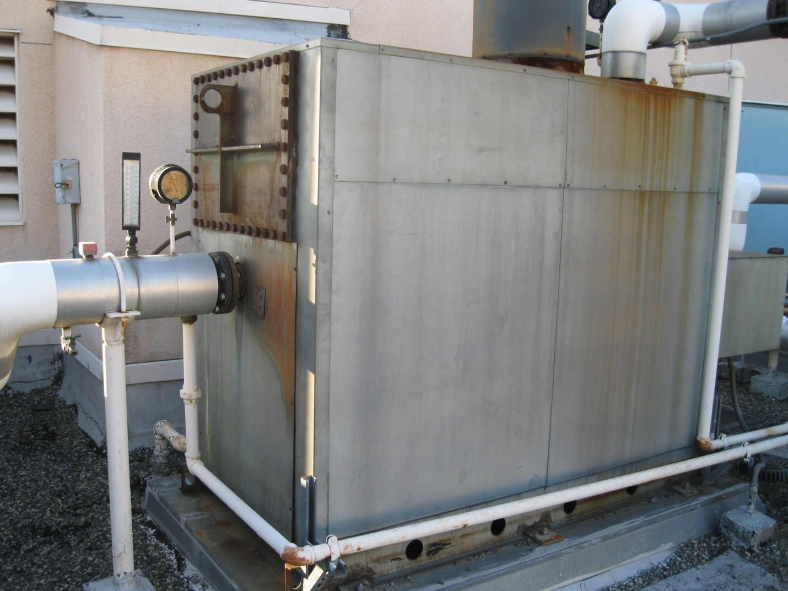
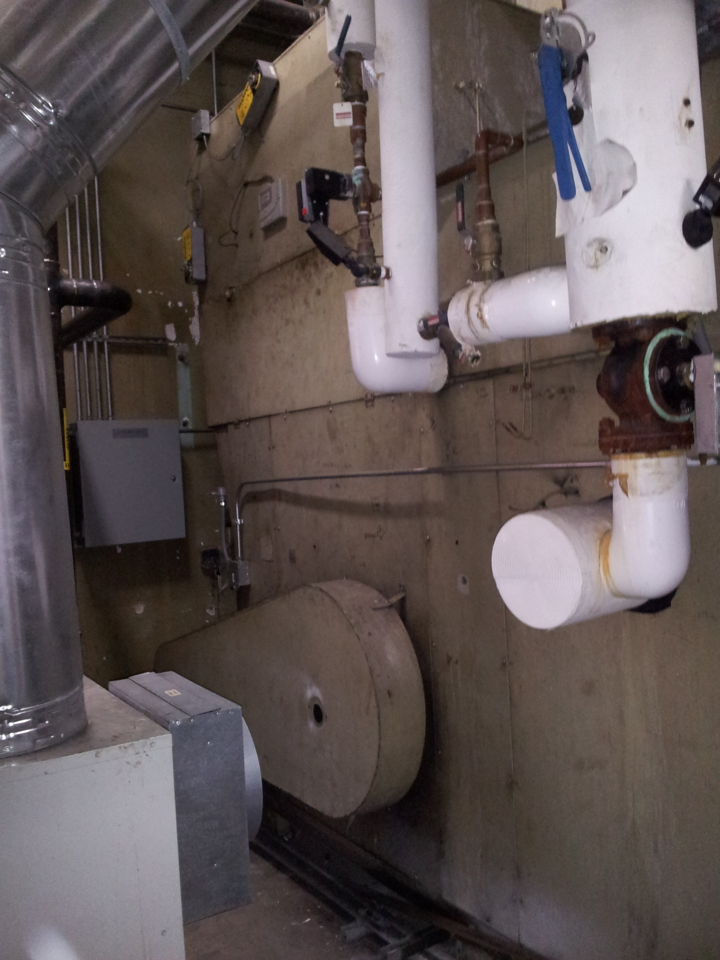
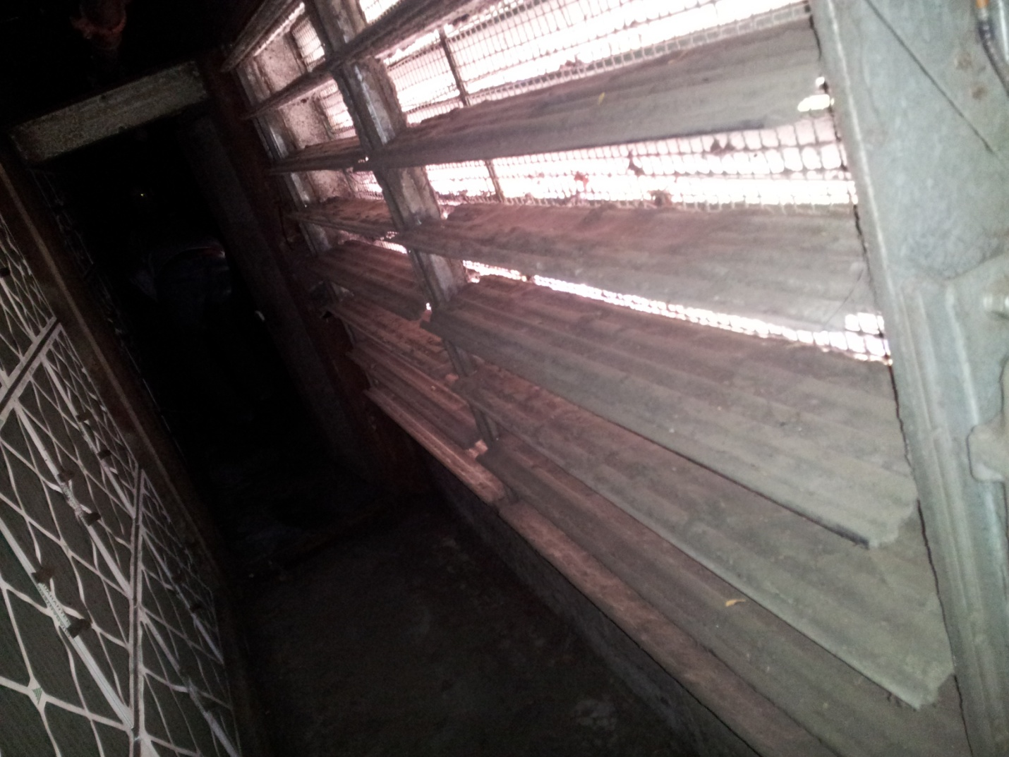
Inefficient or Broken Equipment for Replacement or Repair
Non-AQMD compliant boiler at Library that will be replaced
Stuck open outside air damper at Auditorium that will be repaired
Outdated and inefficient multi-zone unit at Camino Real that will be replaced (typical Library MZ units, too)
Solving a regulatory issue
Using energy savings to cover capital costs
Improving the learning environment
10
Notes:
Add notes

Slide 11
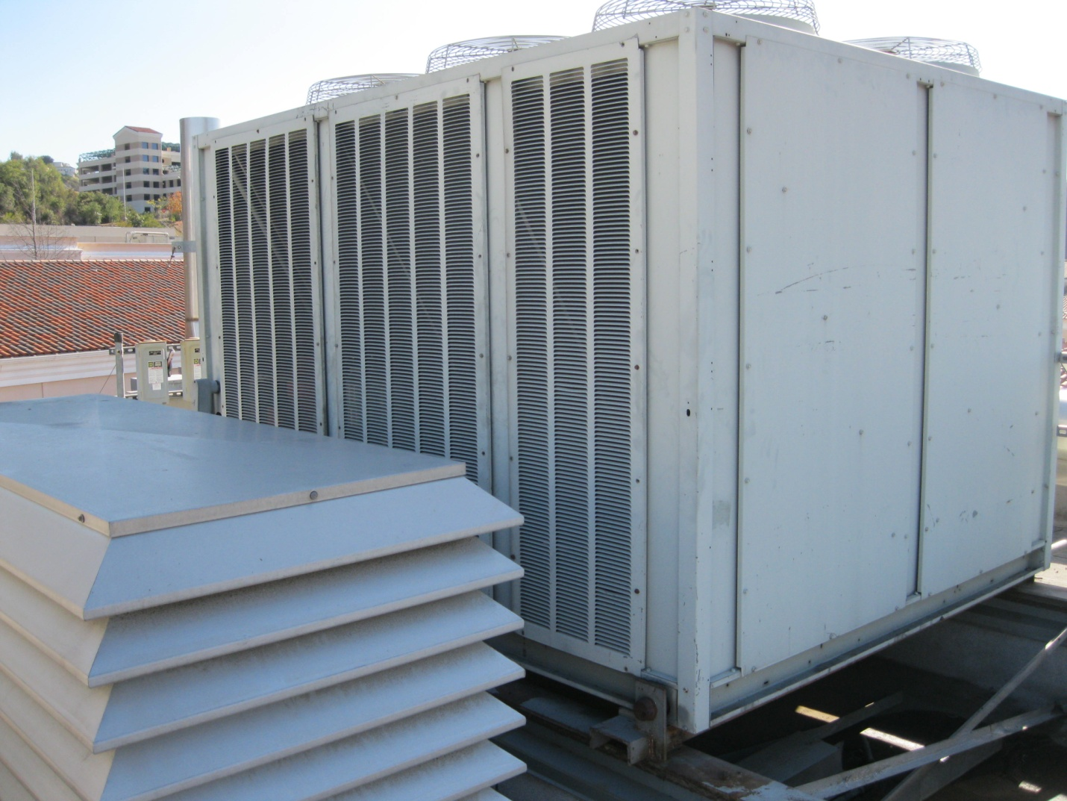
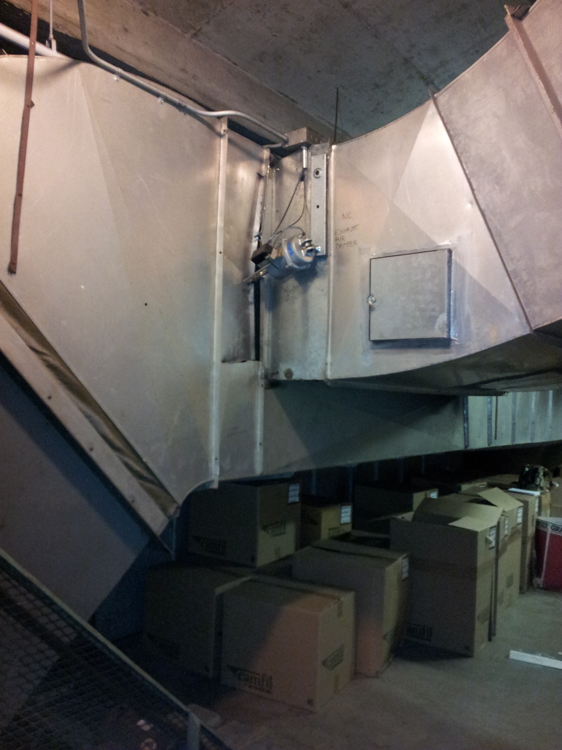
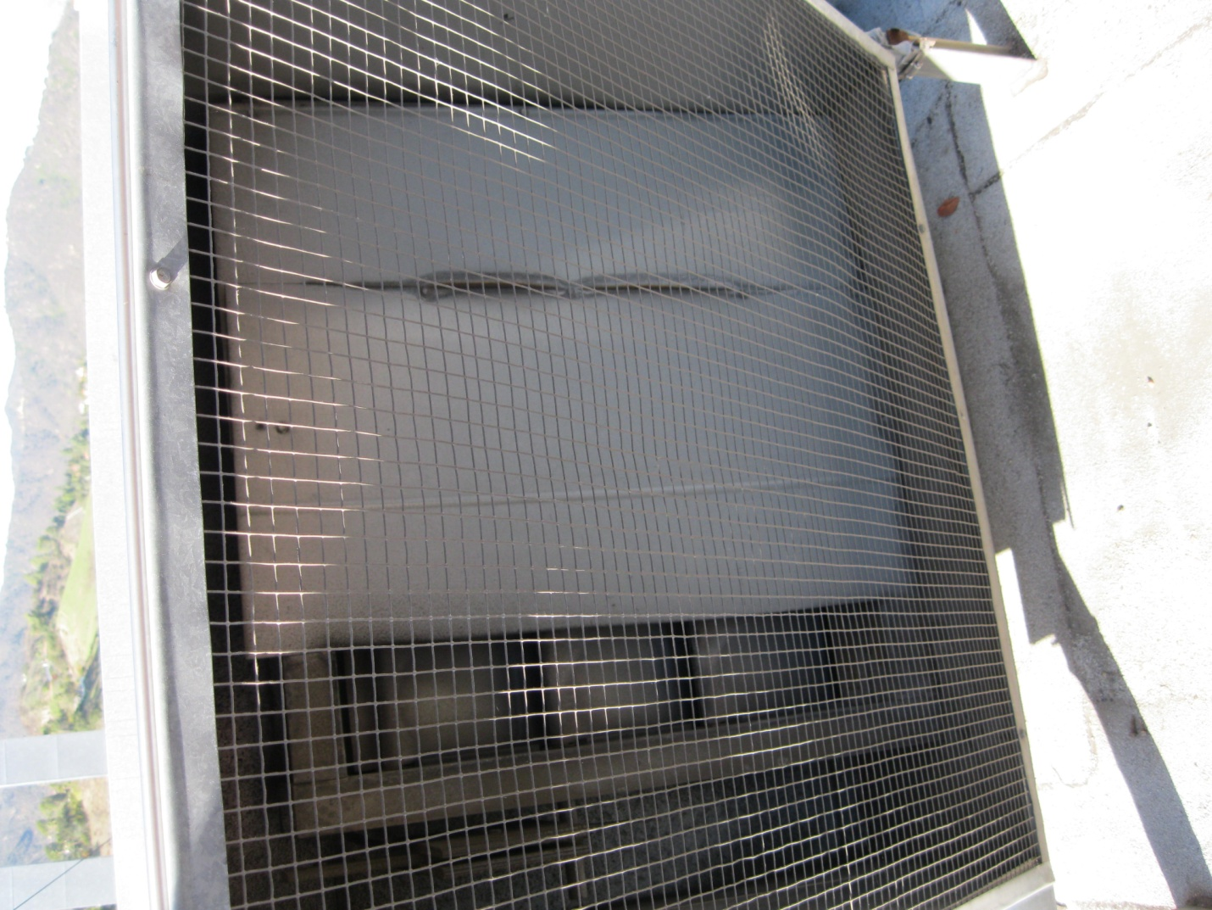
Inefficient or Broken Equipment for Replacement or Repair
Aging Dx condenser unit at Arroyo Seco that will be eliminated
(total of 7 -9 Dx systems will be eliminated across campus through central plant expansions)
Blocked off fume hood bypass at Arroyo Seco that will be repaired (Typical of 4)
Broken actuator and punctured ductwork at Auditorium that will be repaired
11
Notes:
Add notes

