Slide 1


Moodle 2.4 Tutorials for ESL Instructors
By PresenterMedia.com

Slide 2
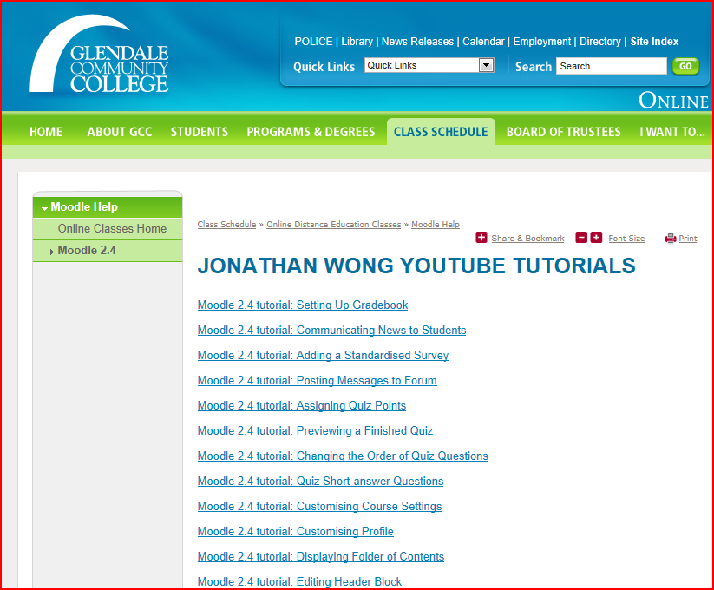
Need some practice with Moodle 2.4?
These tutorials offer help on the most recent version of Moodle

Slide 3
Simply click on the following link:
Moodle 2.4 Tutorials

