Slide 1


Expressing regret about the past
should have/shouldn’t have
ought to have
+
Past participle
Created by Harriet Cohen
Copyright 2013

Slide 2



Regrets and Mistakes
What do you think he said when he got this test grade?
“Oh no! My parents are going to kill me.
I should have studied more for that test.”
(Uh-oh!)
(big mistake!)
“I shouldn’t have played video games all night long.”
“I ought to have paid more attention in class.”

Slide 3


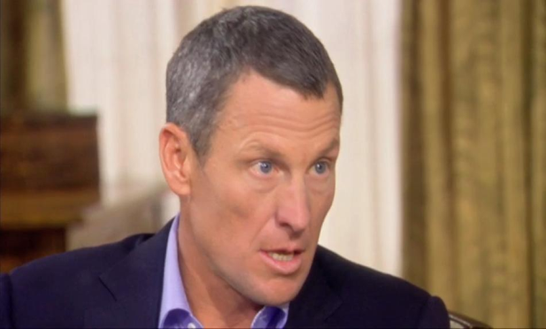
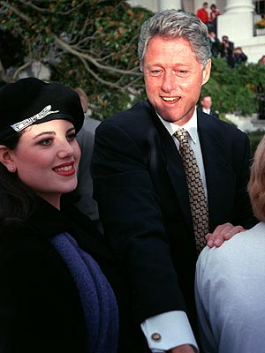
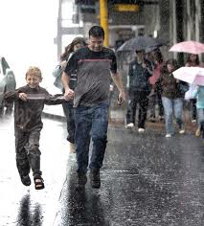
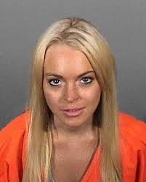
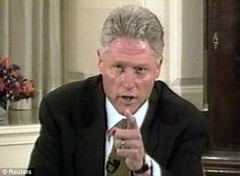
What do you think these people said about what they did?
Express regrets using:
should have shouldn’t have ought to have
2.
3.
1.
6.
7.
5.
4.

Slide 4




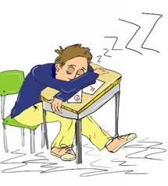
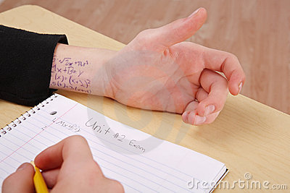
What shouldn’t this person have done/have been doing?
1.
2.
3.
4.
5.
6.

