Slide 1


New ways to talk about
Past events
Created by Harriet Cohen
Copyright 2013

Slide 2
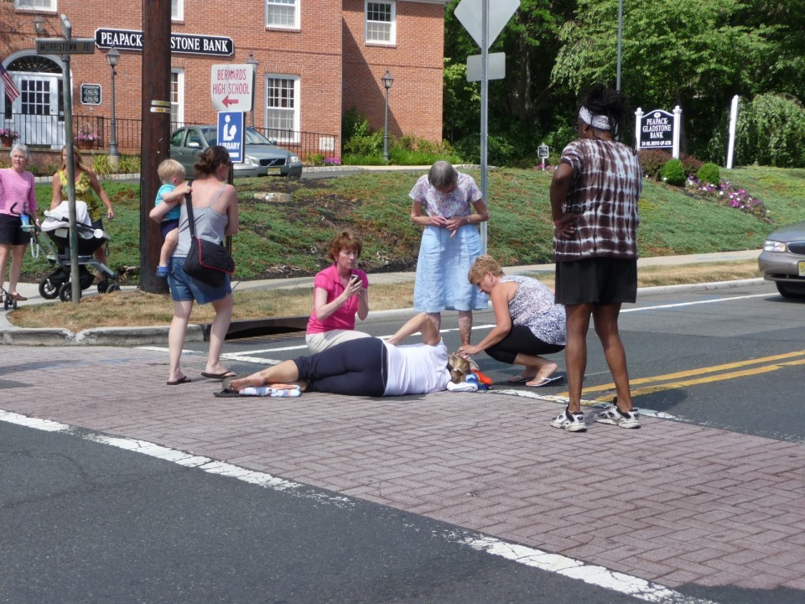
What do you think happened?
might have
may have
could have

Slide 3
She might have tripped and fallen down.
There are many possibilities.
She could have been hit by a car.
The woman may have fainted in the street.

Slide 4

Past Possibilities using Perfect Modals
(I am guessing what happened)
may have might have could have
+
past participle
“Why didn’t he come to school?”
“I really don’t know.”
He may have been sick.
He might have had to work.
He could have had an emergency.

Slide 5
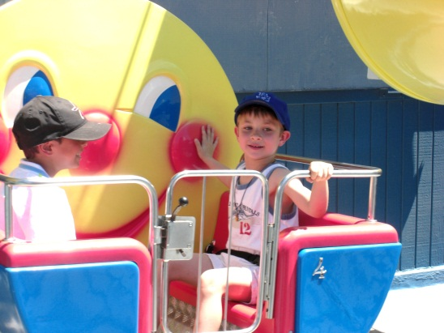
Where did they go last summer?
I’m really not sure.
may have gone
They ________________________ to Disneyland.
They ____________________ to Magic Mountain.
They ___________________ to Knotts Berry Farm.
might have gone
could have gone

Slide 6
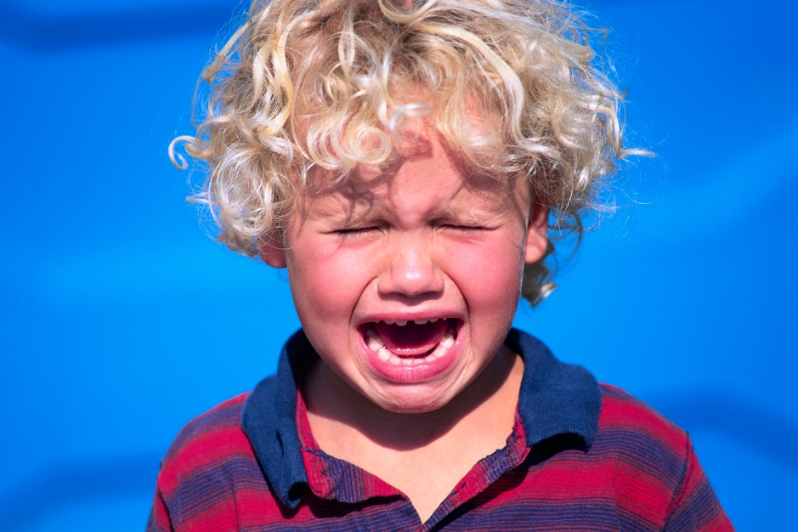
This was Jack yesterday morning. What was the problem?
Do you know? Can you guess?
Lost something?
Got lost?
Broke a toy?

Slide 7


Why was he so happy?
Do you know? Please guess.
What was he worried about?
I bet you are not sure, so please think of
lots of possibilities.

Slide 8

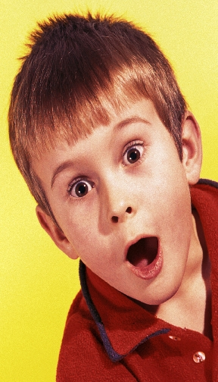
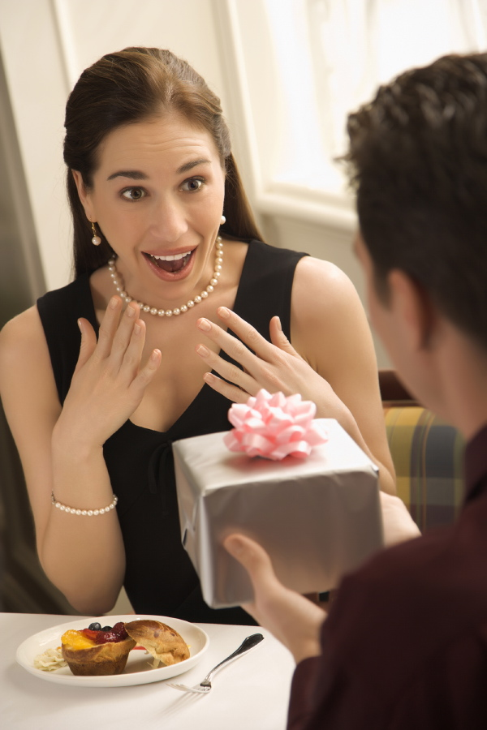
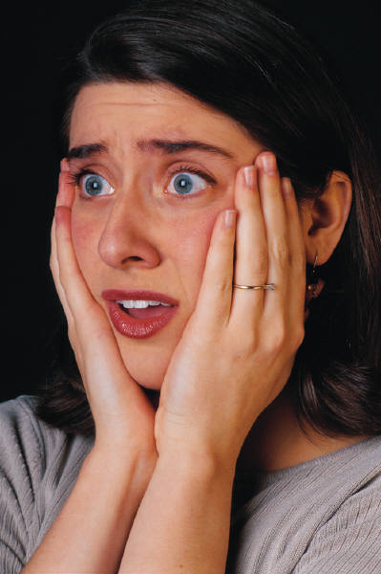

Talk with your partners about what they think happened
the moment before each photo was taken.(may/might/could)
1.
4.
2.
5.
3.

