Slide 1
Glendale Community College
Garfield Campus ESL Certificate Ceremony
CONGRATULATIONS
We are proud of you!
Fall 2012

Slide 2
Your Success
What I’m learning is important.
People will help me.
I can do it.

Slide 3
Your Pathway to Success
Education
Job Family
Future
Advanced Certificate
Intermediate Certificate
Beginning Certificate

Slide 4
Beginning Certificate Recipients
Complete Level 2
Complete Beginning Conversation
We hope these students continue so that they will earn their intermediate certificates.

Slide 5
Intermediate Certificate Recipients
Complete Level 4
Complete Intermediate Conversation
Complete Computer Basics for ESL

Slide 6
Intermediate Certificate Recipients
We hope these students will:
Begin taking Office and Business Technology Classes at Garfield,
and/or
Begin taking General Education Classes at Garfield,
and/or
Continue taking ESL Classes to receive the Advanced ESL Certificate,
and/or
Start taking Credit ESL Classes at the Main Campus

Slide 7
Advanced Certificate Recipients
Complete Level 5
Complete Advanced Conversation
Complete Computer Basics for ESL

Slide 8
Advanced Certificate Recipients
We hope these students will:
Begin taking Office and Business Technology Classes at Garfield, and/or
Begin taking General Education Classes at Garfield,
and/or
Start taking Credit ESL Classes to at the Main Campus

Slide 9
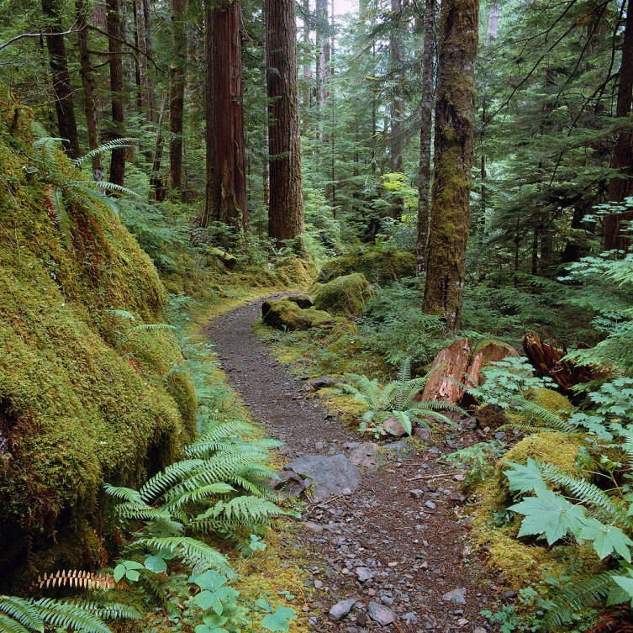
We are always here to help you continue successfully on your pathway to success!

