Slide 1
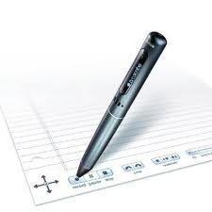
THE SMARTPEN

Slide 2




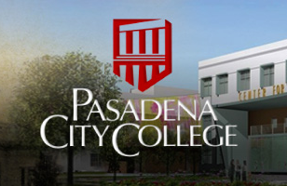

Smartpen Math Pilot Project
Los Angeles Harbor College
Pierce College
Los Angeles City College

Slide 3
Livescribe
www.livescribe.com

Slide 5
Smartxt
www.smartxt.com

Slide 7
The Community
www.box.com

Slide 9

Paper and Pen
The Smartpen uses special dot matrix paper…

Slide 10
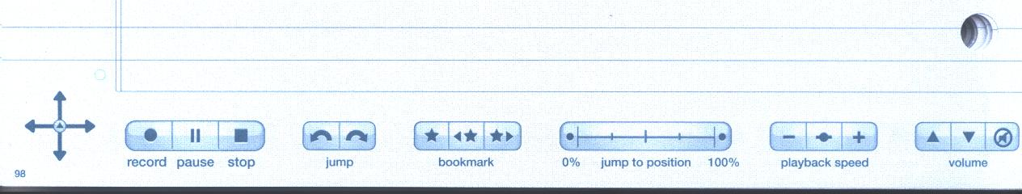
Paper and Pen

Slide 11
Paper and Pen
Livescribe Desktop

Slide 12
Class Flyer

Slide 13
Pencasts

Slide 15
Benefits
Helpful to students with learning differences.
Provides lectures for a students who have missed class.
Students can concentrate on what you are saying and not worry as much about writing everything down.
Creates a repository of lectures from multiple schools.

